Slide 1
Alice Bailey:
Mother of the New Age Movement

Slide 2
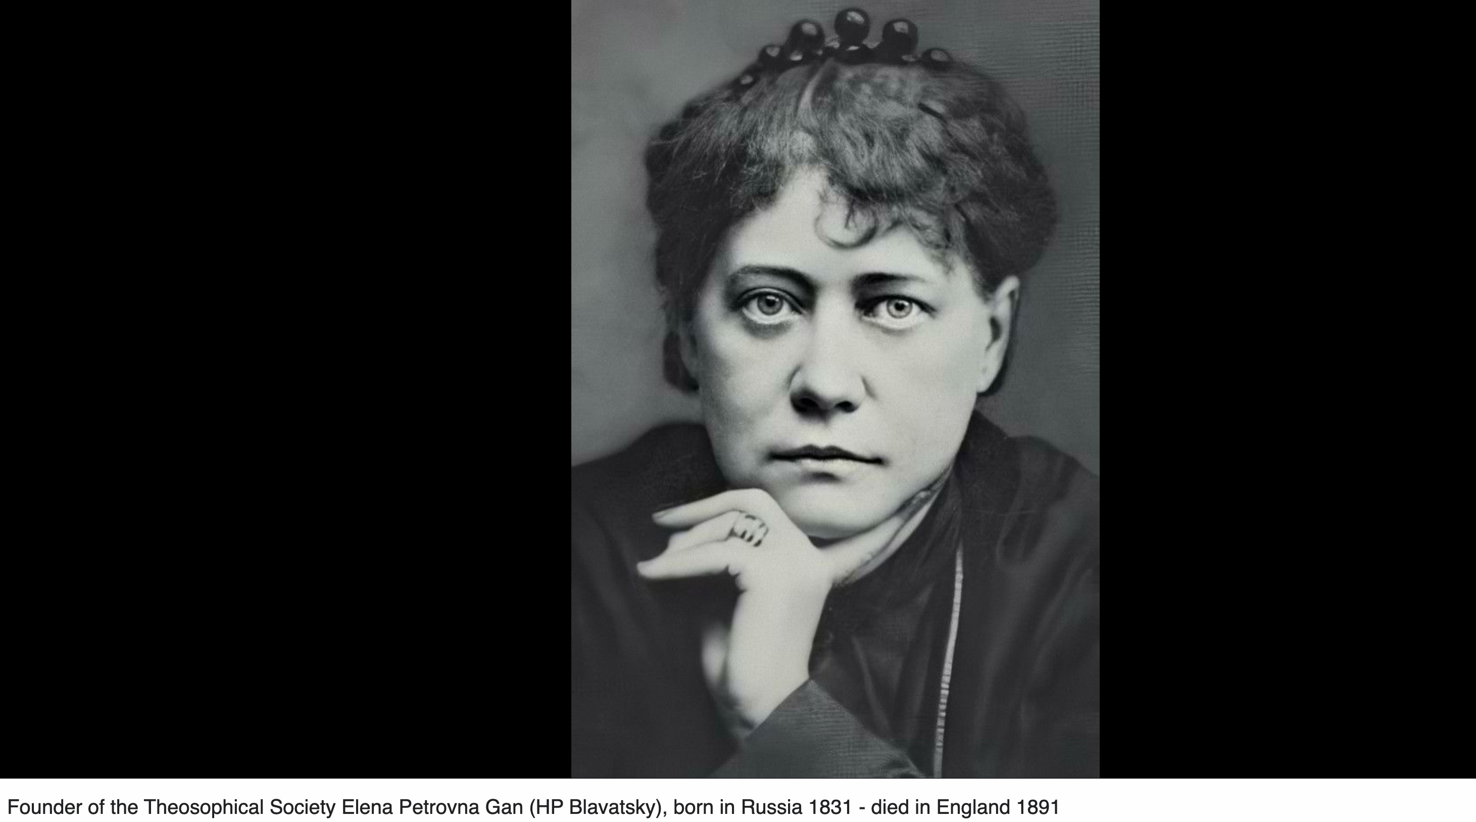

Slide 3
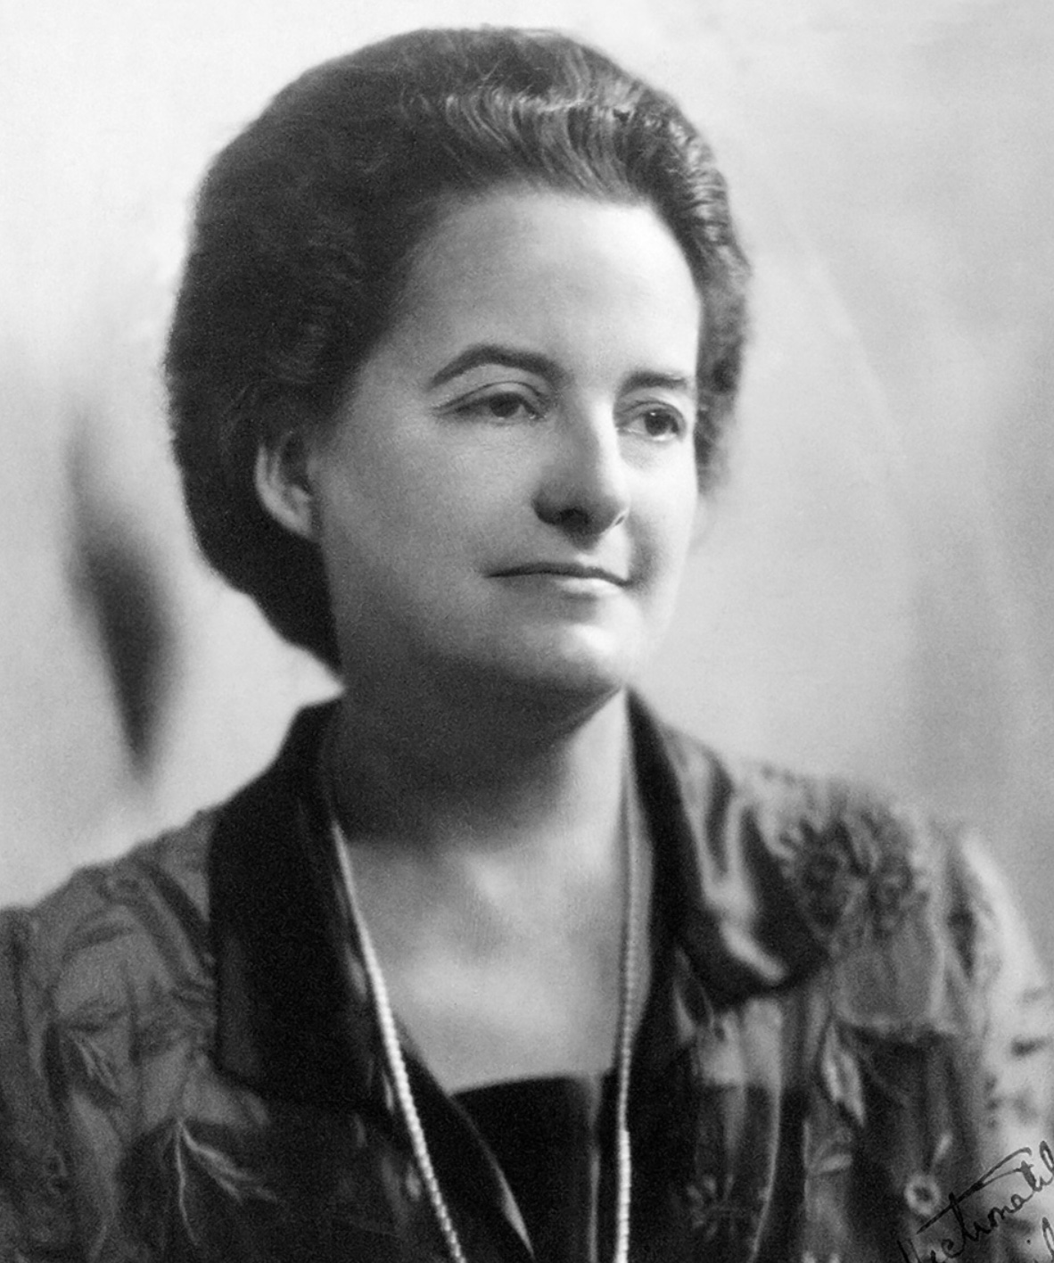
Alice Bailey: “Mother of the New Movement”

Slide 4


Slide 5
Alice Bailey Pamphlet: The Next Three Years
By 1945 we shall have the inner structure of a world faith so clearly defined in the minds of many thousands that its outer structure will inevitably make its appearance before the end of the century. The inner structure of the World Federation of Nations will be equally well organized by 1965, and its outer form taking rapid shape by 2025.

Slide 6

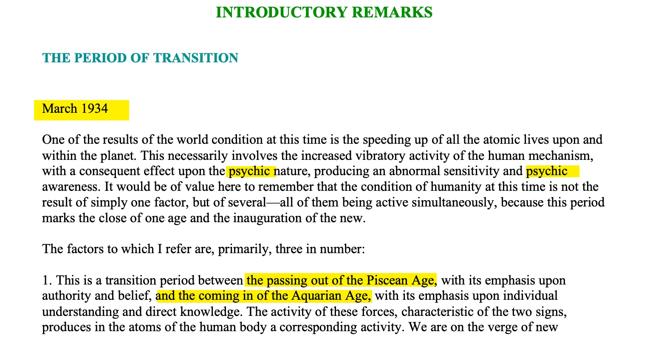

Slide 7
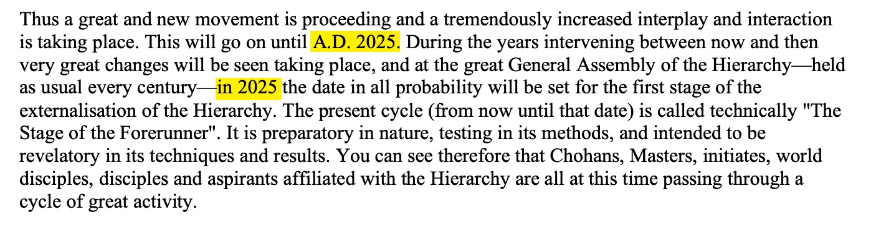

Slide 8
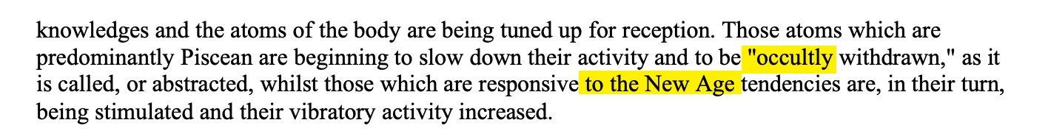

Slide 9
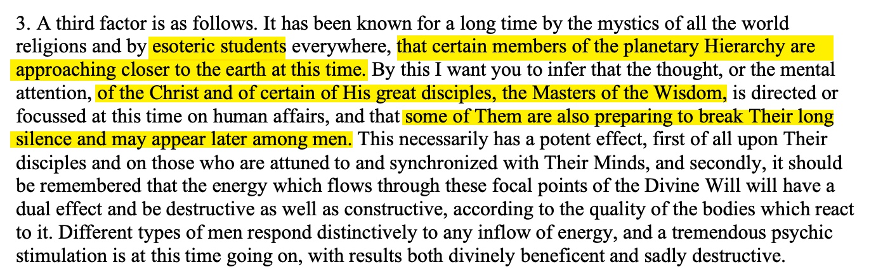

Slide 10
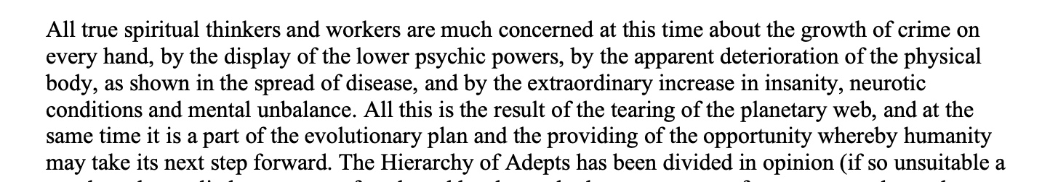

Slide 11
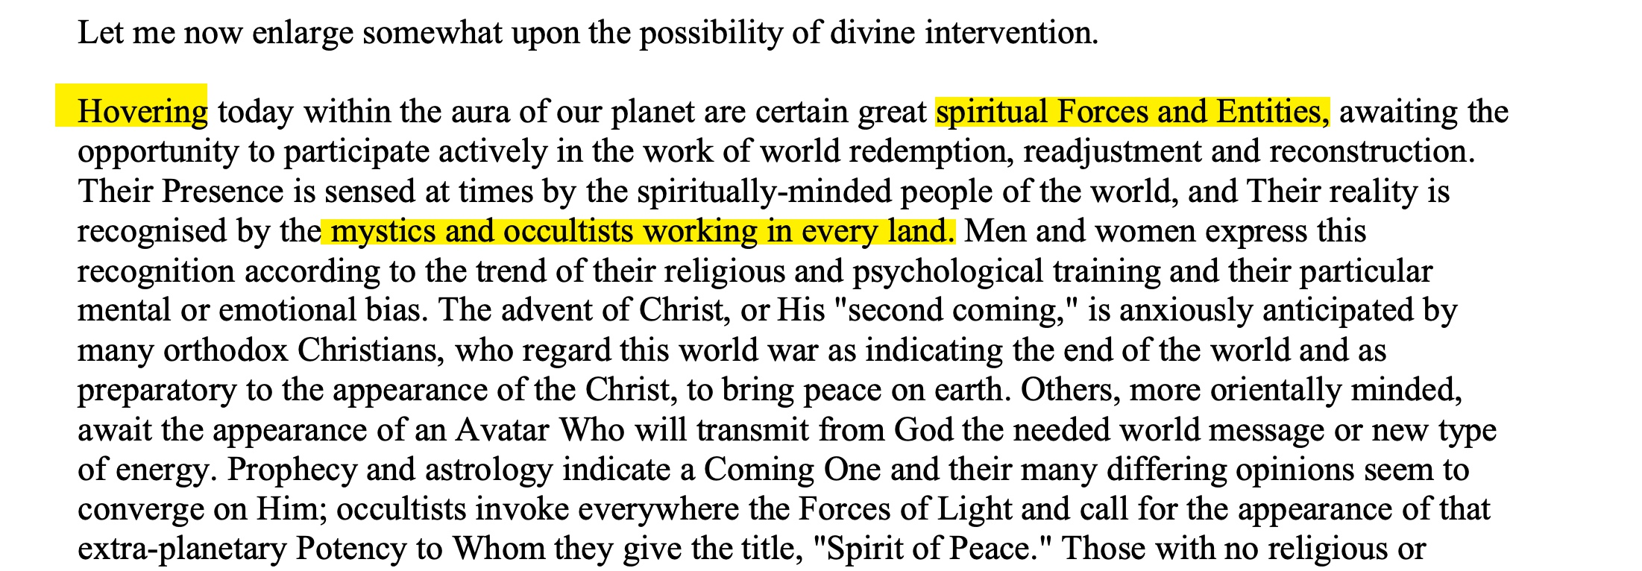

Slide 12
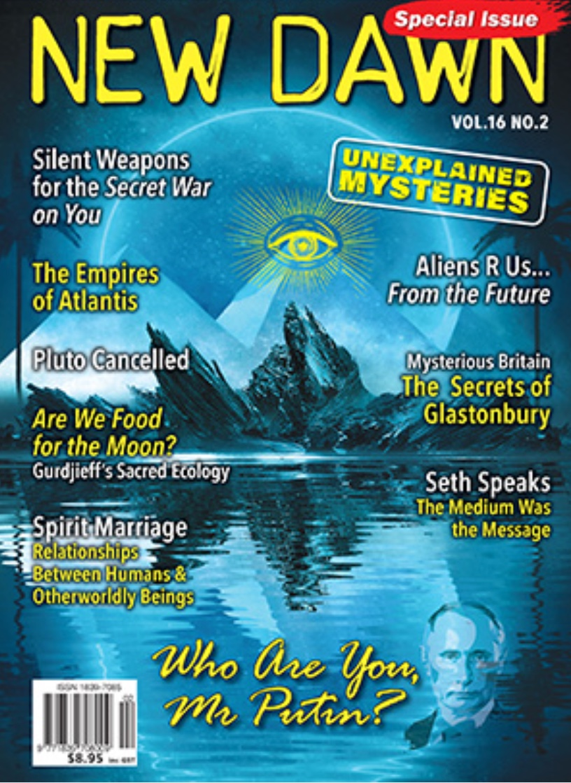

Slide 13
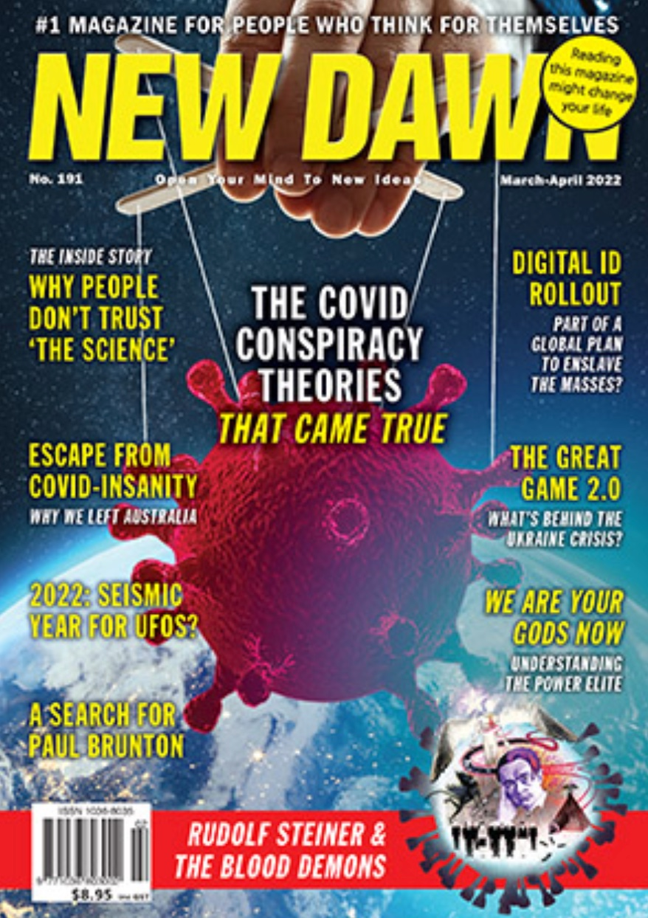

Slide 14
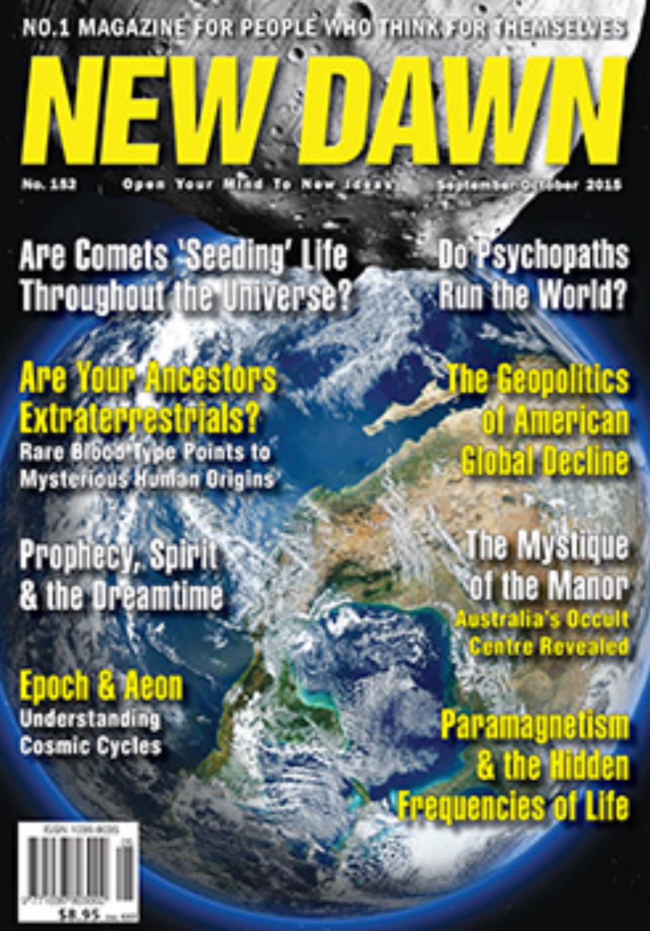

Slide 16
Alice Bailey Pamphlet: The Next Three Years
Do not infer by this that we shall have a perfected world religion and a complete community of nations. Not so rapidly does nature move, but the vision and the idea will be universally recognized, universally desired, and generally worked for When these conditions exist nothing can stop the appearance of the ultimate physical form…Approximately four hundred men and women are working consciously with the Plan.

Slide 17
Alice Bailey in
Esoteric Psychology, Vol. II Writes:
Behind the divisions of humanity stand those Enlightened Ones whose right and privilege it is to watch over human evolution and to guide the destinies of men…This they do through the implanting of ideas in the minds of the world thinkers, so that these ideas in due time receive recognition and eventually become controlling factors in human life.

Slide 18
Alice Bailey in
Esoteric Psychology, Vol. II Writes:
They train the members of the New Group of World Servers in the task of changing these ideas into ideals. These in turn become the desired objectives of the thinkers and are then taught to the powerful middle class and worked up into world forms of government religion, thus forming the basis of the new world order, into which the masses are patiently incorporated.

Slide 19
Alice Bailey in
The Externalisation of the Hierarchy (1957)
…the organizing of the men and women…so they can set the note of world goodwill for the new world order…Group work of a new order…[with] progress defined by service…the work of the Brotherhood…the Forces of Light…[and] out of the spoliation of all existing culture and civilisation, the new world order must be built.

Slide 20
Alice Bailey proclaimed:
This coming age will be as predominantly the age of group interplay, group idealism and group consciousness as the Piscean Age has been one of personality unfoldment…for the will of the individual will voluntarily be blended into group will.

Slide 21
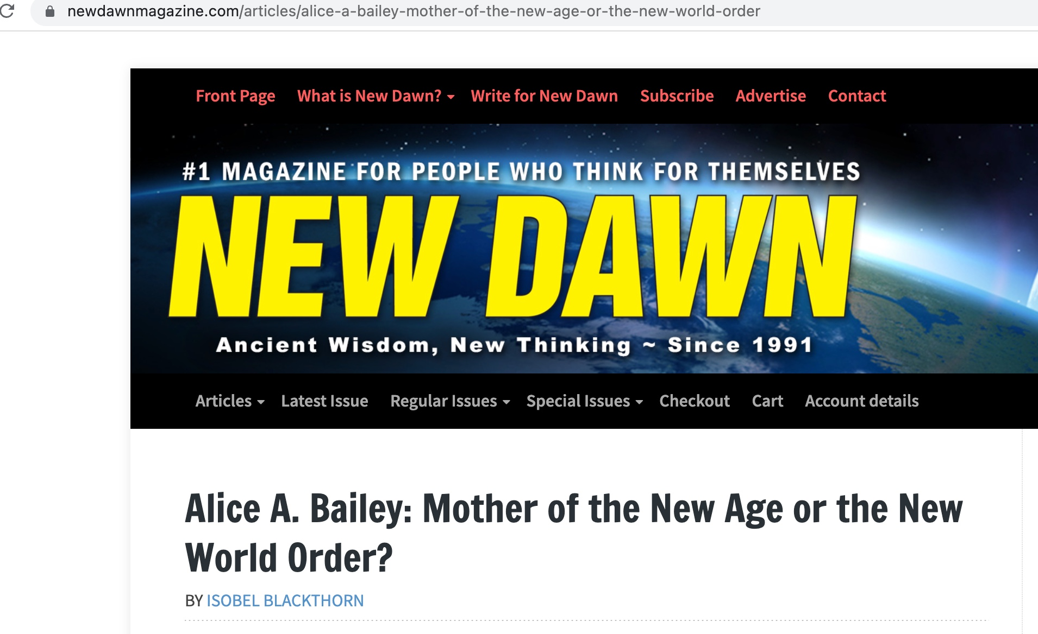

Slide 22
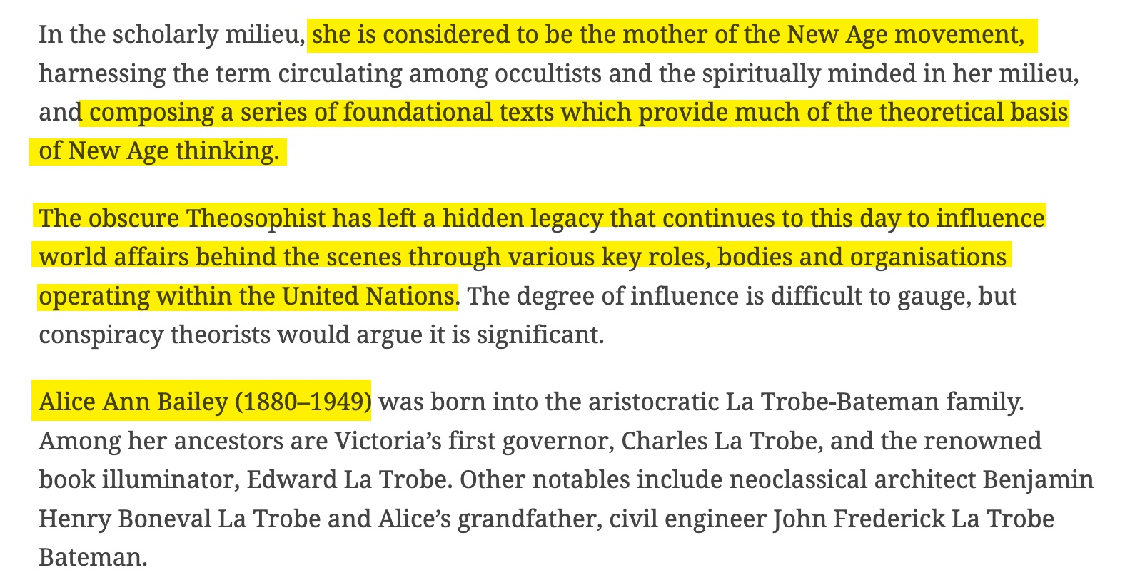

Slide 23
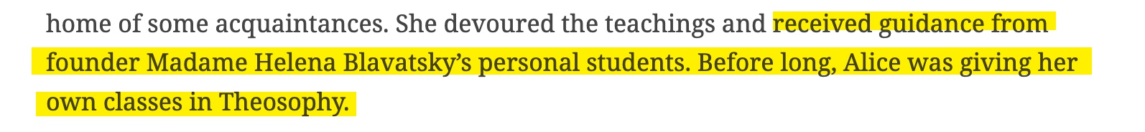

Slide 24
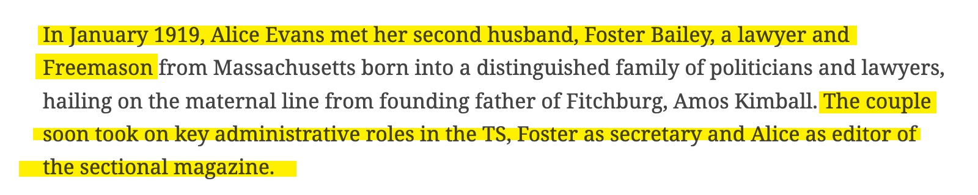

Slide 25

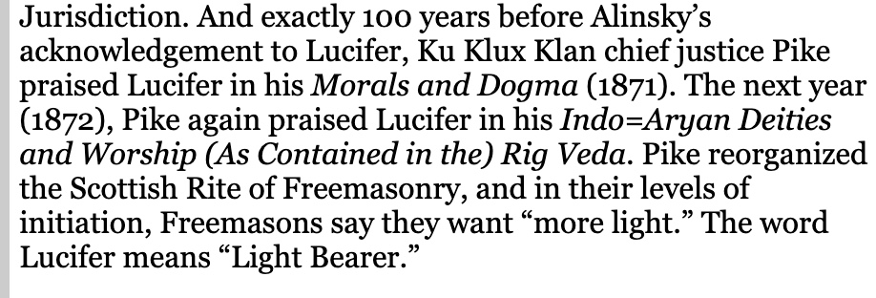

Slide 26
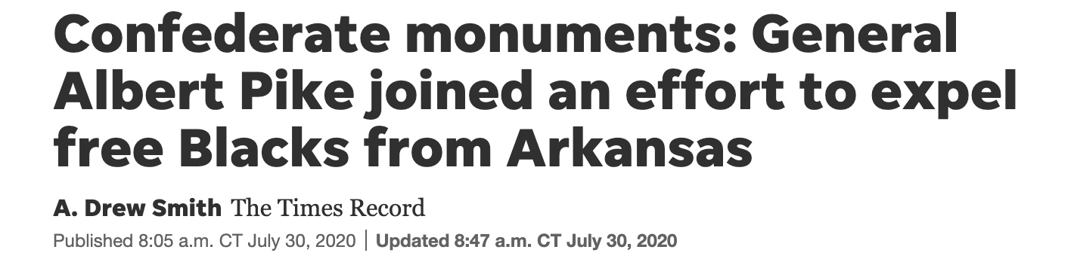
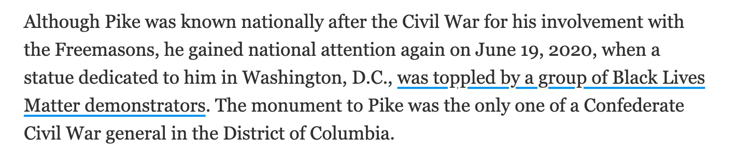

Slide 27
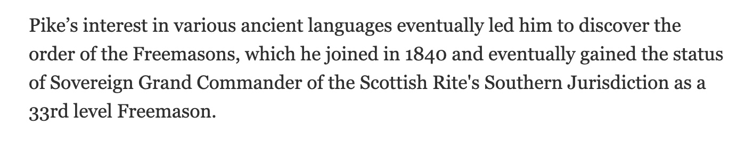

Slide 28
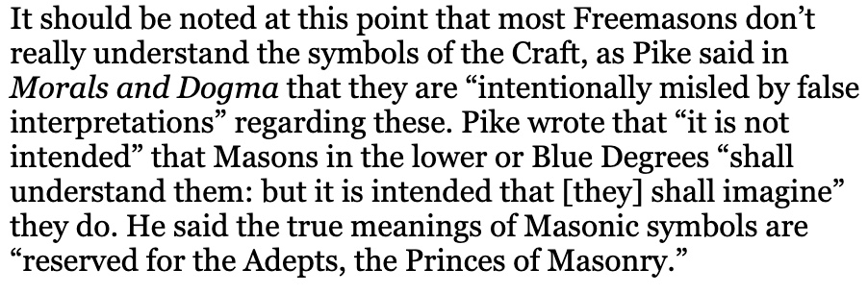

Slide 29
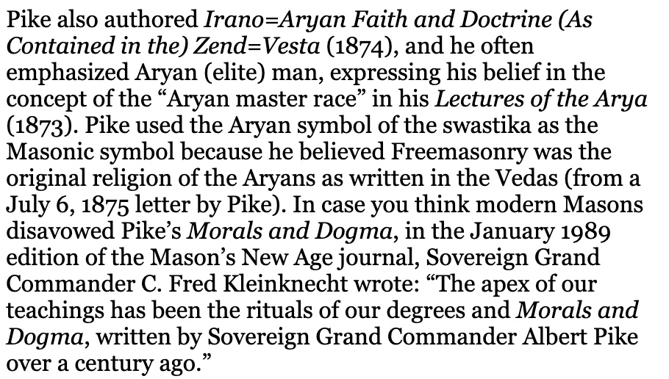

Slide 30
Stopped Here

Slide 37
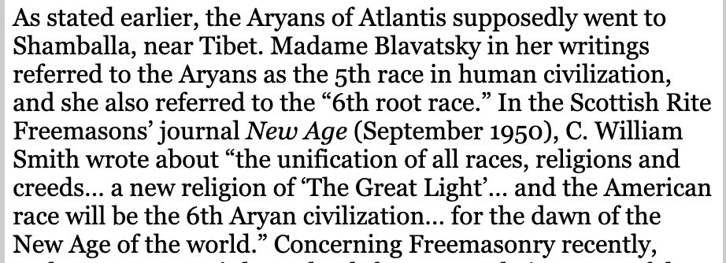

Slide 38
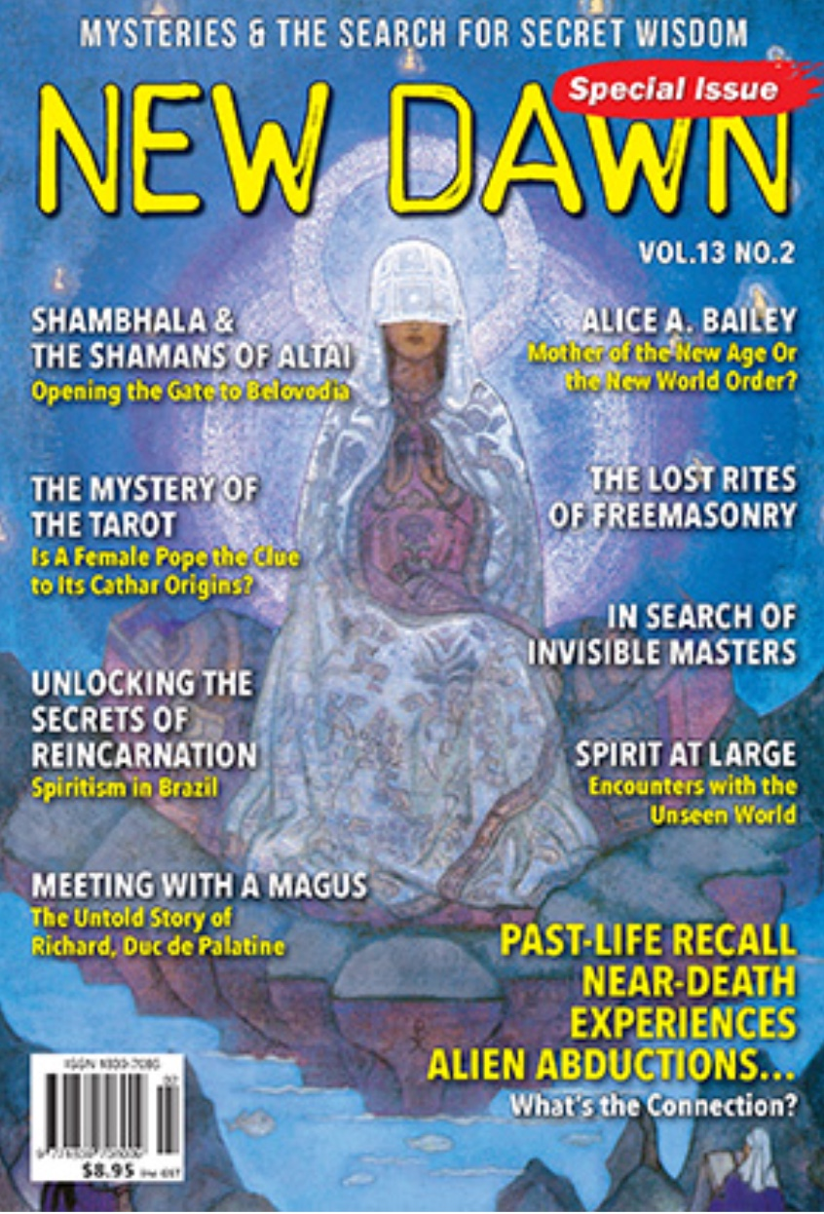

Slide 39


Slide 40
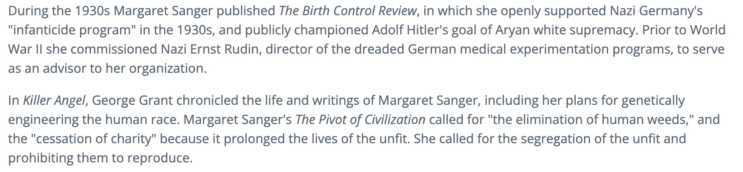

Slide 41
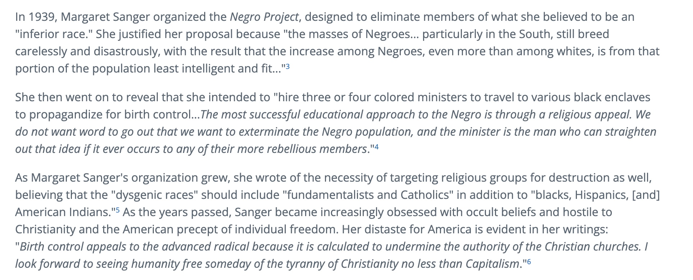

Slide 42

Dr. Erwin Lutzer in his award-winning book, Hitler's Cross, documents Hitler's satanic worldview:

Slide 43
• Even those who knew Hitler from his early days were well aware of his occult powers. August Kubizek, a friend, said, “It was as if another being spoke out of his body…It was not a case of a speaker carried away by his own words…I felt as though he himself listened with astonishment and emotion to what broke forth from him.”

Slide 44
• Hitler's closest advisors, were into occultism and pagan spirituality such as Rudolf Hess, Dietrich Eckart, Karl Haushofer, Joseph Goebbels, Alfred Rosenberg and others.

Slide 45
• Hitler confided to those who were closest to him that he was under orders from a higher being in his unique mission. "I will tell you a secret," he told Rausching, "I am founding an order…the Man-God, that splendid being will be an object of worship…But there are other stages about which I am not permitted to speak."

Slide 46
• After reading his friend Alfred Rosenberg's blasphemous book entitled The Myth of the Twentieth Century, Hitler declared, "Creation is not yet at an end. Man is becoming God…Man is God in the making."

Slide 47
• Allan Bullock, who wrote an extensive biography of Hitler, dutifully listed what Hitler studied in his youth: yoga, hypnotism, astrology, and various other forms of Eastern occultism…

Slide 48
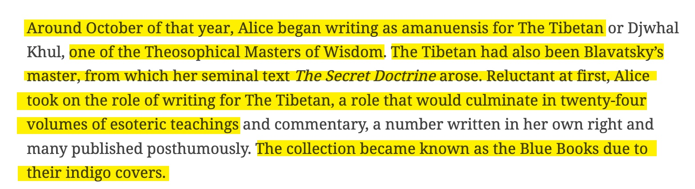

Slide 49
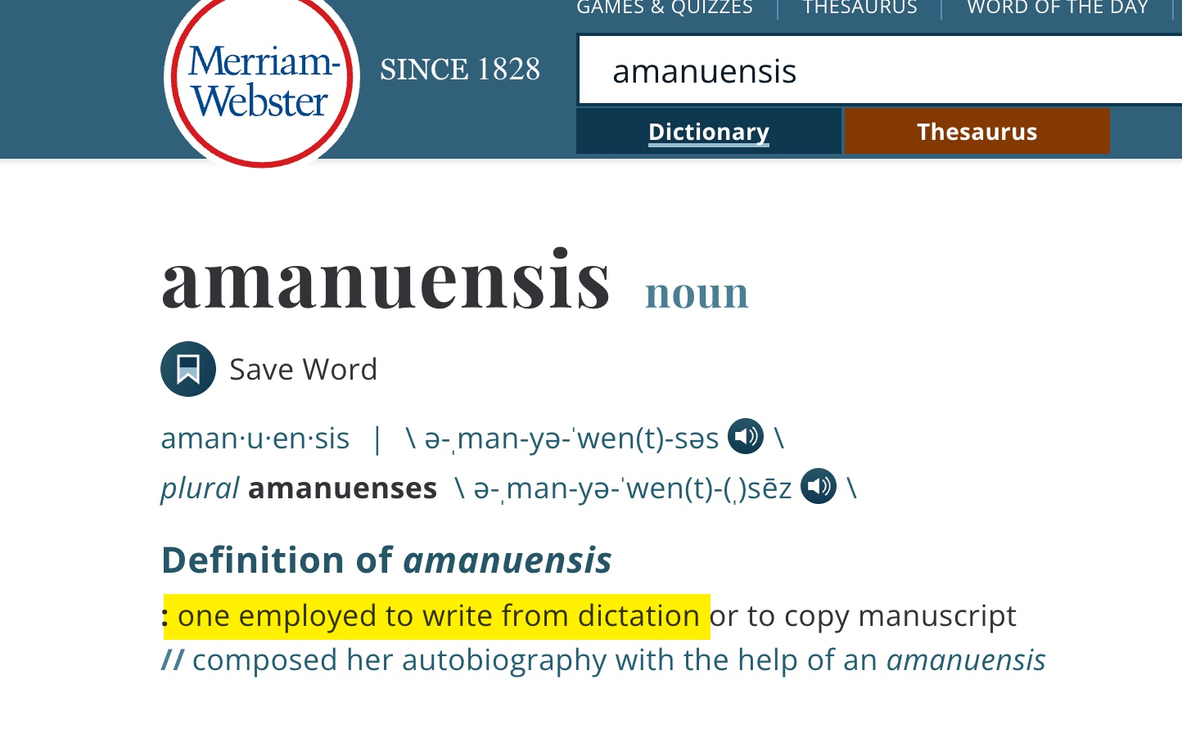

Slide 50
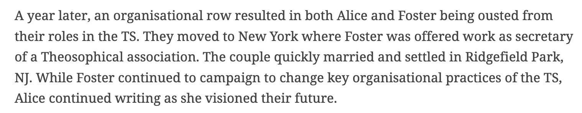

Slide 51
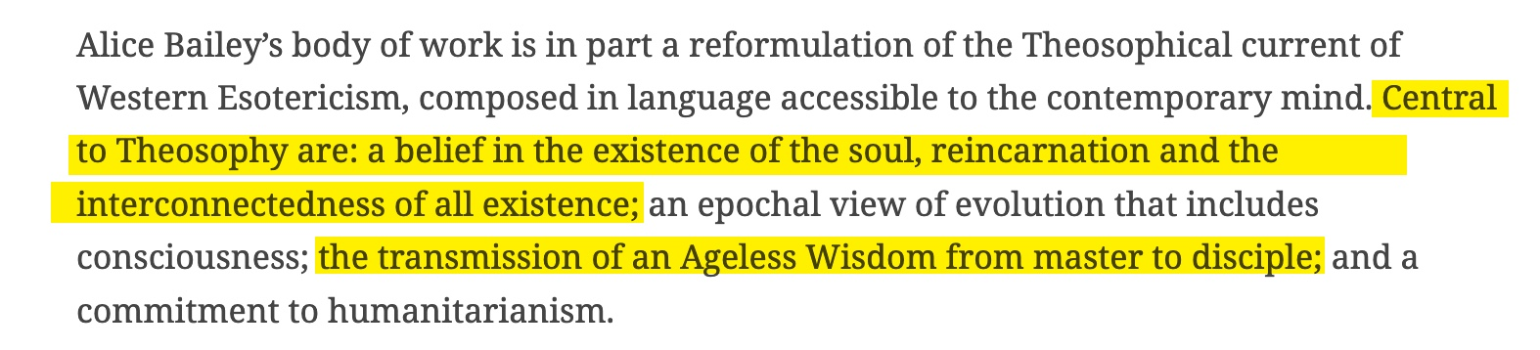

Slide 52
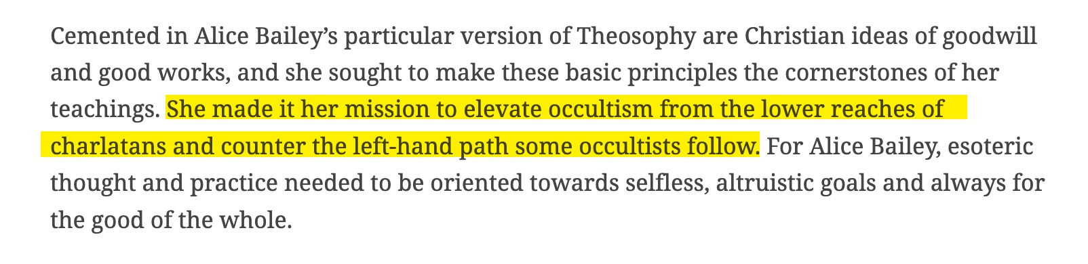

Slide 53
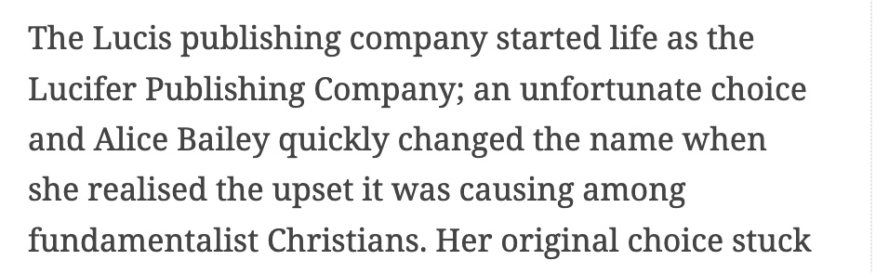

Slide 54
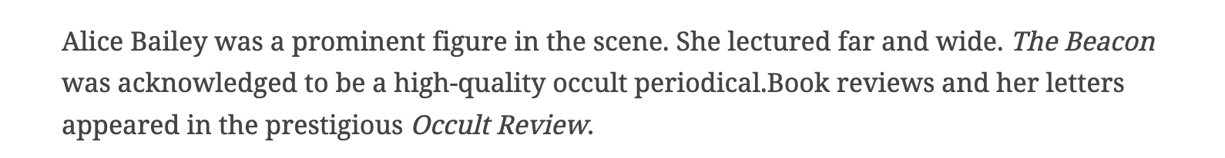

Slide 55
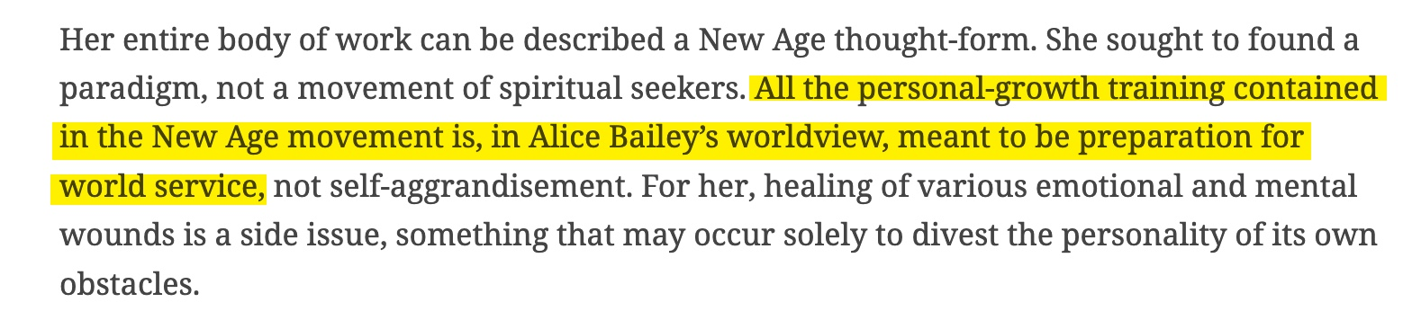

Slide 56
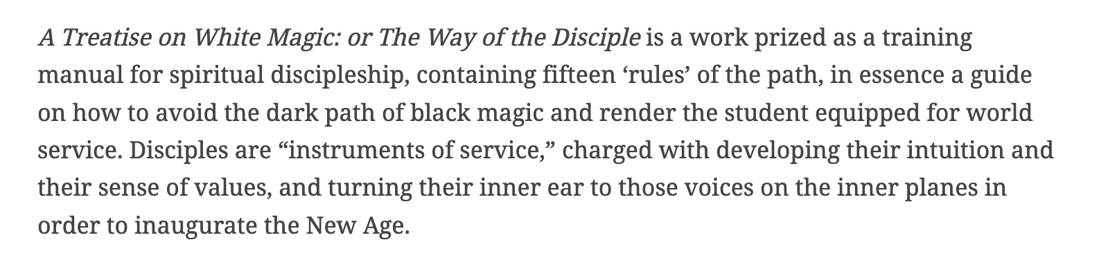

Slide 57
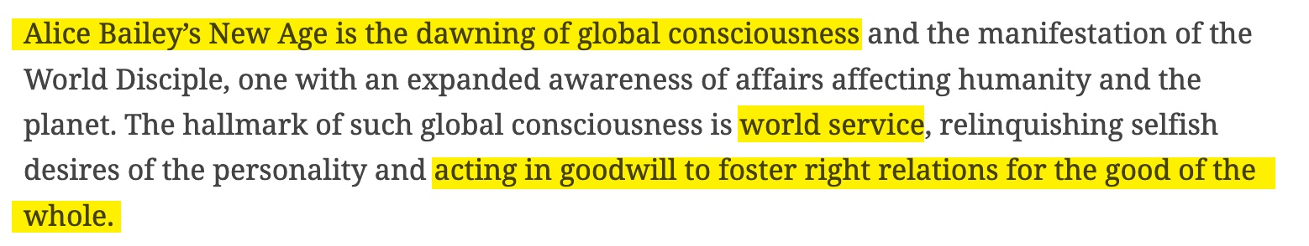

Slide 58
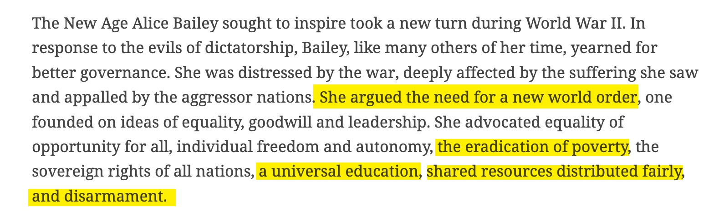

Slide 59
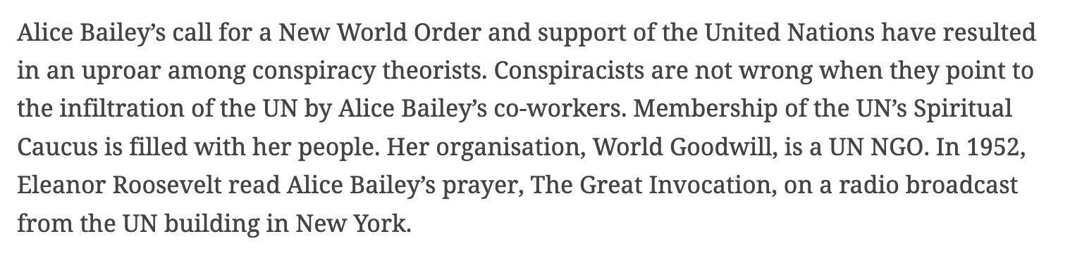

Slide 60
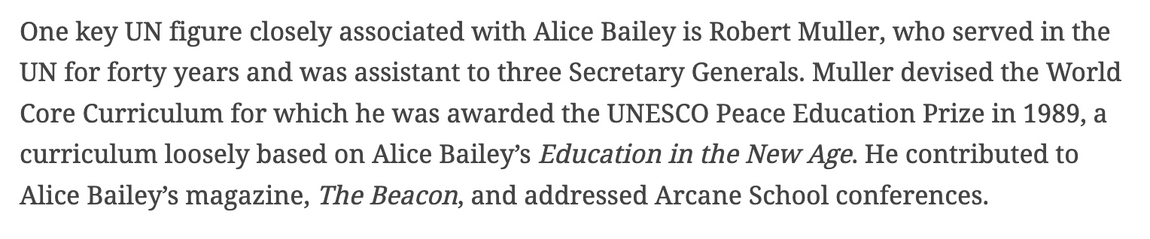

Slide 61
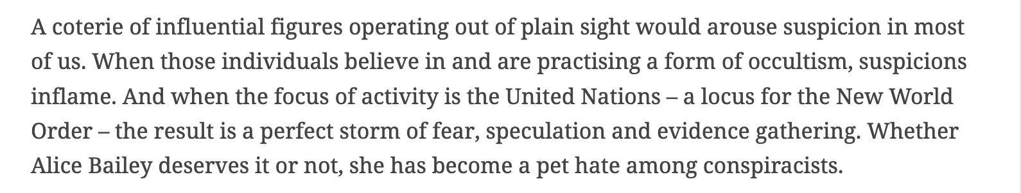

Slide 62
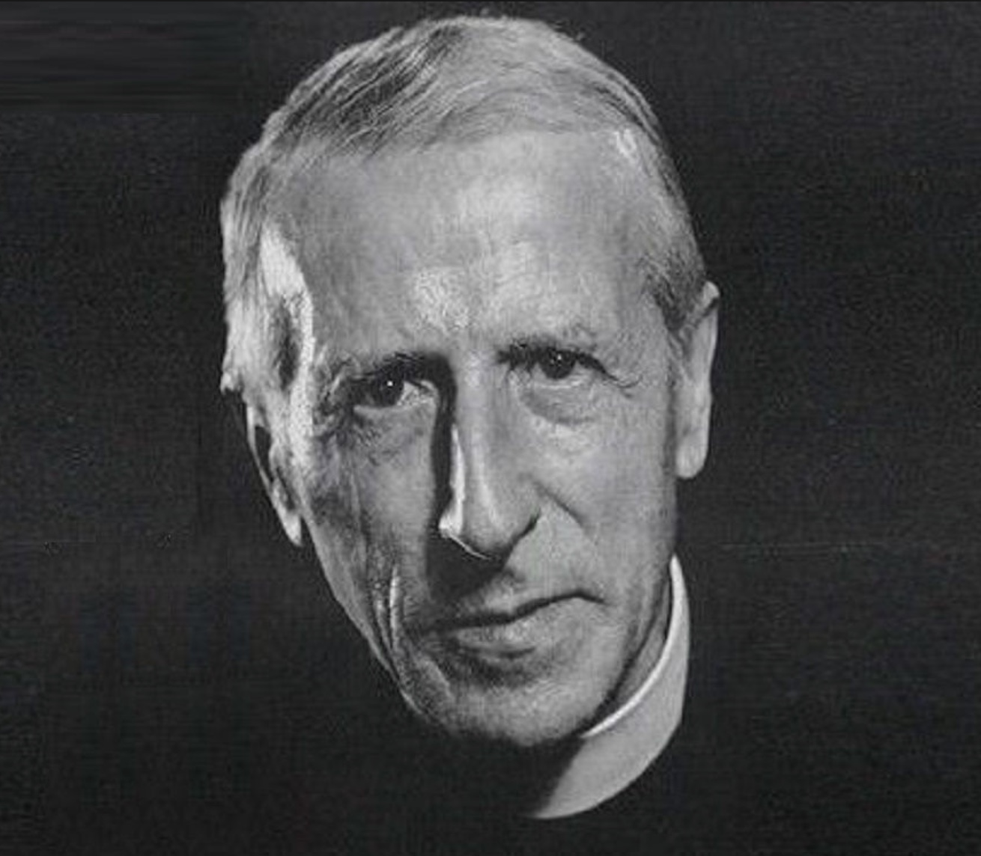
Pierre Teilhard de Chardin

Slide 63
Pierre Teilhard de Chardin
The fate of mankind, as well as of religion, depends upon the emergence of a new faith in the future.

Slide 64

Pierre Teilhard de Chardin:
What I am proposing to do is to narrow that gap between pantheism and Christianity by bringing out what one might call the Christian soul of pantheism or the pantheist aspect of Christianity.
Christianity and Evolution, p. 56

Slide 65

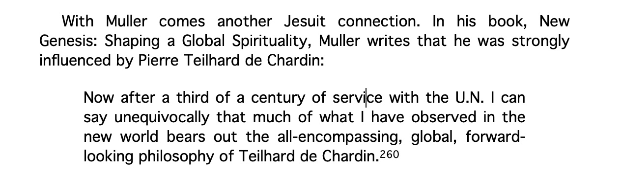

Slide 66
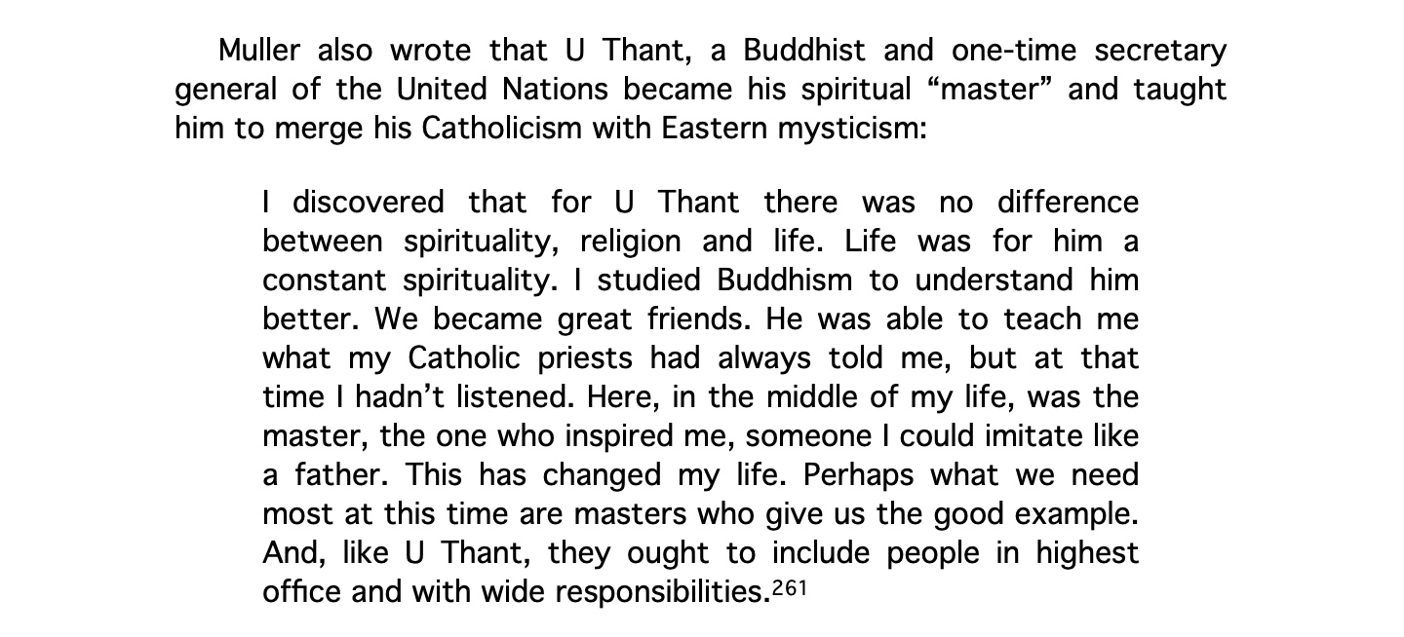

Slide 67
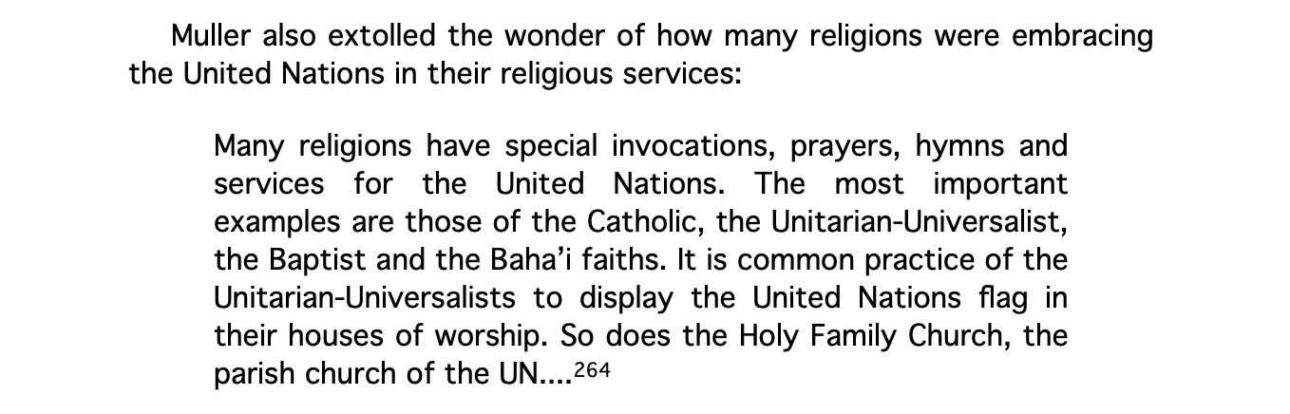

Slide 68
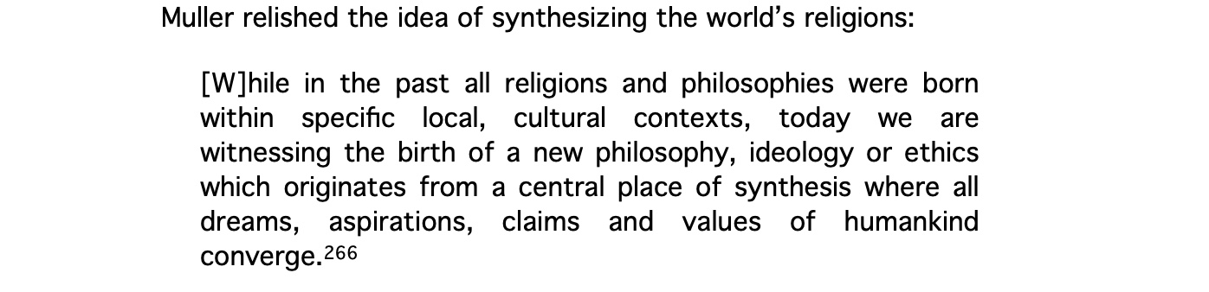

Slide 69
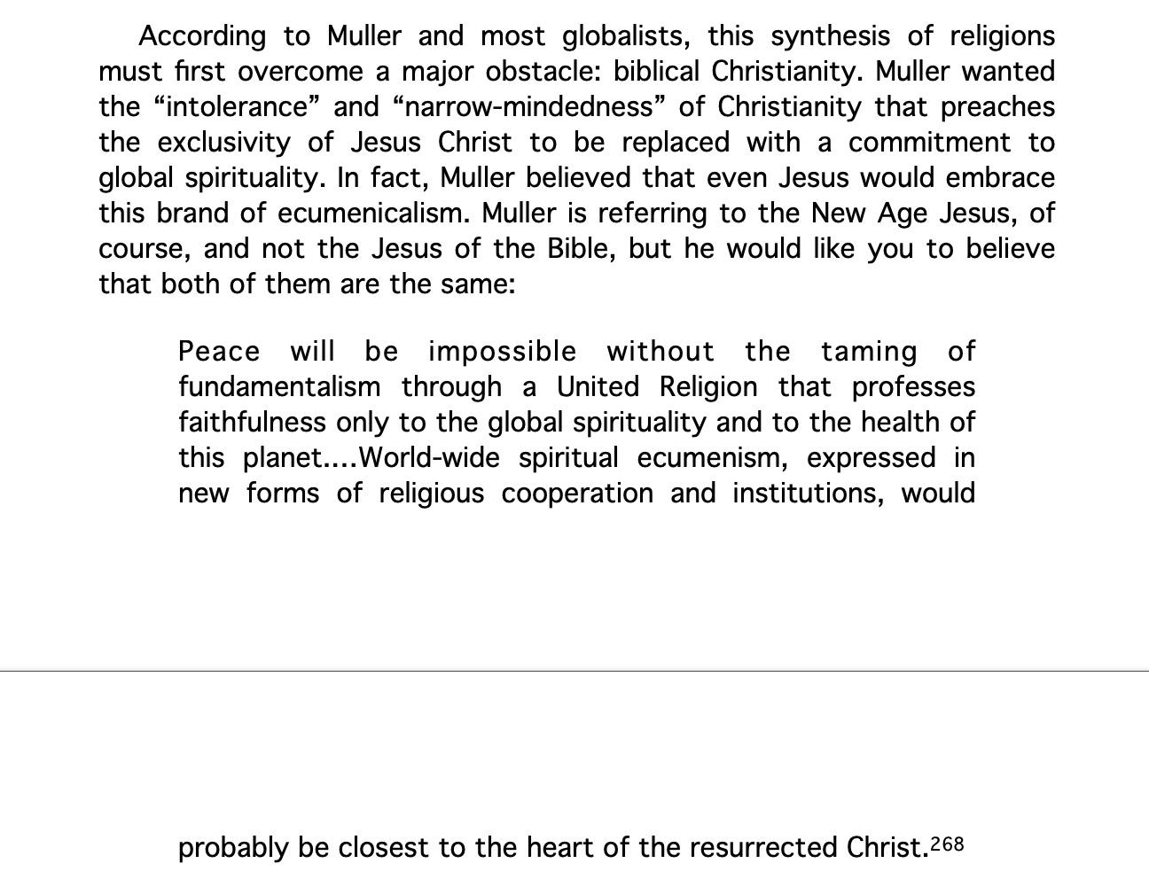

Slide 70
In June of 2009 in His 30,000 Word
Encyclical Pope Benedict XVI Declared:
…In this way it will be possible to experience and to steer the globalization of humanity in relational terms, in terms of communion and the sharing of goods.

Slide 71
In June of 2009 in His 30,000 Word
Encyclical Pope Benedict XVI Declared:
To manage the global economy … to bring about integral and timely disarmament, food security and peace; to guarantee the protection of the environment and to regulate migration: for all this, there is urgent need of a
true world political authority.

Slide 72
Vatican Calls For “Central World Bank”
In October of 2011 the Vatican released an
18 page report that called for a "global public authority" and a "central world bank" and "a supranational authority" with "universal jurisdiction".
The 18 page document released by the Vatican contained the often used communitarian phrase
“common good” twenty-two times.

Slide 73


Slide 74
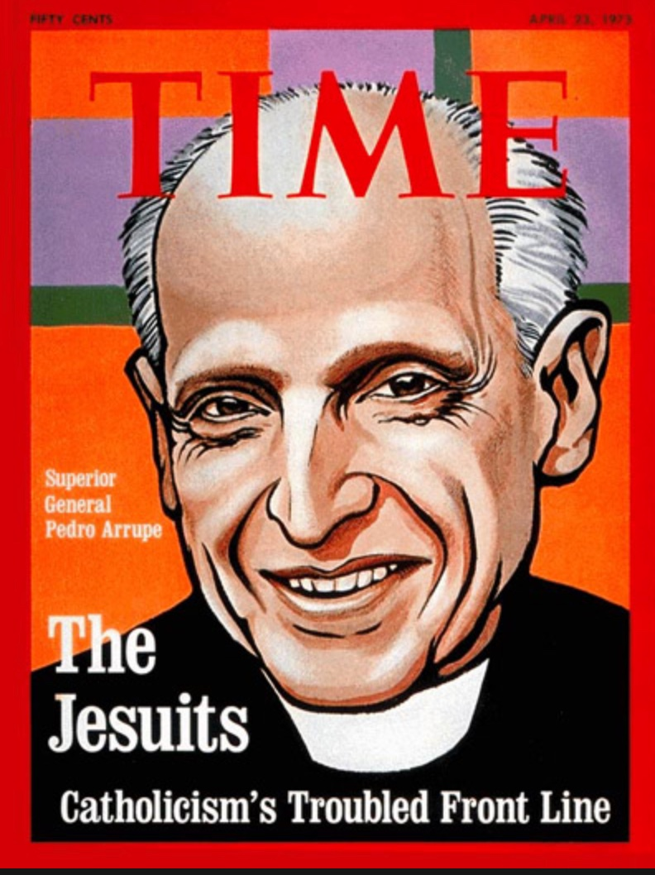
April 1973

Slide 76
Stopped here

Slide 77

Written in 1978 to Warn of the Communist Influence on the Vatican

Slide 78

Malachi Martin
The Keys of This Blood

Slide 79
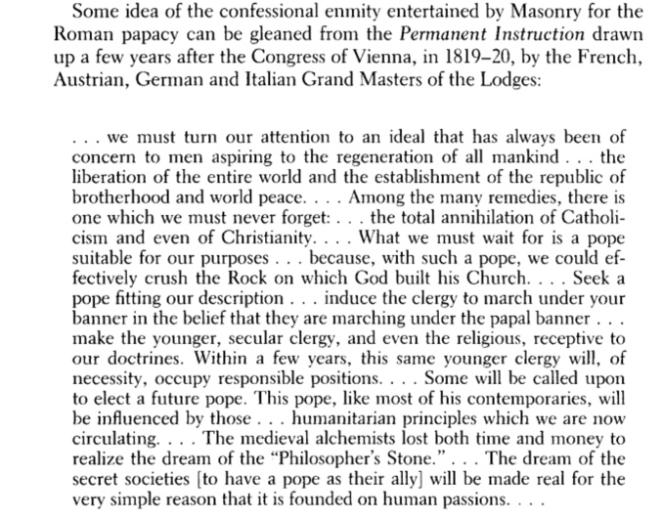

Slide 80
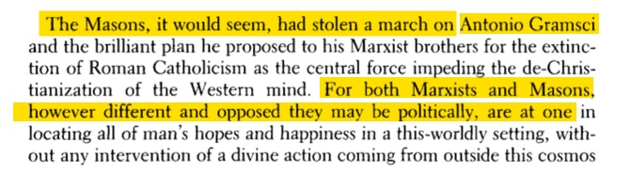

Slide 81
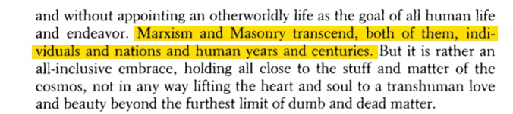

Slide 82
