Slide 1
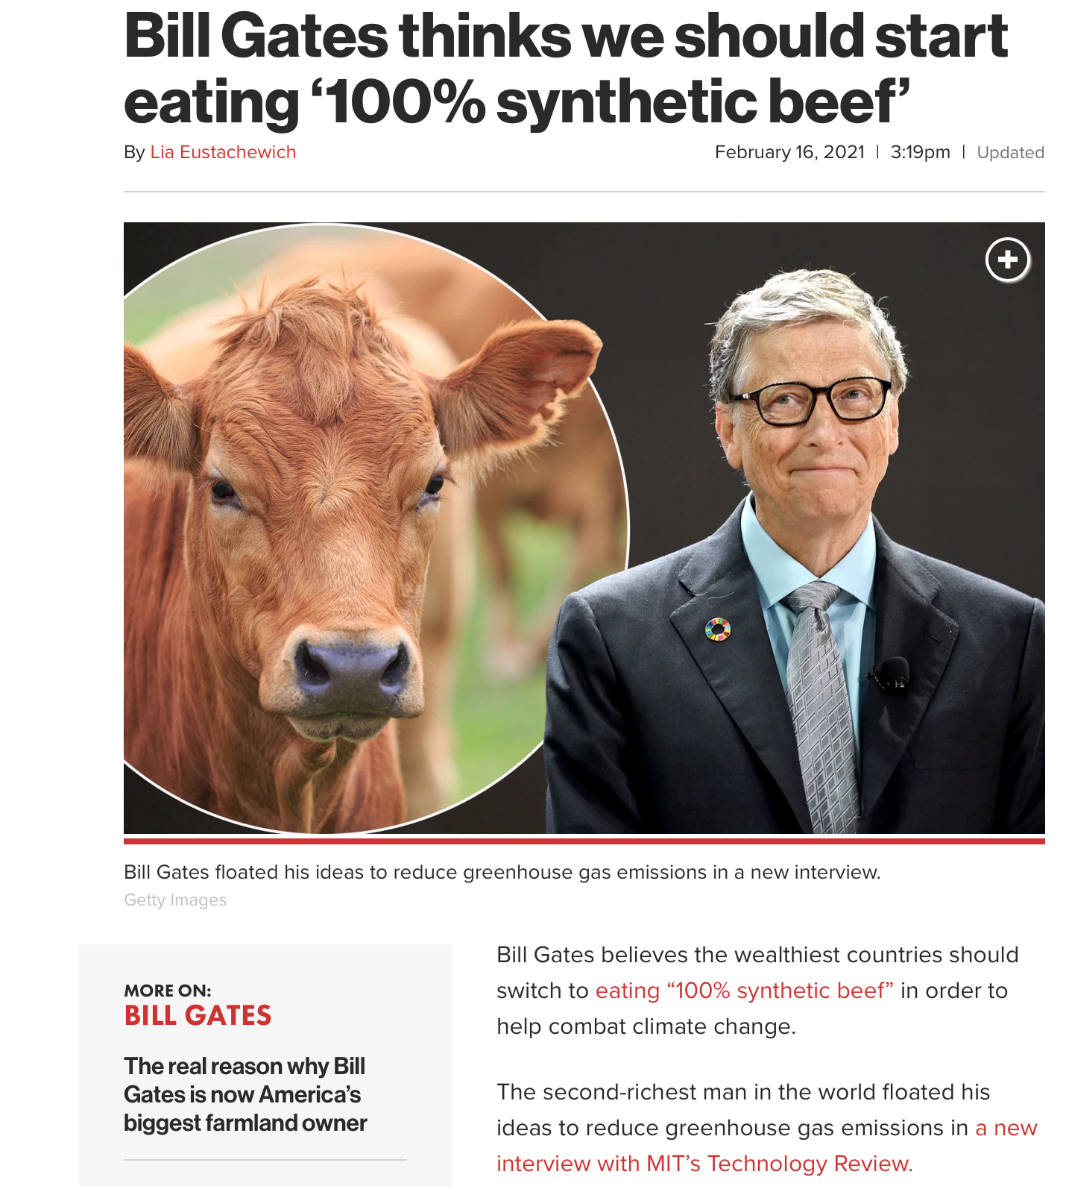

Slide 6
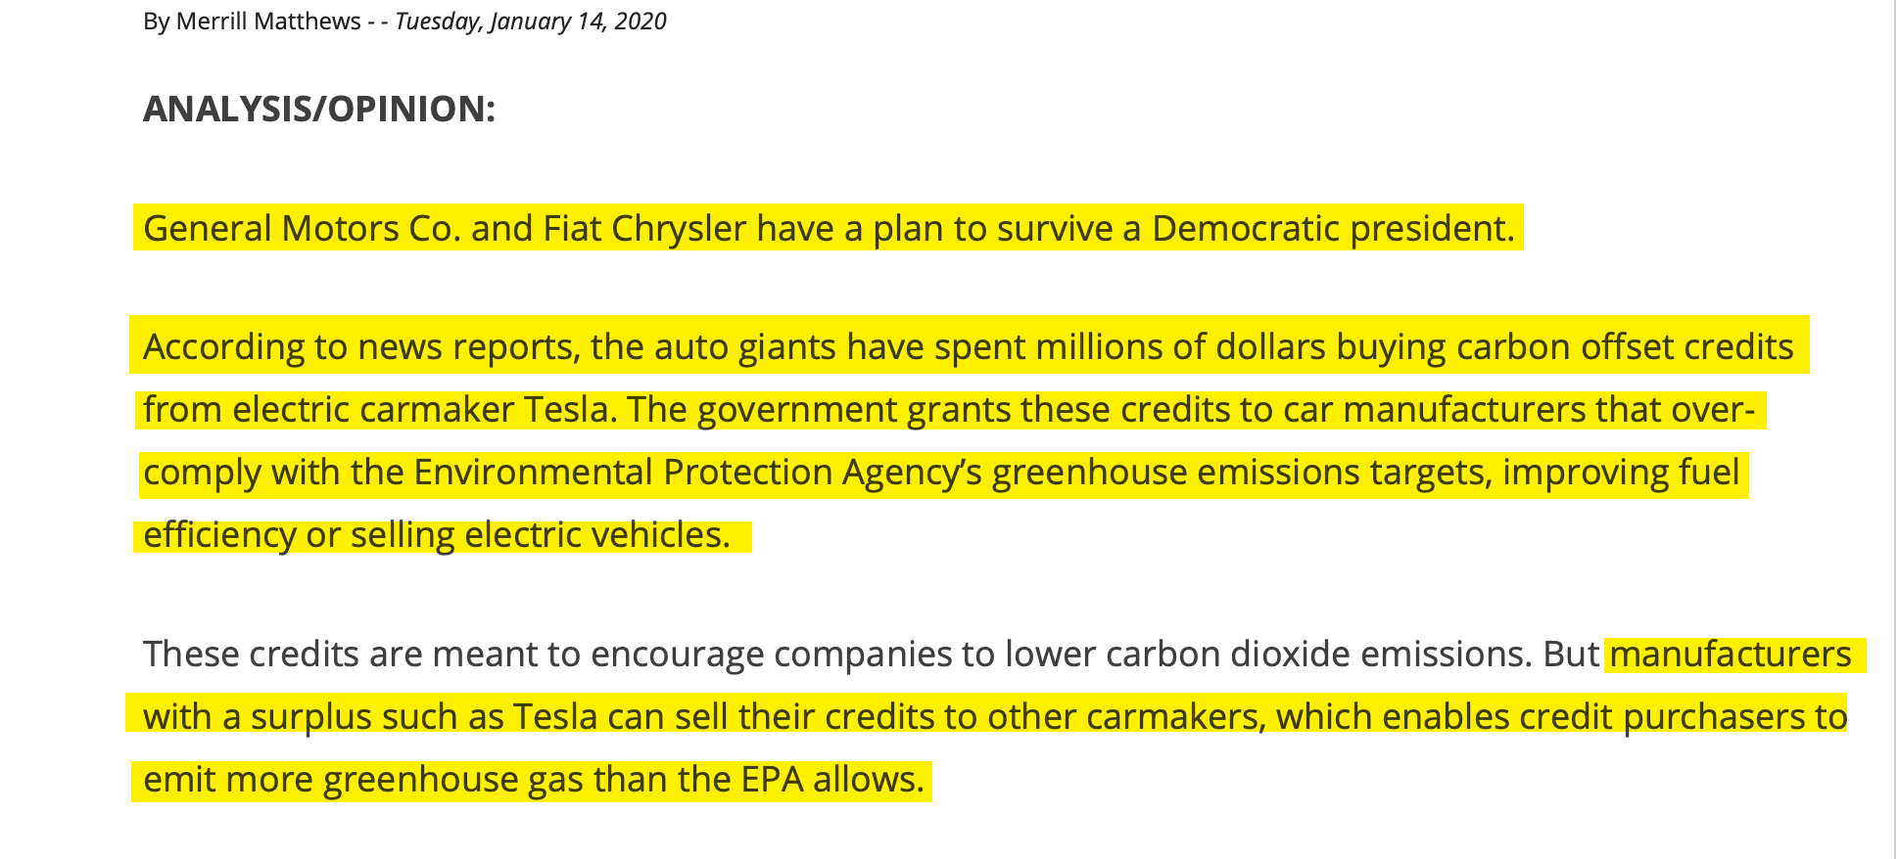

Slide 7
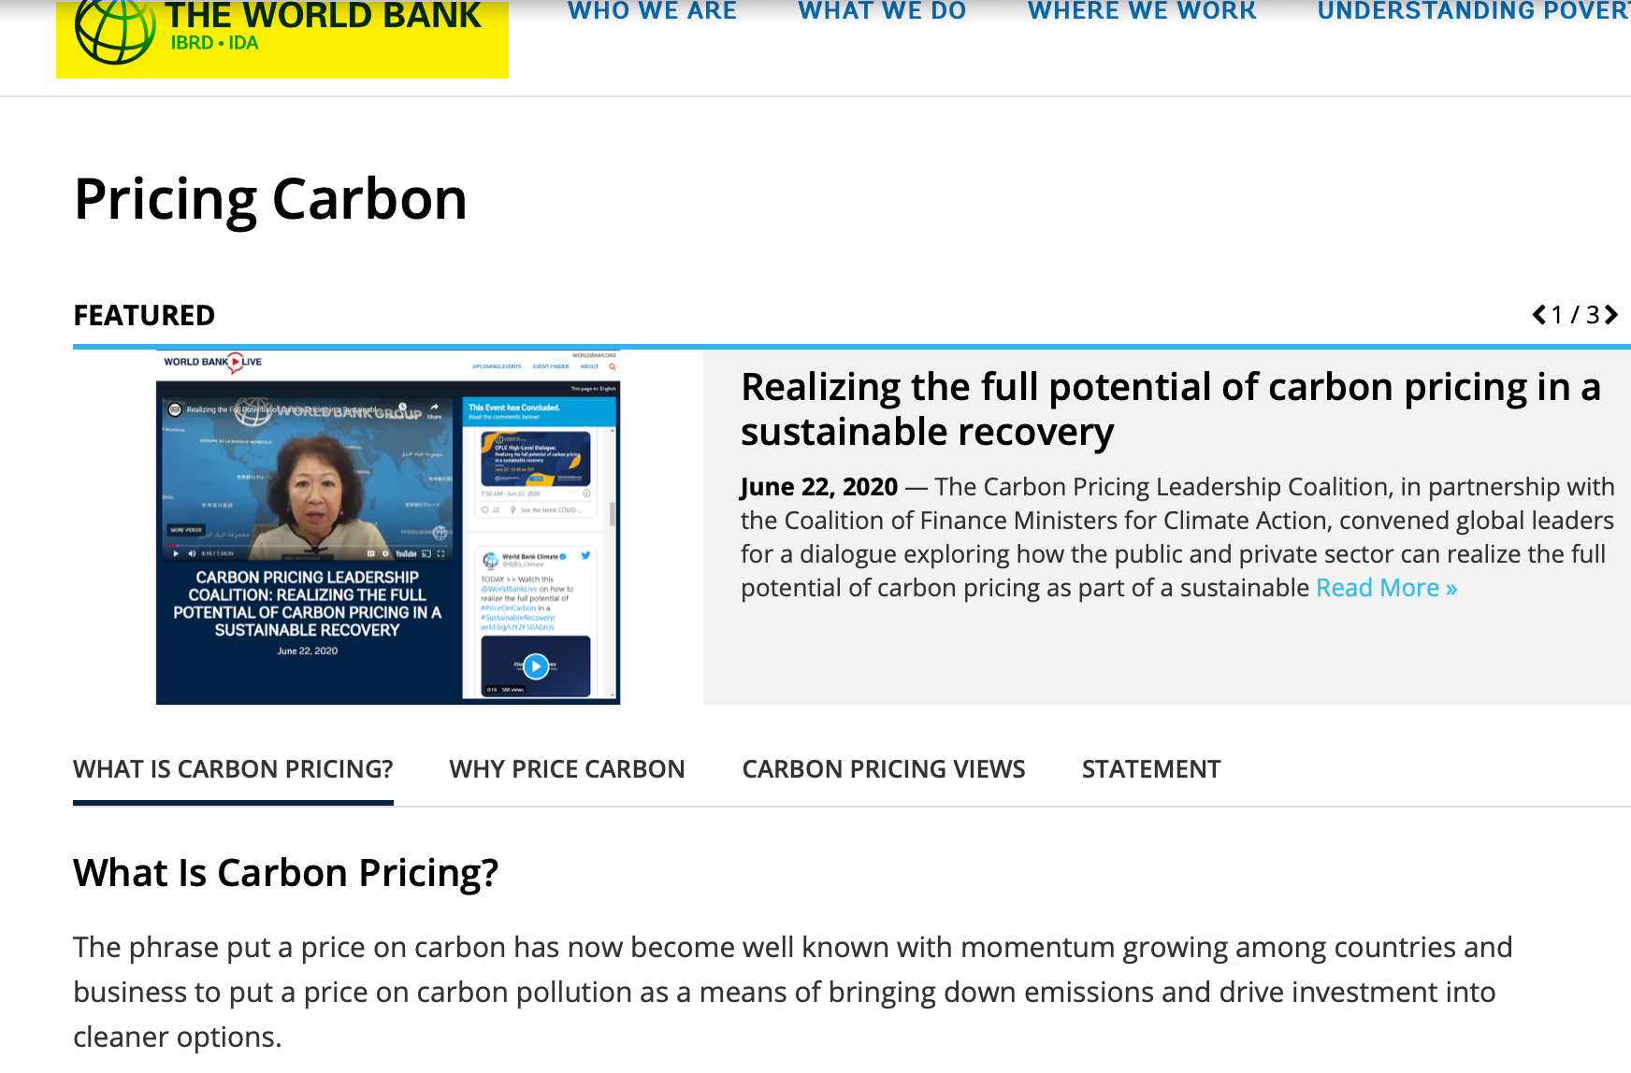

Slide 9
The Paul Ehrlich, His Wife and John Holdren Wrote:
It has been concluded that compulsory population-control laws, even including laws requiring compulsory abortion, could be sustained under the existing constitution if the population crisis becomes sufficiently severe to endanger society…if some individuals contribute to general social deterioration by overproducing children, and if the need is compelling, they can be required by law to exercise reproductive responsibility.

Slide 10
Maurice Strong:
Isn’t the only hope for the planet that the industrialized civilizations collapse? Isn’t it our responsibility to bring that about?

Slide 11
Maurice Strong:
It is simply not feasible for sovereignty to be exercised unilaterally by individual nation-states, however powerful. It is a principle which will yield only slowly and reluctantly to the imperatives of global environmental cooperation.

Slide 12
Helen Caldicott Union of Concerned Scientist:
Free enterprise really means rich people get richer. They have the freedom to exploit and psychologically rape their fellow human beings in the process. Capitalism is destroying the earth.

Slide 13
The Historical Roots of Our Ecologic Crisis By Lynn White Jr.
Christianity, in absolute contrast to ancient paganism and Asia's religions (except, perhaps Zoroastrianism), not only established a dualism of man and nature but also insisted that it is God's will that man exploit nature for his proper ends.By destroying pagan animism, Christianity made it possible to exploit nature in a mood of indifference to the feelings of natural objects.

Slide 14
The Historical Roots of Our Ecologic Crisis By Lynn White Jr.
But, as we now recognize, somewhat over a century ago science and technology hitherto quite separate activities-joined to give mankind powers which, to judge by many of the ecologic effects, are out of control. If so, Christianity bears a huge burden of guilt.

Slide 16
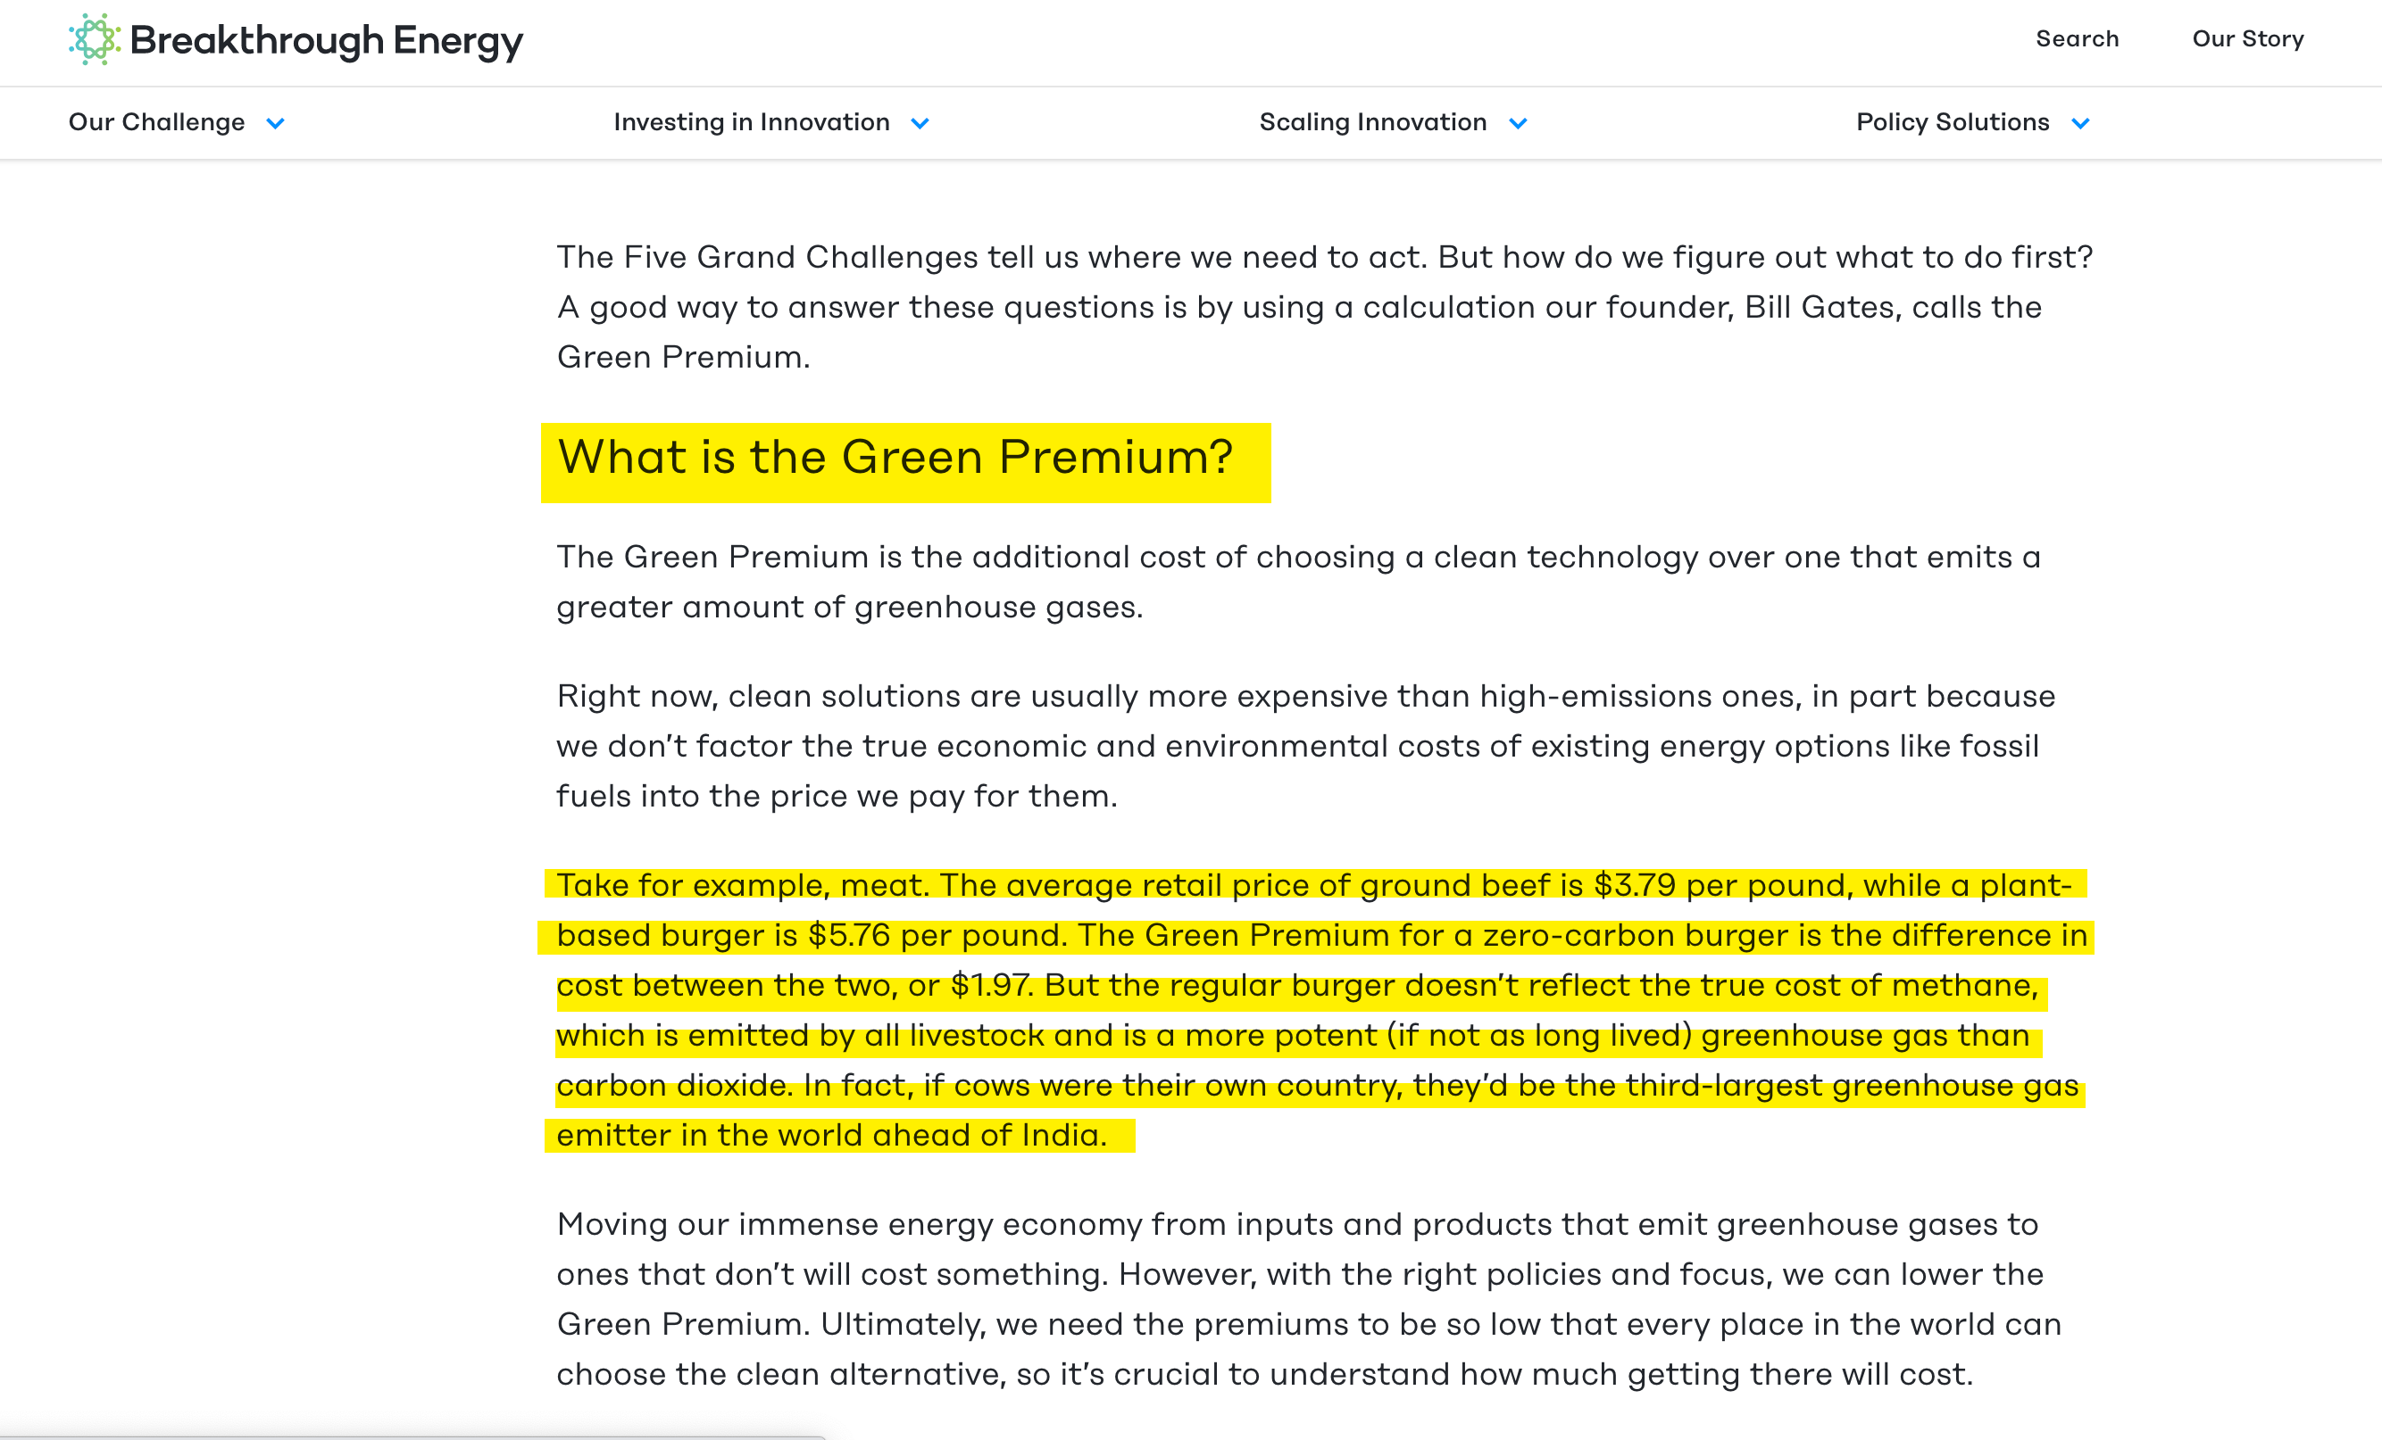

Slide 19
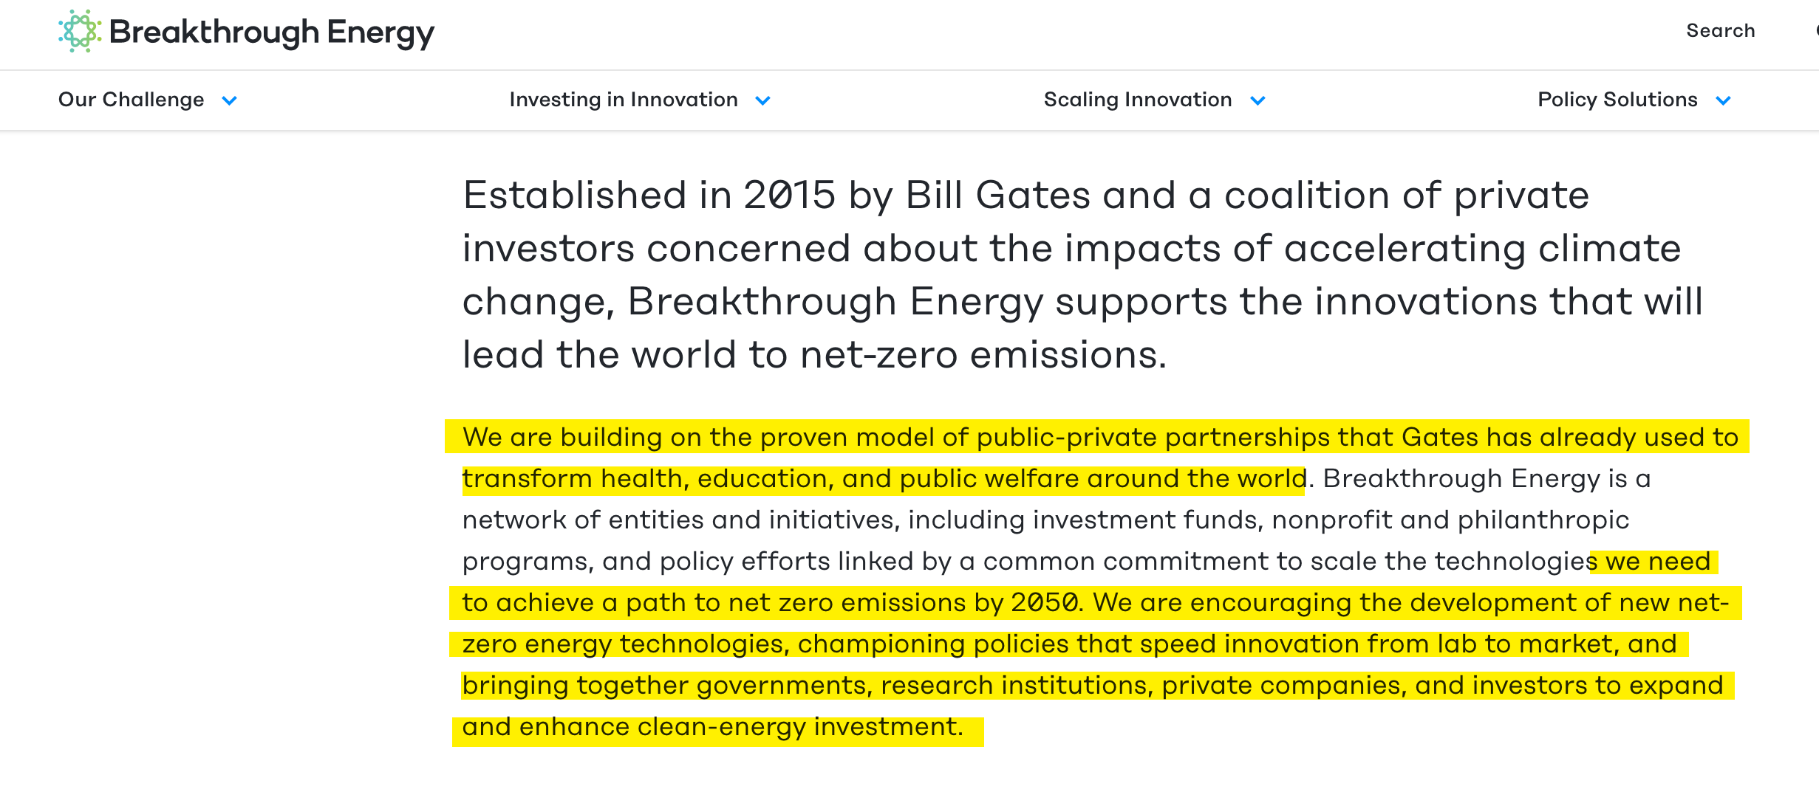

Slide 23
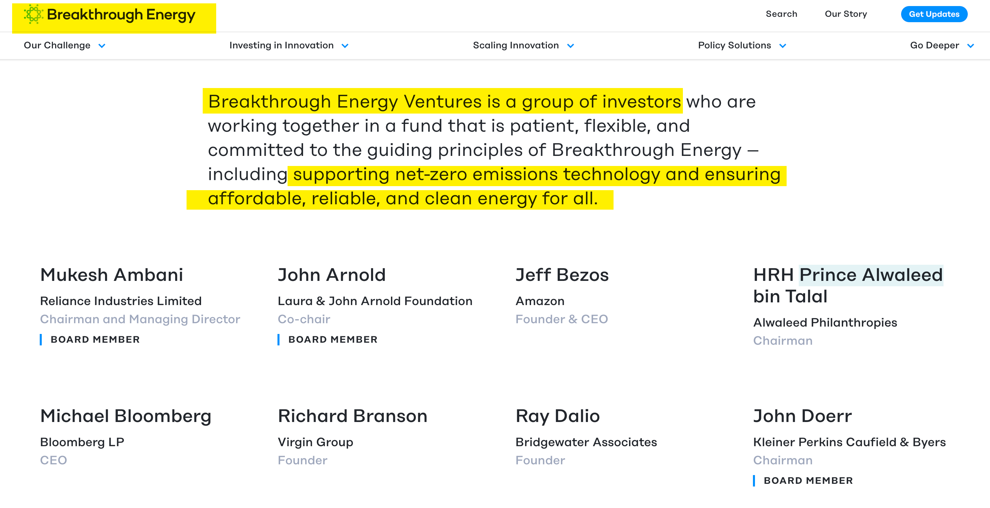

Slide 30
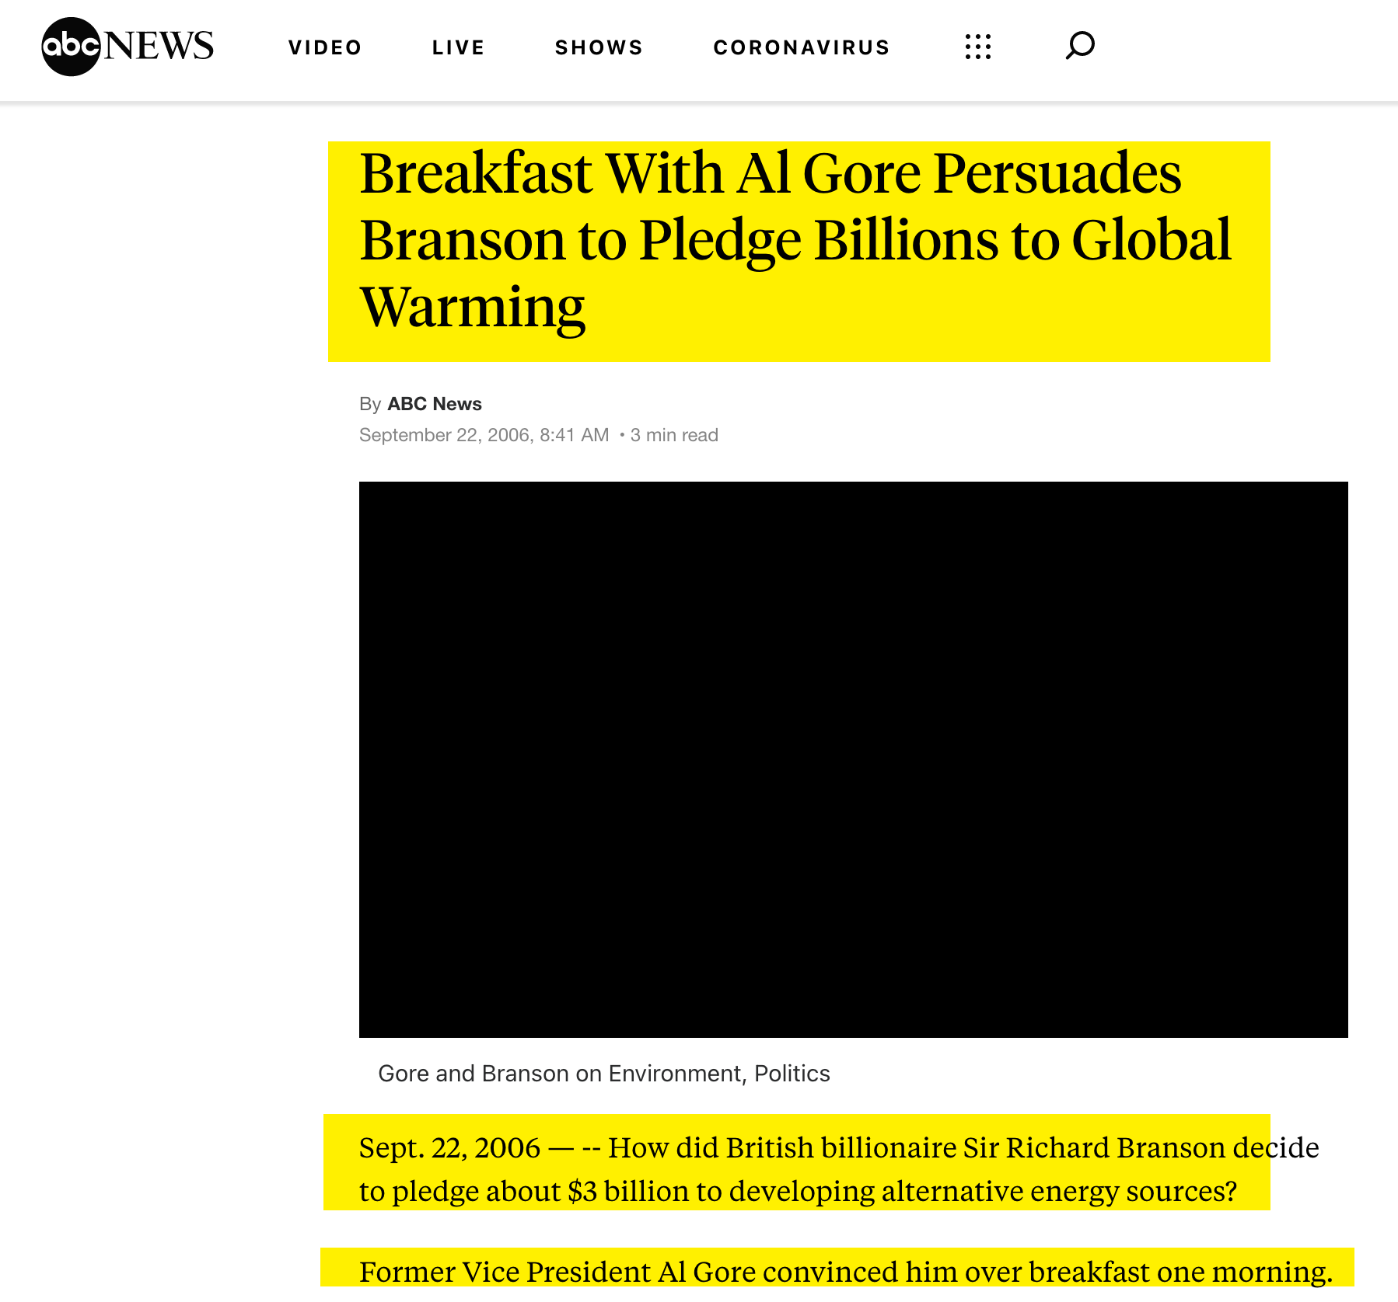

Slide 33
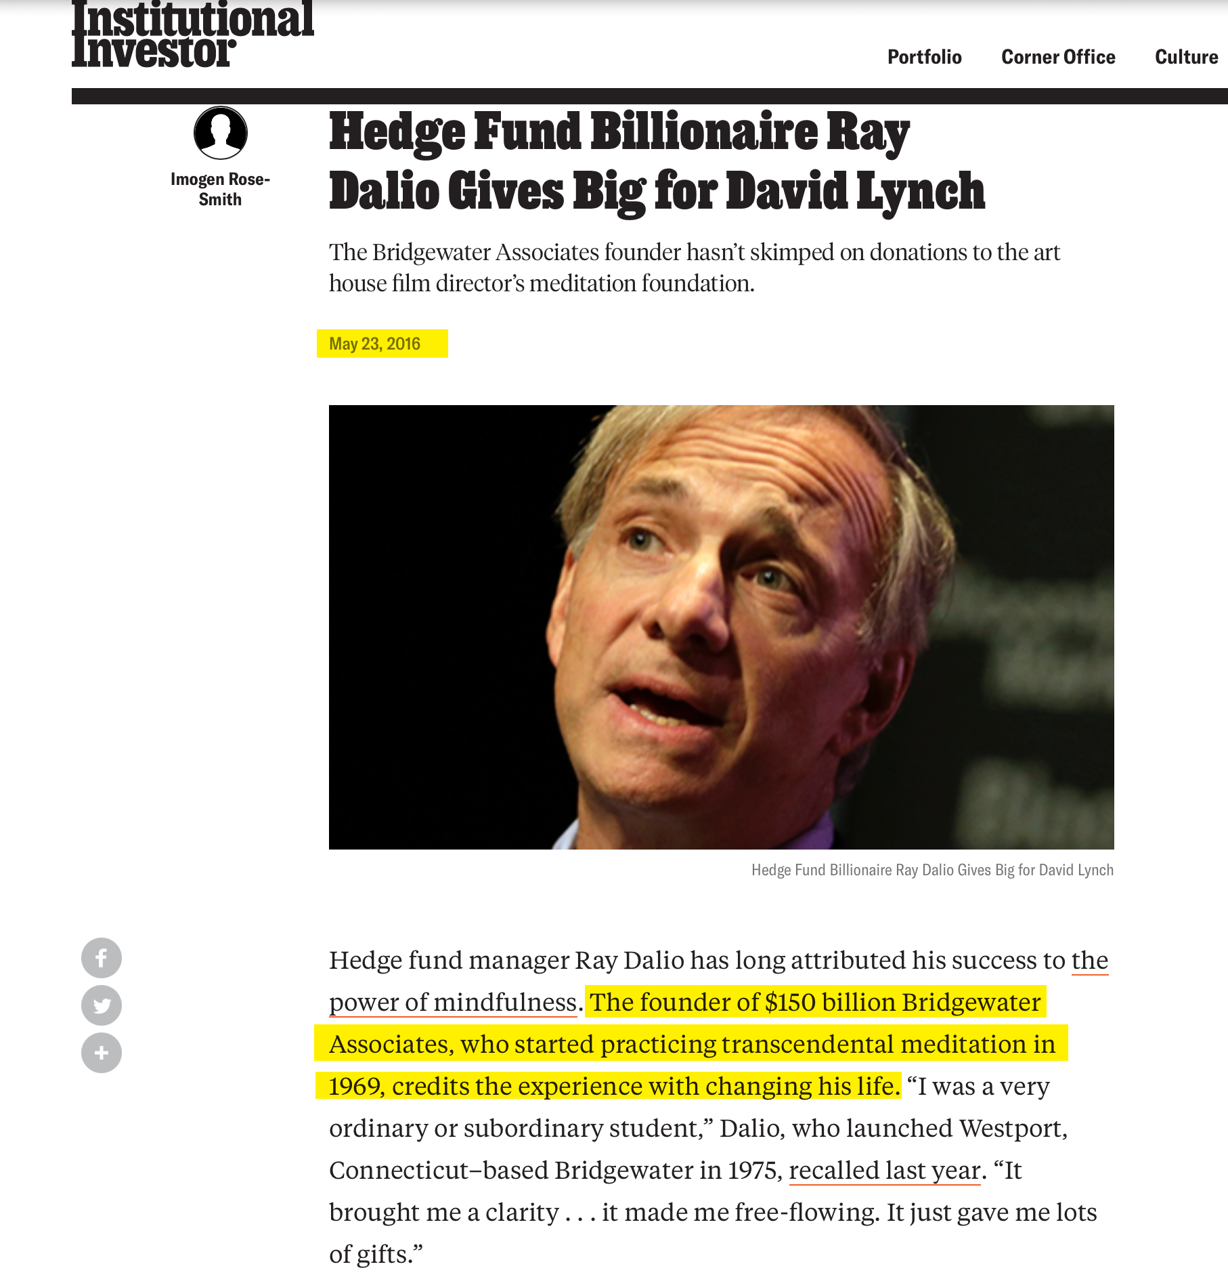

Slide 37
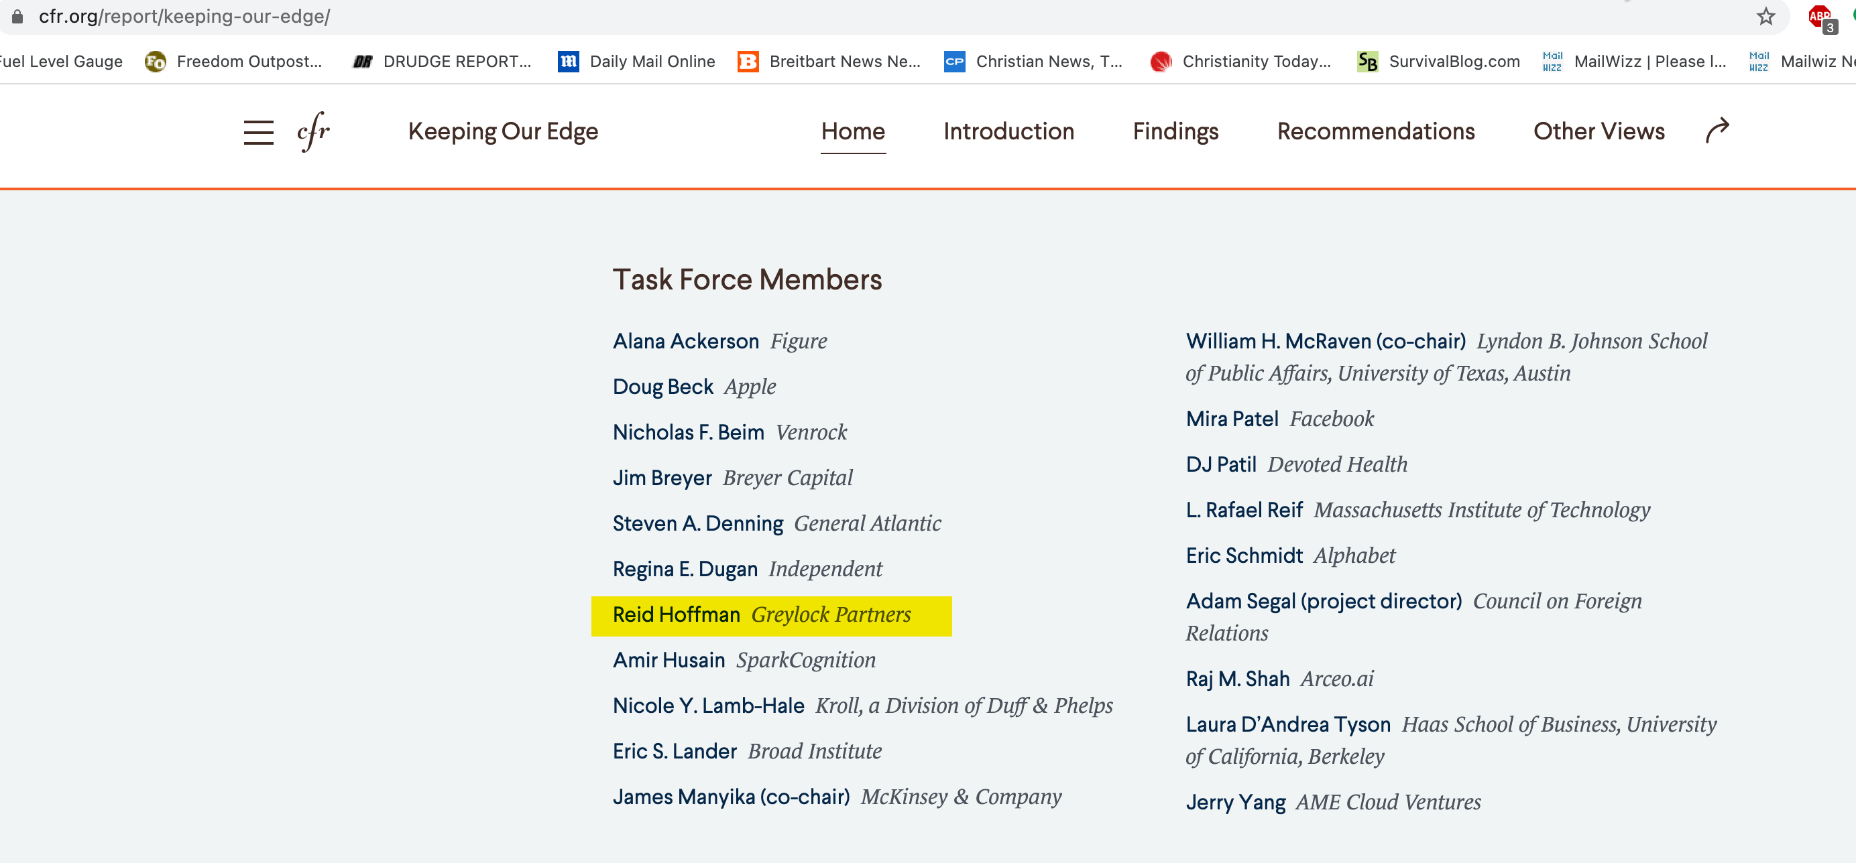

Slide 39
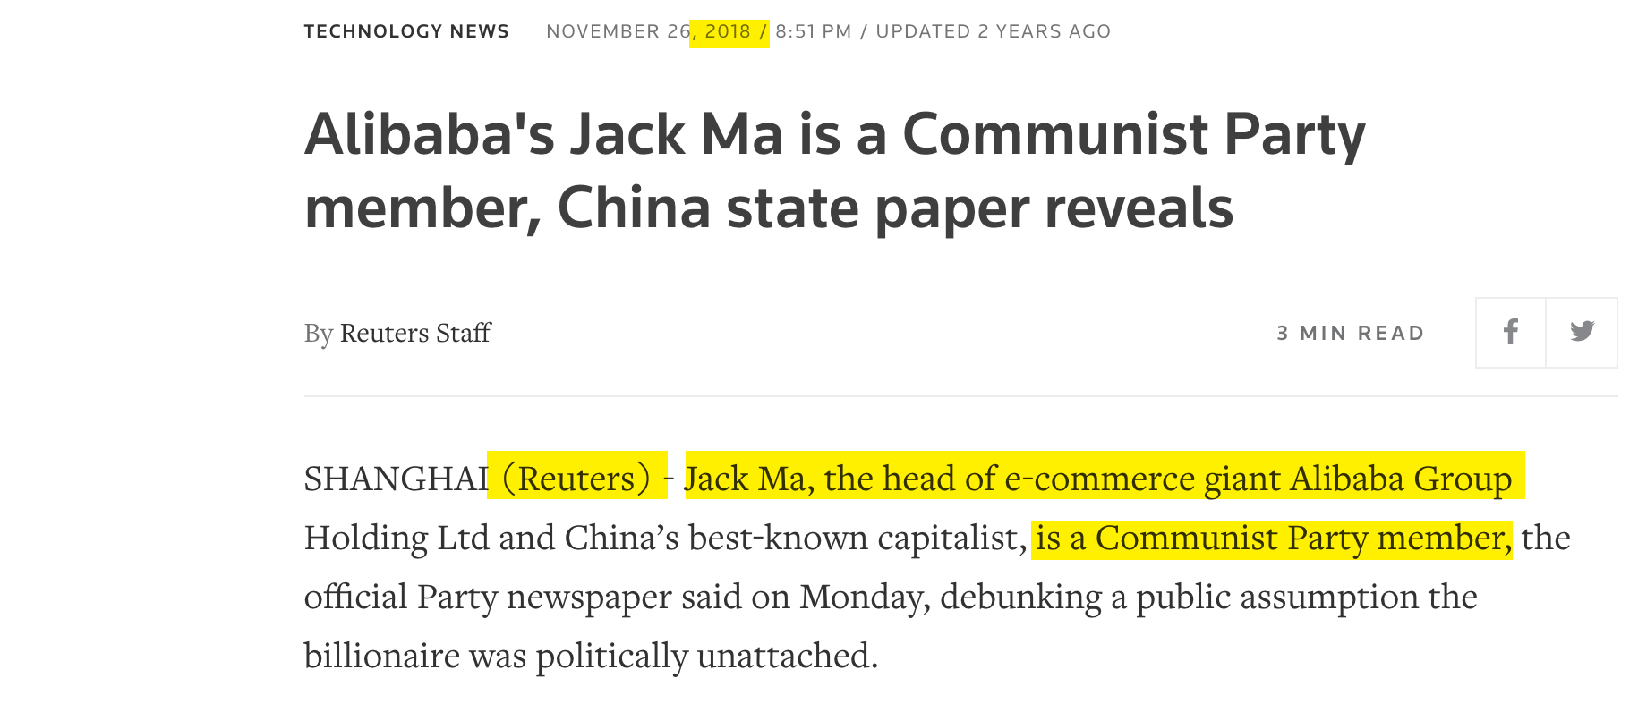

Slide 43
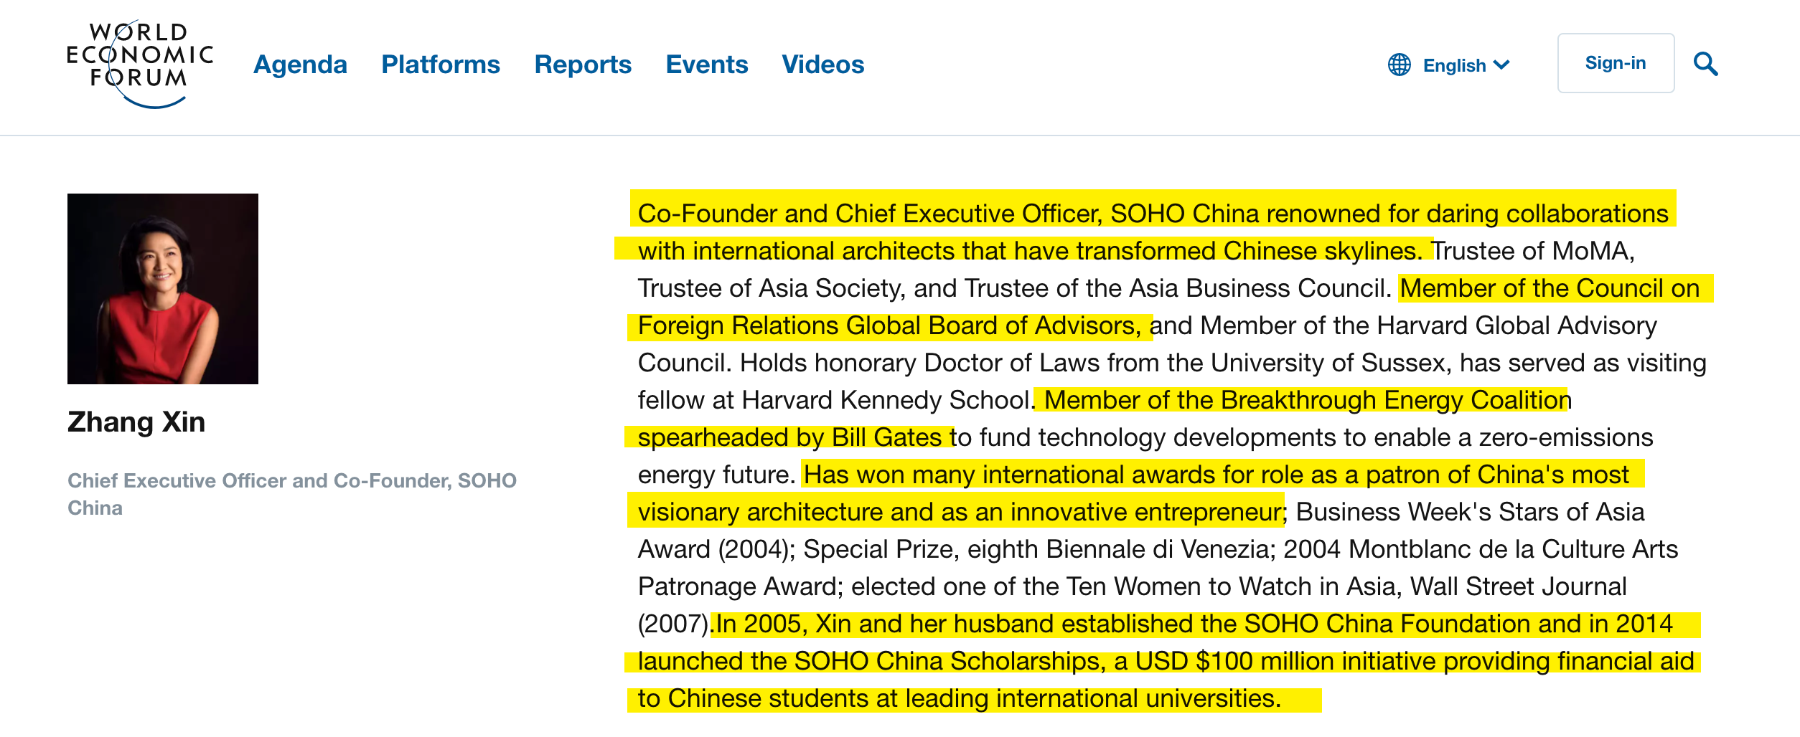

Slide 44
Sustainable Development Includes:
Abortion on demand
Population control
Gun control
Social justice Global governance
The New World Order

Slide 45
Sustainable Development Includes:
Socialized medicine Social welfare programs Elimination of property rights
Elimination of national sovereignty
Elimination of parental authority Elimination of free-market capitalism
Education to serve the masses

Slide 46
Sustainable Development Includes:
Public housing Redistribution of wealth Legal positivism and judicial activism
Hate-crime laws that criminalize Christianity

Slide 47
In June 2009, Pope Benedict XVI Issued a 30,000-Word Encyclical Calling For: Reform of the United Nations so there could be “true world political authority”

Slide 48
In His June 2009 Encyclical
Pope Benedict XVI Also Called For:
A global tax
Global redistribution of wealth from rich countries to poor countries a worldwide redistribution of energy resources, so that countries lacking those resources can have access to them.

Slide 49
Vatican Calls For “Central World Bank” In October of 2011 the Vatican released an 18 page report that called for a "global public authority" and a "central world bank" and "a supranational authority" with "universal jurisdiction". The 18 page document released by the Vatican contained the often used communitarian phrase “common good” twenty-two times.

