Slide 1
The Convergence of
End Time Events

Slide 2
One World Economy

Slide 3
Mark of the Beast
Technology

Slide 4
One World Government

Slide 5
One-World Religion

Slide 6
Jews Return to Israel

Slide 7
The Third Temple
in Jerusalem

Slide 8
The Red Heifer

Slide 9
Israel’s Treasure

Slide 10
Israel Surrounded
By Her Enemies

Slide 11
Jews Are Prepared
to Be Deceived by a False Messiah

Slide 12
Rise of Antisemitism

Slide 13
Global Famine

Slide 14
Plagues

Slide 15
Wars and Rumors of Wars

Slide 16
Earthquakes

Slide 17
The Rise of Apostasy

Slide 18
The Rise of False Christs

Slide 19
Rise of Humanism, Hedonism

Slide 20
Rise of False Prophets

Slide 21
Luke 21:28
Now when these things begin to happen, look up and lift up your heads, because your redemption draws near.”

Slide 22
Revelation 1:1
The Revelation of Jesus Christ, which God gave Him to show His servants—things which must shortly take place. And He sent and signified it by His angel to His servant John,

Slide 23
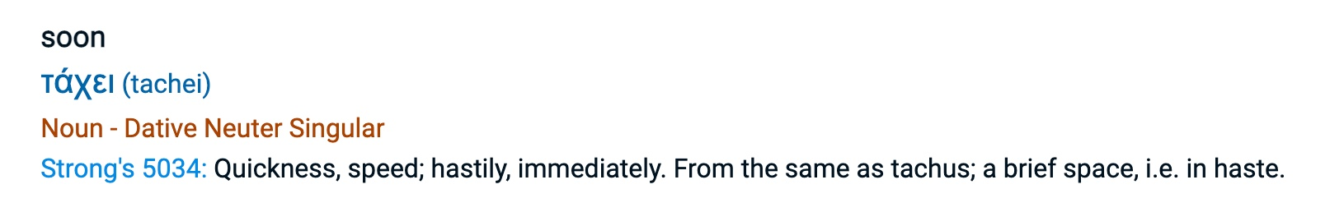
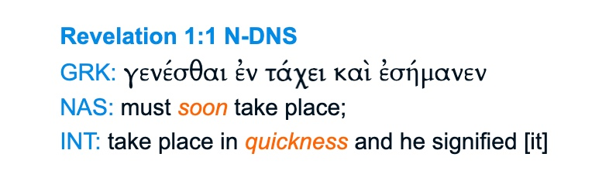

Slide 24
Revelation 1:3
Blessed is he who reads and those who hear the words of this prophecy, and keep those things which are written in it; for the time is near.

Slide 25
One World Economy

Slide 26
Revelation 13:16-17

Slide 27
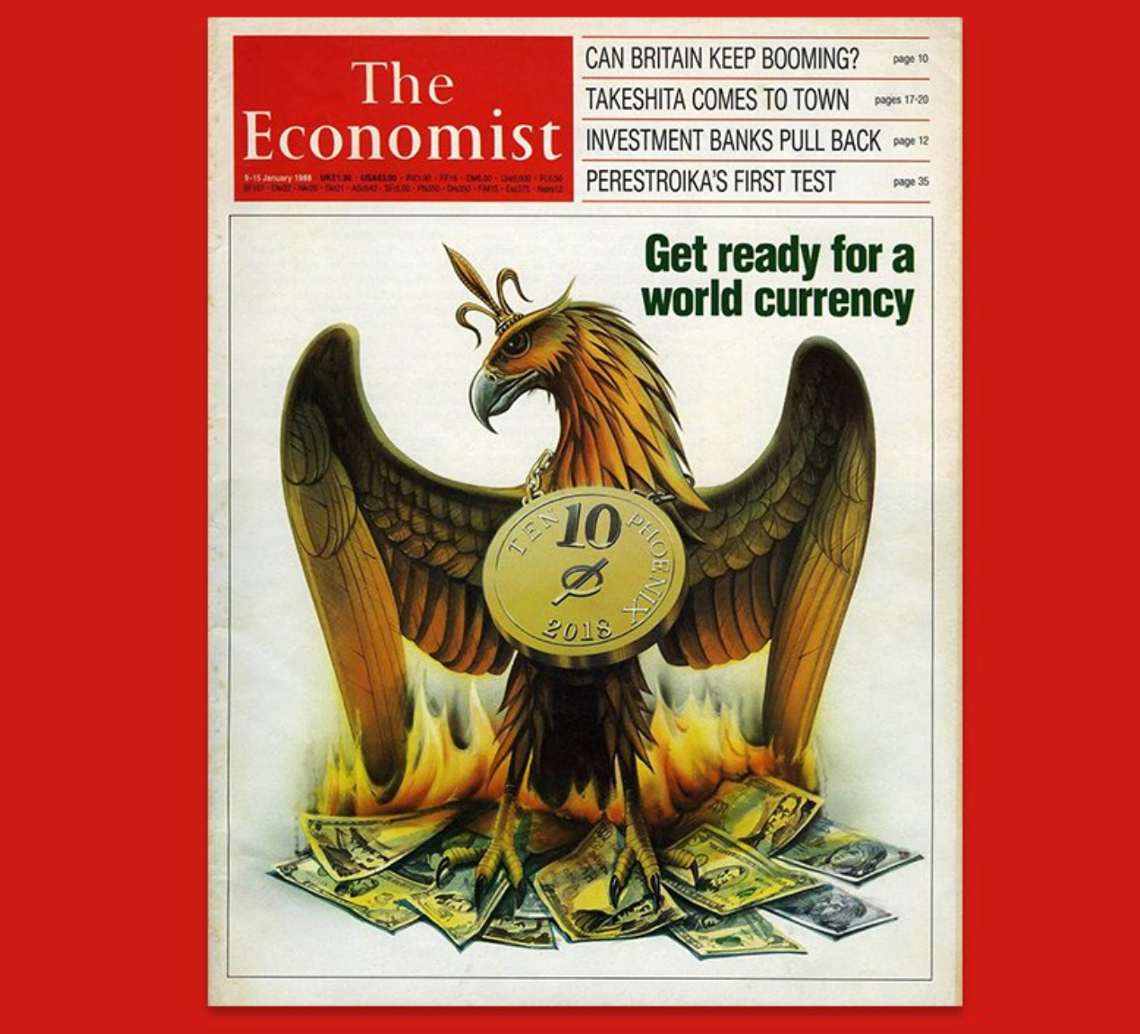
January 1988

Slide 28
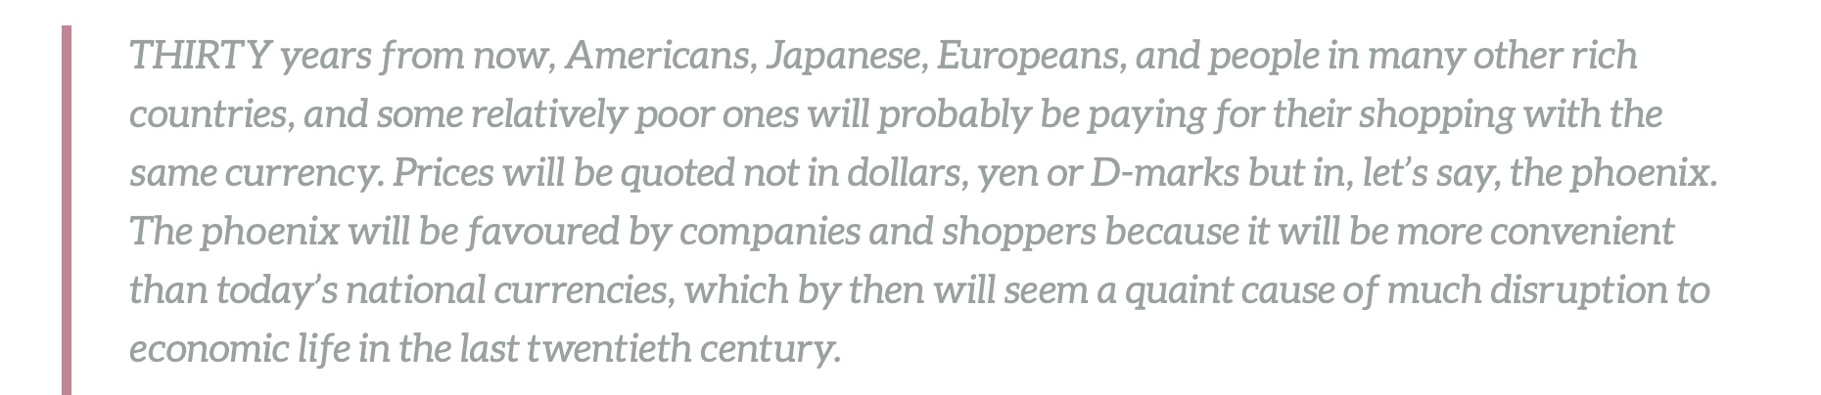
The Economist Magazine, January 1988

Slide 29
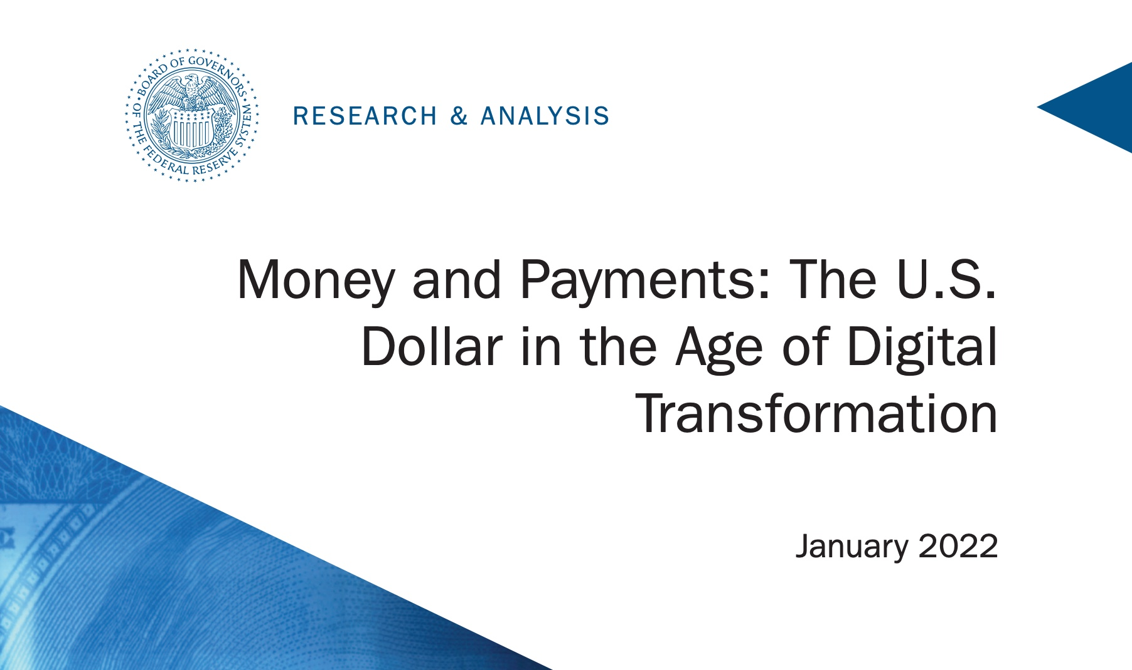

Slide 30
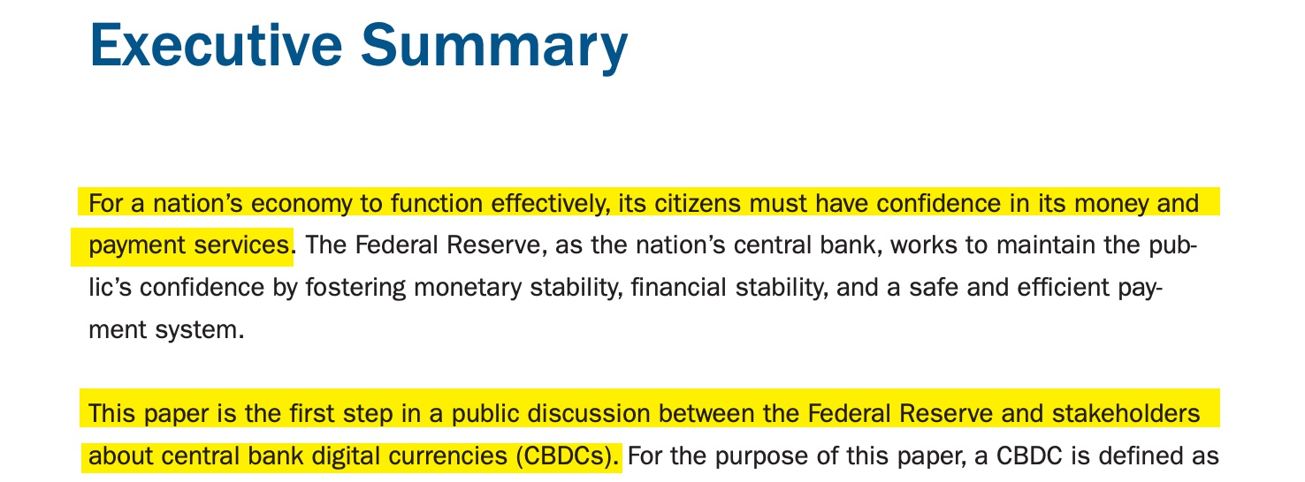

Slide 31
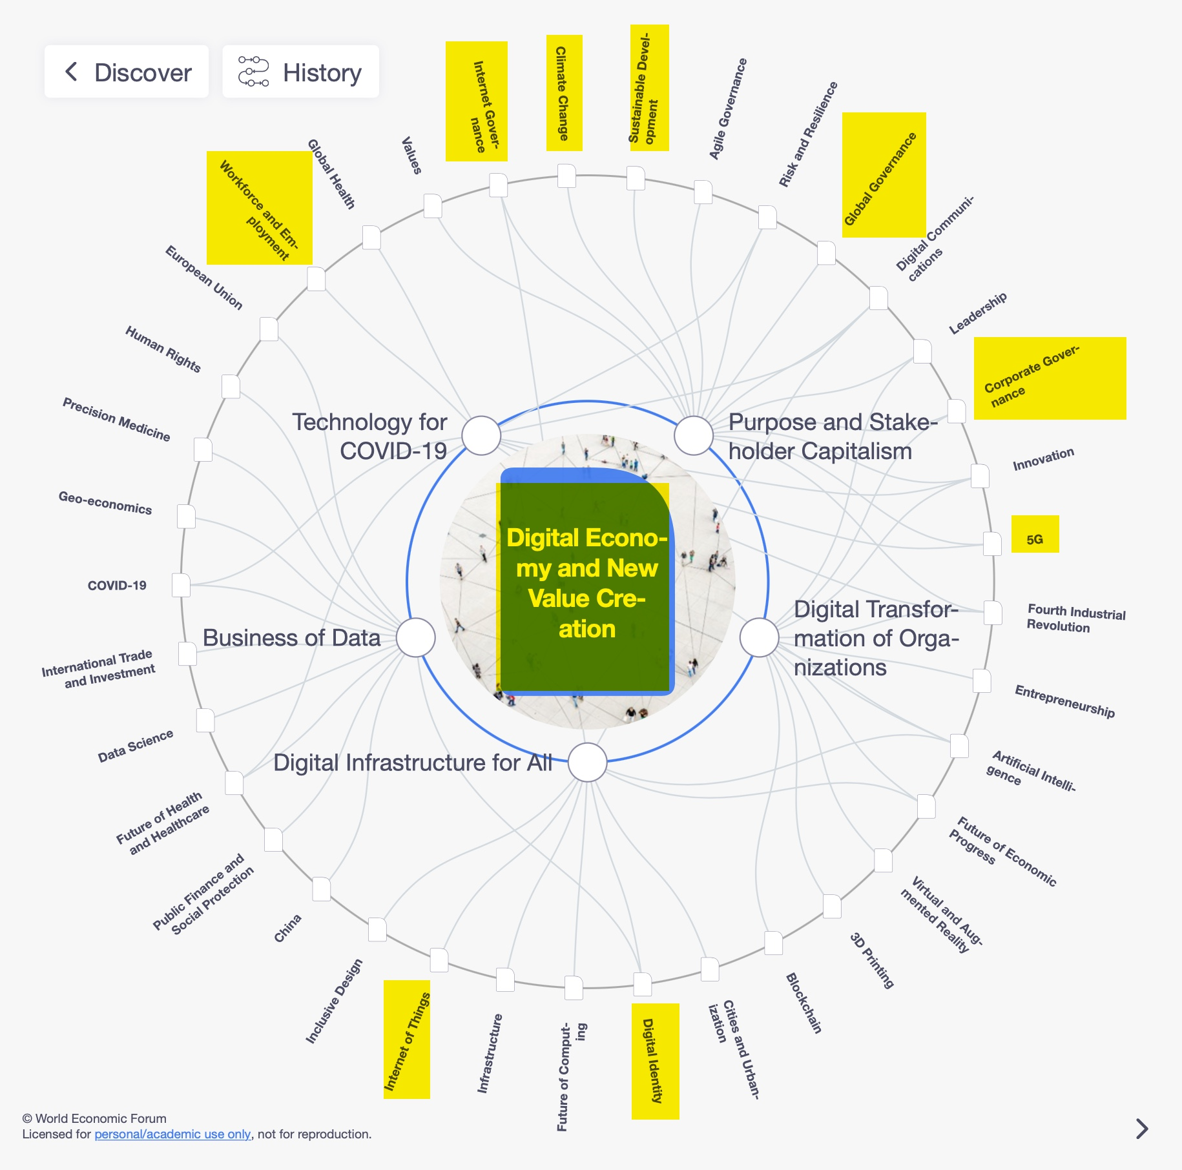

Slide 32
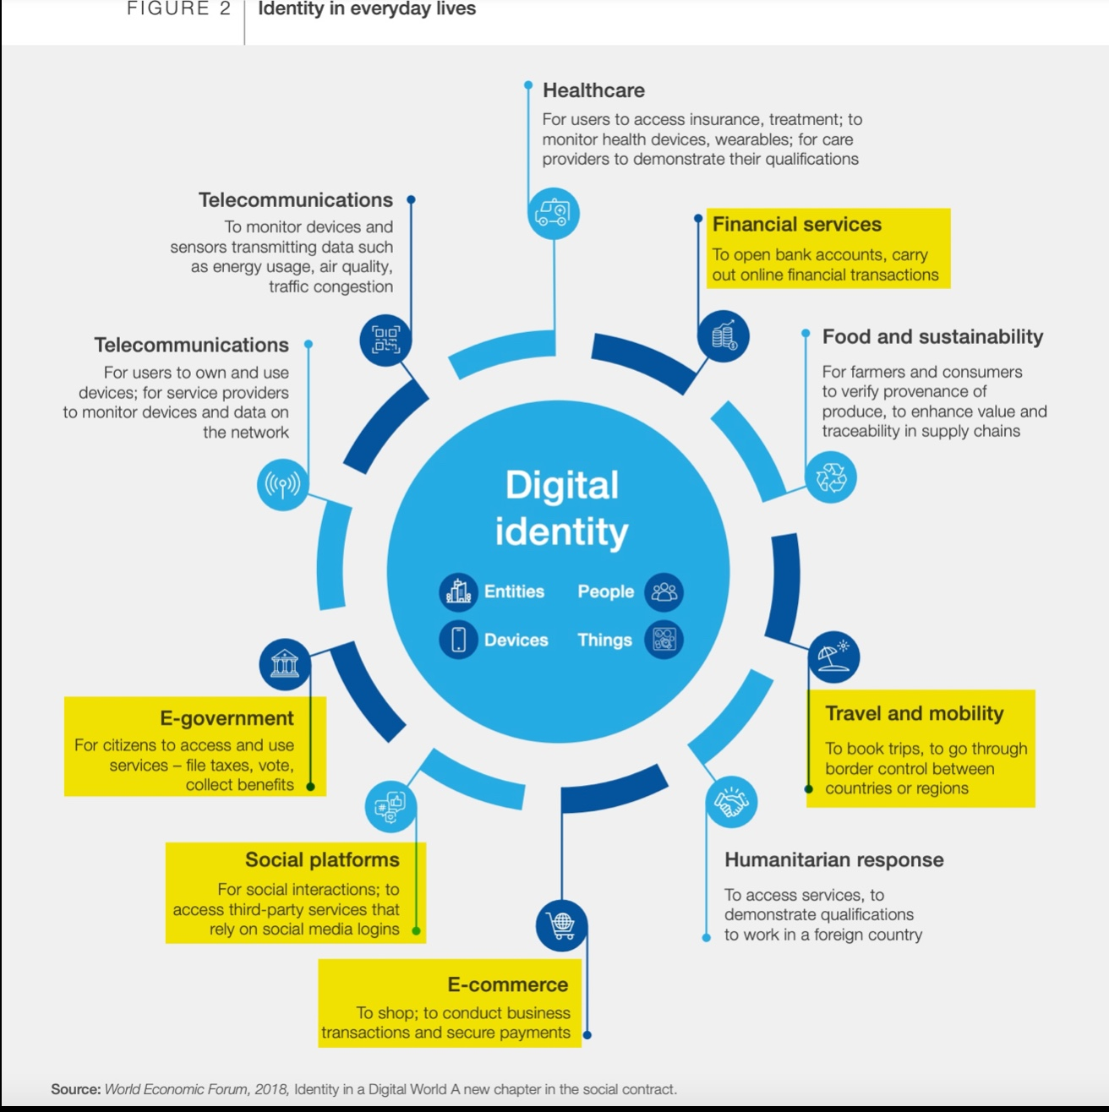

Slide 33


Slide 34


Slide 35


Slide 36


Slide 37
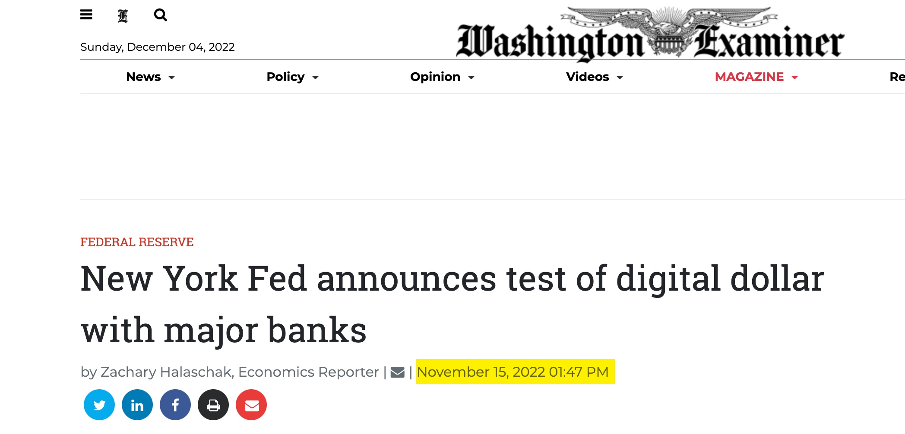

Slide 38
Mark of the Beast
Technology

Slide 39
Revelation 13:16-17

Slide 40



Slide 41


Slide 42


Slide 43
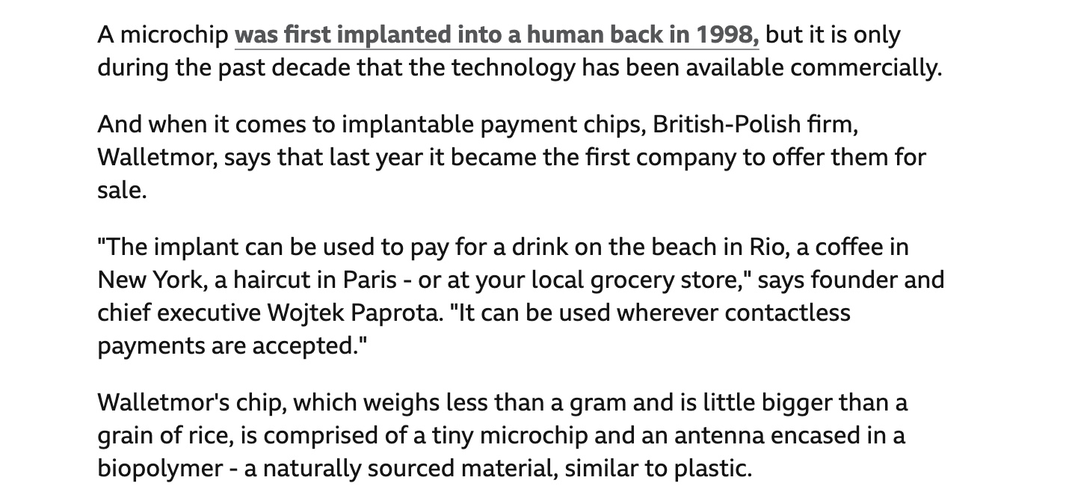

Slide 44


Slide 45


Slide 46
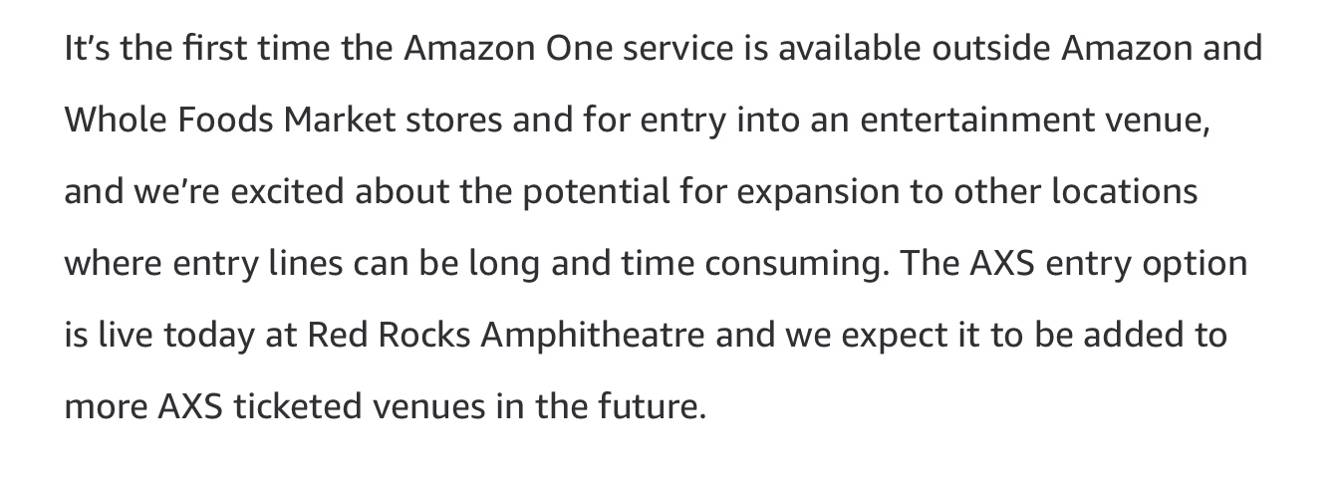

Slide 47


Slide 48


Slide 49
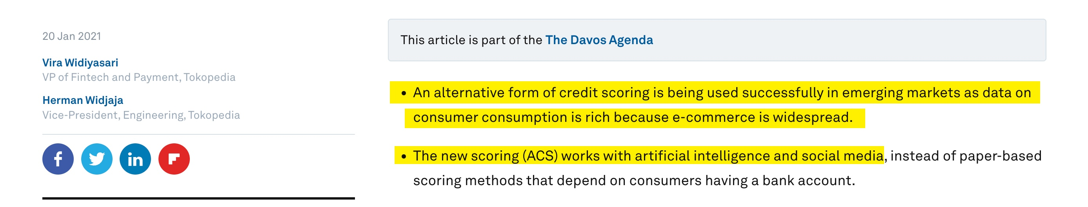

Slide 50
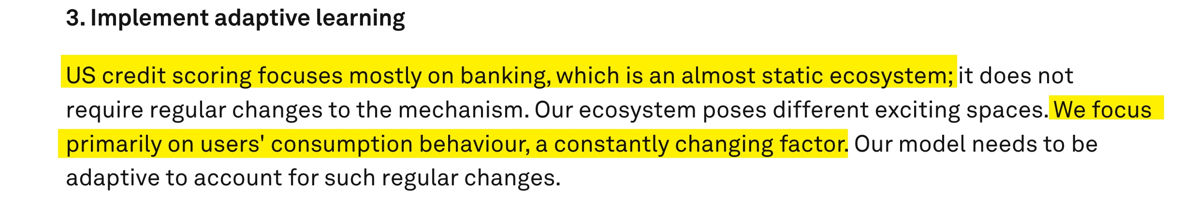

Slide 51
Revelation 13:16-17

Slide 52
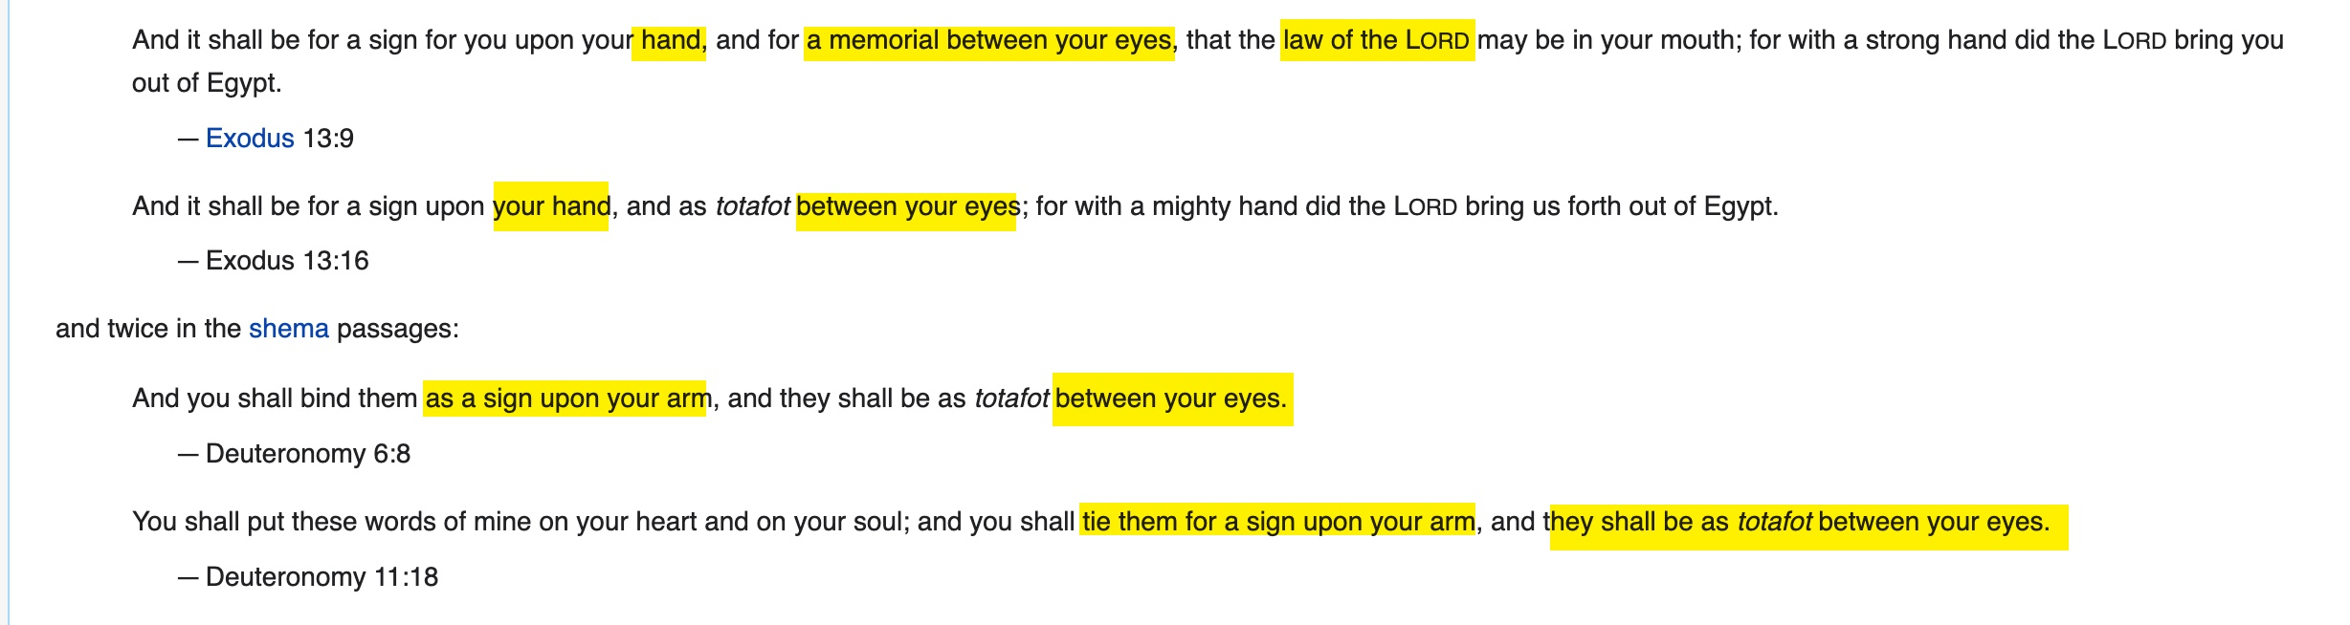

Slide 53

Israel Defense Forces soldier Asael Lubotzky prays with tefillin.

Slide 54
The Convergence of
End Time Events
(Part 2)

Slide 55
One World Economy

Slide 56
Mark of the Beast
Technology

Slide 57
One World Government

Slide 58
One-World Religion

Slide 59
Jews Return to Israel

Slide 60
The Third Temple
in Jerusalem

Slide 61
The Red Heifer

Slide 62
Israel’s Treasure

Slide 63
Israel Surrounded
By Her Enemies

Slide 64
Jews Are Prepared
to Be Deceived by a False Messiah

Slide 65
Rise of Antisemitism

Slide 66
Global Famine

Slide 67
Plagues

Slide 68
Wars and Rumors of Wars

Slide 69
Earthquakes

Slide 70
The Rise of Apostasy

Slide 71
The Rise of False Christs

Slide 72
Rise of Humanism, Hedonism

Slide 73
Rise of False Prophets

Slide 74
Luke 21:28
Now when these things begin to happen, look up and lift up your heads, because your redemption draws near.”

Slide 75
Revelation 1:1
The Revelation of Jesus Christ, which God gave Him to show His servants—things which must shortly take place. And He sent and signified it by His angel to His servant John,

Slide 77
One World Economy
Update

Slide 78


Slide 79
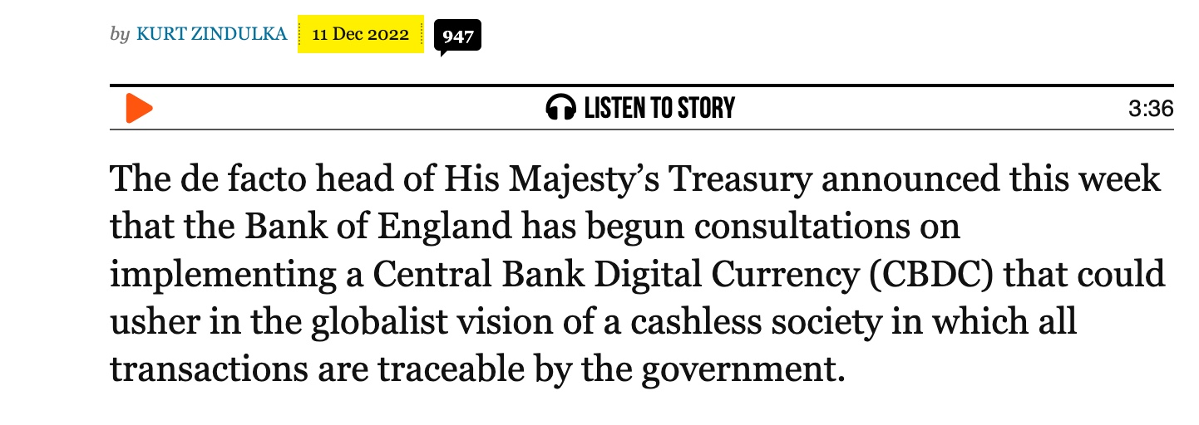

Slide 80
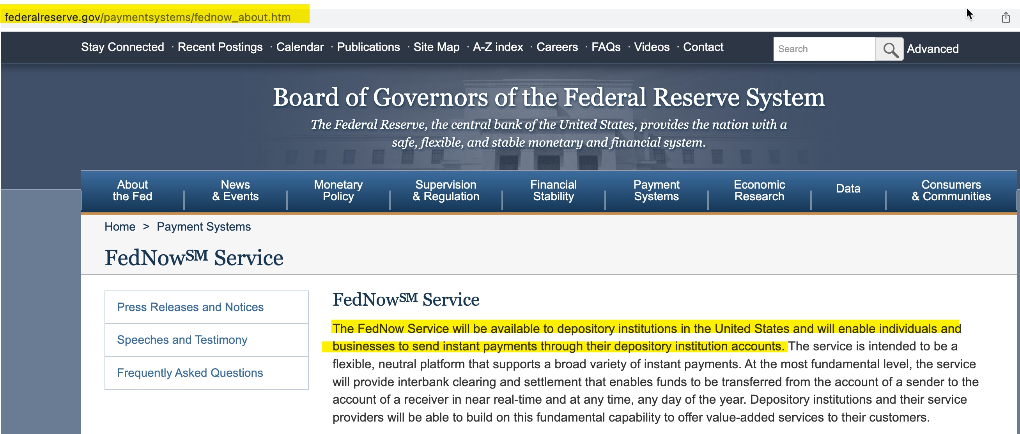

Slide 81
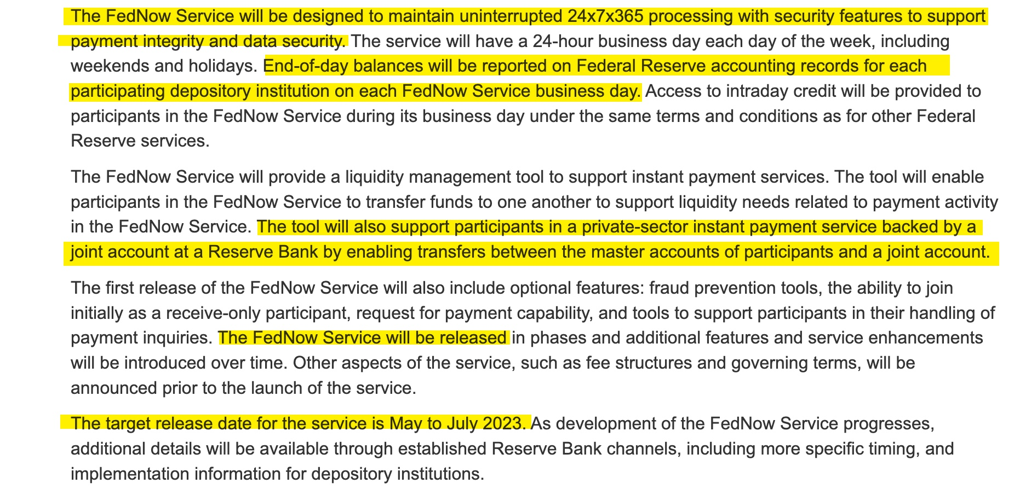

Slide 82


Slide 83
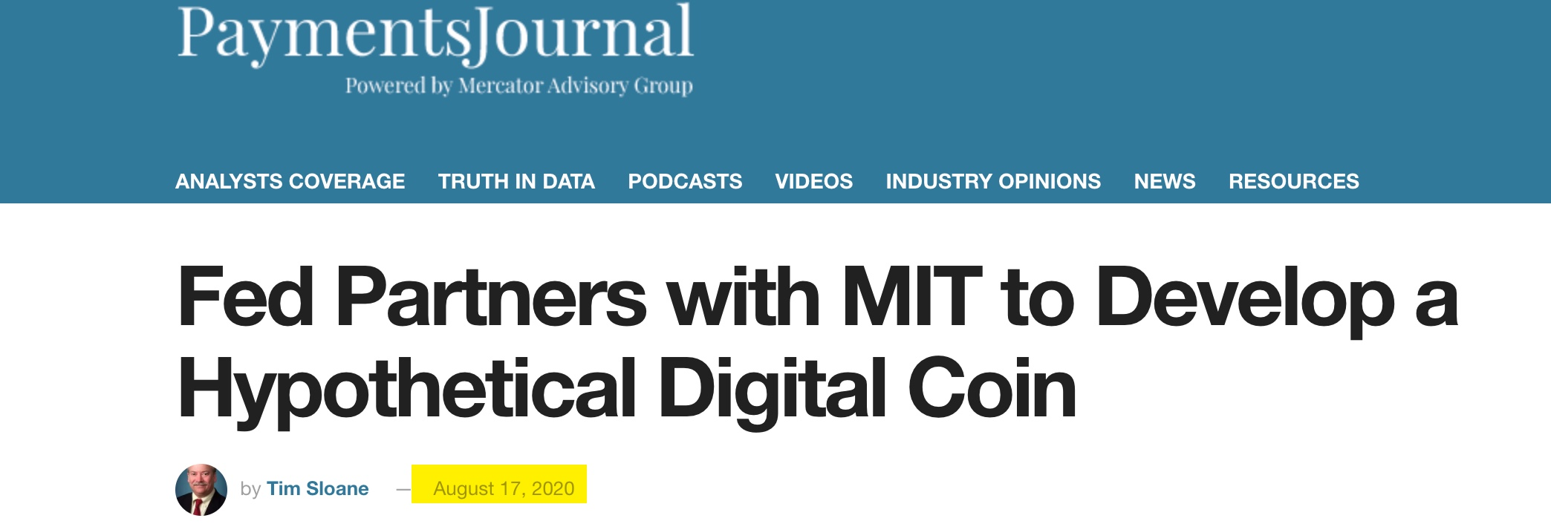

Slide 84
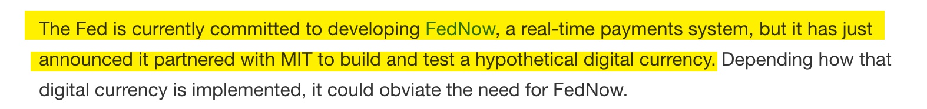

Slide 85


Slide 86
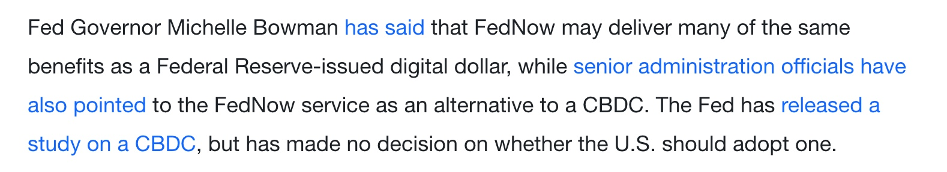

Slide 87
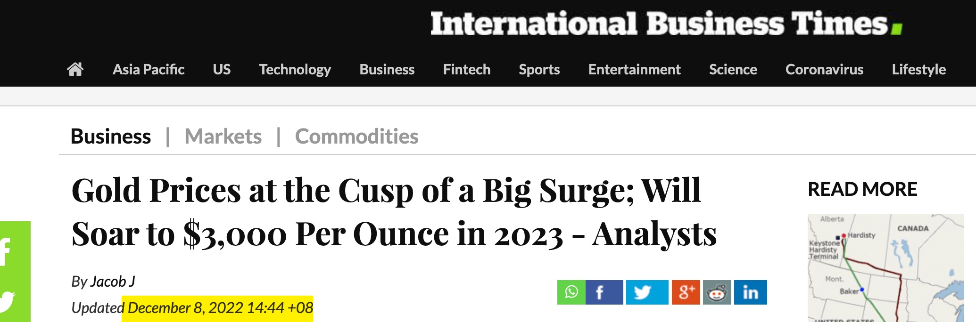

Slide 88
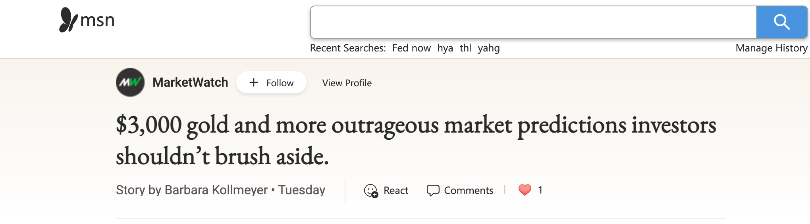

Slide 89
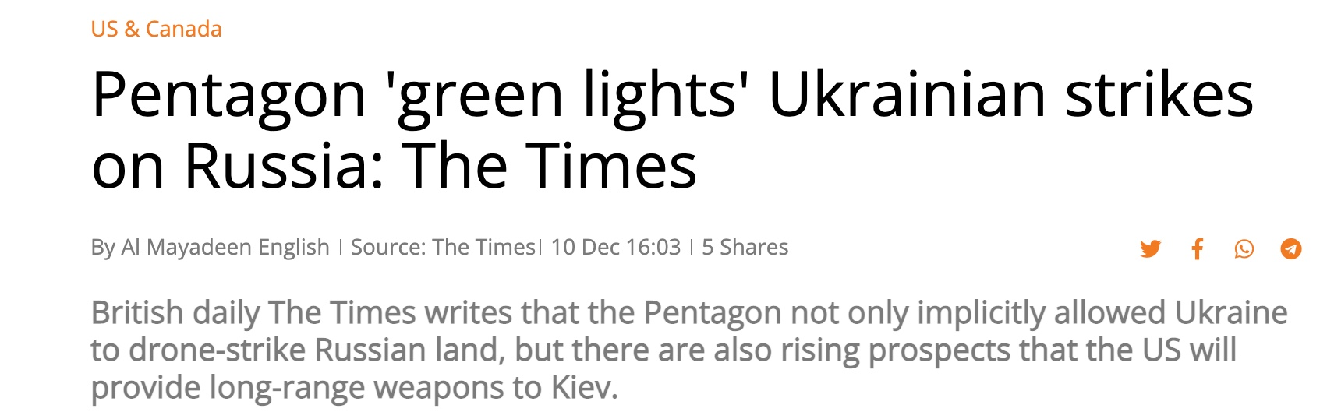

Slide 90
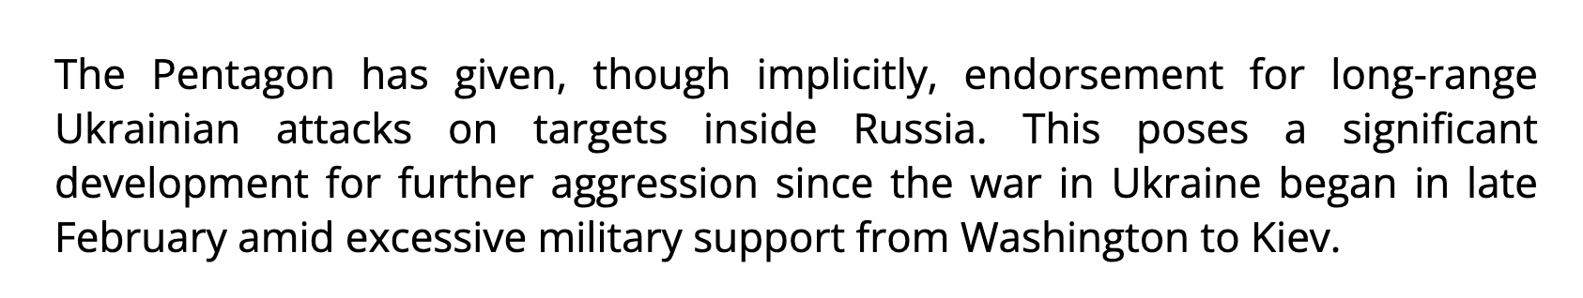

Slide 91
One World Government

Slide 92
The Bible Describes
World Government:
Revelation 13
Revelation 17
Revelation 18
Daniel 2
Daniel 7

Slide 93


Slide 94


Slide 95


Slide 96
Jean-Claude Trichet,
President of the European Central Bank,
April 26, 2010:
The evolution of global governance:
Let me turn to the question of how global governance is evolving after the crisis.

Slide 97
Overall, the system is moving decisively genuine global governance that is much more inclusive, encompassing the key emerging economies as well as industrialized countries. The significant transformation of global governance that we are engineering today is illustrated by three examples.

Slide 98
First, the emergence of the G20 a the prime group for global economic governance at the level of ministers, governors and heads of state or government.

Slide 99
Secondly, the establishment of the Global Economy Meeting of central bank governors under the auspices of the BIS as the prime group for the governance of central bank cooperation.

Slide 100
…the Global Economy Meeting (GEM),
which gathers at the BIS headquarter in Basel. Over the past few years, this forum has included 31 governors as permanent members plus a number of other governors attending on a rotating basis.

Slide 101
The GEM, in which all systemic emerging economies’ Central Bank governors are fully participating, has become the prime group for global governance among central banks.

Slide 102


Slide 103


Slide 104
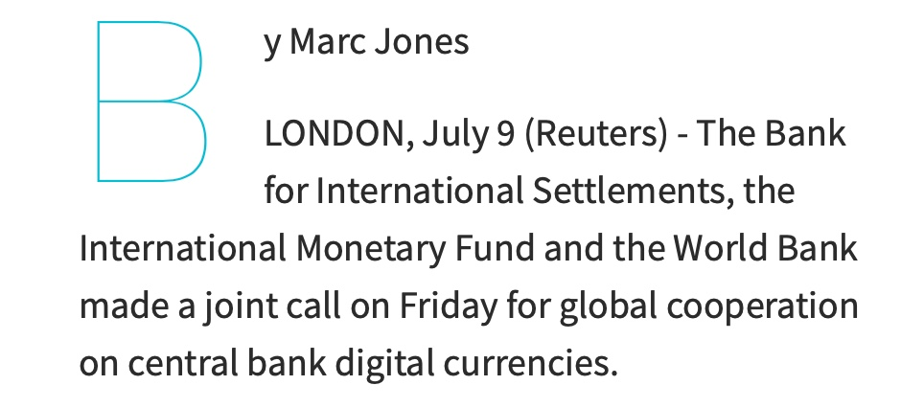

Slide 105
The Convergence of
End Time Events
(Part 3)

Slide 106
Luke 21:28
Now when these things begin to happen, look up and lift up your heads, because your redemption draws near.”

Slide 107
One World Economy

Slide 108
Mark of the Beast
Technology

Slide 109
One World Government

Slide 110
One-World Religion

Slide 111
Jews Return to Israel

Slide 112
The Third Temple
in Jerusalem

Slide 113
The Red Heifer

Slide 114
Israel’s Treasure

Slide 115
Israel Surrounded
By Her Enemies

Slide 116
Jews Are Prepared
to Be Deceived by a False Messiah

Slide 117
Rise of Antisemitism

Slide 118
Global Famine

Slide 119
Plagues

Slide 120
Wars and Rumors of Wars

Slide 121
Earthquakes

Slide 122
The Rise of Apostasy

Slide 123
The Rise of False Christs

Slide 124
Rise of Humanism, Hedonism

Slide 125
Rise of False Prophets

Slide 126
One-World Religion

Slide 127
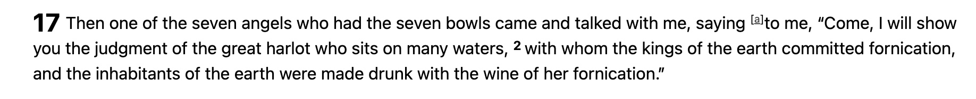
Revelation 17:1-2

Slide 128
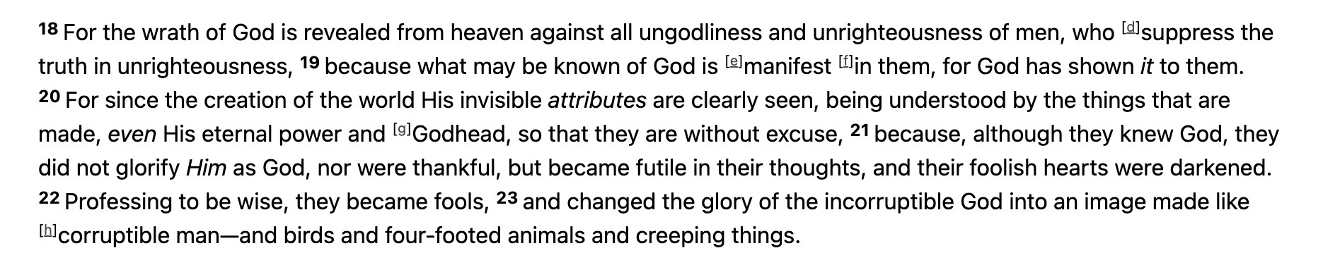
Romans 1:18-22

Slide 129
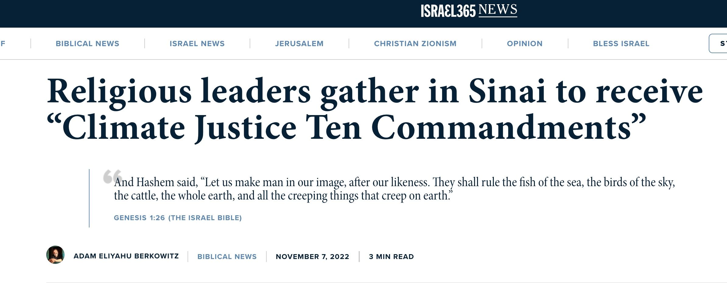

Slide 130
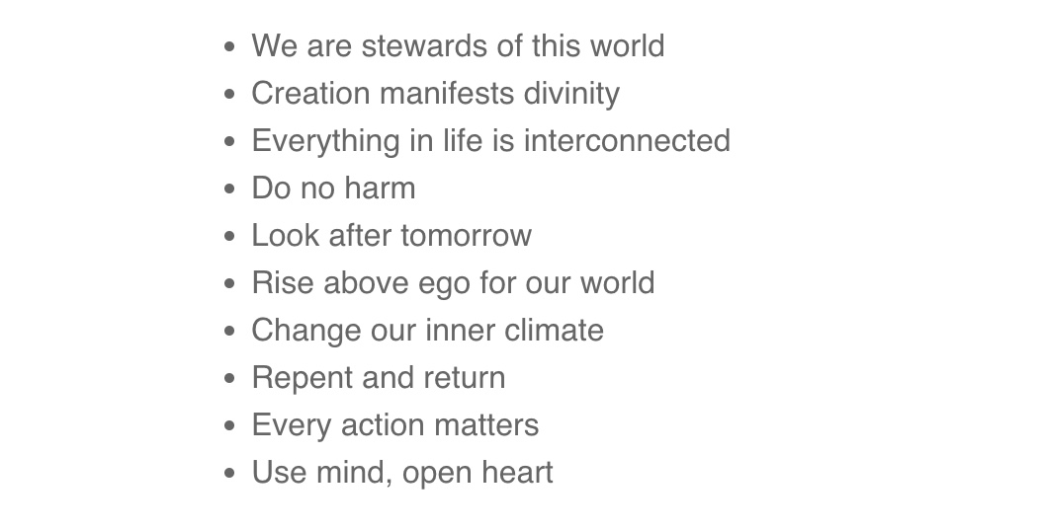
Interfaith Movement Unveils
Climate Justice Ten Commandments
at U.N. Cop27 Conference
in Egypt November of 2022
We are stewards of this world
Creation manifests divinity
Everything in life is interconnected
Do no harm
Look after tomorrow
Rise above ego for our world
Change our inner climate
Repent and return
Every action matters
Use mind, open heart

Slide 131
Jews Return to Israel

Slide 132

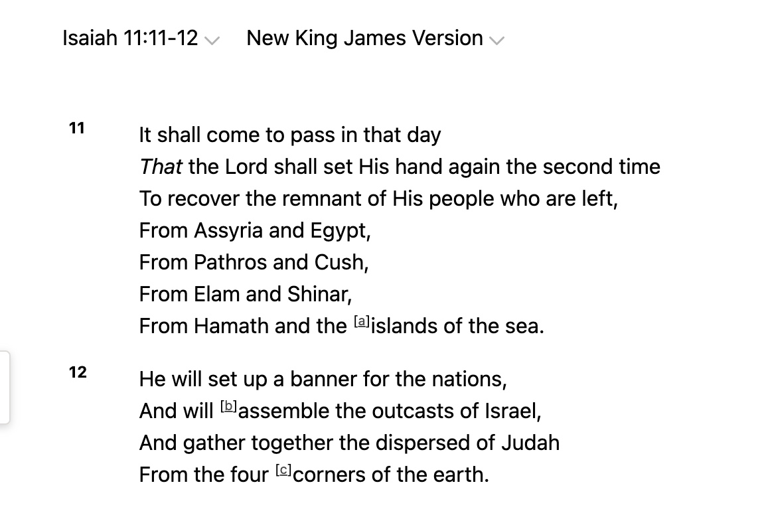

Slide 133
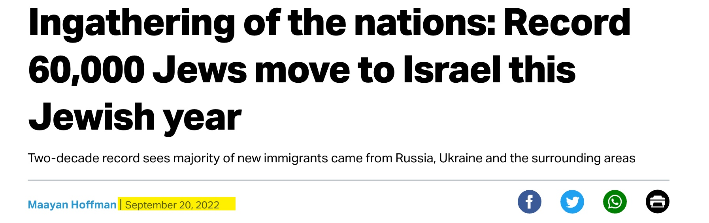

Slide 134
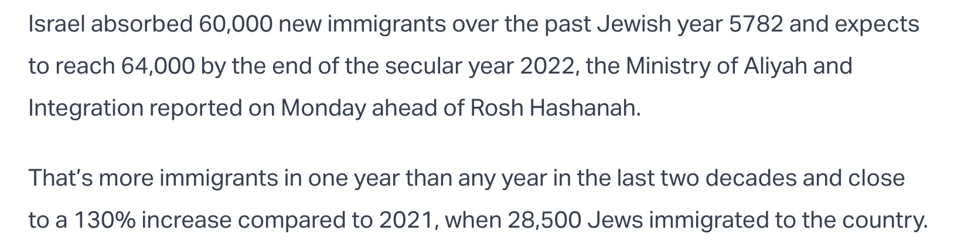

Slide 135
The Third Temple
in Jerusalem

Slide 136
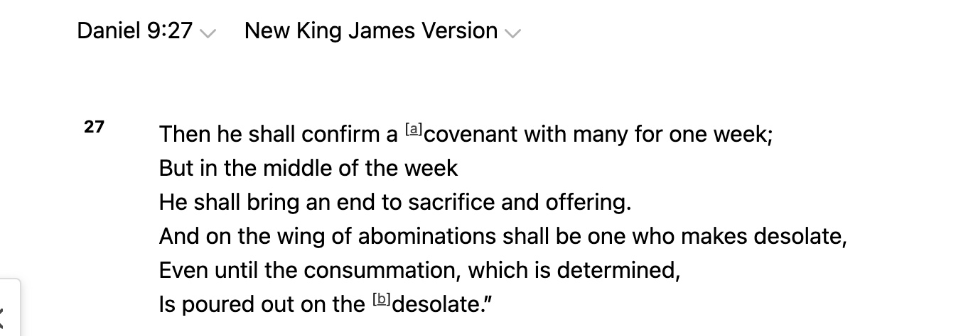

Slide 137
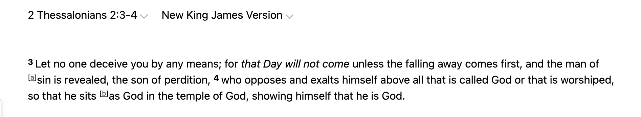

Slide 138


Slide 139


Slide 141


Slide 142
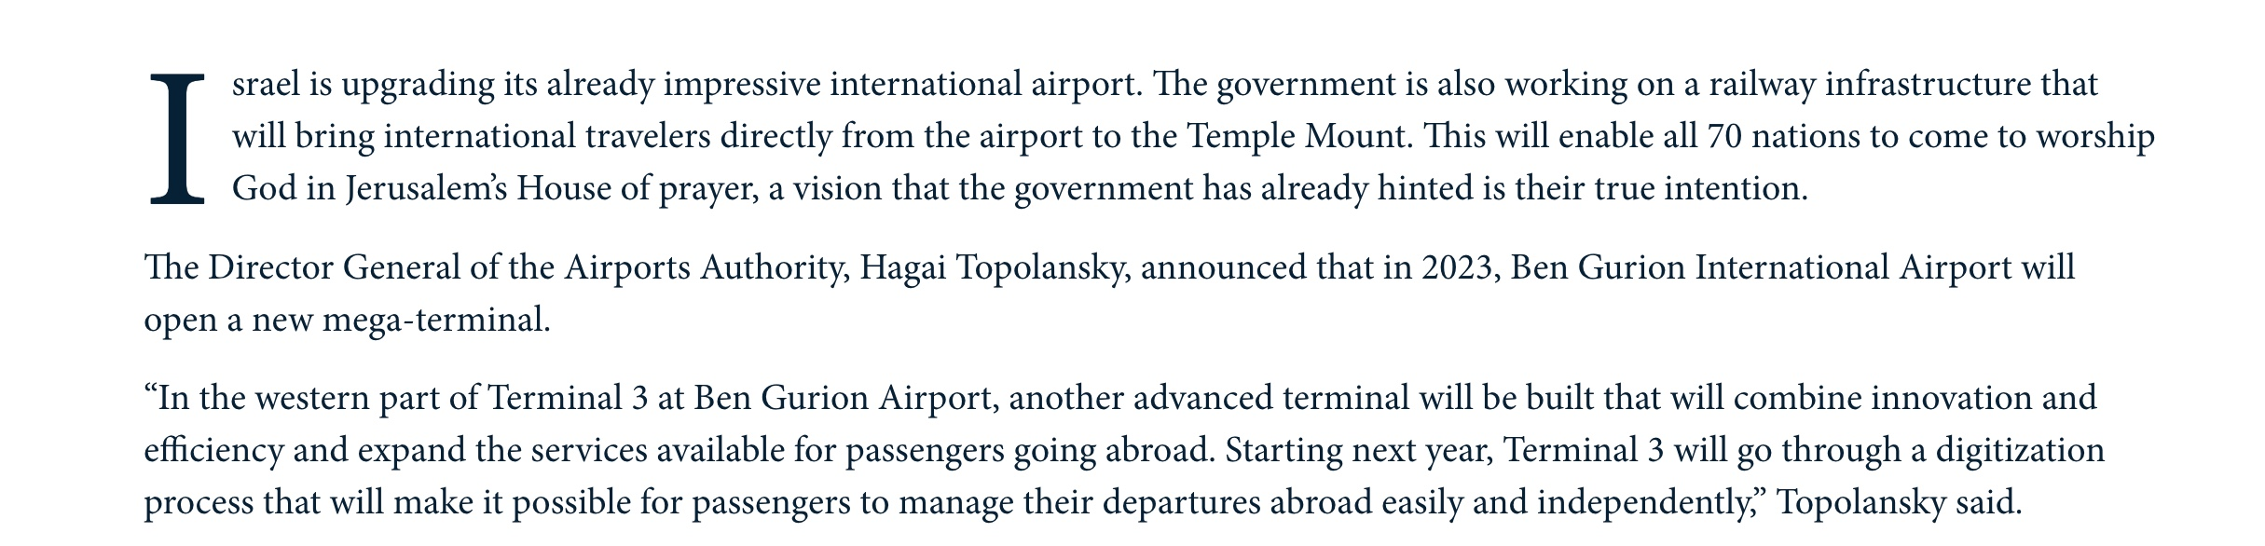

Slide 143
The Red Heifer

Slide 144
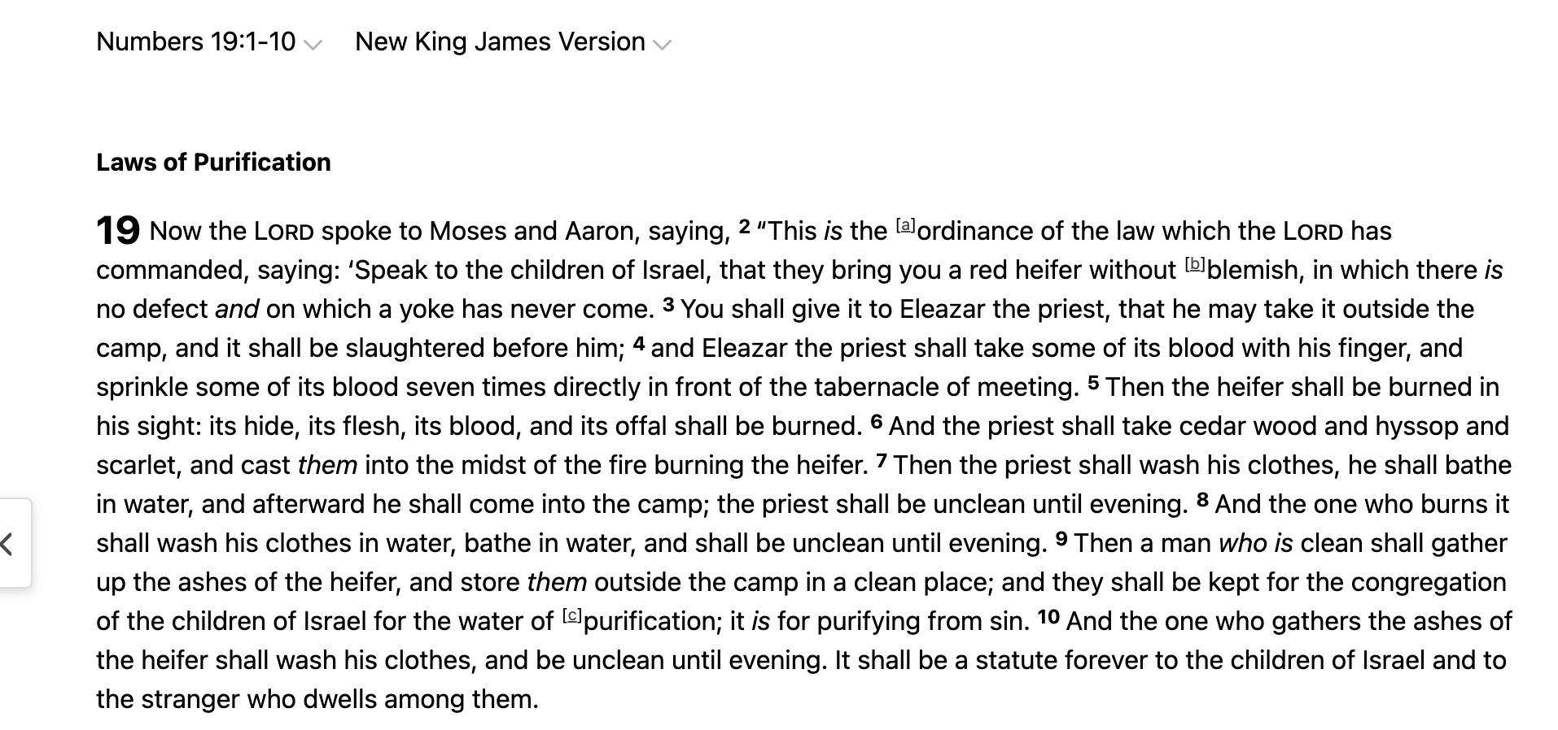

Slide 145
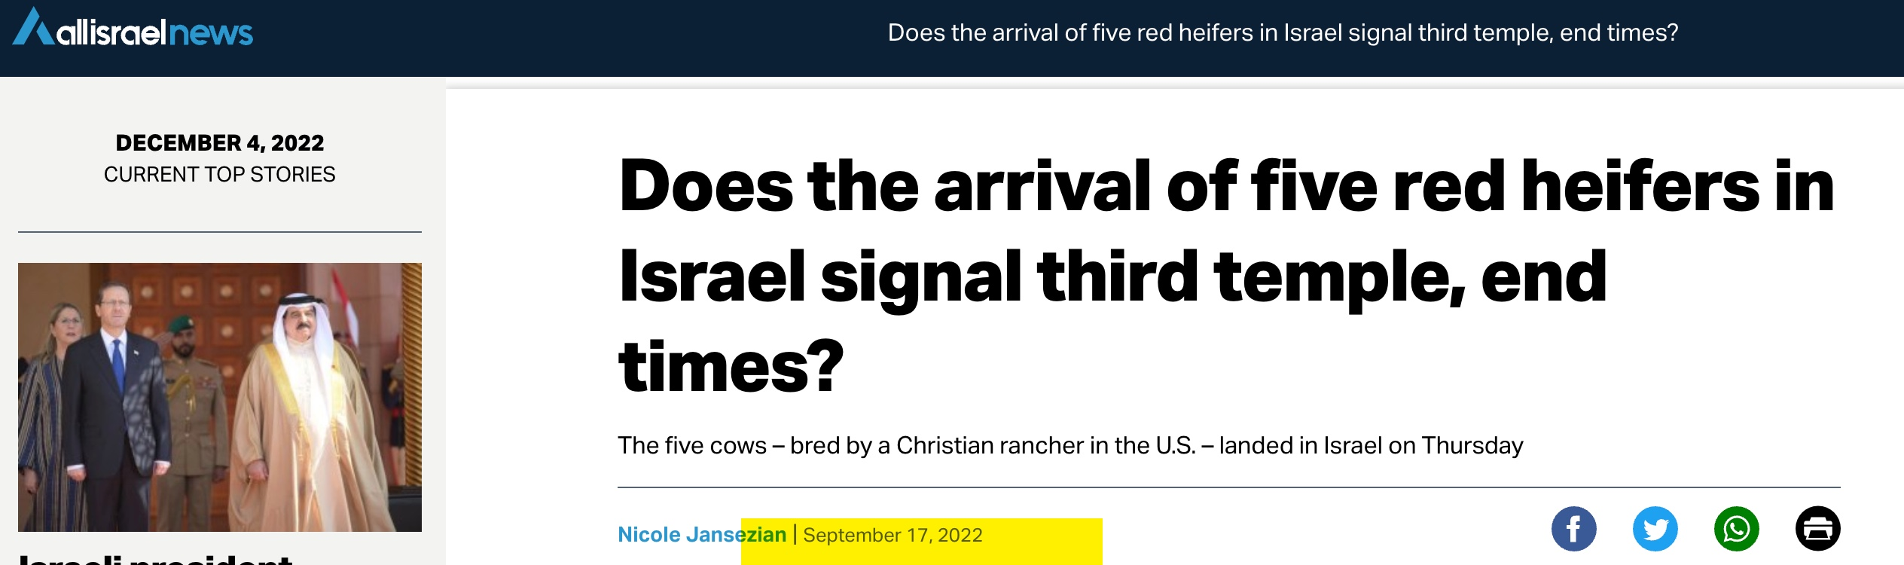

Slide 146
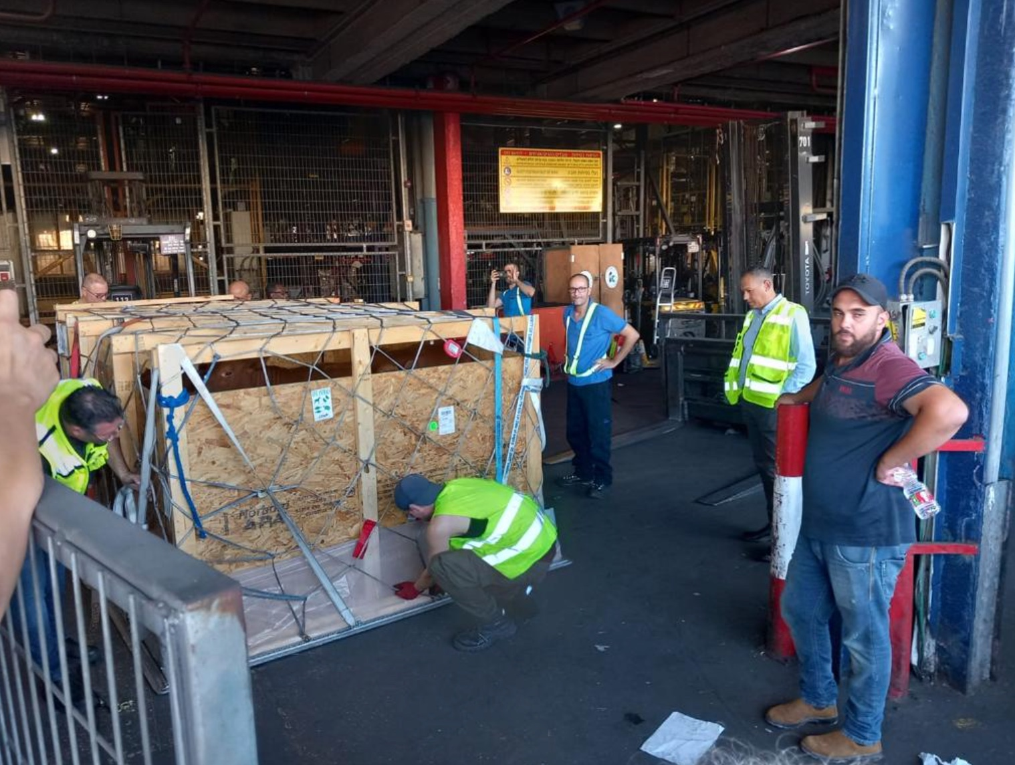

Slide 147
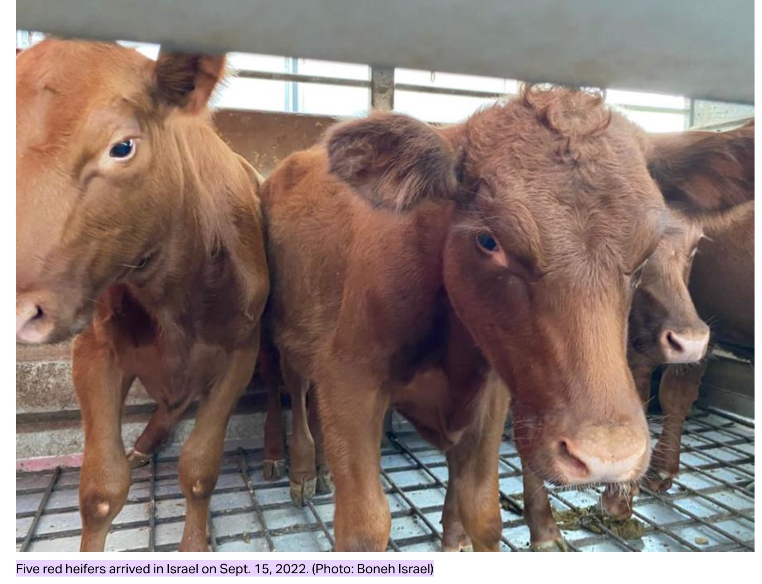

Slide 148
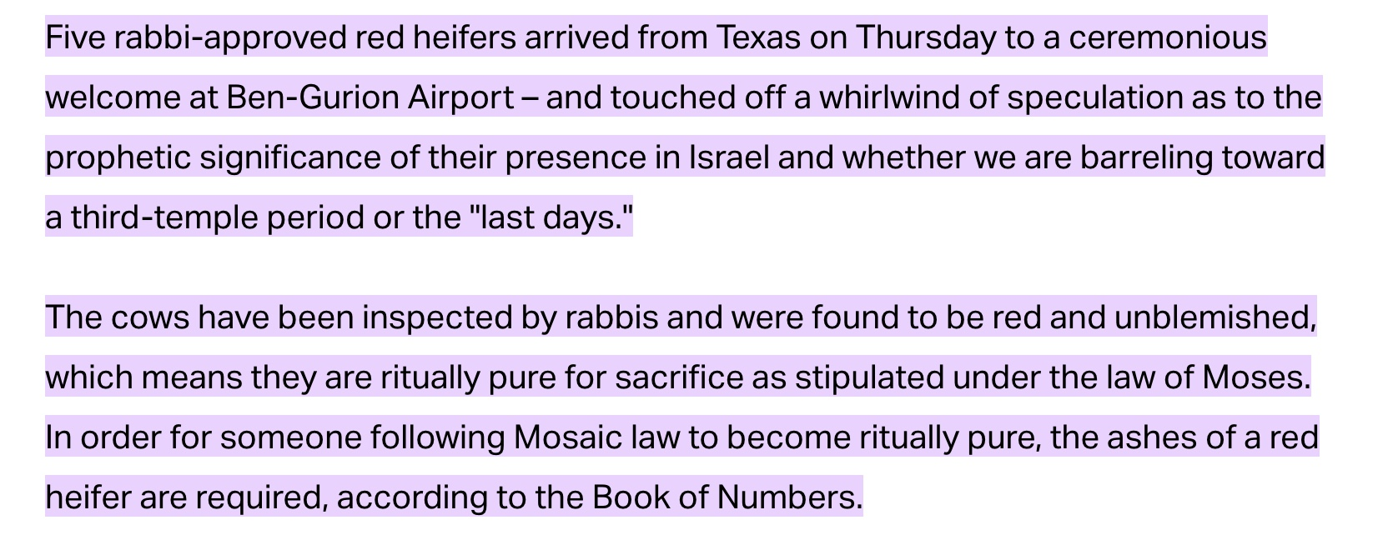

Slide 149
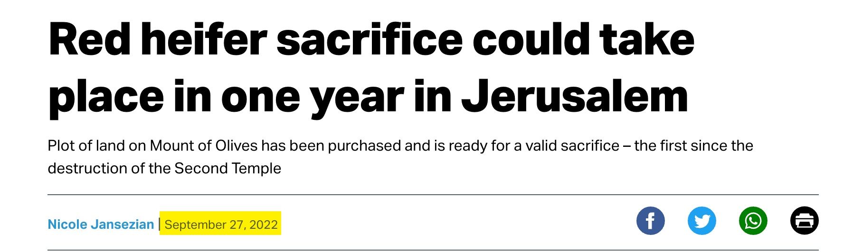

Slide 150
Jews Are Prepared
to Be Deceived by a False Messiah

Slide 151
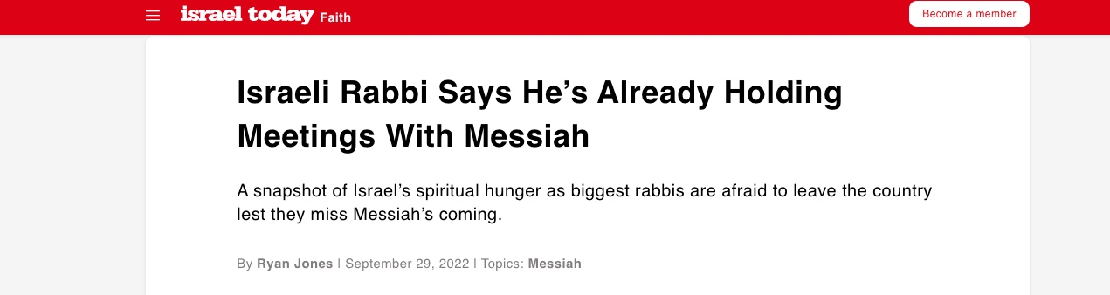

Slide 152
Israel’s Treasure

Slide 153
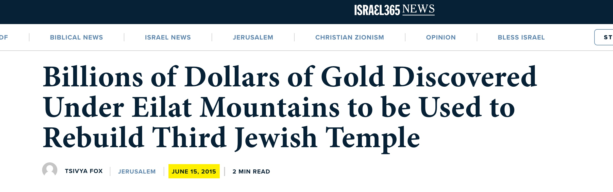

Slide 154
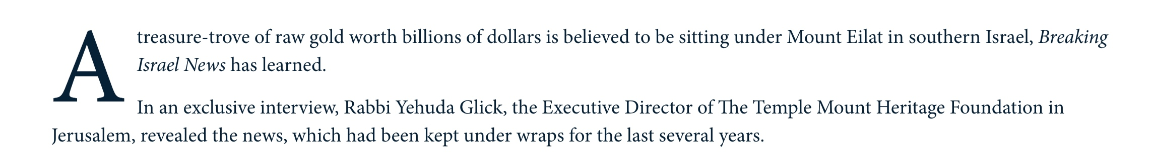

Slide 155
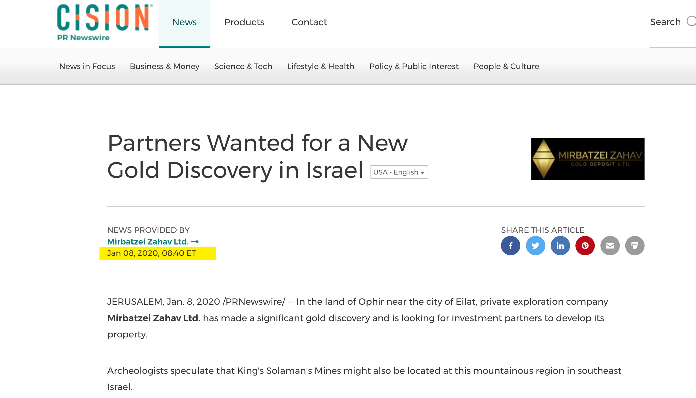

Slide 156

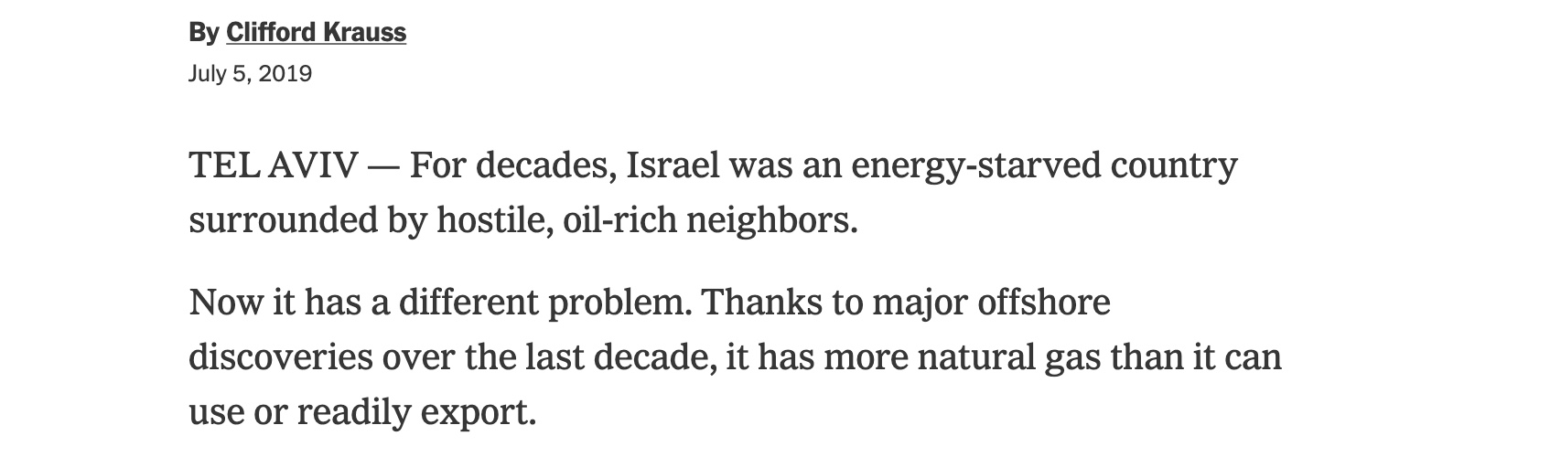

Slide 157
The Convergence of
End Time Events
(Part 4)

Slide 158
One World Economy

Slide 159
Mark of the Beast
Technology

Slide 160
One World Government

Slide 161
One-World Religion

Slide 162
Jews Return to Israel

Slide 163
The Third Temple
in Jerusalem

Slide 164
The Red Heifer

Slide 165
Israel’s Treasure

Slide 166
Israel Surrounded
By Her Enemies

Slide 167
Jews Are Prepared
to Be Deceived by a False Messiah

Slide 168
Rise of Antisemitism

Slide 169
Global Famine

Slide 170
Plagues

Slide 171
Wars and Rumors of Wars

Slide 172
Earthquakes

Slide 173
The Rise of Apostasy

Slide 174
The Rise of False Christs

Slide 175
Rise of Humanism, Hedonism

Slide 176
Rise of False Prophets

Slide 177
Luke 21:28
Now when these things begin to happen, look up and lift up your heads, because your redemption draws near.”

Slide 178
The Third Temple
in Jerusalem (Update)

Slide 179
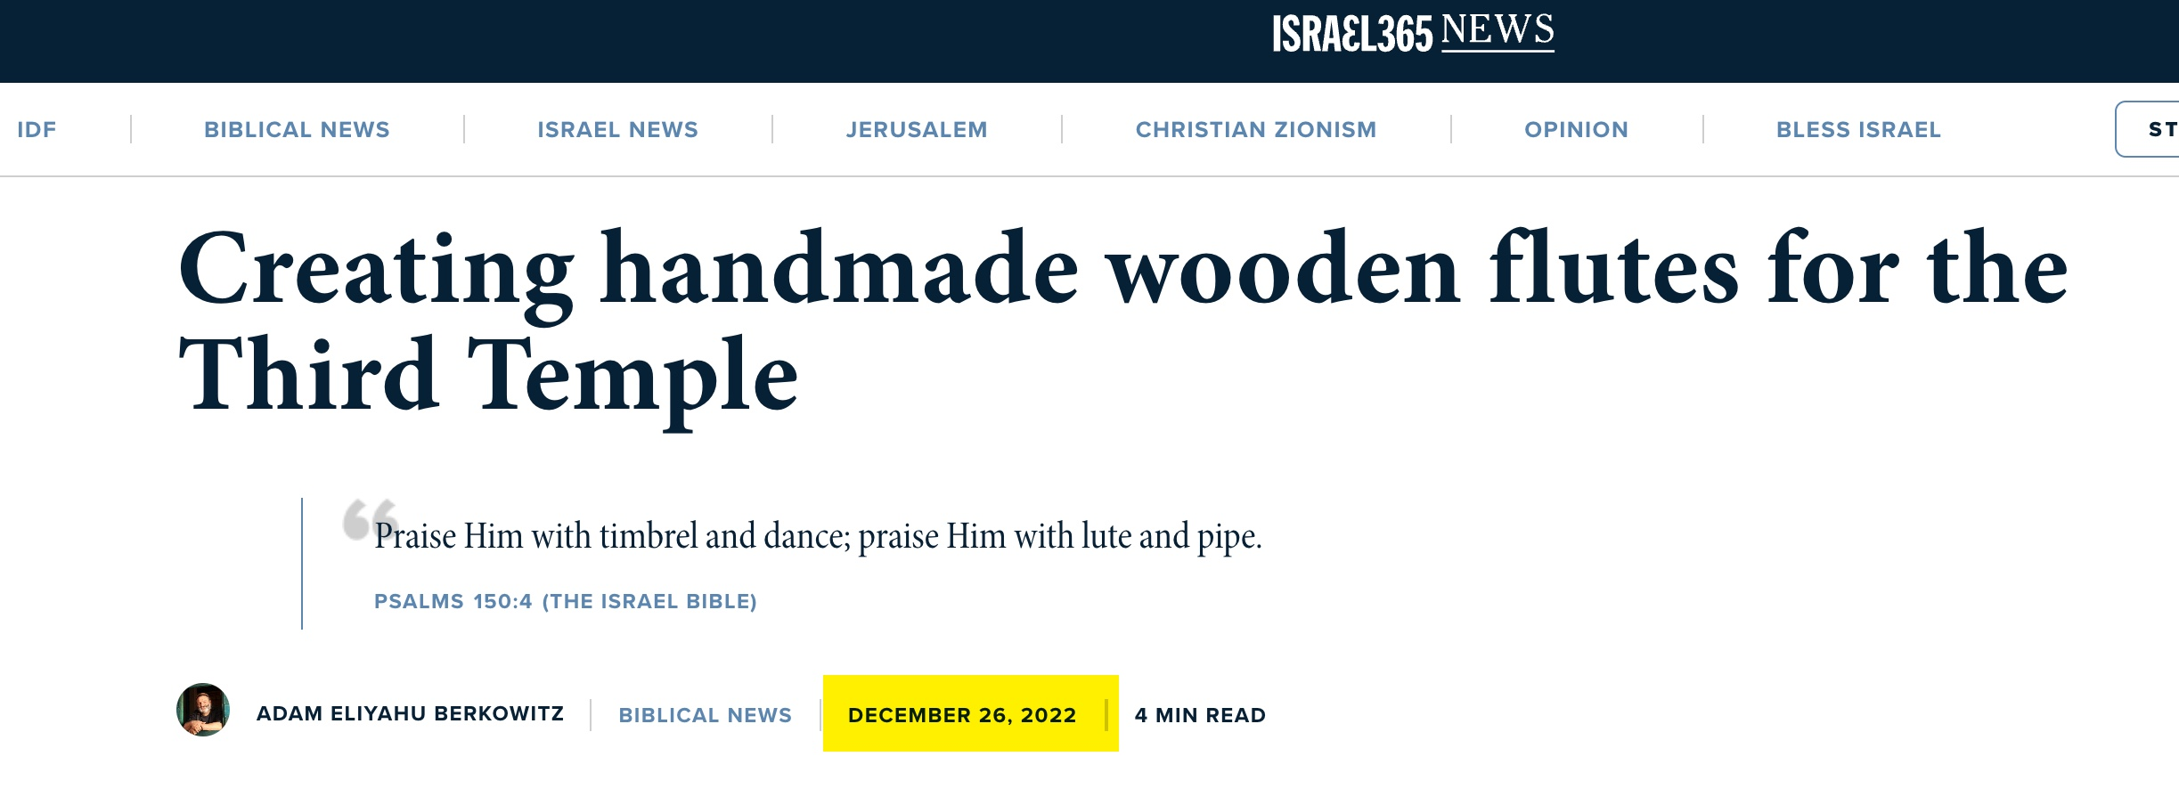

Slide 180
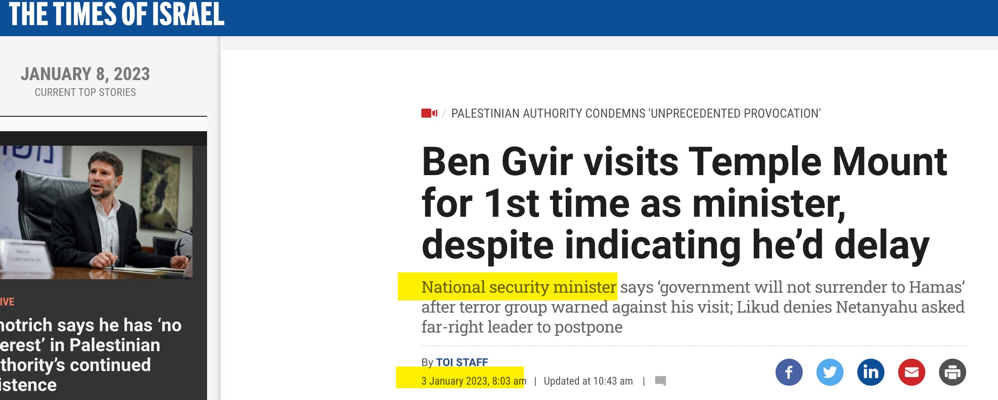

Slide 181
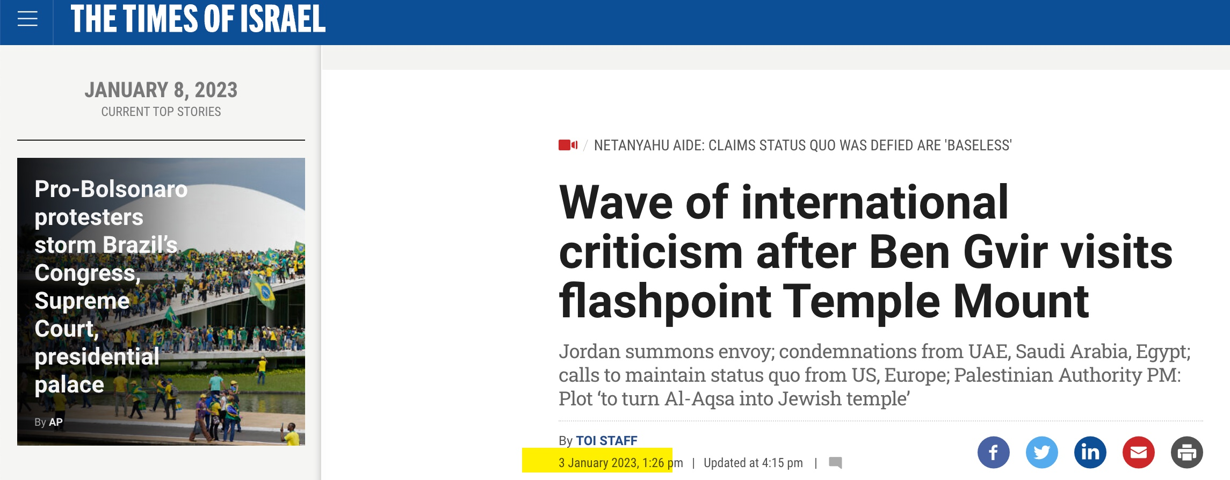

Slide 182


Slide 183
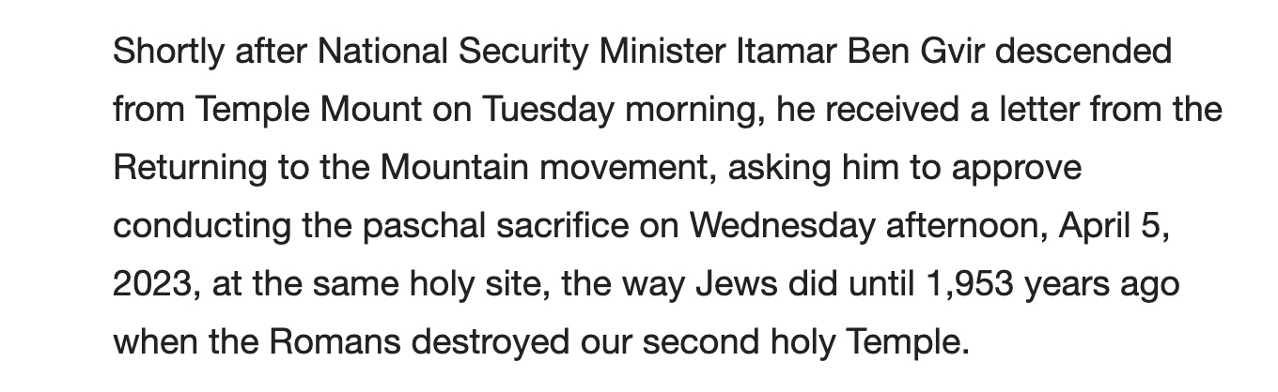

Slide 184


Slide 185


Slide 186


Slide 187


Slide 188


Slide 189


Slide 190
Rise of Antisemitism

Slide 191


Slide 192


Slide 193


Slide 194


Slide 195


Slide 196


Slide 197



Slide 198


Slide 199
Israel Surrounded
By Her Enemies

Slide 200


Slide 201


Slide 202


Slide 203


Slide 204
The Convergence of
End Time Events
(Part 5)

Slide 205
One World Economy

Slide 206
Mark of the Beast
Technology

Slide 207
One World Government

Slide 208
One-World Religion

Slide 209
Jews Return to Israel

Slide 210
The Third Temple
in Jerusalem

Slide 211
The Red Heifer

Slide 212
Israel’s Treasure

Slide 213
Israel Surrounded
By Her Enemies

Slide 214
Jews Are Prepared
to Be Deceived by a False Messiah

Slide 215
Rise of Antisemitism

Slide 216
Global Famine

Slide 217
Plagues

Slide 218
Wars and Rumors of Wars

Slide 219
Earthquakes

Slide 220
The Rise of Apostasy

Slide 221
The Rise of False Christs

Slide 222
Rise of Humanism, Hedonism

Slide 223
Rise of False Prophets

Slide 224
Global Famine

Slide 225
Matthew 24:7
And there will be famines, pestilences, and earthquakes in various places.

Slide 226


Slide 227


Slide 228


Slide 229



Slide 230


Slide 231


Slide 232



Slide 233


Slide 234


Slide 235


Slide 236
Plagues

Slide 237
Matthew 24:7
And there will be famines, pestilences, and earthquakes in various places.

Slide 238


Slide 239
Wars and Rumors of Wars

Slide 240
Matthew 24:6-7
And you will hear of wars
and rumors of wars…For nation will rise against nation, and kingdom against kingdom.

Slide 241



Slide 242
Earthquakes

Slide 243
Matthew 24:7
And there will be famines, pestilences, and earthquakes in various places.

Slide 244


Slide 245


Slide 246
The Rise of Apostasy

Slide 247


Slide 248



Slide 249


Slide 250


Slide 251
Vance Havner:
The devil is not fighting religion; he is too smart for that. He is producing a counterfeit Christianity so much like the real one that good Christians are afraid to speak out against it.

Slide 252
The Rise of False Christs

Slide 253
Matthew 24:4-5:
And Jesus answered and said to them: “Take heed that no one deceives you. For many will come in My name, saying, ‘I am the Christ,’ and will deceive many.

Slide 254


Slide 255
Rise of Humanism, Hedonism

Slide 256
2 Timothy 3:1-5
But know this, that in the last days perilous times will come: For men will be lovers of themselves, lovers of money, boasters, proud, blasphemers, disobedient to parents, unthankful, unholy, unloving, unforgiving, slanderers, without self-control, brutal,

Slide 257
despisers of good, traitors, headstrong, haughty, lovers of pleasure rather than lovers of God, having a form of godliness but denying its power. And from such people turn away!

Slide 258
Rise of False Prophets

Slide 259
Matthew 24:11
Then many false prophets
will rise up and deceive many

Slide 260
One World Economy

Slide 261
Mark of the Beast
Technology

Slide 262
One World Government

Slide 263
One-World Religion

Slide 264
Jews Return to Israel

Slide 265
The Third Temple
in Jerusalem

Slide 266
The Red Heifer

Slide 267
Israel’s Treasure

Slide 268
Israel Surrounded
By Her Enemies

Slide 269
Jews Are Prepared
to Be Deceived by a False Messiah

Slide 270
Rise of Antisemitism

Slide 271
Global Famine

Slide 272
Plagues

Slide 273
Wars and Rumors of Wars

Slide 274
Earthquakes

Slide 275
The Rise of Apostasy

Slide 276
The Rise of False Christs

Slide 277
Rise of False Prophets

