Slide 1
Defense Bill To Require
America’s DaughtersTo Register For Military Draft & Force All Students Into Brainwashing Programs Disguised As Service Learning

Slide 4
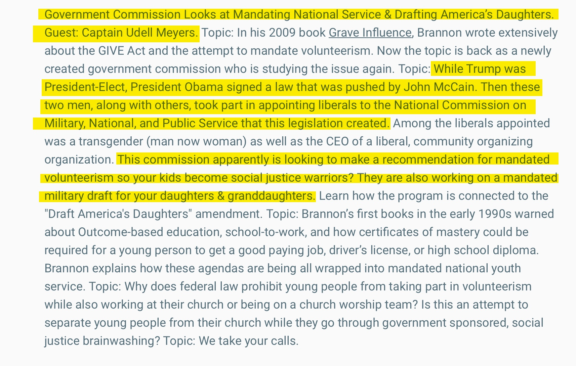

Slide 5
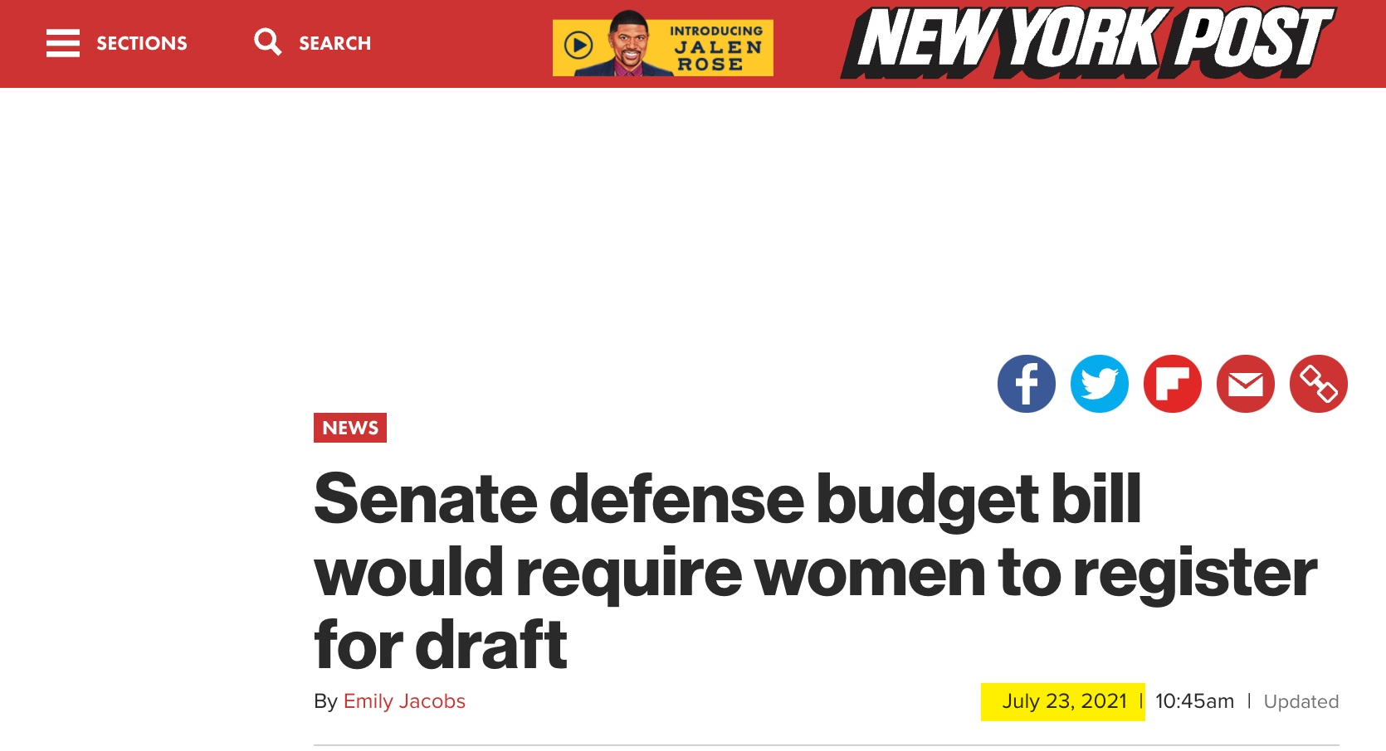

Slide 6
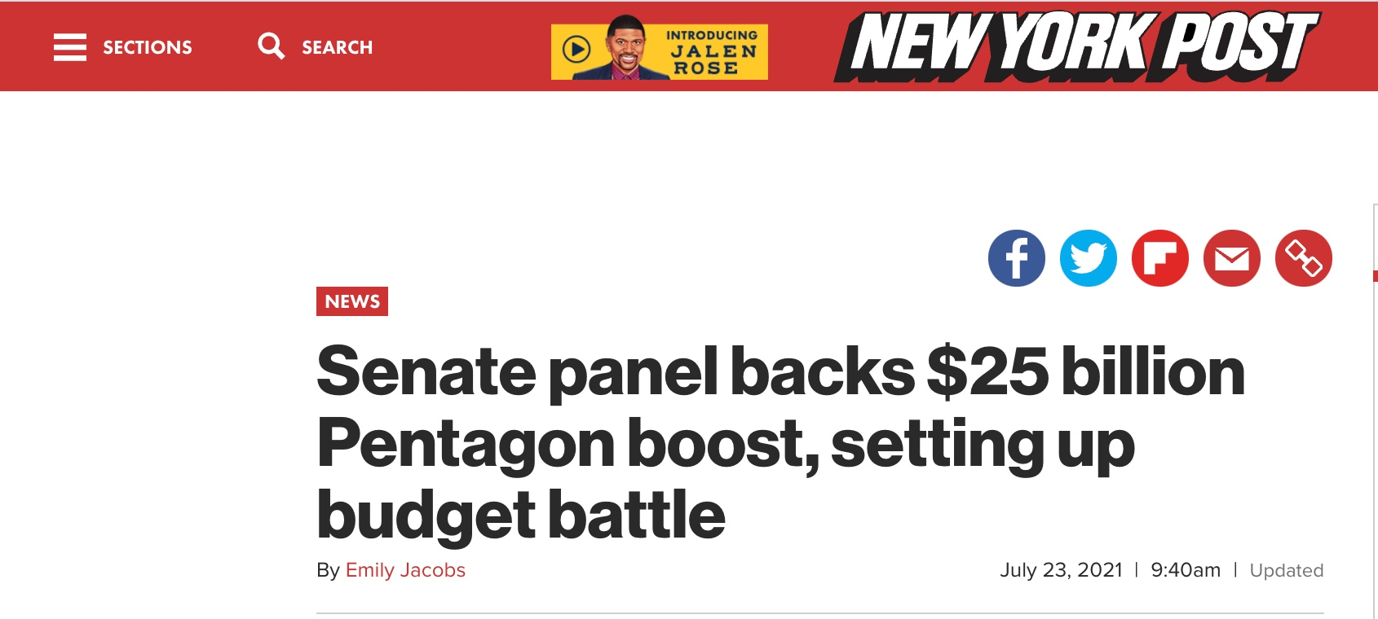

Slide 7
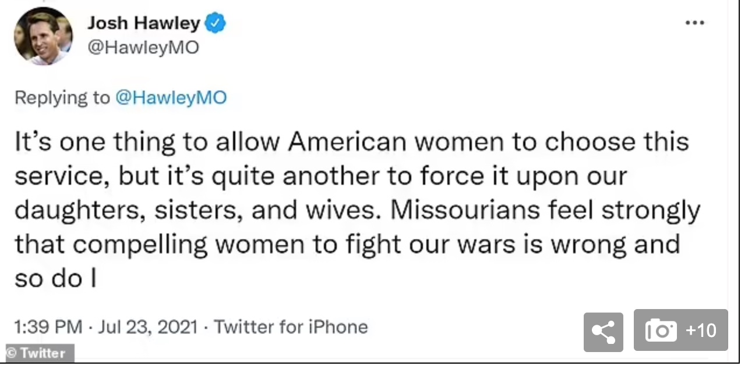

Slide 8
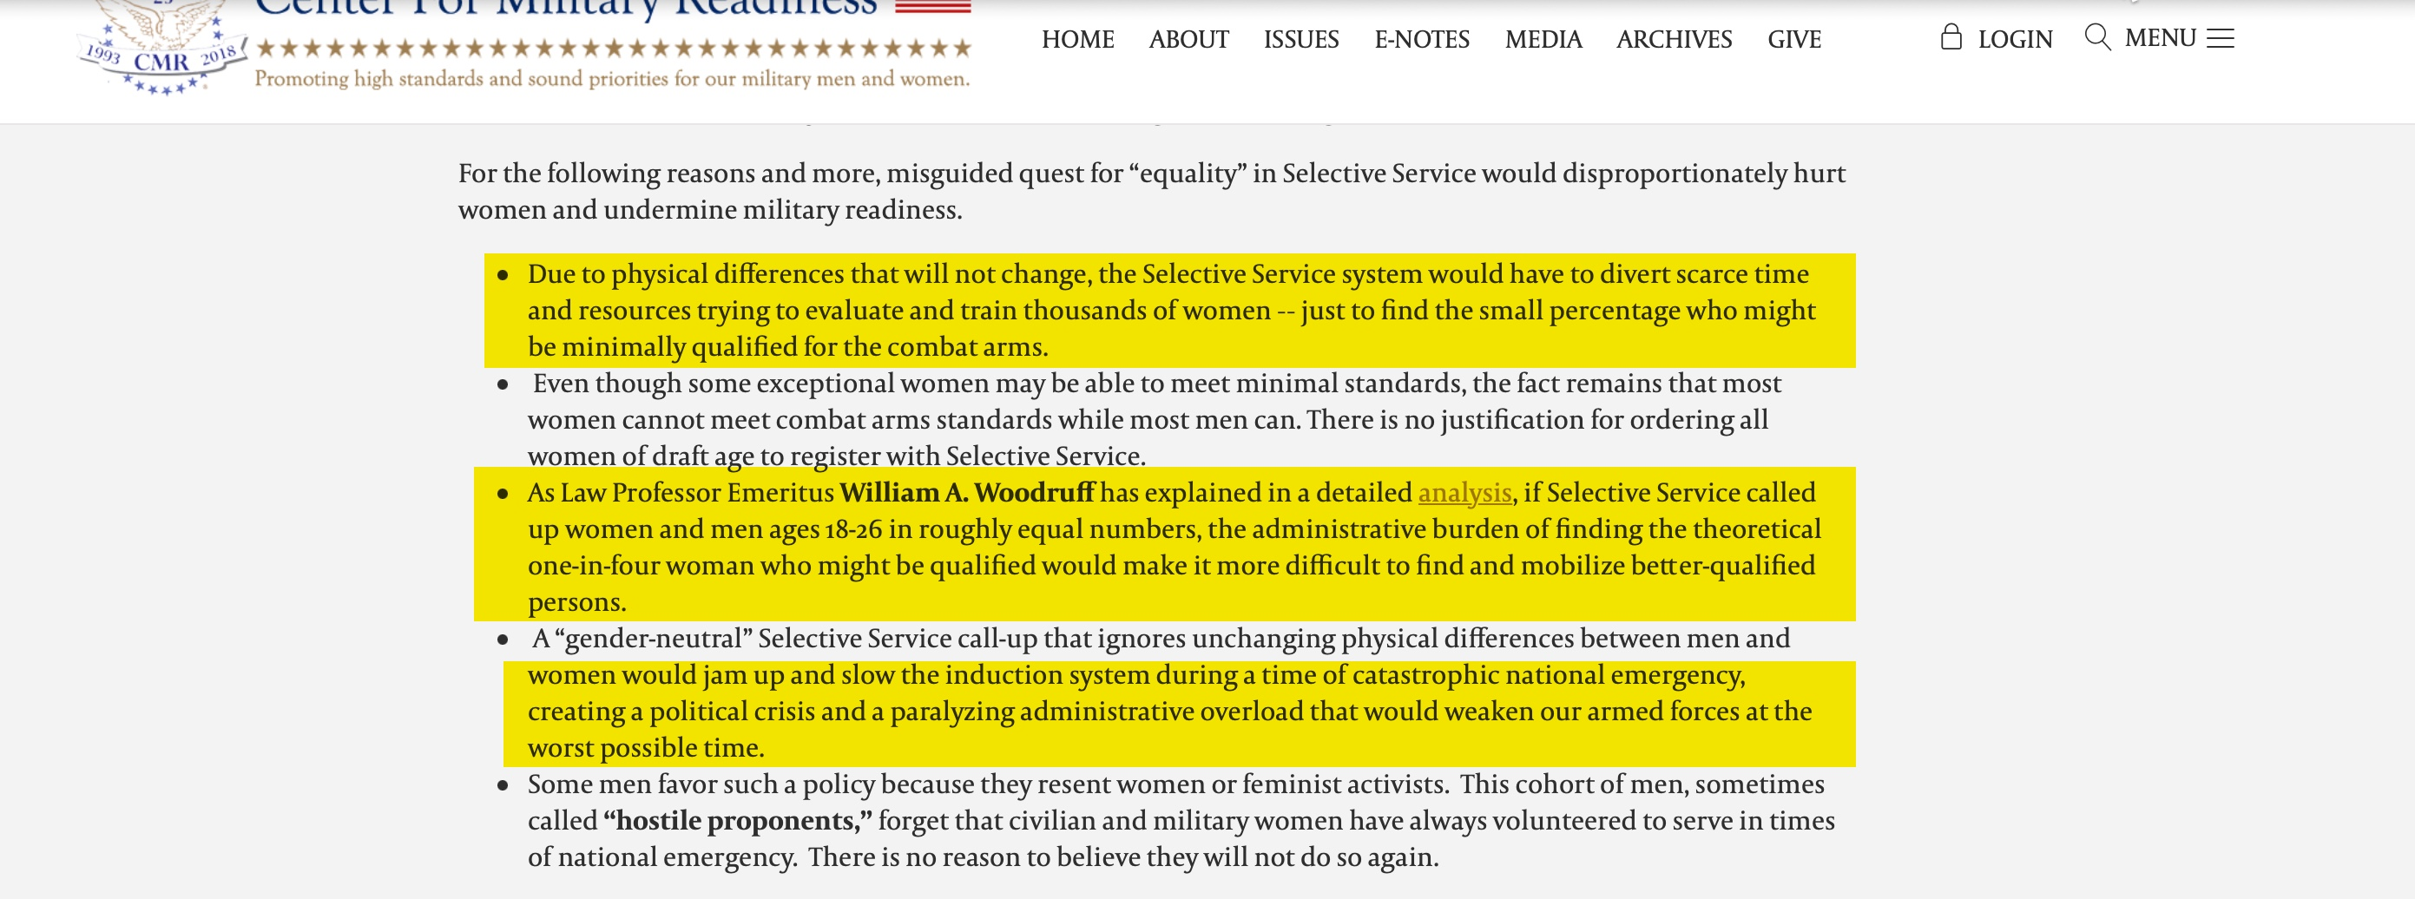

Slide 16
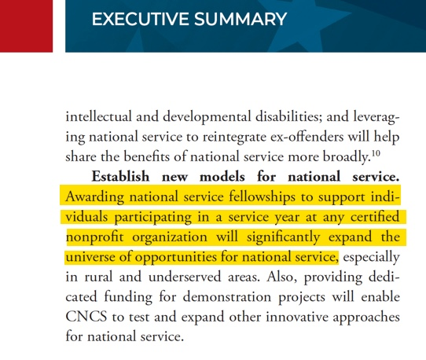

Slide 17
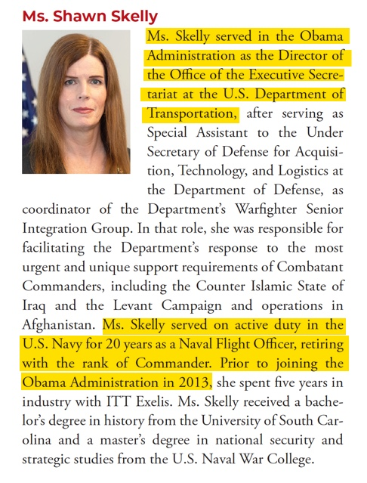

Slide 18
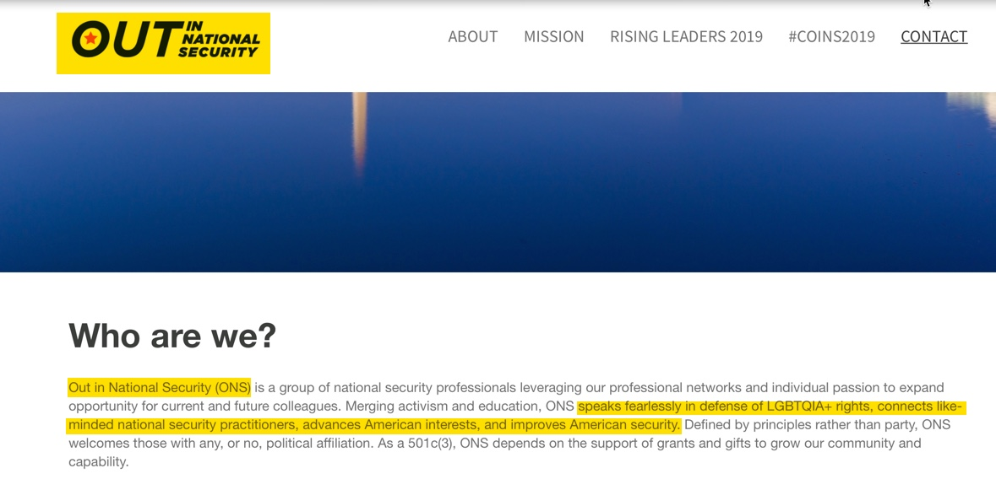

Slide 19
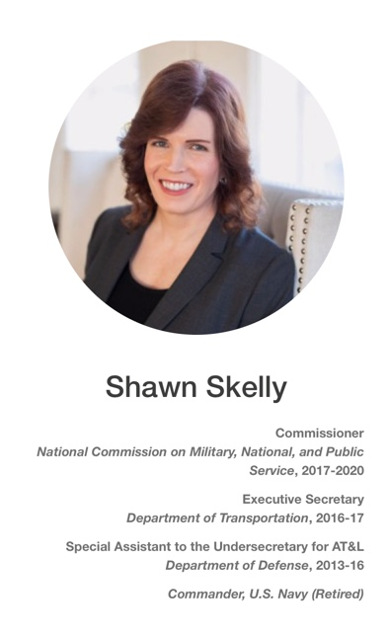
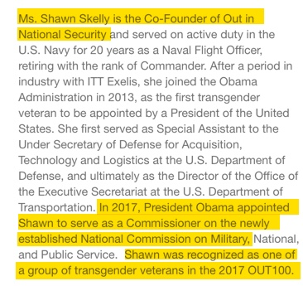

Slide 20
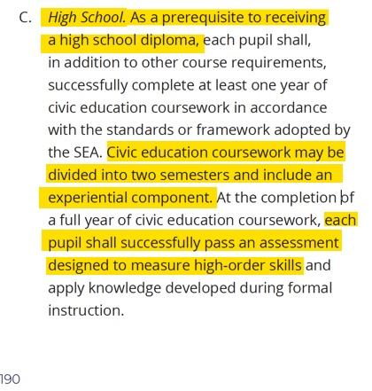

Slide 21
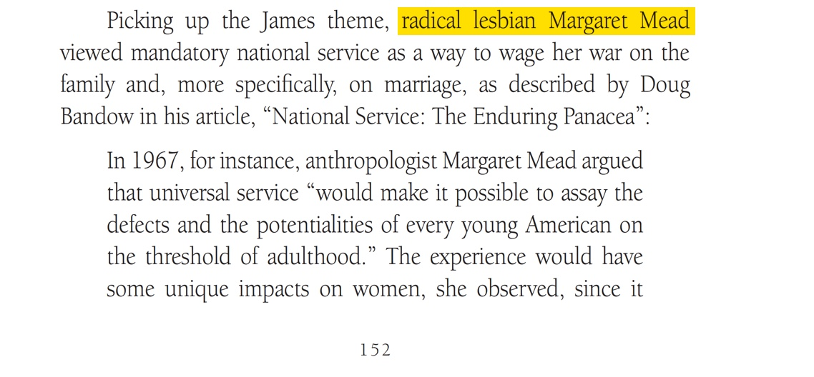
From Grave Influence by Brannon Howse

Slide 22
From Grave Influence by Brannon Howse

Slide 23
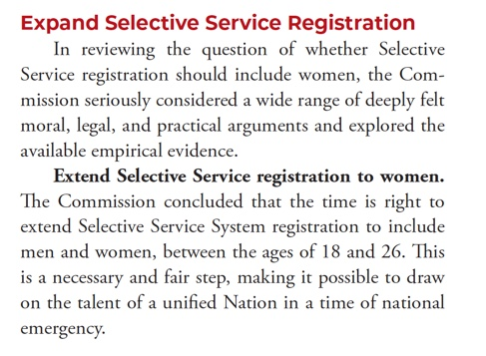

Slide 25
The GIVE Act passed into law as a voluntary program. However, Obama’s intentions were made clear before he was even elected as President of the United States. In 2008, the Obama-Biden campaign website declared:
Obama will call on citizens of all ages to serve America, by developing a plan to require 50 hours of community service in middle school and high school and 100 hours of community service in college every year.

Slide 26
The GIVE Act states:
They cannot engage in religious instruction, conducting worship services, providing instruction as part of a program that includes mandatory religious instruction or worship, constructing or operating facilities devoted to religious instruction or worship, maintaining facilities primarily or inherently devoted to religious instruction or worship or engage in any form of religious proselytization. (see 45 CFR § 2520.65):

Slide 27
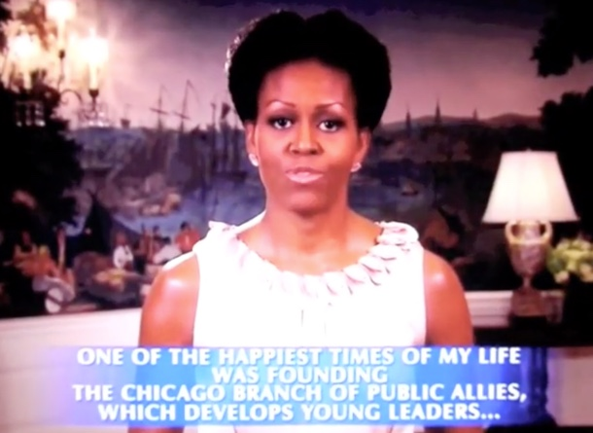

Slide 28
In 1992, Mr. Obama was a founding board member of Pubic Allies, and Michelle Obama became executive director of the Chicago chapter of Public Allies in 1993. Public Allies was nothing more than an organization that seeks to turn America’s youth into community organizers that follow the worldview of Saul Alinsky.

Slide 29
The September 4, 2008 issue of Investor's Business Daily , "Michelle's Boot Camp for Radicals" Declared:
Big Brother had nothing on the Obamas. They plan to herd American youth into government-funded reeducation camps where they'll be brainwashed into thinking America is a racist, oppressive place in need of "social change."

Slide 30
The September 4, 2008 issue of Investor's Business Daily , "Michelle's Boot Camp for Radicals" Declared:
But its [Public Allies] real mission is to radicalize American youth and use them to bring about "social change" through threats, pressure, tension and confrontation — the tactics used by the father of community organizing, Saul "The Red" Alinsky.

Slide 31
The September 4, 2008 issue of Investor's Business Daily , "Michelle's Boot Camp for Radicals" Declared:
"Our alumni are more than twice as likely as 18-34 year olds to . . . engage in protest activities," Public Allies boasts in a document found with its tax filings. It has already deployed an army of 2,200 community organizers like Obama to agitate for "justice" and "equality" in his hometown of Chicago and other U.S. cities, including Cincinnati, Los Angeles, Milwaukee, New York, Phoenix, Pittsburgh and Washington.

Slide 32
The September 4, 2008 issue of Investor's Business Daily , "Michelle's Boot Camp for Radicals" Declared:
I get to practice being an activist," and get paid for it, gushed Cincinnati recruit Amy Vincent.

Slide 33
The September 4, 2008 issue of Investor's Business Daily , "Michelle's Boot Camp for Radicals" Declared:
When they're not protesting, they're staffing AIDS clinics, handing out condoms, bailing criminals out of jail and helping illegal aliens and the homeless obtain food stamps and other welfare.

Slide 34
The September 4, 2008 issue of Investor's Business Daily , "Michelle's Boot Camp for Radicals" Declared:
Public Allies brags that more than 80% of graduates have continued working in nonprofit or government jobs. It's training the "next generation of nonprofit leaders"—future "social entrepreneurs.”

Slide 35
The September 4, 2008 issue of Investor's Business Daily , "Michelle's Boot Camp for Radicals" Declared:
"It was too touchy-feely," said Nelly Nieblas, 29, of the 2005 Los Angeles class. "It's a lot of talk about race, a lot of talk about sexism, a lot of talk about homophobia, talk about -isms and phobias.”

Slide 36
The September 4, 2008 issue of Investor's Business Daily , "Michelle's Boot Camp for Radicals" Declared:
Obama wants to fully fund it and expand it into a national program that some see costing $500 billion. "We've got to have a civilian national security force that's just as powerful, just as strong, just as well-funded" as the military, he said.

Slide 37
The September 4, 2008 issue of Investor's Business Daily , "Michelle's Boot Camp for Radicals" Declared:
The gall of it: The Obamas want to create a boot camp for radicals who hate the military —and stick American taxpayers with the bill.

Slide 38
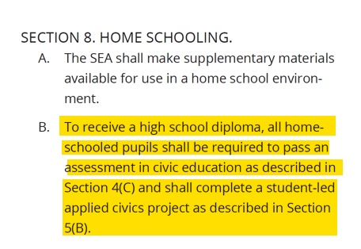

Slide 40
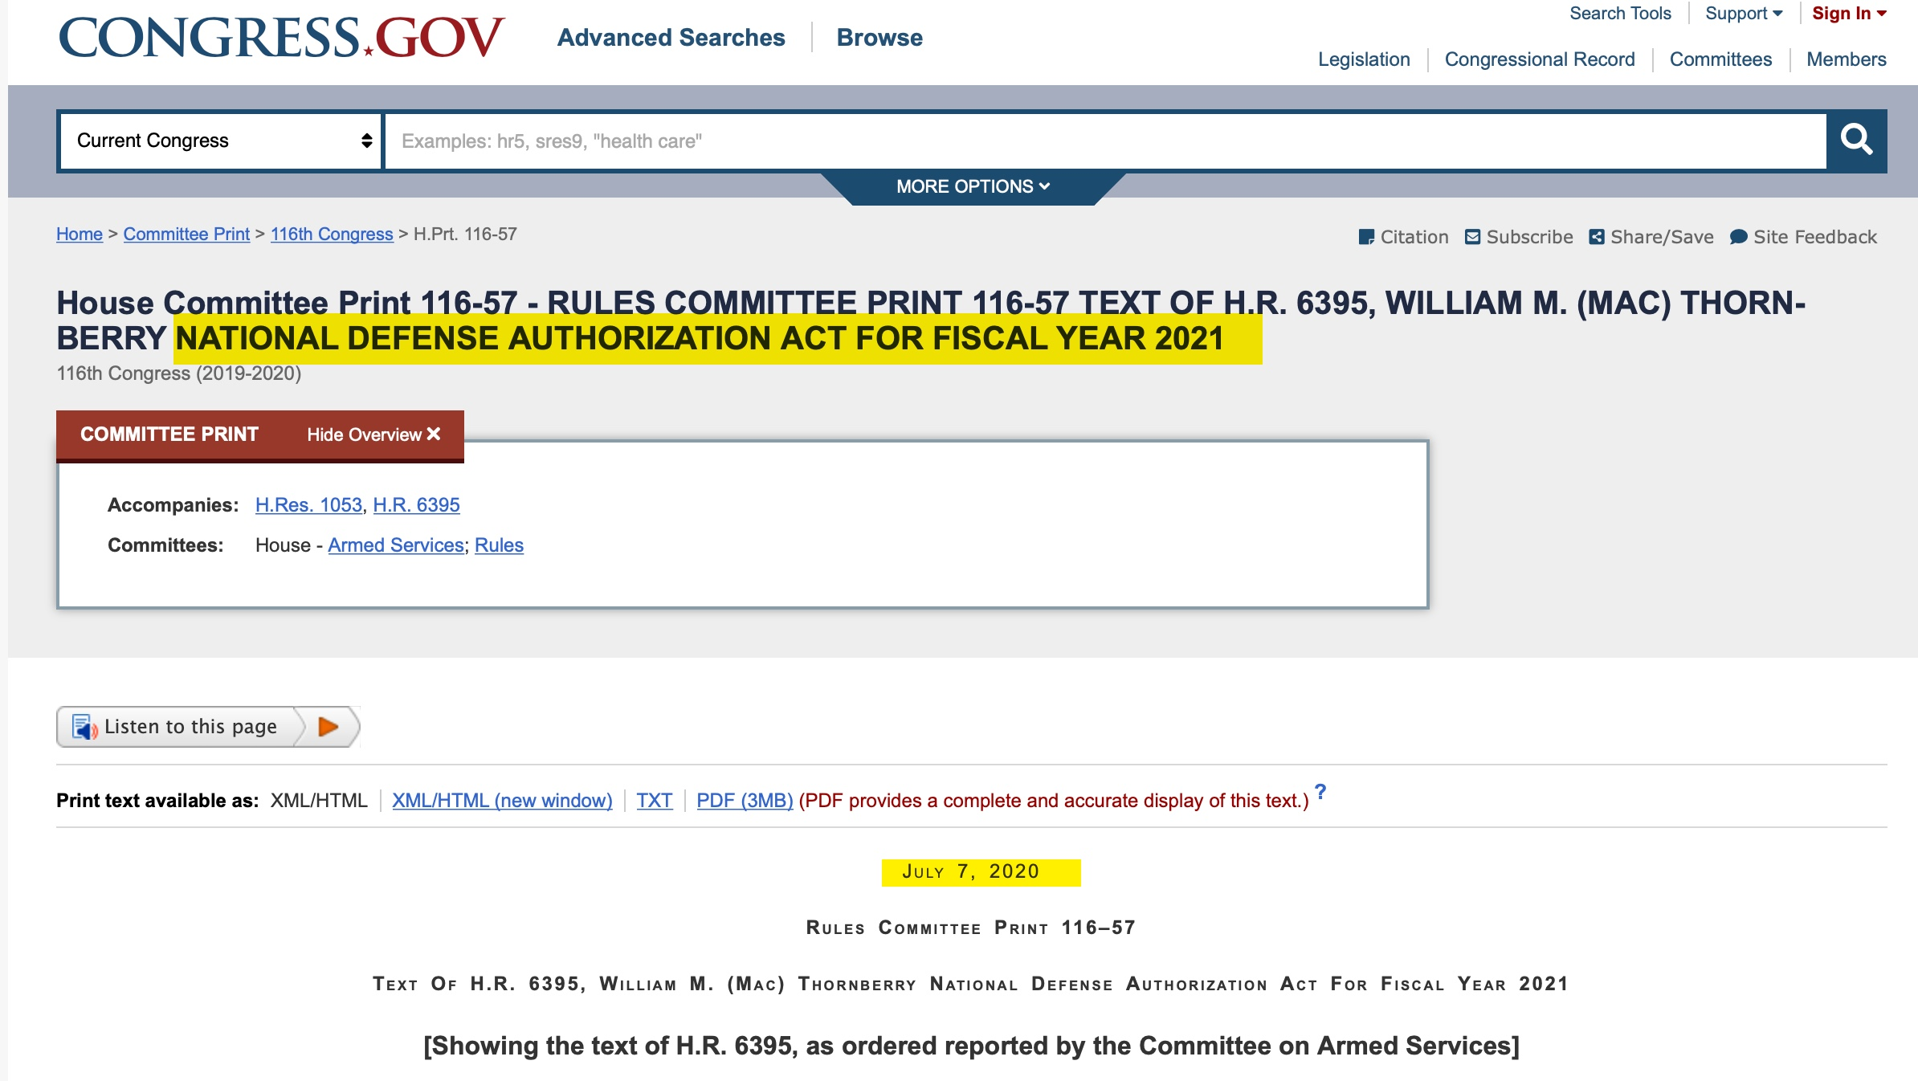

Slide 41
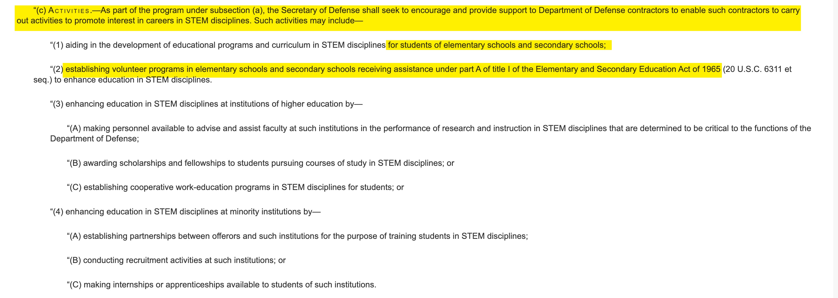

Slide 42
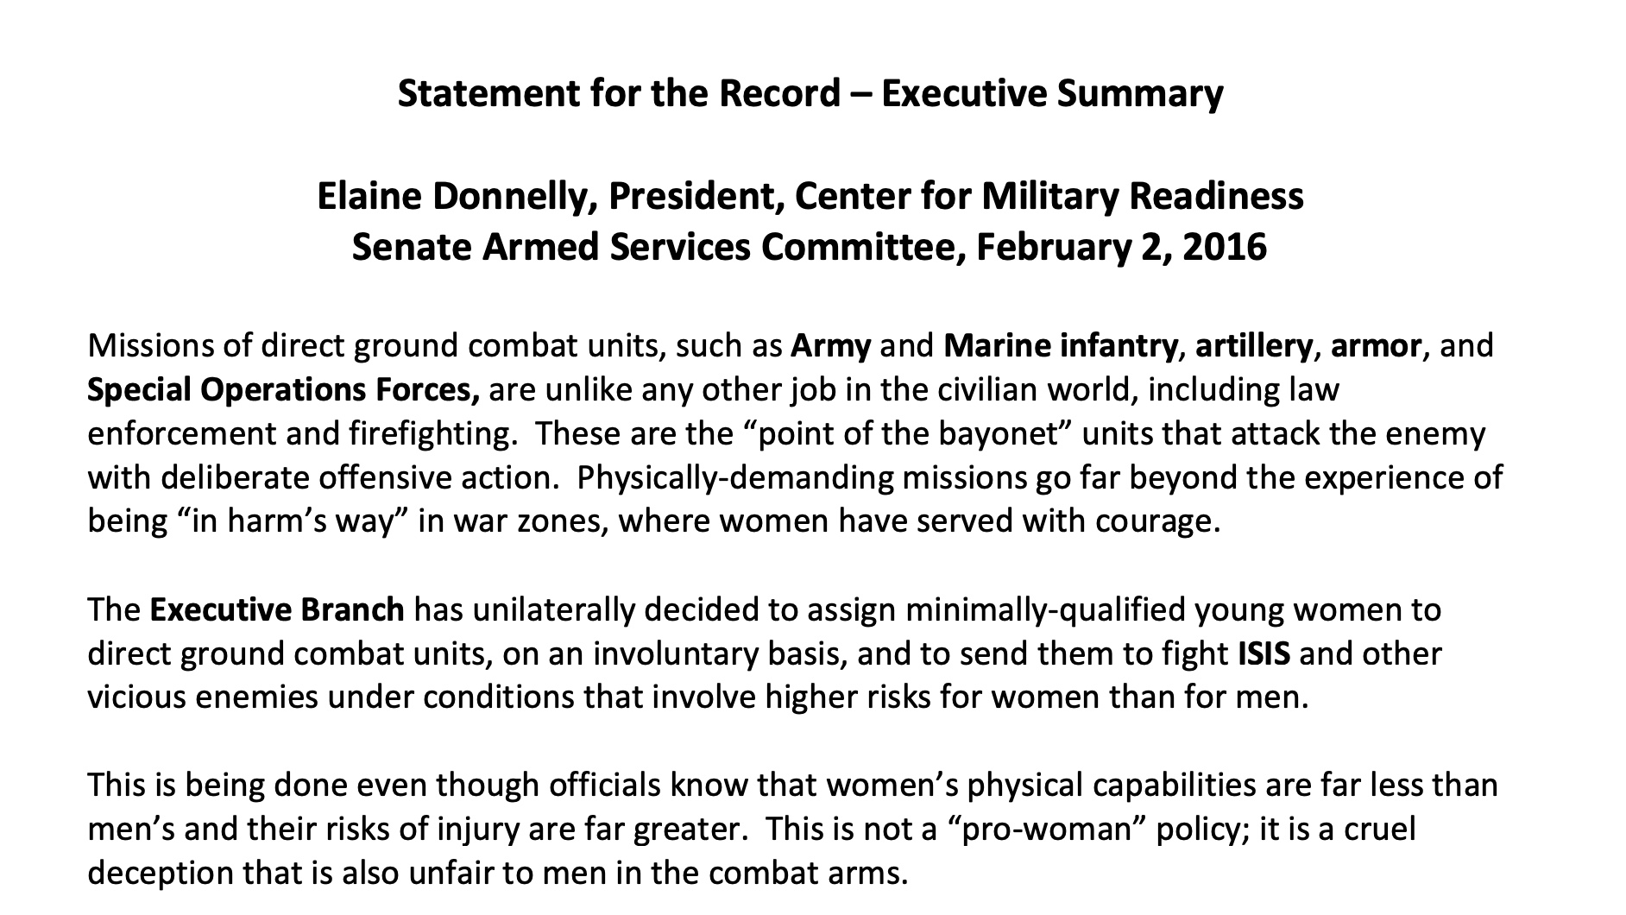

Slide 44
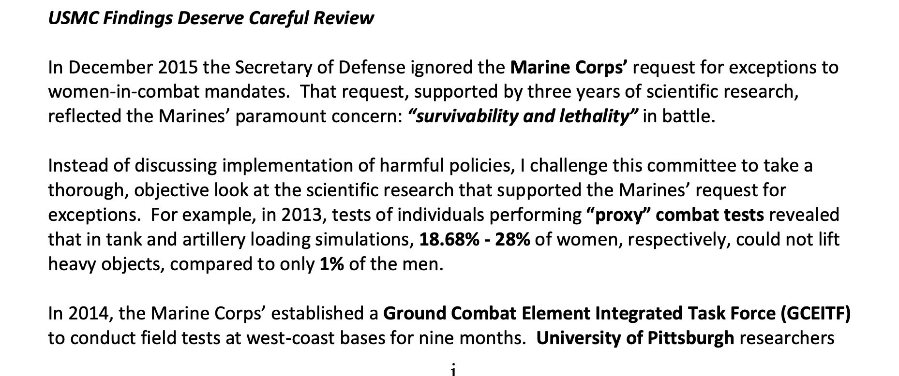

Slide 45
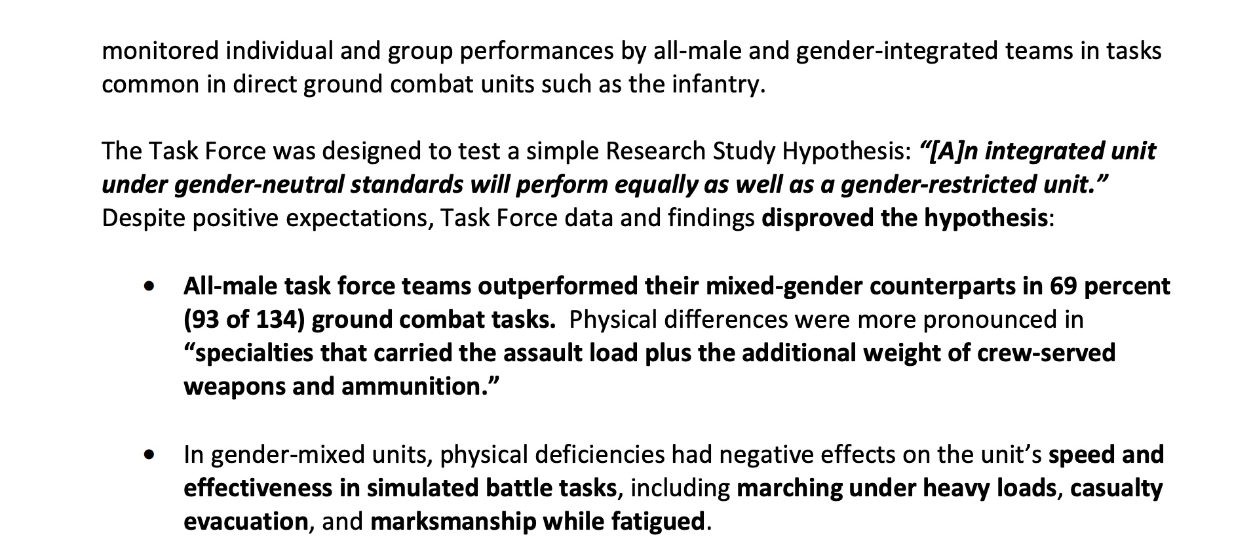

Slide 46
