Slide 1
Hamas in America

Slide 2
Hamas in America: Part 1

Slide 3
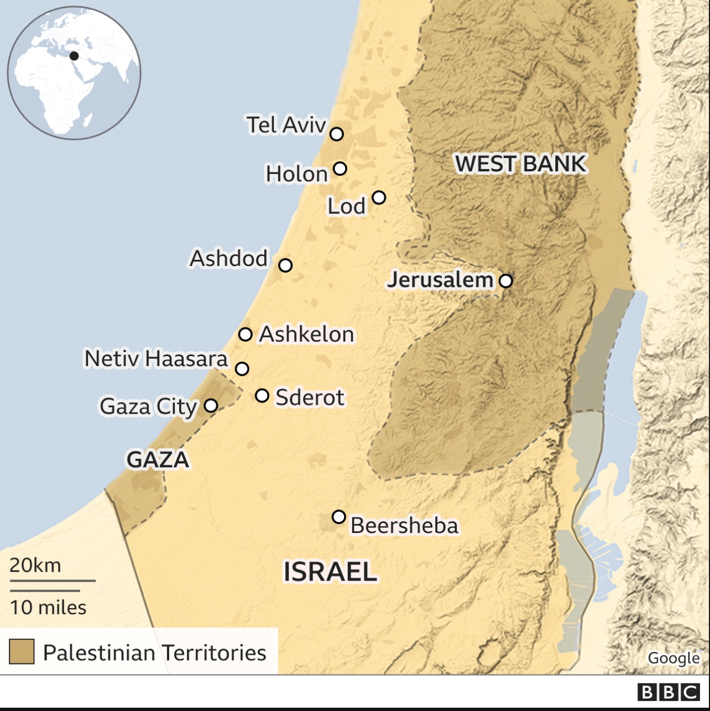

Slide 4
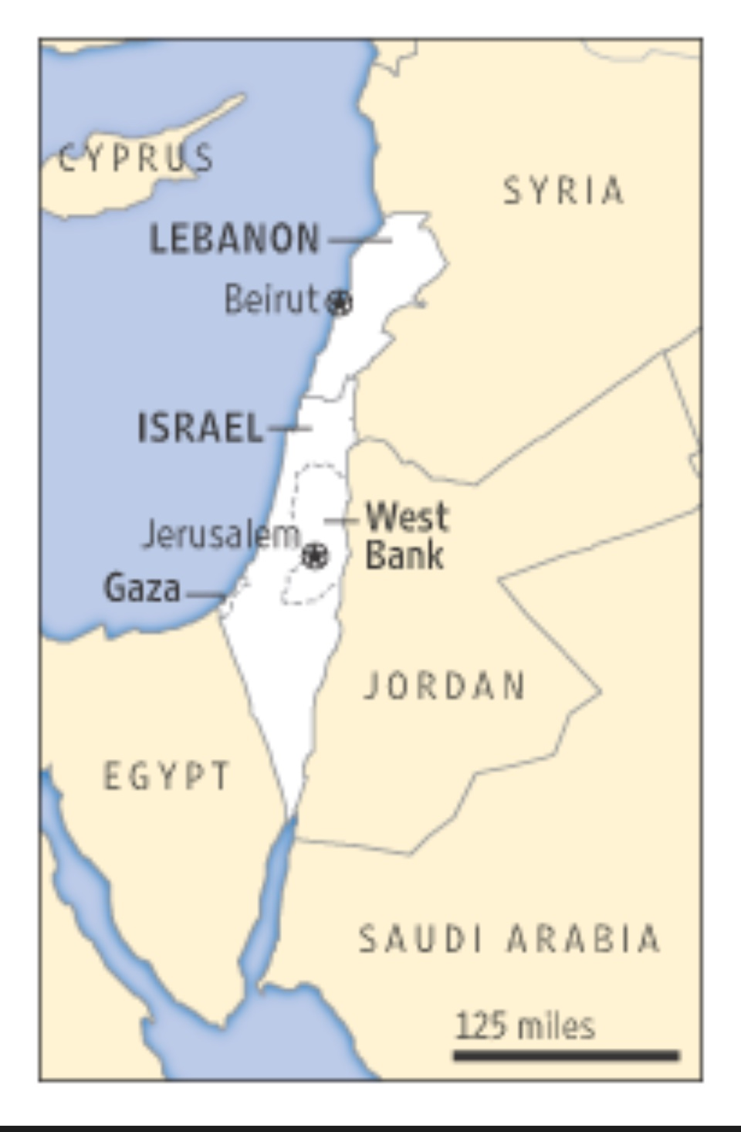

Slide 8
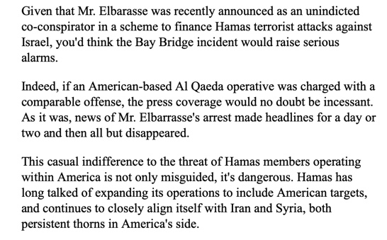

Slide 9
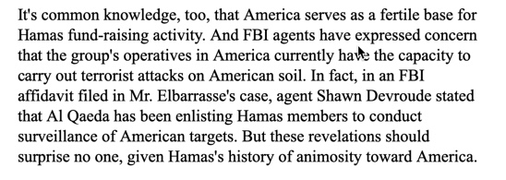

Slide 10
In 2008 in the Holyland Terror Funding Trial The Federal Government Entered Into Evidence The Following Information From a Muslim Brotherhood Document: The process of settlement is a ‘Civilization-Jihadist Process’ with all the word means. The Ikhwan [Muslim Brotherhood] must understand that their work in America is a kind of grand jihad in eliminating and destroying the Western civilization from within

Slide 11
and ‘sabotaging’ its miserable house by their hands and the hands of the believers…We must possess a mastery of ‘coalitions’, the art of ‘absorption’ and the principles of ‘cooperation.’”

Slide 12
December 2015, Executive Director of Council of American-Islamic Relations (CAIR): Black Lives Matter is our matter. Black Lives Matter is our campaign.

Slide 13
In His Book Revolutionary Islam Carlos The Jackal Declared: “Only a coalition of Marxists and Islamists can destroy the US.”

Slide 14
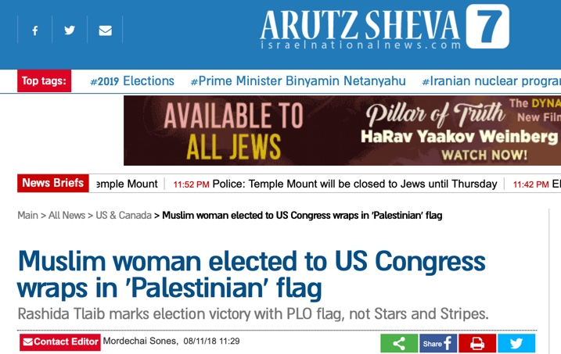

Slide 15
Congresswomen Elect Rashida Tlaib Wrapped in Palestinian Flag on Night of Election Win

Slide 16
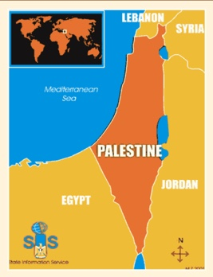
PLO Map Does Not Include Existence For Israel

Slide 17
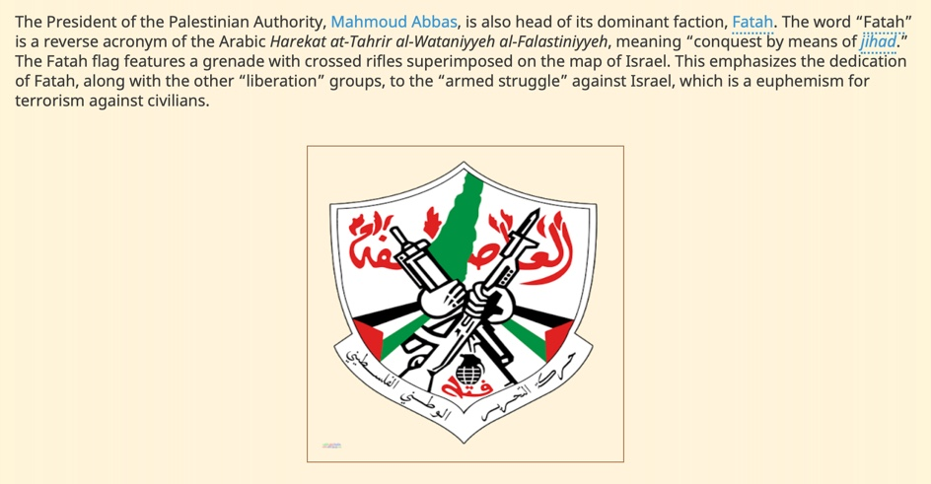

Slide 18
Pamelageller.com
January 13, 2019

Slide 19
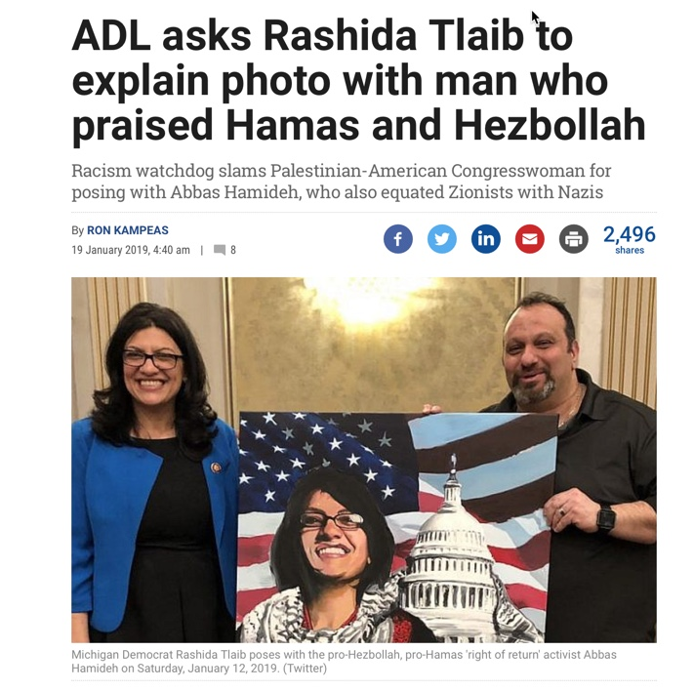
Times of Israel, January 2019

Slide 20
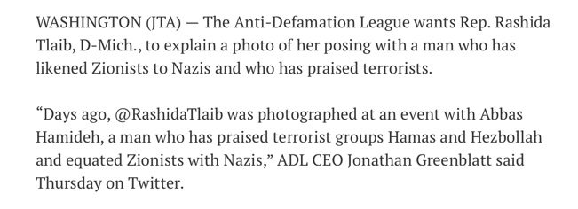
Times of Israel, January 2019

Slide 21
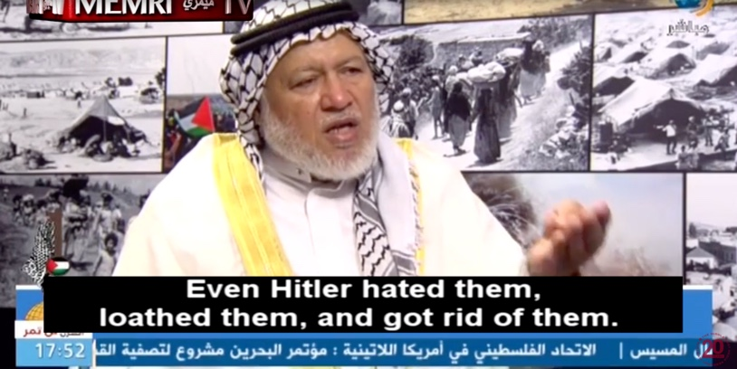
Hamas Leader

Slide 22
Hamas Leader

Slide 26
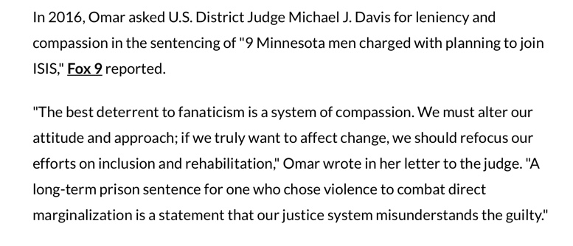

Slide 29
Islamic Relief Banquet, February 23, 2019

Slide 30
February 13, 2019 The Jerusalem Post

Slide 31
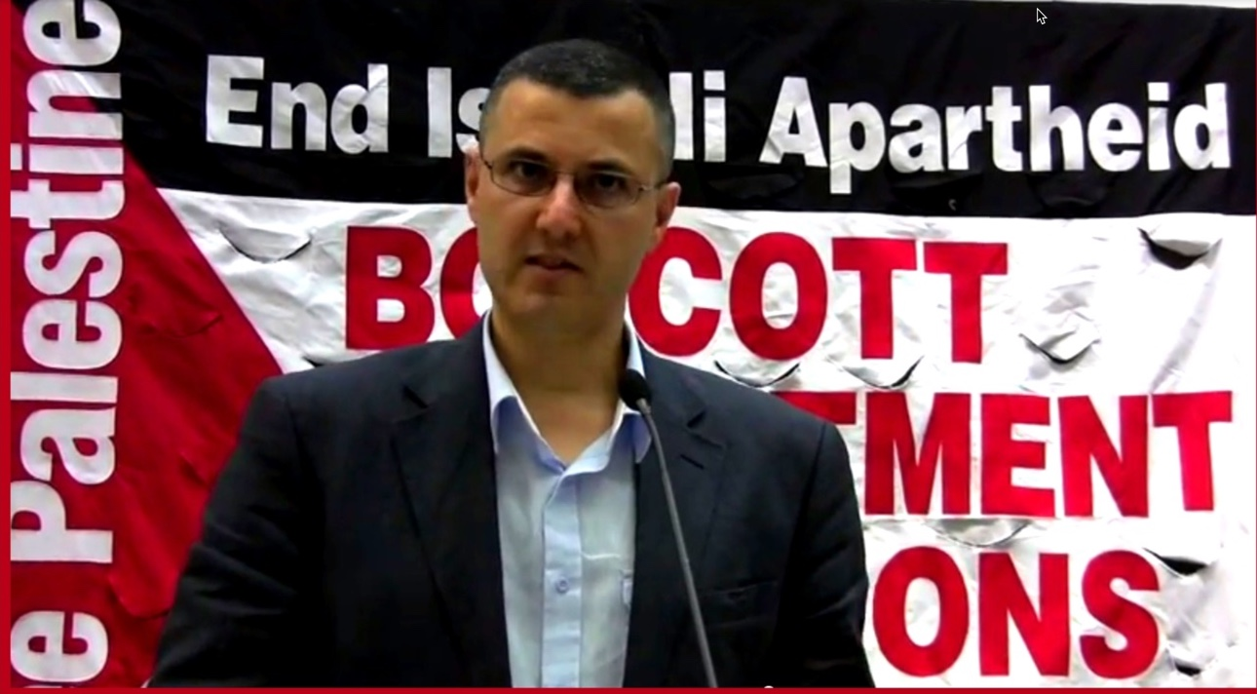
Omar Barghouti: Co-Founder of BDS

Slide 32
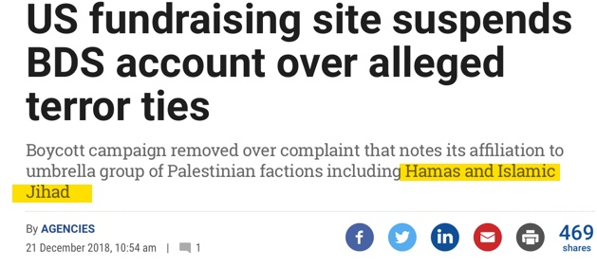

Slide 33
Muslim Brotherhood was Founded in 1928
Muslim Brotherhood Founded Hamas in 1987
Brotherhood & Hamas Officials Founded CAIR in 1994

Slide 34
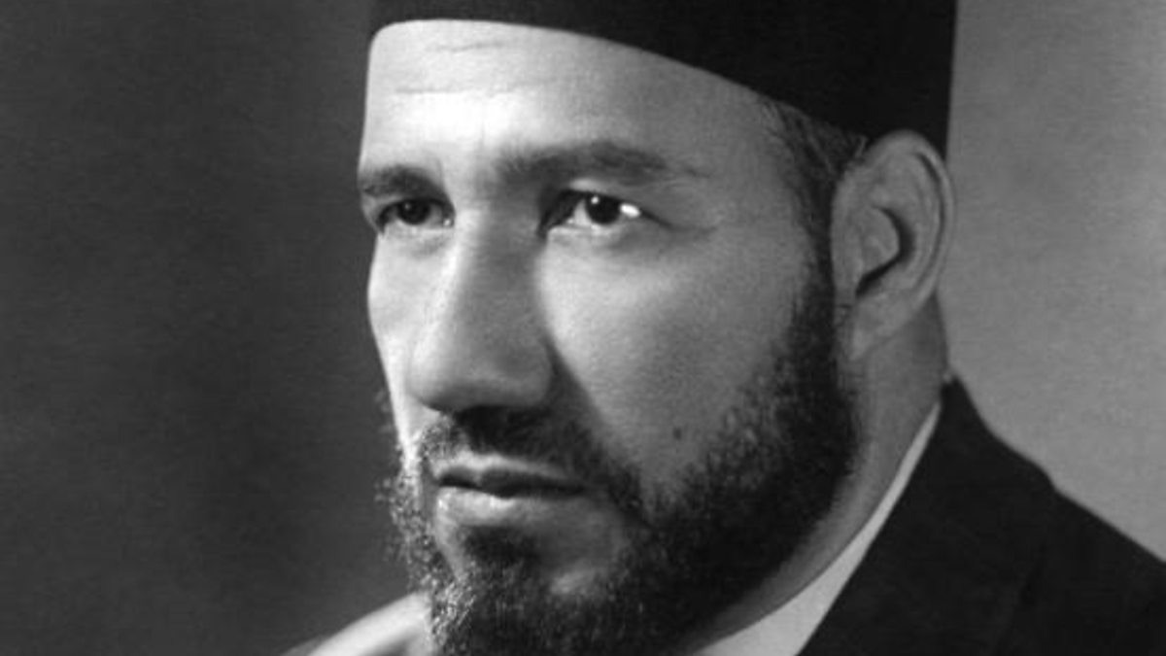
Muslim Brotherhood Was Founded in 1928 By Hasan al-Banna

Slide 35
In 1934, Muslim Brotherhood Founder Al-Banna wrote:
it is a duty incumbent on every Muslim to struggle towards the aim of making every people Muslim and the whole world Islamic, so that the banner of Islam can flutter over the earth and the call of the Muezzin can resound in all the corners of the world…

Slide 36
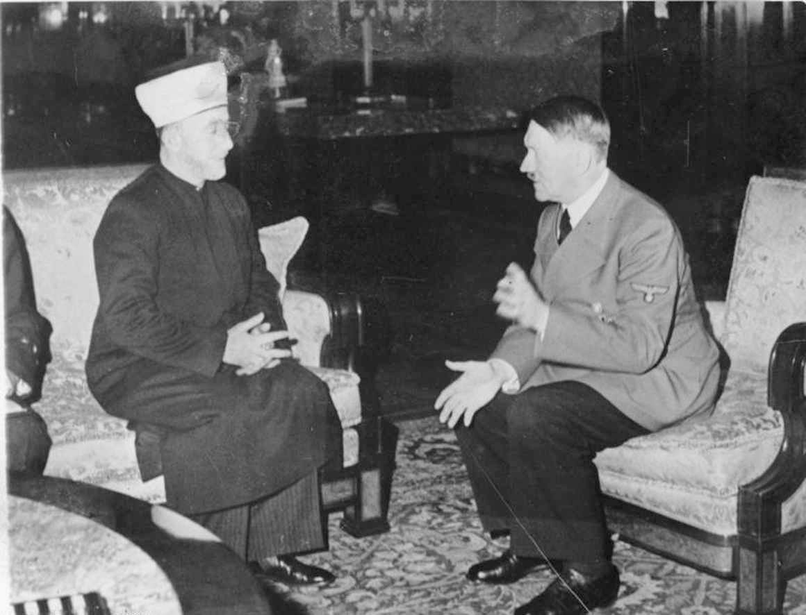
Muslim Brotherhood Hajj Muhammad Amin Al-Husseini & Adolf Hitler November 28, 1941

Slide 37
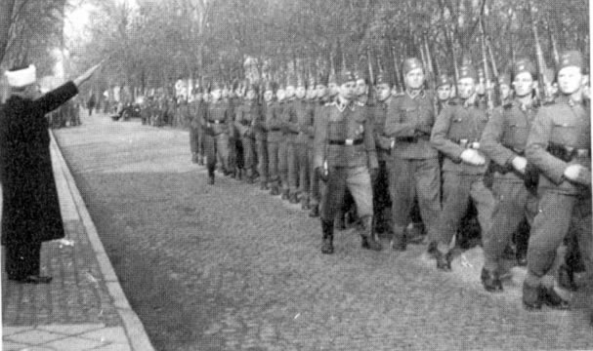
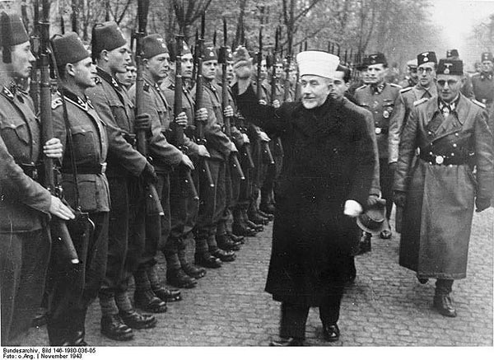
The Muslim Brotherhood and Their Work With Nazi Adolf Hitler
Hajj Muhammad Amin Al-Husseini

Slide 38
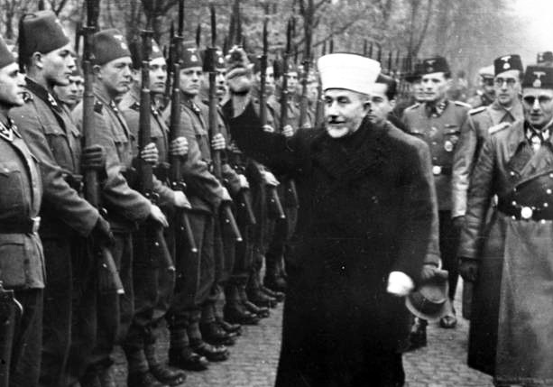
November 1943 Al-Husseini With Bosnian Waffen-SS Volunteers as He Gives the Nazi Salute

Slide 39
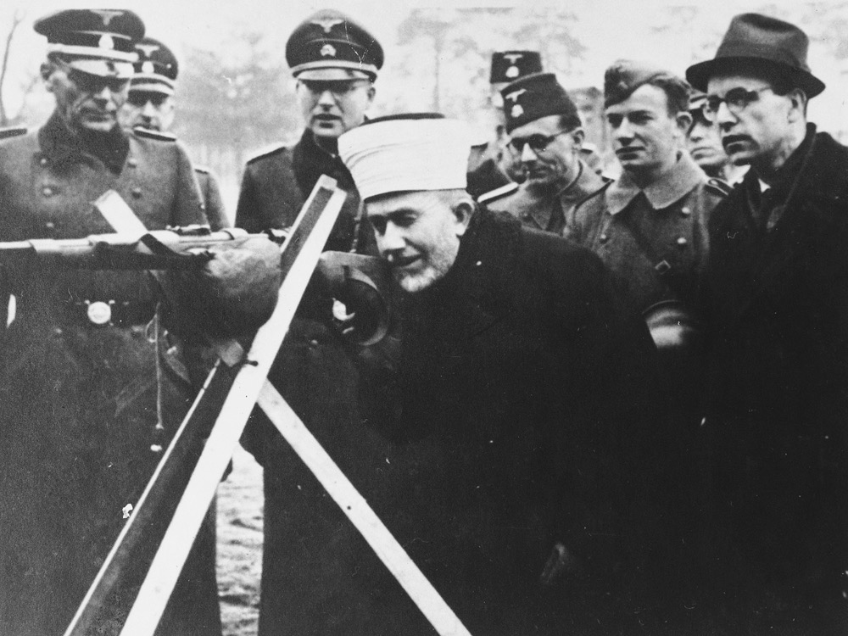
Hajj Amin al-Husayni with German SS and Bosnian members of the Waffen-SS during an official visit to Bosnia in 1943. — US Holocaust Memorial Museum, courtesy of Robert Kempner

Slide 40
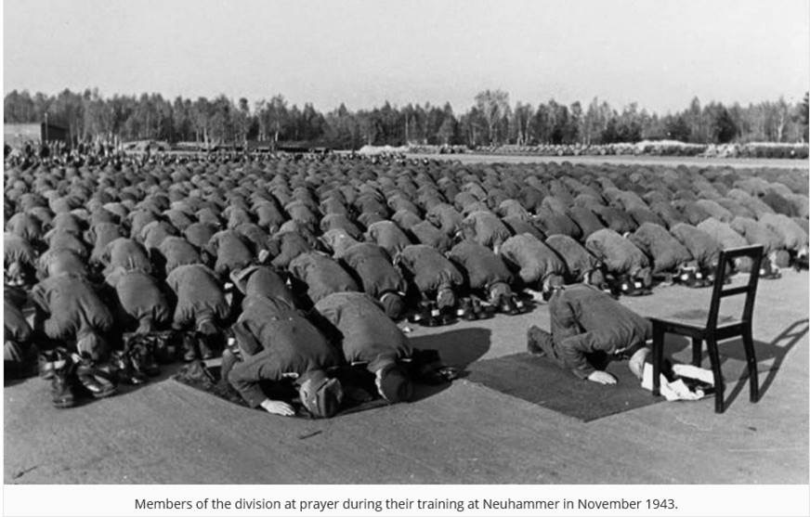
Muslims Training at Neuhammer in November of 1943

Slide 41
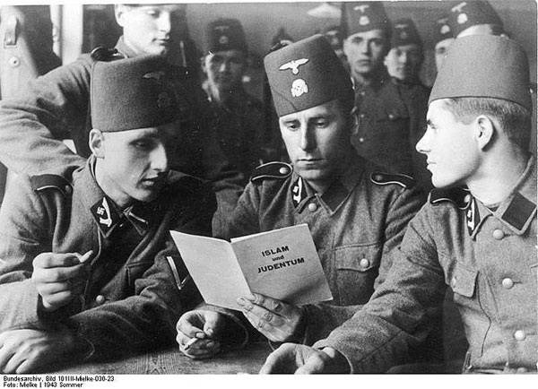
Bosnian Muslims Wearing Nazi Uniform

Slide 42
Bosnian Muslims Displayed This Symbol on Their Uniforms

Slide 43
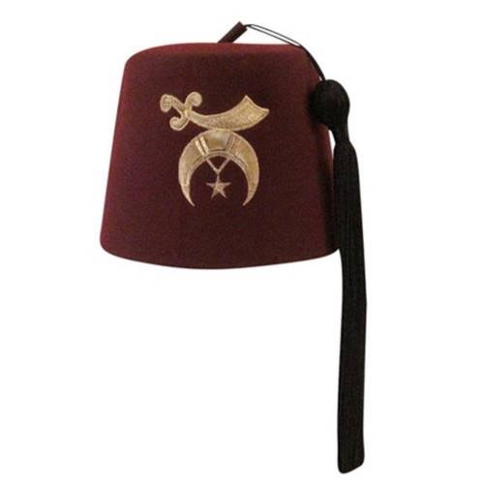
Shriners Hat

Slide 44
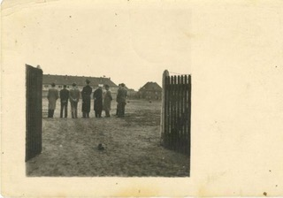
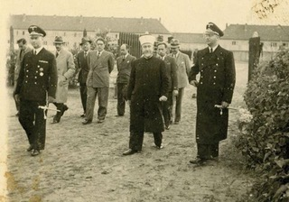
The Muslim Brotherhood and Their Work With Nazi Adolf Hitler
Hajj Muhammad Amin Al-Husseini & SS Head Heinrich Himmler in 1943 At Auschwitz

Slide 45
Hamas in America: Part Two

Slide 46
Muslim Brotherhood was Founded in 1928
Muslim Brotherhood Founded Hamas in 1987
Brotherhood & Hamas Officials Founded CAIR in 1994

Slide 47
Japanese Writer Yashiko Sagamori Wants to Know:

Slide 48
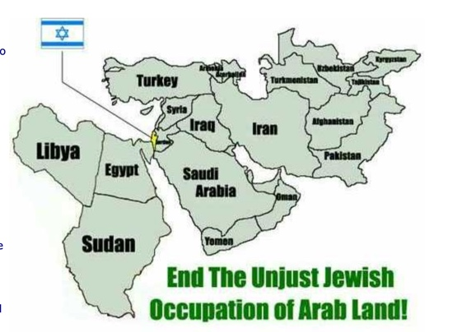

Slide 49
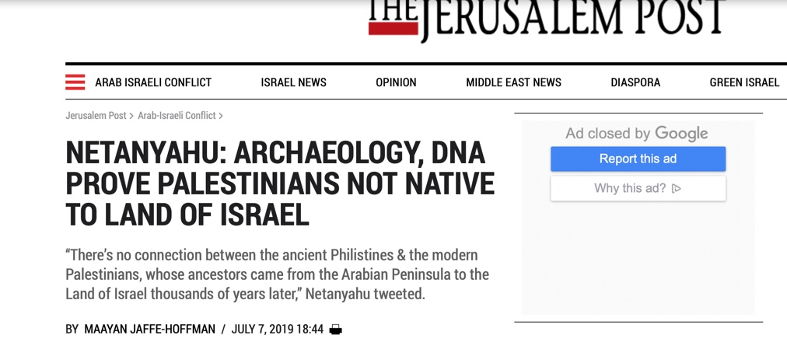

Slide 50
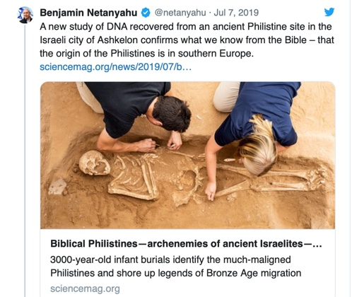

Slide 51
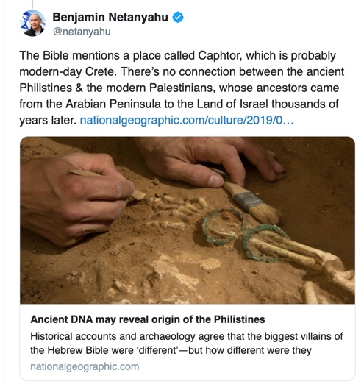

Slide 52
Muslim Brotherhood Hajj Muhammad Amin Al-Husseini & Adolf Hitler November 28, 1941

Slide 53
The Muslim Brotherhood and Their Work With Nazi Adolf Hitler
Hajj Muhammad Amin Al-Husseini

Slide 54
November 1943 Al-Husseini With Bosnian Waffen-SS Volunteers as He Gives the Nazi Salute

Slide 55
Hajj Amin al-Husayni with German SS and Bosnian members of the Waffen-SS during an official visit to Bosnia in 1943. — US Holocaust Memorial Museum, courtesy of Robert Kempner

Slide 56
Bosnian Muslims Wearing Nazi Uniform

Slide 57
Bosnian Muslims Displayed This Symbol on Their Uniforms

Slide 58
The Muslim Brotherhood and Their Work With Nazi Adolf Hitler
Hajj Muhammad Amin Al-Husseini & SS Head Heinrich Himmler in 1943 At Auschwitz

Slide 59
Mein Kampf Was Translated into Arabic as My Jihad By The Muslim Brotherhood In the 1930s As They United To Support Hitler in the Extermination of the Jewish People

Slide 60
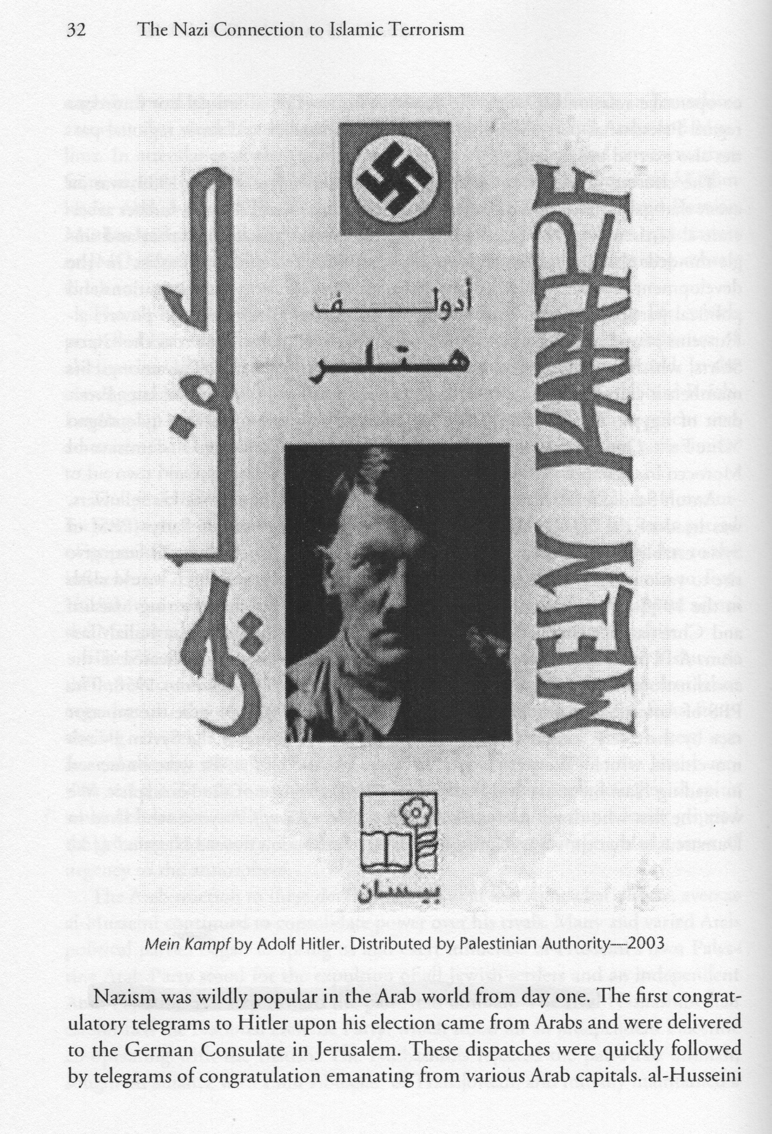
Mein Kampf By Adolf Hitler, Distributed by Palestinian Authority 2003

Slide 62
Congresswomen Elect Rashida Tlaib Wrapped in Palestinian Flag on Night of Election Win

Slide 63
PLO Map Does Not Include Existence For Israel

Slide 64
Hitler Gave Al-Husseini a Radio Station By Which To Broadcast Nazism to the Arab World. In One Such Broadcast Al-Husseini Declared:

Slide 65
According to the Muslim religion, the defense of your life is a duty which can only be fulfilled by annihilating the Jews. This is your best opportunity to get rid of this dirty race, which has usurped your rights and brought misfortune and destruction on your countries. Kill the Jews, burn their property, destroy their stores, annihilate these base supporters of British imperialism.

Slide 66
Your sole hope of salvation lies in annihilating the Jews before they annihilate you.

Slide 67
SS Hampsturmfuerer Dieter Wisliceny, was a witness for the Nuremberg Prosecution. The Nazi Officer Testified:
The Grand Mufti has repeatedly suggested to the Nazi authorities – including Hitler, von Ribbentrop and Himmler – the extermination of European Jewry. … The Mufti was one of the initiators of the systematic extermination of European Jewry and had been a collaborator and adviser of Eichmann and Himmler in the execution of this plan…

Slide 68
He was one of Eichmann’s best friends and had constantly incited him to accelerate the extermination measures. I heard him say, accompanied by Eichmann, he had visited incognito the gas chambers of Auschwitz.

Slide 69
Adolf Eichmann, the architect of the Holocaust Declared to the Muslims:
You 360 million Mohammedans to whom I have had a strong inner connection since the days of my association with your Grand Mufti of Jerusalem…You who have a greater truth in the surahs of your Koran, I call upon you to pass judgment on me.

Slide 70
In The Hadith, The Sayings of Muhammad, He Declared:
“The Hour will not begin until you fight the Jews, until a Jew will hide behind a rock or a tree, and the rock or tree will say: ‘O Muslim, O slave of Allah, here is a Jew behind me; come and kill him

Slide 71
And according to the Arab Higher Committee:
In virtually identical letters, the Mufti, in the summer of 1944, approached Germany, Romania, Bulgaria, and Hungary to speed the extermination of the Jews by sending them to Poland where the Nazi death chambers were located.

Slide 72
Pamela Geller:
The Mufti successfully demanded that 400,000 Jews who were about to be deported to the Holy Land instead be sent to their deaths. That’s not merely a collaborator, that’s a partner with great influence
and power.

Slide 73
The Goals of The Muslim Brotherhood Today

Slide 74
In 2009 on Al-Jazeera Television, Muslim Brotherhood Leader Yusuf Al-Qaradawi Declared:
“The last punishment was carried out by Hitler… Allah willing, the next time will be at the hand of the believers,”

Slide 75
Muslim Brotherhood was Founded in 1928
Muslim Brotherhood Founded Hamas in 1987
Brotherhood & Hamas Officials Founded CAIR in 1994

Slide 76
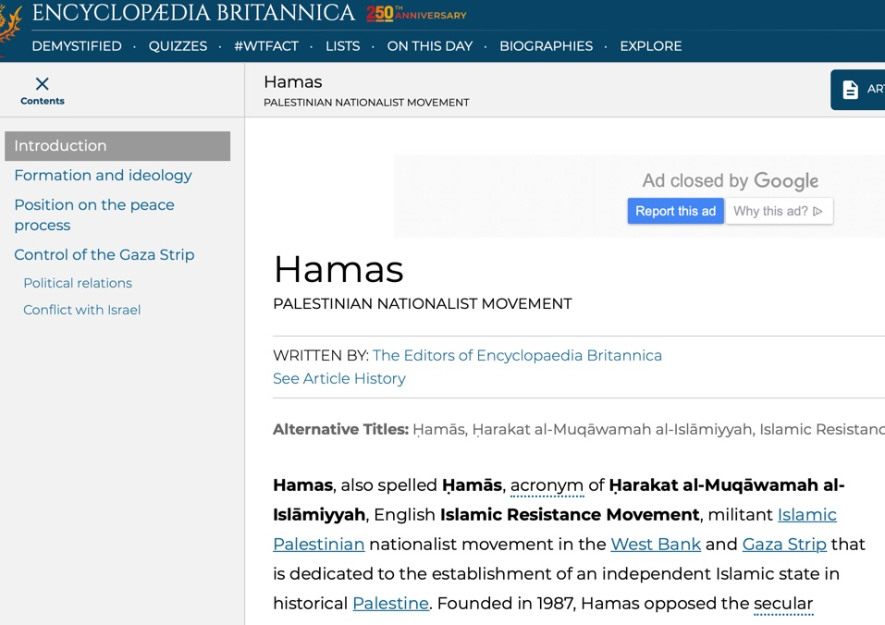

Slide 77
Introduction, The Covenant of the Islamic Resistance Movement: (Hamas, August 18th, 1988)
Our struggle against Jews is very great and very serious. It needs all
sincere efforts. It is a step that inevitably should be followed by other
steps. The Movement is but one squadron that should be supported by
more and more squadrons from this vast Arab and Islamic world, until
the enemy is vanquished and Allah’s victory is realized.

Slide 78
Article Thirteen,
The Covenant of the Islamic Resistance Movement
There is no solution for the Palestinian question except through Jihad. Initiatives, proposals and international conferences are all a waste of time and vain endeavors.

Slide 79
Article Six of the Hamas Charter:
The Islamic Resistance Movement is a distinct Palestinian Movement which owes its loyalty to Allah, derives from Islam its way of life, and strives to raise the banner of Allah over every inch of Palestine.

Slide 80
Article Two of the Hamas Charter:
The Islamic Resistance Movement is one of the wings of Muslim Brotherhood in Palestine…which constitutes the largest Islamic movement in modern times.

Slide 81
Article Seven, Hamas Charter:
…the Islamic Resistance Movement aspires to the realization of Allah’s promise, no matter how long that should take. The Prophet, Allah bless him and grant him salvation, has said: “The Day of Judgement will not come about until Muslims fight the Jews, when the Jew will hide behind stones and trees. The stones and trees will say O Muslims, O Abdulla there is a Jew behind me, come and kill him,”

Slide 82
Muslim Brotherhood was Founded in 1928
Muslim Brotherhood Founded Hamas in 1987
Brotherhood & Hamas Officials Founded CAIR in 1994

Slide 84
Read This Full Report at Securefreedom.org

Slide 85
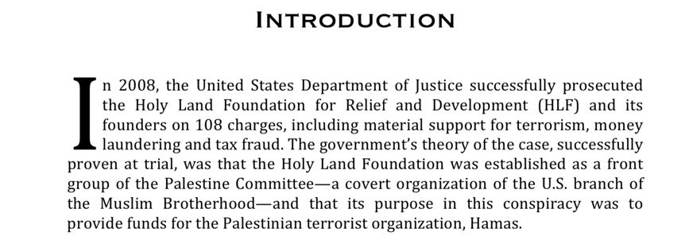

Slide 97
Hamas in America: Part Three

Slide 98
BDS: Marginalize, Characterize, Racialize, Terrorize, Legalize,

Slide 99
Genesis 12:3:
I will bless those who bless you, And I will curse him who curses you; And in you all the earth shall be blessed.

Slide 100
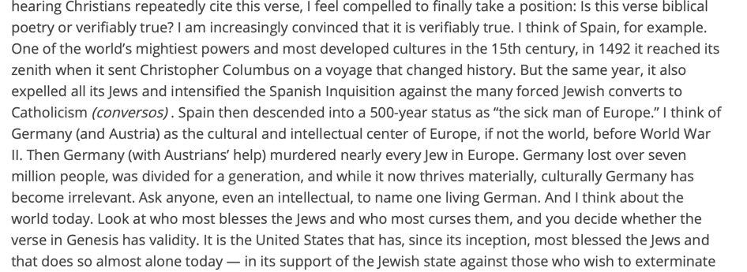

Slide 102
What is a Zionist?
Zion in Hebrew is a Reference to Jerusalem or the City of David
Dr. Tommy Ice Defines Zionism:
“Zionism encompasses anyone, for any reason desiring to see the nation of Israel continue as Jewish state and prosper.”

Slide 103
What is a Christian Zionist?
Dr. Tommy Ice in His Book The Case for Zionism Writes:
Christian Zionists generally believe Israel’s return to their Promise Land is fulfilling dozens of Bible prophecies from the Old Testament. They believe this is an indication that God is setting the stage for the events that will take place during the future seven-year period commonly called the Tribulation. For that time period to take place, Israel must be a nation again and in control of Jerusalem. Since 1967 this has been the case concerting the modern state of Israel.

Slide 105
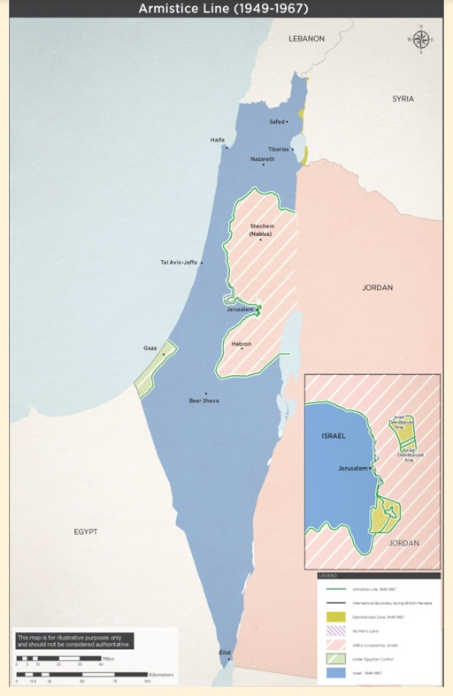

Slide 106
Paul Wilkinson Defines Christian Zionism as Follows:
1. A clear, biblical distinction between Israel and the Church
2. The any moment, pre-Tribulation Rapture of the Church.
3. The return of the Jews to the land.
4. The rebuilding of the Temple.
5.The rise of the Anti-christ.

Slide 107
Paul Wilkinson Defines Christian Zionism as Follows:
6. A seven-year period known as the Great Tribulation.
7. The national salvation of the Jews.
8. The return of Christ to Jerusalem.
9.The thousand-year reign of Christ on earth.

Slide 108
BDS: Their Hatred of Jews & Zionists

Slide 109
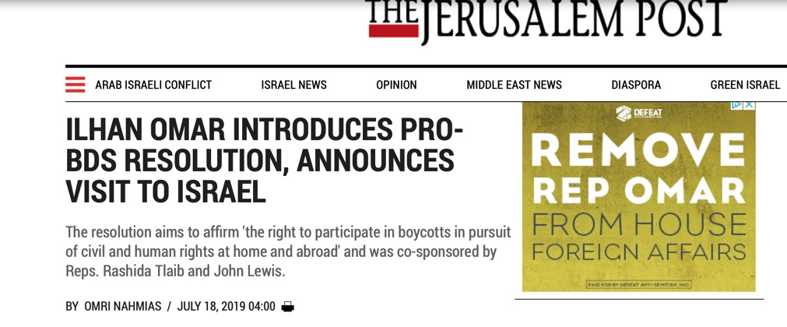

Slide 110
July 18, 2019

Slide 111
July 18, 2019

Slide 113
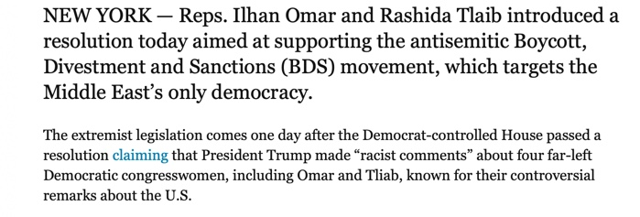

Slide 114
Congresswomen Elect Rashida Tlaib Wrapped in Palestinian Flag on Night of Election Win

Slide 115
Times of Israel, January 2019

Slide 117
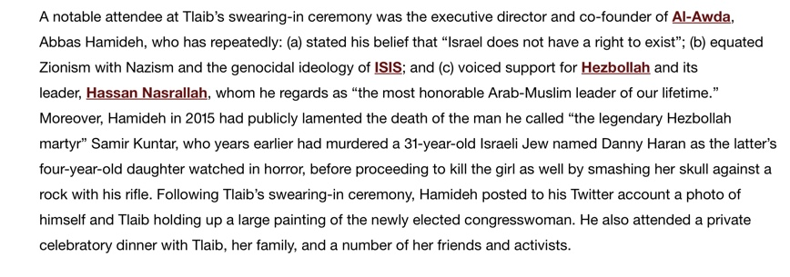

Slide 118
Alan Dershowitz, The Case Against BDS:
BDS was birthed at an anti-Semite hate fest in Durban… its grandparents on one side were the Nazis who organized the boycott of Jewish businesses, academics and artists in the 1930s. Its grandparents on the other side where the Muslim leaders who organized the Arab boycott of all Israeli and Jewish commerce in the years following the establishment of Israel.

Slide 119
Alan Dershowitz, The Case Against BDS:
Its parents are the contemporary bigots who single out only Israel for boycott and seek to use this tactic to end the existence of the world only nation state for the Jewish people.”

Slide 121
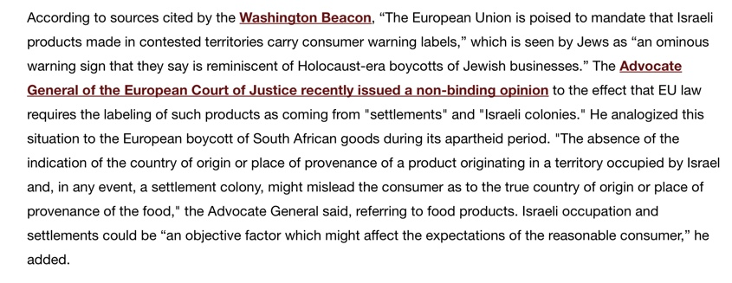

Slide 124
From Ozarks 2019 Worldview Weekend Presentation by Olivier Melnick

Slide 125
From Ozarks 2019 Worldview Weekend Presentation by Olivier Melnick

Slide 126
Hamas in America: Part Four

Slide 127
Hamas Charter:
Our struggle against the Jews is very great and very serious. It needs all sincere efforts. It is a step that inevitably should be followed by other steps. The Movement is but one squadron that should be supported by more and more squadrons from this vast Arab and Islamic world, until the enemy is vanquished and Allah’s victory is realized.

Slide 130
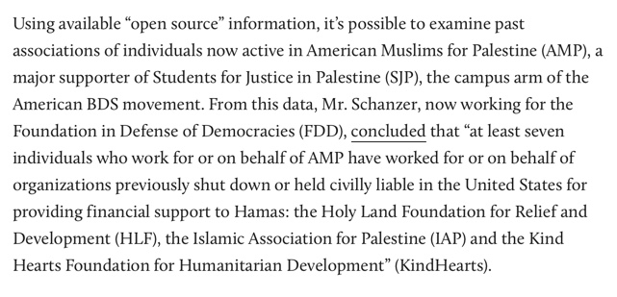

Slide 131
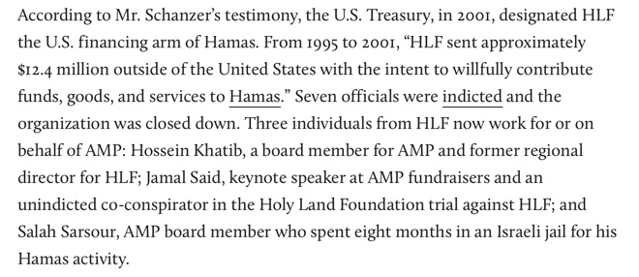

Slide 132
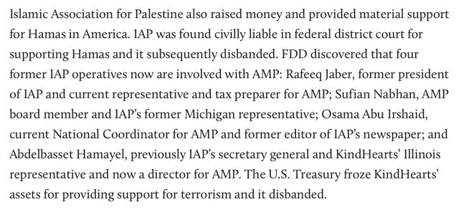

Slide 141
Times of Israel, December 21, 2018

Slide 142
Omar Barghouti: Co-Founder of BDS

Slide 147
BDS: A Coalition of Socialists, Fascists, Jew Haters, & Islamists

Slide 148
Moshe Perlman Writes:
Once upon a time, Arabs and Jews lived peacefully in Palestine. Their leaders walked and planned together. Then came Haj Amin el Husseini, Uncle of Yassir Arafat. He chose fascism and jihad. Moderate leaders had to go, and he dispensed with them by murder and intimidation. His bloody projects were temporarily interrupted by WWII, during which he fled to Germany and cooperated closely with Nazi leaders.

Slide 149
Moshe Perlman Writes:
in plans of extermination and battle. Designated as a war criminal, he escaped Allied hands to continue his work of terror, a work continued by his relatives and associates after his death…
source: The Case for Zionism by Dr. Tommy Ice

Slide 151
Chuck Morse, P. 108.

Slide 152
In 2008 in the Holyland Terror Funding Trial The Federal Government Entered Into Evidence The Following Information From a Muslim Brotherhood Document: The process of settlement is a ‘Civilization-Jihadist Process’ with all the word means. The Ikhwan [Muslim Brotherhood] must understand that their work in America is a kind of grand jihad in eliminating and destroying the Western civilization from within

Slide 153
and ‘sabotaging’ its miserable house by their hands and the hands of the believers…We must possess a mastery of ‘coalitions’, the art of ‘absorption’ and the principles of ‘cooperation.’”

Slide 154
December 2015, Executive Director of Council of American-Islamic Relations (CAIR): Black Lives Matter is our matter. Black Lives Matter is our campaign.

Slide 155
In His Book Revolutionary Islam Carlos The Jackal Declared: “Only a coalition of Marxists and Islamists can destroy the US.”

Slide 157
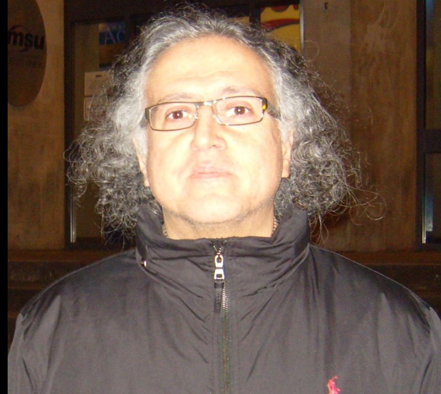
Dr. As’ad Abukhalil Professor of Political Science at University of California, Stanislaus

Slide 158
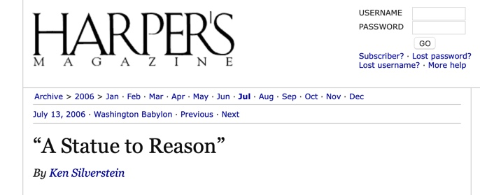

Slide 160
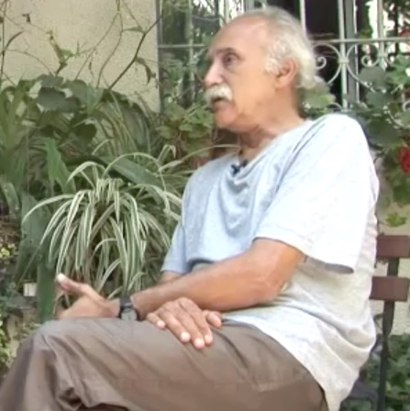
Michel Warschawski
Anti-Zionist Jew, He Led The Marxist Revolutionary Communist League Until Its Demise in the 1990s

Slide 162
John Spritlzer
Anti-Zionist, Socialist Jew Living in Boston

Slide 163
The Book Describes How to Have an “Egalitarian Revolution”

Slide 165
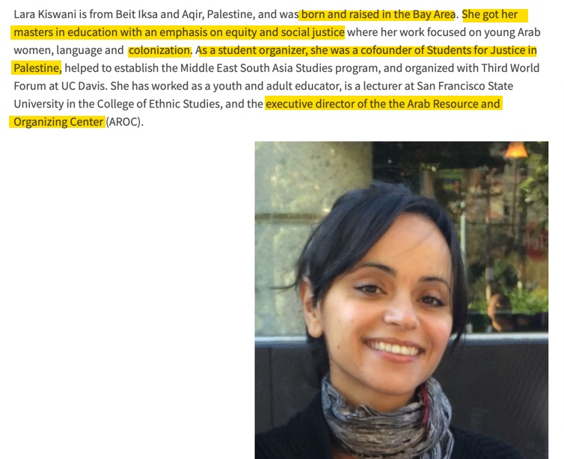

Slide 166
Ilhan Omar Tweet After El Paso Shooting

Slide 168
Hamas in America: Part Five

Slide 169
BDS, Hamas, Christian Palestinianism, & Replacement Theology Denies Israel’s Divine & Legal Right to the Land

Slide 179
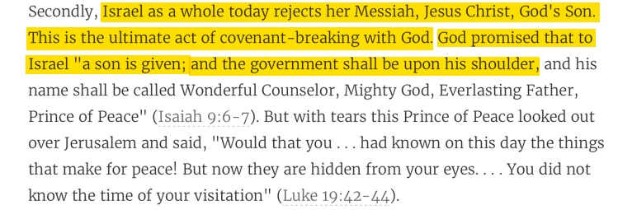

Slide 181
Matthew 21:43 in Context Refutes Replacement Theology & Kingdom Now Theology

Slide 182
John Piper’s Twisting of Mathew 21:43

Slide 184
Dr. Andy Woods

Slide 185
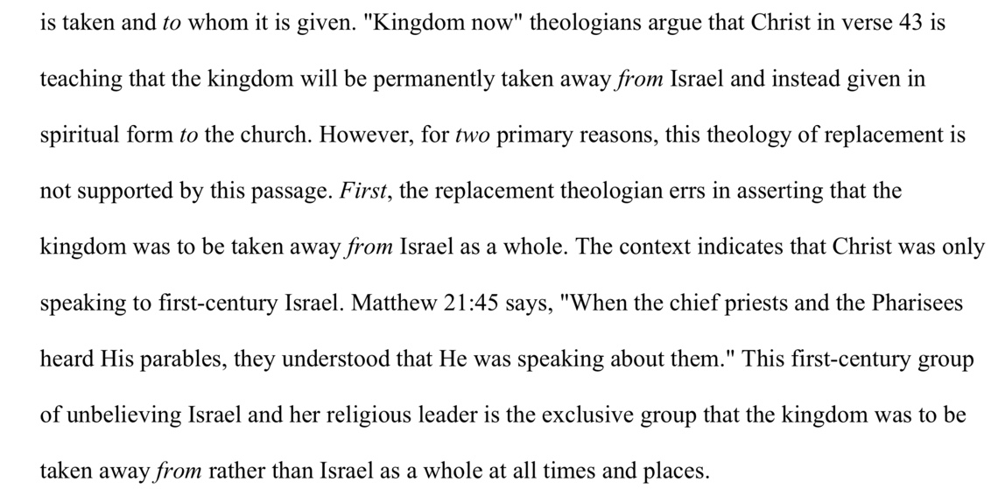

Slide 186
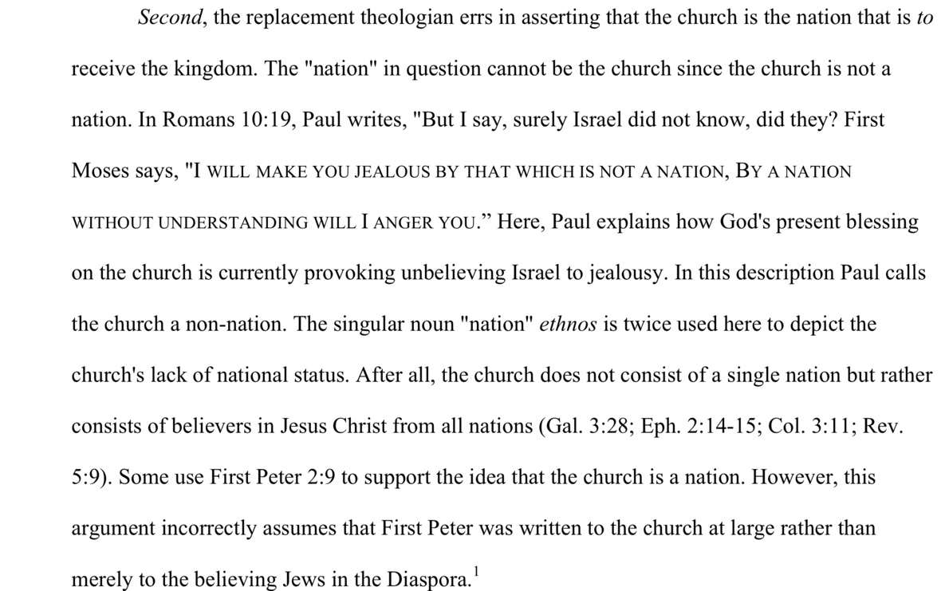

Slide 188
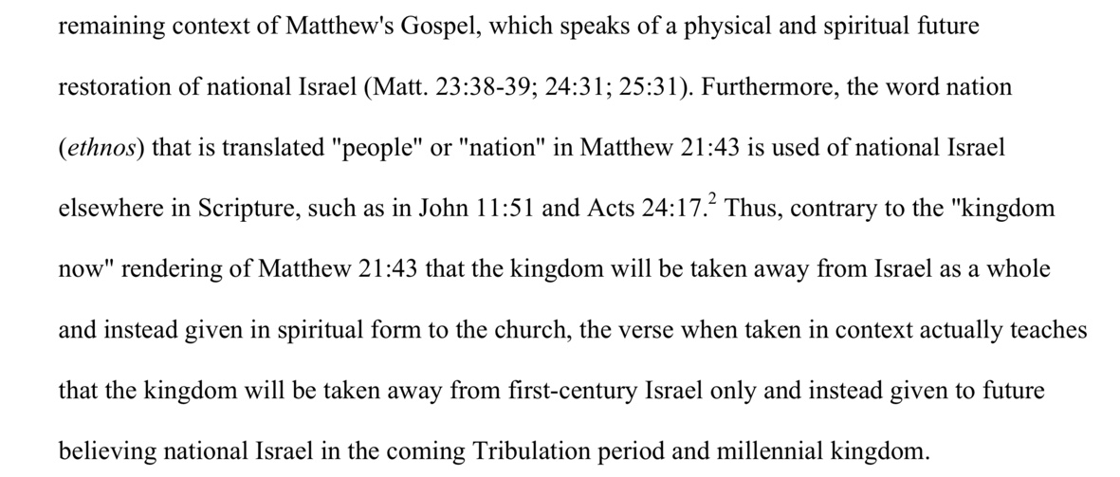

Slide 191
Has The Kingdom of God Been Transferred From Physical Jerusalem to Spiritually Within Believers?

Slide 193
John Piper

Slide 194
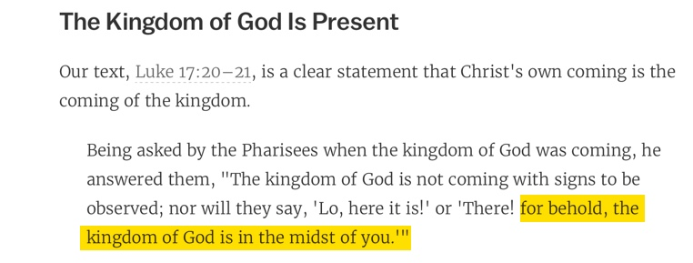
John Piper

Slide 195
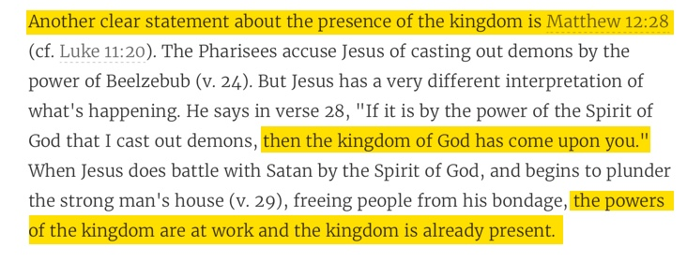
John Piper

Slide 198
Jesus is King of This World While Satan is the god of this World?

Slide 199
John Piper

Slide 200
Hamas in America: Part Six

Slide 201
BDS, Hamas, Christian Palestinianism, & Replacement Theology Denies Israel’s Divine & Legal Right to the Land

Slide 203
John Piper

Slide 204
The Lord’s Prayer:

Slide 206
The Anti-Zionism of John Piper

Slide 208
John Piper

Slide 209
PLO Map Does Not Include Existence For Israel

Slide 213
John Piper

Slide 214
John Piper

Slide 217
John Piper

Slide 218
John Piper

Slide 219
John Piper

Slide 220
John Piper

Slide 223
John Piper

Slide 226
Hamas in America: Part Seven

Slide 228
John Piper’s Twisting of Mathew 21:43

Slide 231
John Piper

Slide 232
John Piper

Slide 233
God Predicted The Return of Israel To The Land

Slide 238
John Piper Article:
Israel, Palestine & The Middle East

Slide 239
For the second time in his article Piper only quotes verse 28 and not verse 29-31

Slide 241
John Piper Article:
Israel, Palestine & The Middle East

Slide 242
John Piper Article:
Israel, Palestine & The Middle East

Slide 246
John Piper Article:
Israel, Palestine & The Middle East

Slide 255
Galatians 3:29:
Does Not Support Replacement Theology

Slide 257
Mosaic Covenant Versus Abrahamic Covenant

Slide 261
What is Christian Palestinianism?

Slide 262
The Six Dangers of Christian Palestinianism by Olivier Melnick

Slide 263
The Six Dangers of Christian Palestinianism by Olivier Melnick
1. A Distortion of God’s Word 2. A Rejection of God’s Word
3. A One-Sided Reconciliation
4. God the Covenant Breaker
5. A Demonization of Israel
6. A Promotion of Islam

Slide 275
What is a Zionist?
Zion in Hebrew is a Reference to Jerusalem or the City of David
Dr. Tommy Ice Defines Zionism:
“Zionism encompasses anyone, for any reason desiring to see the nation of Israel continue as Jewish state and prosper.”

Slide 276
What is a Christian Zionist?
Dr. Tommy Ice in His Book The Case for Zionism Writes:
Christian Zionists generally believe Israel’s return to their Promise Land is fulfilling dozens of Bible prophecies from the Old Testament. They believe this is an indication that God is setting the stage for the events that will take place during the future seven-year period commonly called the Tribulation. For that time period to take place, Israel must be a nation again and in control of Jerusalem. Since 1967 this has been the case concerning the modern state of Israel.

Slide 277
Paul Wilkinson Defines Christian Zionism as Follows:
1. A clear, biblical distinction between Israel and the Church
2. The any moment, pre-Tribulation Rapture of the Church.
3. The return of the Jews to the land.
4. The rebuilding of the Temple.
5.The rise of the Anti-christ.

Slide 278
Paul Wilkinson Defines Christian Zionism as Follows:
6. A seven-year period known as the Great Tribulation.
7. The national salvation of the Jews.
8. The return of Christ to Jerusalem.
9.The thousand-year reign of Christ on earth.

Slide 279
Christian Palestinianism is:
Anti-Zionism Pro-Islam Anti-Americanism

Slide 282
Melanie Phillips in Londonistan Writes:
So when Arab Christians reinterpreted Scripture in order to delegitimize the Jews’ claim to the land of Israel, this kicked-started replacement theology, which roared back into the imaginations, sermons, and thinking of the Anglican Church.

Slide 283
Melanie Phillips in Londonistan Writes:
This revisionism held that Palestinian Arabs were the original possessors of the land of Israel. The Anglican bishop of Jerusalem, Riah Abu el-Assal, claimed of Palestinian Christians: “We are the true Israel…”

Slide 284
Hamas in America: Part Eight

Slide 285
Gary DeMar:
Where is this “super sign” found in the Bible? Not in the New Testament. There is not a single verse in the entire New Testament that says anything about Israel becoming a nation again. Nothing prophetic in the New Testament depends on Israel becoming a nation again. If Israel becoming a nation again is such “a significant sign,” then why doesn’t the New Testament specifically mention it?

Slide 286
Romans 11:1:
“I say then, God has not rejected His people, has He? May it never be!”

Slide 287
Romans 11:28-29:
“From the standpoint of the gospel they [Israel] are enemies for your sake, but from the standpoint of God’s choice they [Israel] are beloved for the sake of the fathers; for the gifts and the calling of God
are irrevocable.”

Slide 288
Gary DeMar on Joshua 21:43-45:
So the Lord gave Israel all the land which he had sworn to give to their fathers, and they possessed it and lived in it. And the Lord gave them rest on every side, according to all that He had sworn to their fathers, and no one of all their enemies stood before them; the Lord gave all their enemies into their hand. Not one of the good promises which the Lord had made to the house of Israel failed; all came to pass.

Slide 289
Joshua 11:23:
So Joshua took the whole land, according to all that the Lord had spoken to Moses, and Joshua gave it for an inheritance to Israel according to their divisions by their tribes. Thus the land had rest from war.

Slide 292
Donald Campbell:
Some theologians have insisted that the statement in Joshua 21:43 means that the land promise of the Abrahamic Covenant was fulfilled then. But this cannot be true because later the Bible gives additional predictions about Israel possessing the land after the time of Joshua (e.g., Amon 9:14-15).

Slide 293
Donald Campbell:
Joshua 21:43, therefore, refers to the extent of the land as outlined in Numbers 34, and not to the ultimate extent as it will be in the messianic kingdom (Gen. 15:18-21). Also though Israel possessed the land at this time it was later dispossessed, whereas the Abrahamic Covenant promised Israel that she would possess the land forever (Gen.17:8)

Slide 294
How The “Christian” Left & Right Converge with The Red-Green Axis To Persecute Those Standing With The People of Israel

Slide 295
How Neo-Calvinists & Neo-Evangelicals Converge with The Red-Green Axis:
1. Liberation Theology = Marxianity/Social Justice
2. Replacement Theology = Antisemitism 3. Dominion Theology = Theocracy
4. Interfaith Dialogue = Muslim Brotherhood/Gamaliel Network
5. Anti-zionist Hatred
6. Support of Illegal Immigration
7. Promotion of Social & Political Liberalism

Slide 296
Calvinism &
The Enemies of Israel

Slide 297
John Calvin:
But here he [the rabbi] not only betrays his ignorance, but his utter stupidity, since God so blinded the whole people that they were like restive dogs. I have had much conversation with many Jews: I have never seen either a drop of piety or a grain of truth or ingenuousness—nay,

Slide 298
John Calvin:
I have never found common sense in any Jew. But this fellow, who seems so sharp and ingenious, displays his own impudence to his great disgrace.

Slide 299
John Calvin Refers to the Jews as:
“profane unholy sacrilegious dogs”
“a barbarous nation”
“the people of Israel rejected by God”

Slide 300
John Calvin on Augustine:
Augustine is so wholly with me, that if I wished to write a confession of my faith, I could do so with all fullness and satisfaction to myself out of his writings.

Slide 301
Augustine, The City of God
God has shown the Church in her enemies the Jews the grace of his compassion since, as saith the apostle, "their offense is the salvation of the Gentiles."

Slide 302
Augustine:
The Jews are our attendant slaves, who carry, as it were, our satchels and bear the manuscripts while we study them. ... When we argue with the heathen we adduce the predictions found in the Bible written by the Jews.
“Augustine, Enarratio in Psalmum XL, 14; Patrologiae cursus completus, series latina, XXXVI, 463. Cited in J.E. Seaver, The Persecution of Jews in the Roman Empire, p. 51.”

Slide 303
Augustine:
"The true image of the Hebrew is Judas Iscariot, who sells the Lord for silver. The Jews can never understand the scriptures, and forever bear the guilt of the death
of Christ.”
Source: “Augustine, Tractatus adversus Iudaeos; Patrologiae cursus completus, series latina.

Slide 304
Andrew Robison:
Augustin of Hippo is “the unrivaled Patron Saint of Replacement Theology.”

Slide 305
February 27, 2008 Pope Benedict XVI
With today’s meeting I wish to conclude the presentation of the figure of St. Augustine. After having dwelt on his life, works, and some aspects of his thought, I would like today to return to his inner experience which made him one of Christian history’s greatest converts. Last year, during my Pilgrimage to Pavia to venerate the mortal remains of this Father of the Church,

Slide 306
February 27, 2008 Pope Benedict XVI
I particularly dedicated my reflection to this experience of his. By doing so I wished to express to him the homage of the entire Catholic Church, but also to manifest my personal devotion and gratitude in regard to a figure to whom I feel very linked for the role he has had in my life as a theologian, priest and pastor.

Slide 307
Paul R. Wilkinson:
When arguably the most influential Protestant Reformer [John Calvin] expresses his indebtedness to a man so venerated by the Roman Catholic pope, questions must raised concerning (1) Augustine’s theology (2) Calvin’s endorsement of Augustine’s theology, and (3) any endorsement by Calvin!

Slide 308
Of the Jews and Their Lies
By Martin Luther (1543)
First, their synagogues should be set on fire…Secondly, their homes should likewise be broken down and destroyed…Thirdly, they should be deprived of their prayer books and Talmud…

Slide 309
Of the Jews and Their Lies
By Martin Luther (1543)
Fourthly, their rabbis must be forbidden under threat of death to teach any more…Fifthly, passport and traveling privileges should be absolutely forbidden to the Jews…Sixthly, they ought to be stopped from usury…

Slide 310
Of the Jews and Their Lies
By Martin Luther (1543)
Seventhly, let the young and strong Jews and Jewesses be given the flail, the ax, the hoe, the spade, the distaff, and spindle, and let them earn their bread by the sweat of their noses…We ought to drive the rascally lazy bones out of our system…

Slide 311
Of the Jews and Their Lies
By Martin Luther (1543)
…Therefore away with them…to sum up, dear princes and Nobels who have Jews in your domains, if this advice of mine does not suit you, then find a better one so that you and we may all be free of this insufferable devilish burden—

Slide 312
Dr. Andy Woods Ever Reforming
In that same year, Luther also wrote a pamphlet called Of the Unknowable Name and the Generations of the Messiah. In it, he calls the Jews “little devils.” Then in 1546, he preached his final four sermons in Eisleben, calling the Jews the enemies of Christianity, and calling for them to be kicked out of the country.

Slide 313
Olivier Melnick:
In 1543, when the Jewish community didn’t meet his expectations, Luther published the book Of the Jews and Their Lies, where his description of the Jewish people is so venomous that Hitler was quoted saying that he was just finishing up what Luther started…As a matter of fact, many scholars and historians believe that Luther’s view of the Jews had a profound effect

Slide 314
Olivier Melnick:
on Germans for centuries to come and also had a serious influence on Hitler’s ideology and implementing the final solution to the Jewish question. The connection between Luther and Hitler is not difficult to make.

Slide 315
Dr. Tommy Ice:
…Hitler was not alone in his irrational desire to murder Jews, it was embedded in the German, Austrian, and Eastern European nations. The original source for such anti-Semitism goes back to the common experience of all of Europe’s medieval Roman Catholic Jew-hatred. Most of the people throughout Europe did not have to be taught by Hitler or the Nazis to hate the Jews,

Slide 316
Dr. Tommy Ice:
it was endemic in their culture for hundreds of years. When the Nazis crystalized their anti-Semitism into murdering the Jews as a virtue, they already had a willing mass of people ready to join their crusade. After all, Hitler quoted the founder of the Reformation three times in Mein Kampf and called Martin Luther one of the greatest

Slide 317
Dr. Tommy Ice:
Christians in all of history. It is not surprising (for the most part) the German clergy were great Hitler enthusiasts since almost all of them were liberal and held to replacement theology.

Slide 318
The Lutheran World Federation 1984:
We Lutherans take our name and much of our understanding of Christianity from Martin Luther. But we cannot accept or condone the violent verbal attacks that the Reformer made against the Jews…The sins of Luther’s anti-Jewish remarks, the violence of his attacks on the Jews, must be acknowledged with

Slide 319
The Lutheran World Federation 1984:
deep distress. And all occasions for similar sin in the present or the future must be removed from our churches…Lutherans of today refuse to be bound by all of Luther’s utterances on the Jews.

Slide 320
Martin Luther Preface to the New Testament, 1522
I miss more than one thing in this book, and this makes me hold it to be neither apostolic nor prophetic…I think of it almost as I do of the Fourth Book of Esdras, and can in no way detect that the Holy Spirit produced it…It is just the same as if we did not have it, and there are many far better books for us to keep…

Slide 321
Martin Luther Preface to the New Testament, 1522
Finally, let everyone think of it as his own spirit give him to. My spirit cannot fit itself into this book. There is one sufficient reason for me not to think highly of it—Christ is not taught or known in it; but to teach Christ is the thing which an apostle is bound, above all else, to do, as He says in Acts 1, “Ye shall be my witnesses,” Therefore, I stick to the books which give me Christ, clearly and purely.

Slide 322
Dr. Andy Woods:
Apparently, Luther rejected the book of Revelation as being the product of Divine inspiration…In fact, in 1545, Luther printed the book of Revelation, along with Hebrews, James, and Jude, as an appendix to the New Testament.

Slide 323
Paul R. Wilkinson
Israel Betrayed: The Rise of Christian Palestinianism
The Christian Palestinianist campaign to theologically destroy Israel, underpinned as it is by Augustinian allegorist and Calvinistic amillennialism, is a clear symptom of the end-times apostasy within the church—and a clear signpost to the second coming of Jesus Christ.

Slide 324
Hamas in America: Lesson Nine

Slide 326
John Calvin on Augustine:
Augustine is so wholly with me, that if I wished to write a confession of my faith, I could do so with all fullness and satisfaction to myself out of his writings.

Slide 327
Augustine, The City of God
God has shown the Church in her enemies the Jews the grace of his compassion since, as saith the apostle, "their offense is the salvation of the Gentiles."

Slide 328
Augustine:
The Jews are our attendant slaves, who carry, as it were, our satchels and bear the manuscripts while we study them. ... When we argue with the heathen we adduce the predictions found in the Bible written by the Jews.
“Augustine, Enarratio in Psalmum XL, 14; Patrologiae cursus completus, series latina, XXXVI, 463. Cited in J.E. Seaver, The Persecution of Jews in the Roman Empire, p. 51.”

Slide 329
Augustine:
"The true image of the Hebrew is Judas Iscariot, who sells the Lord for silver. The Jews can never understand the scriptures, and forever bear the guilt of the death
of Christ.”
Source: “Augustine, Tractatus adversus Iudaeos; Patrologiae cursus completus, series latina.

Slide 330
Andrew Robison:
Augustin of Hippo is “the unrivaled Patron Saint of Replacement Theology.”

Slide 336
Paul R. Wilkinson:
When arguably the most influential Protestant Reformer [John Calvin] expresses his indebtedness to a man so venerated by the Roman Catholic pope, questions must raised concerning (1) Augustine’s theology (2) Calvin’s endorsement of Augustine’s theology, and (3) any endorsement by Calvin!

Slide 337
Dave Hunt
What Love is This?
And here we confront another odd contradiction…that those of the so-called Reformed position (in general) who put such emphasis upon foreknowledge and predestination have, following Augustine’s lead yet further, rejected the premillennial rapture of the church, the literal thousand year-year reign of Christ David’s throne,

Slide 338
Dave Hunt
What Love is This?
and the literal fulfillment of all of God’s promises to His chosen people, Israel, along with so much else that is clearly prophesied for the future. Instead, like Augustine, to their own harm they allegorize and spiritualize away this massive and vital portion of God’s revealed foreknowledge—the very prophecies about Israel that constitute the major proofs God has provided for His existence and that the Bible is His word.

Slide 339
How John Calvin’s Calvinism Helps Satan:
1. It is a false gospel (perseverance)
2. Distorts the purpose of the church (dominionism)
3. Promotes anti-semitism (replacement theology)
4. Sets up persecution of real Christians & the Jews

Slide 340
Replacement Theology & Anti-Semitism within Christianity Prepared the Way For Hitler & it is Now Preparing the Way for Antichrist

Slide 341
Satan tried to stop Jesus from being our sacrificial Lamb & is now trying to stop Jesus from being our victorious King

Slide 342
How Hamas, Neo-Evangelicals, Neo-Calvinists, & Fabian Socialists Are Waging War on America & American Zionists

Slide 343
Article By Tommy Ice
On CATC 2016 Speakers:

Slide 344
Mahmoud Abbas President of The PLO and PA
Wrote his doctoral thesis in 1984 on “The Connection Between the Nazis and the Leaders of the Zionist Movement.”

Slide 346
Alan Hart, Article at alanhart.net The New Nazis,
January 13, 2009:
Knowing the documented truth about the creation of Israel by Zionist terrorism and ethnic cleaning, and watching (mainly thanks to Al Jazeera and PressTV live feeds) the war on Gaza, Israel’s latest display of state terrorism, I have come to a conclusion.

Slide 347
Alan Hart, Article at alanhart.net The New Nazis,
January 13, 2009:
It’s time to give Israel’s hardcore Zionists their real name. They are the New Nazis. Europeans and Americans could have stopped the original Nazis and prevented the extermination of six million jews. If Europeans and Americans don’t stop the New Nazis, it’s likely that their end game will be the extermination of millions of Palestinians.

Slide 350
In March of 2011, The Edinburgh University Student’s Association called for a boycott of Israel as part of the BDS movement.
Denis MacEoin, of the Gatestone Institute and an expert on Arabic and Islam responded:

Slide 351
I am shocked and disheartened by the EUSA motion and vote. I am shocked for a simple reason: there is not and has never been a system of apartheid in Israel. That is not my opinion, that is fact that can be tested against reality by any Edinburgh student, should he or she choose to visit Israel to see for themselves.

Slide 352
Let me spell this out, since I have the impression that those members of EUSA who voted for this motion are…in all likelihood, the victims of extremely biased propaganda coming from the anti-Israel lobby. Being anti-Israel is not objectionable. But I’m not talking about ordinary criticism of Israel. I’m speaking of a hatred that permits itself no boundaries in the lies and myths it pours out.

Slide 353
Thus, Israel is repeatedly referred to as a “Nazi” state. In what sense is this true, even as a metaphor? Where are the Israeli concentration camps? The Einzatsgruppen? The SS? The Nuremberg Laws? The Final Solution? None of these things nor anything remotely resembling them exists in Israel, precisely because the Jews more than anyone on earth, understand what Nazism stood for.

Slide 354
It is claimed that there has been an Israeli Holocaust in Gaza (or elsewhere). Where? When? No honest historian would treat that claim with anything but the contempt it deserves. But calling the Jews “Nazis” and saying they have committed a holocaust is as basic a way to subvert historical facts as anything I can think of.

Slide 355
On January 22, 2015, a New York City Council was about to vote on a resolution to commemorate the 70th anniversary of the liberation of Auschwitz.
Demonstrators were upset that some of the council members were about to embark on a trip to Israel.

Slide 356
City Councilman David Greenfield, Grandson of Holocaust Survivors, Responded When Anti-Israel Protestors Unraveled a PLO Flag:
I have to tell you…I’m still shaken to my core, I’m upset, I’m angry, but I’ll tell you honestly, I’m actually somewhat pleased at what we saw here today. If you’re wondering why I’m saying that, it’s because for the last few weeks we’ve heard from people who’ve said, “Oh we don’t dislike Jews, we only dislike the State of Israel…” But we know that’s

Slide 357
City Councilman David Greenfield, Grandson of Holocaust Survivors:
not really at the core of what they were saying, and today they proved it. While we were discussing a resolution regarding the murder of 1.1 million human beings—I will point out that 90 percent of whom were Jewish, but the other 10 percent were political dissidents…While we were discussing that tehy had the nerve, the chutzpah, the temerity to unfurl a Palestinian flag and to yell at us…And so the reason I’m pleased is because we can stop pretending that this is about Israel,

Slide 358
City Councilman David Greenfield, Grandson of Holocaust Survivors:
when the reality is that every Middle Eastern country that is in existence today is not democratic, and persecutes people of other faiths, and persecutes gays, and persecutes people who disagree with them, and persecutes people on Twitter, and persecutes women who drive, except for one country, which is the State of Israel. And so what you saw here today was naked, blind anti-Semitism,

Slide 359
City Councilman David Greenfield, Grandson of Holocaust Survivors:
that’s what you saw, that’s what you watched, and that’s what you witnessed—people who are upset for one reason. Do you want to know why they’re angry; do you want to know why they’re unfurling that flag today? Because Hitler did not finish the job, he only wiped out half of my family, and only by the grace of God is the other half, me, the grandchild, still alive today, that’s why those people are upset. Shame on them, shame on them for hating Jews,

Slide 360
City Councilman David Greenfield, Grandson of Holocaust Survivors:
shame on them for hating people…I am embarrassed at what happened here today, but I am pleased that we finally see what the its all about: good old-fashioned anti-Semitism.

Slide 361
Paul Wilkinson Reports:
The opening address [of CATCP 2012] was given by Dr. Salam Fayyad, then Prime Minister of the Palestinian Authority and one-time minister of finance during Arafat’s chairmanship.

Slide 362
Christ at The Checkpoint, March 2016 Theme:
“The Gospel in the Face of Religious Extremism”

Slide 363
Paul R. Wilkinson
Attended The 2016 Christ at The Checkpoint Conference & Reported in His Book Israel Betrayed: The Rise of Christian Palestinianism
Chawkat Moucarry, director of interfaith relations with World Vision International…Blindly asserted that mercy and forgiveness are central themes in Islam. Moucarry suggested that Islamic teaching can be summed up in the words of Surah al-Fatiha (The Opening), which begins the Qur’an:

Slide 364
In the Name of God [Allah], The Ever-Merciful,
The All-Merciful
Praise be to God [Allah], The Lord of the Worlds
The Ever-Merciful, The All-Merciful.

Slide 365
Moucarry then asked the predominantly evangelical audience, “Do you have anything in this prayer which you could not accept? If you had found it in the Psalms would you have been shocked?”

Slide 366
Hank Hanegraaff A Gospel Response to Zionism
Speech at Christ At The Checkpoint, March 2016
Ironically, perhaps, three years to the day that Bonhoeffer was martyred in the struggle against anti-semitism, another Semitic horror unfolded on the outskirts of Jerusalem at Deir Yassin…Before the day had ended, more than a hundred Arabs, mostly non-combatants, were murdered. And that was only the beginning. By 1948, Zionist murder, terrorism and ethnic cleansing drove upward of 750,000 Palestinians from their land and from their home, and that has produced today the largest displaced group in the world.

Slide 367
Hamas in America: Lesson Ten
Hamasianity: How So-Called Evangelicals Are Helping Hamas Sabotage America

Slide 368
How Neo-Calvinists & Neo-Evangelicals Converge with The Red-Green Axis:
1. Liberation Theology = Marxianity/Social Justice
2. Replacement Theology = Antisemitism 3. Dominion Theology = Theocracy
4. Interfaith Dialogue = Muslim Brotherhood/Gamaliel Network
5. Anti-zionist Hatred
6. Support of Illegal Immigration
7. Promotion of Social & Political Liberalism

Slide 369
Christian Palestinianism = Hamasianty =
Helping Hamas by:
1. Making enemies of the Jews
2. Making enemies of righteous Gentiles
3. Stopping Christians from speaking up for the Jews
4. Giving validity to Hamas
5. Opening the door to interfaith dialogue
6. Helping build a false religious system that persecutes righteous gentiles and Jews
7. Convincing more Americans to vote for Islamic candidates that will lead to Sharia in America & America turning against Israel
(List Compiled by Brannon S. Howse)

Slide 370
The Word of Faith teaches believers have replaced the Jews & promise blessings by name it and claim it.
The Bible teaches believers will protect the Jews & promises blessings by defending them & understand it.
Genesis 12:3 Revelation 1:3
Mathew 25:31-46

Slide 374
Paul Wilkinson The Rise of Christian Palestinianism
In August 2016, World Vision, which has been in Israel and the Gaza Strip since 1975, hit the headlines when it was revealed that Mohammed el-Halabi, the Palestinian director of its Gaza branch, had been diverting 60 percent of the organization’s annual budget to Hamas. El-Halabi, an active member of Hamas’ military wing, had managed to funnel over $7,000,000 into the coffers of the Palestinian terrorists organization over a ten-year period.

Slide 375
Paul Wilkinson The Rise of Christian Palestinianism
According to Luke Mood, deputy director of the Philos Project, “World Vision’s failure to identify this corruption stems from three sources. Willingness to overlook terrorist atrocities, institutional antagonism toward Israel, and hostility towards Christian Zionism.

Slide 376
Paul Wilkinson Reports that Tony Campolo Spoke at the 2012 CATC:
In his Checkpoint address, among others Campolo named Ignatius of Loyola, and Erich Fromm as inspirational figures in his life.

Slide 377
Paul Wilkinson Reports that Other Speakers at CATC 2016 Included:
Mark Labberton, President of Fuller Theological Seminary in Pasadena, California
Rick Love, President of the Colorado-based Peace Catalyst International

Slide 390
Article From Website of Matt Chandler’s Village Church

Slide 397
Paul Wilkinson Reports that Other Speakers at CATC 2016 Included:
Mark Labberton, President of Fuller Theological Seminary in Pasadena, California
Rick Love, President of the Colorado-based Peace Catalyst International

Slide 398
Article on Village Church Website

Slide 410
Hamas in America: Lesson Eleven
Hamasianity: How So-Called Evangelicals Are Helping Hamas Sabotage America

Slide 411
How Neo-Calvinists & Neo-Evangelicals Converge with The Red-Green Axis:
1. Liberation Theology = Marxianity/Social Justice
2. Replacement Theology = Antisemitism 3. Dominion Theology = Theocracy
4. Interfaith Dialogue = Muslim Brotherhood/Gamaliel Network
5. Anti-zionist Hatred
6. Support of Illegal Immigration
7. Promotion of Social & Political Liberalism

Slide 412
James White & Yasir Qadhi

Slide 413
How Neo-Calvinists & Neo-Evangelicals Converge with The Red-Green Axis:
1. Liberation Theology = Marxianity/Social Justice
2. Replacement Theology = Antisemitism 3. Dominion Theology = Theocracy
4. Interfaith Dialogue = Muslim Brotherhood/Gamaliel Network
5. Anti-zionist Hatred
6. Support of Illegal Immigration
7. Promotion of Social & Political Liberalism

Slide 427
How Neo-Calvinists & Neo-Evangelicals Converge with The Red-Green Axis:
1. Liberation Theology = Marxianity/Social Justice
2. Replacement Theology = Antisemitism 3. Dominion Theology = Theocracy
4. Interfaith Dialogue = Muslim Brotherhood/Gamaliel Network
5. Anti-zionist Hatred
6. Support of Illegal Immigration
7. Promotion of Social & Political Liberalism

Slide 428
The Lies of Hamas, Muslim Brotherhood, CAIR, Anti-Semitism & Christian Palestinianism

Slide 429
Lie #1:
Israel is a Racist, Apartheid State

Slide 430
From Ozarks 2019 Worldview Weekend Presentation by Olivier Melnick

Slide 433
Rudy Boschwitz

Slide 458
Hamas in America: Lesson Twelve
Hamasianity: How So-Called Evangelicals Are Helping Hamas Sabotage America

Slide 459
Lie #2:
Israel is a Terrorist State

Slide 461
Securefreedom.org

