Slide 1
John MacArthur p. 6.

Slide 2
John MacArthur p. 7

Slide 3
John MacAthur p. 12

Slide 4
John MacArthur p. 5

Slide 5
John MacArthur p. 7

Slide 6
John MacArthur p. 21.

Slide 7
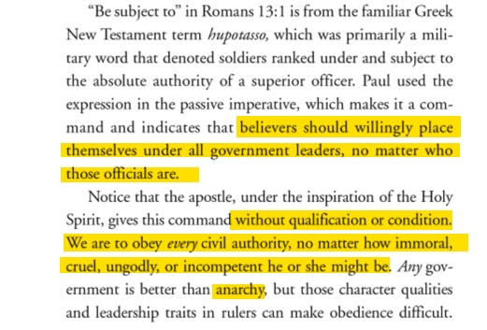
John MacArthur p. 21

Slide 8
John MacArthur p. 22

Slide 9
John MacArthur: Why Government Can’t Save You P. 27
Regardless of the numerous immoral, unjust, and ungodly failures of secular government, believers are to pray and seek to influence the world for Christ by godly, selfless, and peaceful living under that authority, not by protests against the government or by acts of civil disobedience.

Slide 10
John MacArthur: Why Government Can’t Save You P. 27
In what ever form it exists, government and its authority derive directly from God and exist to benefit human society. Like marriage, government is a universal institution that is valid regardless of place, circumstance, or other considerations.

Slide 11
John MacArthur p. 130.

Slide 13
Sponsored with Mark Dever’s Church

Slide 14
Living Out Survey Promoted by Mark Dever’s Church & Tim Keller

Slide 15
