Slide 1


Slide 2

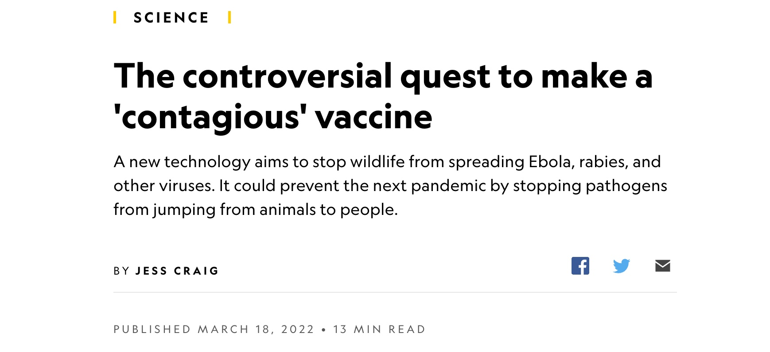

Slide 3


https://jhsphcenterforhealthsecurity.s3.amazonaws.com/181009-gcbr-tech-report.pdf

Slide 4


https://www.openphilanthropy.org/focus/global-catastrophic-risks/biosecurity/center-health-security-biosecurity-health-security-gcrs-2019

Slide 5
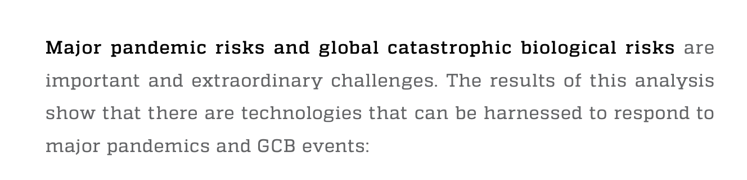
https://jhsphcenterforhealthsecurity.s3.amazonaws.com/181009-gcbr-tech-report.pdf

Slide 6
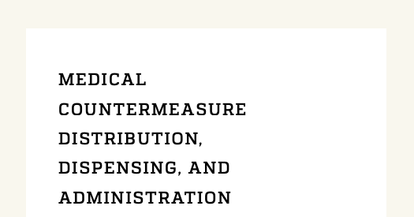
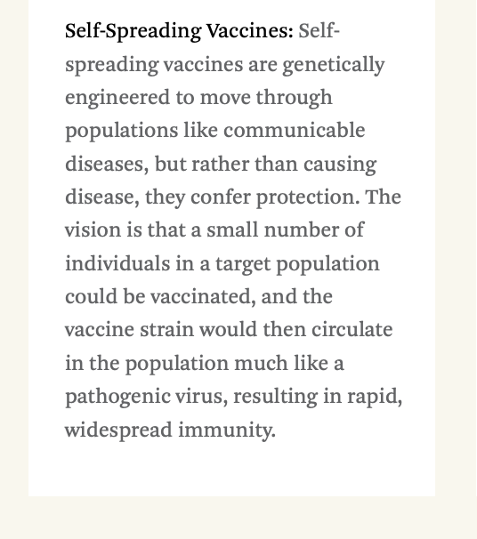
https://jhsphcenterforhealthsecurity.s3.amazonaws.com/181009-gcbr-tech-report.pdf

Slide 7

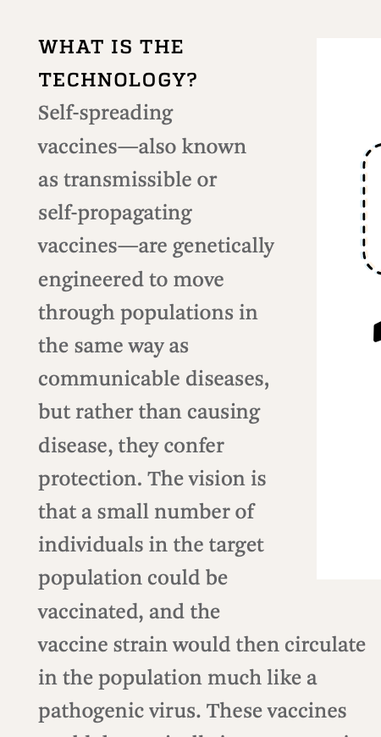

https://jhsphcenterforhealthsecurity.s3.amazonaws.com/181009-gcbr-tech-report.pdf

