Slide 1
On June 19th, 1962, the leader of the
Communist Party and U.S.S.R.,
Nikita Khrushchev, declared:
The United States will eventually
fly the Communist Red Flag…
the American people will hoist it themselves.

Slide 2
The Tavistock Institute:
Social Turbulence, Peer Pressure,
Manufactured Confusion, Herd Instinct,
& Change Agents

Slide 3
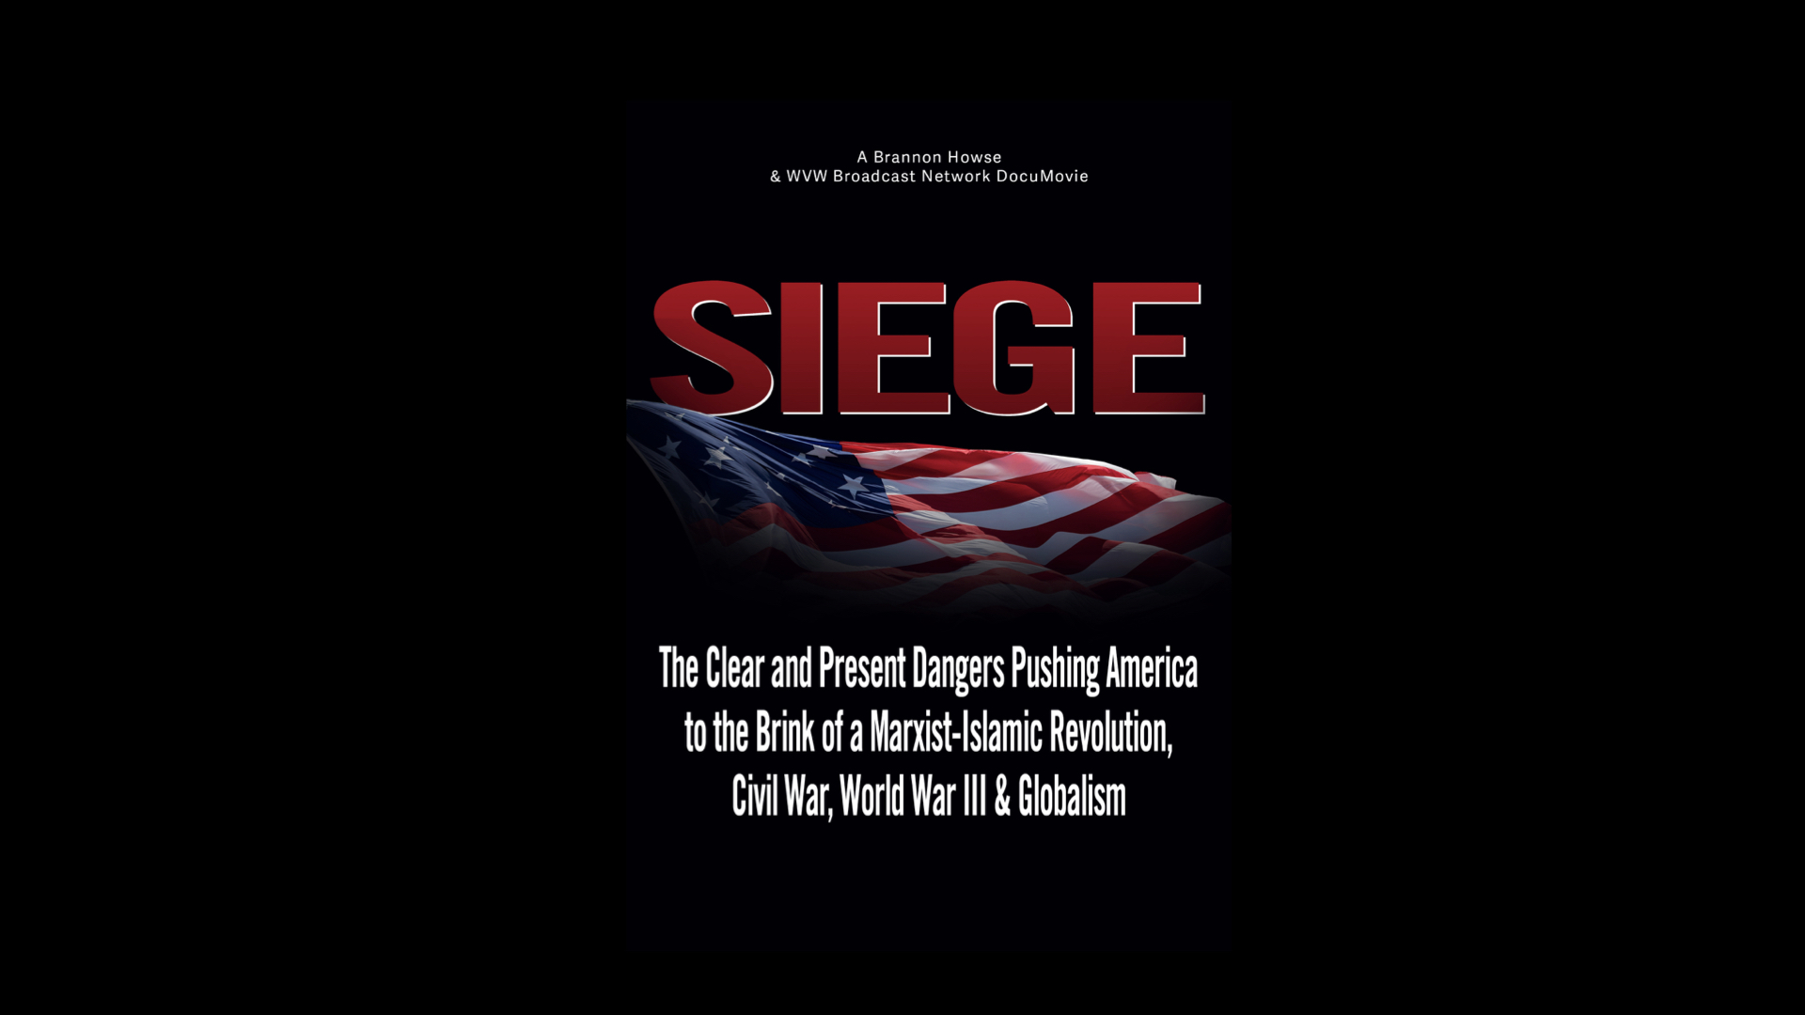

Slide 4
Before he died in 1924,
Lenin declared:
First, we will take eastern Europe, then the masses of Asia, then we will encircle the United States,
which will be the last bastion of capitalism.
We will not have to attack.
It will fall like an overripe fruit into our hands.

Slide 5
General George Stratemeyer, the Air Force commander in Korea,
testified before a Senate committee:
We were required to lose the Korean War.

Slide 6
John Stormer writes in
None Dare Call it Treason:
During the Korean War, the chain of command
from the United Nations Security Council
to General MacArthur,
was through the Under-Secretary
for Political and Security Council affairs,
Constantine Zinchenko, a Communist.

Slide 7
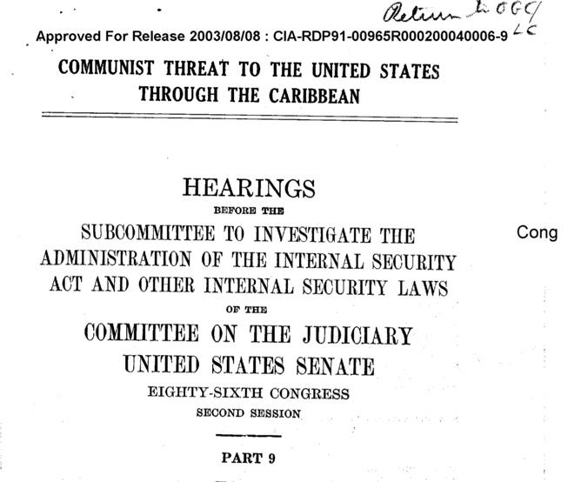

Slide 8
Bernie Reeves writes:
So what do we know 67 years later? For one thing,
that McCarthy actually underestimated the number of American Soviet spies working for the USSR in the FDR administration. It took a while, but in 1995 NSA and CIA released 190,000 formerly classified cablegrams they, and their predecessor agencies, intercepted from 1943 to 1980. The number of American Soviet agents identified from Venona has reached 500, more than double the 205 McCarthy predicted — as researchers have decrypted
only ten percent of the documents thus far.

Slide 9
Bernie Reeves writes:
Most of the spies named so far are well known:
Julius and Ethel Rosenberg and Alger Hiss, whom the left maintained were victims of American imperialism, are now proved guilty. Assistant U.S. Treasurer Harry Dexter White, now deceased, who became head of the World Bank; and Lauchlan Currie, highly placed in the President’s office; and hundreds more placed in every Cabinet level organization
in the U.S. government. Due to the left-leaning
U.S. media, Venona has been ignored.

Slide 10
Bernie Reeves writes:
Fortunately, journalist Stanton Evans wrote,
"Blacklisted By History," relying on newly declassified
FBI and CIA documents that reveal a sinister plot,
but not by McCarthy. The person harmed
by the so-called witch hunt was McCarthy himself.

Slide 11
John Stormer writes in
None Dare Call it Treason:
John Stewart Service, a career diplomat, was arrested
by the FBI on June 7th, 1945, for passing secret documents to Soviet espionage agents. He was deeply involved in the Communist-influenced web in the
State Department which lost China to Communism…
Alger Hiss had reached a high State Department
post and sat at FDR’s side.

Slide 12
John Stormer writes in
None Dare Call it Treason:
He was there at Yalta when decisions were made which ultimately committed 700-million human beings
to Communist enslavement…Harry Dexter White, John Abt, Nathan Witt, and other agents who reached top spots in at least six cabinet departments before,
during and after World War II were exposed…

Slide 13
John Stormer writes in
None Dare Call it Treason:
The web of subversion which reached into dozens
of executive agencies unraveled. The White House Staff itself had been infiltrated as Lauchlin Currie became executive assistant to President Roosevelt.

Slide 14
John Stormer writes in
None Dare Call it Treason:
Could the seemingly dramatic changes in the Society Union and the U.S. responses be setting the stage for a long planned Soviet move to either smash the U.S. or force America to capitulate to nuclear blackmail?
Dimitri Manuilsky gave the blue print to his students
at the Lenin School of Political Warfare in Moscow in 1930. One of the students, Zack Kornfeder, later broke
with the Communist Party and told the story in sworn testimony to a Congressional committee in 1951.

Slide 15
John Stormer writes in
None Dare Call it Treason:
He reported that Manuilsky, who served later
as Russia’s UN representative said:
War to the hilt between Communism and capitalism is inevitable. Today, of course, we are not strong enough to attack. Our time will come in 20 to 30 years. To win, we shall need the element of surprise. The bourgeoisie will have to be put to sleep. So we shall begin by launching the most spectacular peace movement on record.

Slide 16
John Stormer writes in
None Dare Call it Treason:
There will be electrifying overtures and unheard of concessions. The capitalist countries, stupid and decadent, will rejoice to cooperate in their own destruction.
They will leap at another chance to be friends.
As soon as their guard is down, we will smash them
with our clenched fist. By bourgeoisie, he meant that the American capitalist or property owners would have to be
put to sleep or distracted so as not to pay attention
to the clear and present dangers facing America.

Slide 17
John Stormer writes in
None Dare Call it Treason:
The rush to shore up Moscow’s collapsing economy
was not limited to the $8 billion in consumer goods
the Reds purchased. High technology items
essential to the Soviet military and
space programs were included.

Slide 18
In his book, Revolutionary Islam,
Carlos the Jackal declared:
Only a coalition of Marxists and Islamists
can destroy the US.

Slide 19
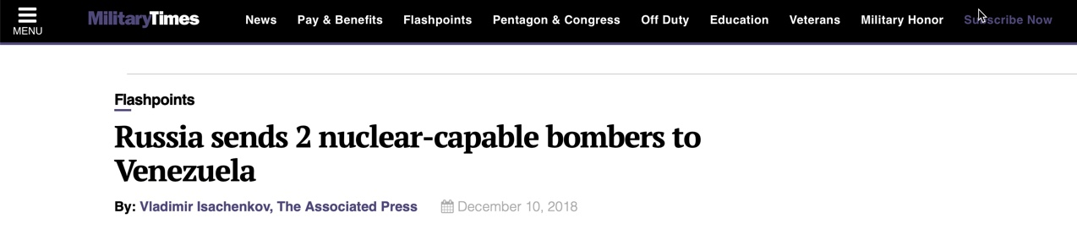

Slide 20
In 1982, Anatoliy Golitsyn wrote:
…Communist strategists are now poised to enter into the final, offensive phase of their long-range policy…
for the complete triumph of Communism…
the Communist strategists are equipped in pursing their policy, to engage in maneuvers and stratagems beyond the imagination of Marx or the practical reach
of Lenin and unthinkable to Stalin.

Slide 21
In his book, Through the Eyes of the Enemy,
Stanislav Lunev wrote:
What will be a great surprise to the American people
is that the GRU and KGB had a larger budget for anti-war propaganda in the United States than it did
for economic and military support for the Vietnamese.
The antiwar propaganda cost the GRU more than $1 billion, but as history shows, it was a hugely successful campaign and well worth the cost. The anti-war sentiment created an incredible momentum that greatly weakened the U.S. military.

Slide 22
Winston Churchill:
If you will not fight for the right when you can easily win without bloodshed, if you will not fight when your victory will be sure and not too costly, you may come to the moment when you will have to fight with all the odds against you and only a small chance of survival. There may even be a worse case: you may have to fight when there is no hope of victory, because it is better to perish than to live as slaves.

