Slide 1
The Cultural Marxist Plan to
Destroy the U.S. Military
& Recruit Social Justice Warriors

Slide 2

Published 1993

Slide 3
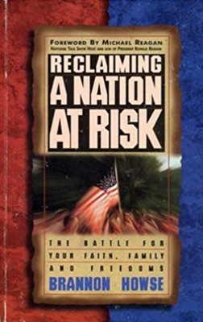
Published in 1995

Slide 4
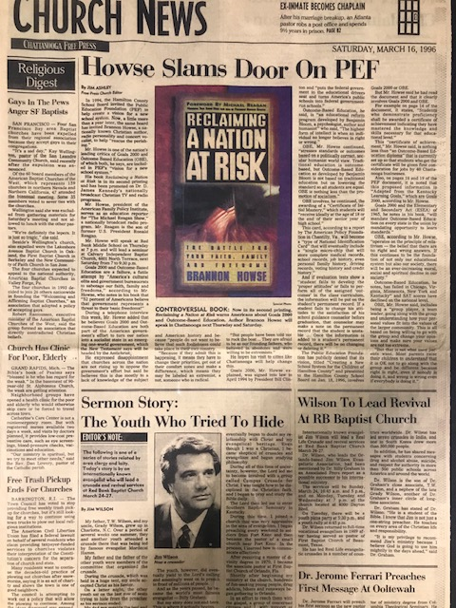
Chattanooga Free Press, March 16, 1996

Slide 5
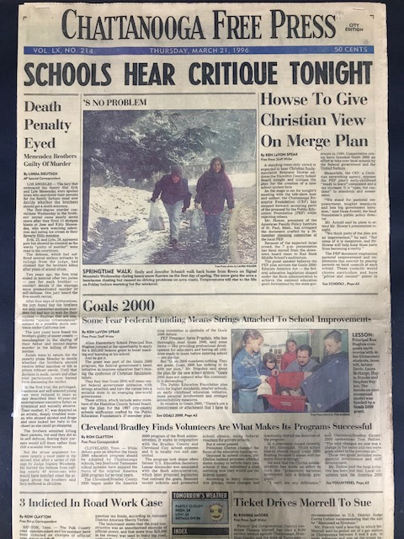
Chattanooga Free Press, March 21, 1996

Slide 6
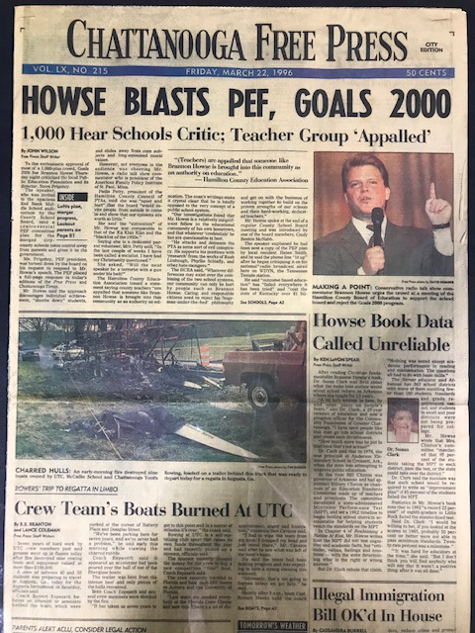
Chattanooga Free Press, March 22, 1996

Slide 7
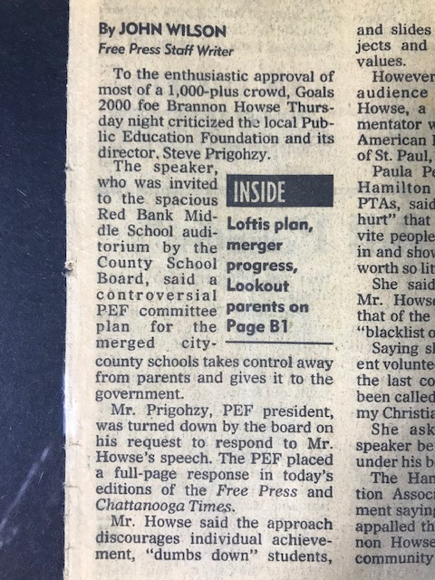
Chattanooga Free Press, March 22, 1996

Slide 8
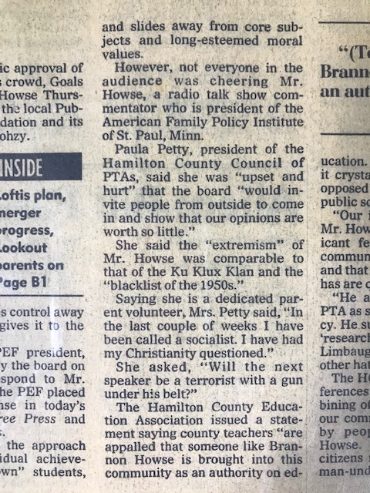
Chattanooga Free Press, March 22, 1996

Slide 9
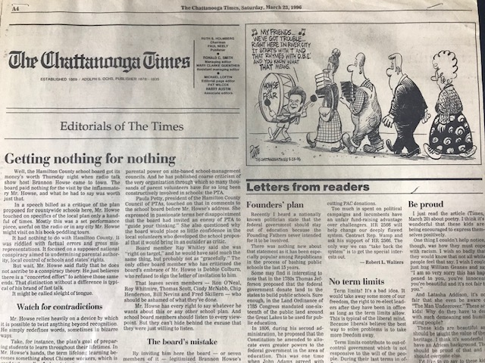
The Chattanooga Times, March 23, 1996

Slide 10
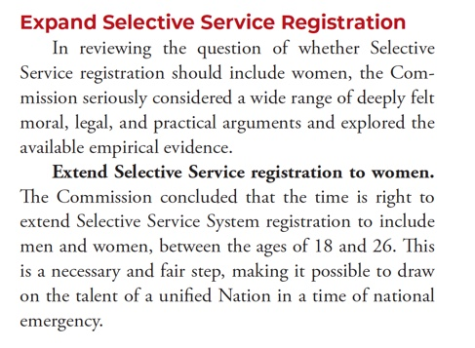

Slide 11
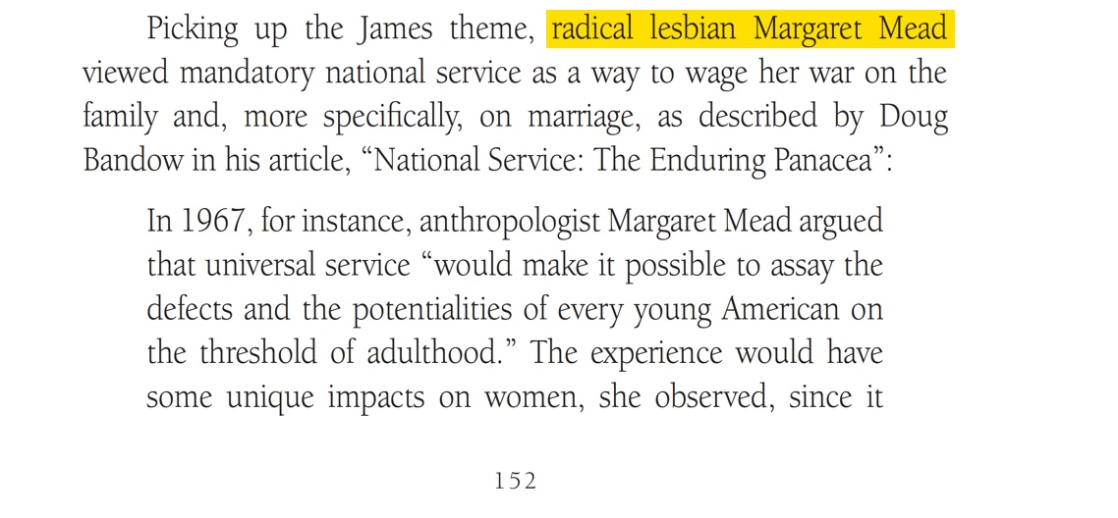
From Grave Influence by Brannon Howse

Slide 12
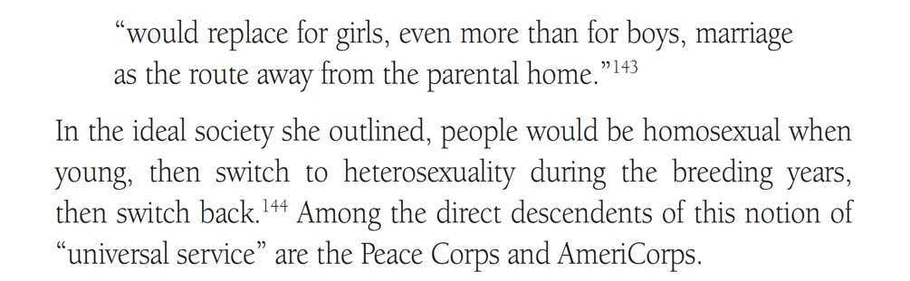
From Grave Influence by Brannon Howse

Slide 13


Slide 14
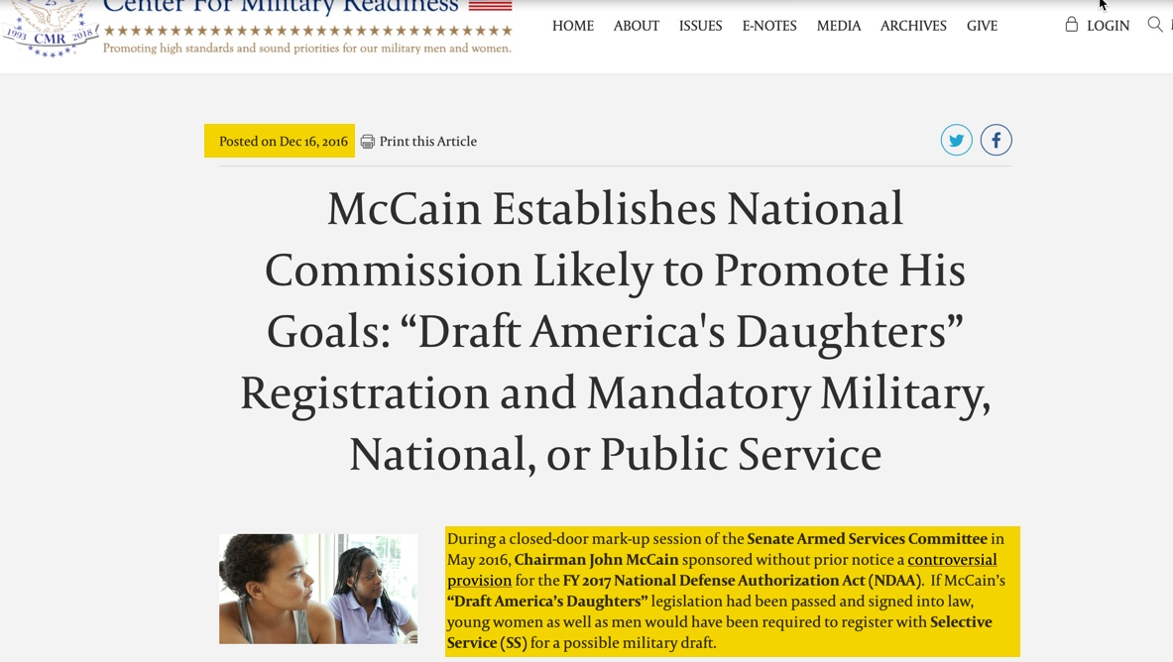

Slide 15
The GIVE Act passed into law as a voluntary program. However, Obama’s intentions were made clear before he was even elected as President of the United States. In 2008, the Obama-Biden campaign website declared:
Obama will call on citizens of all ages to serve America, by developing a plan to require
50 hours of community service in middle school and high school and 100 hours of community service in college every year.

Slide 16
The GIVE Act states:
They cannot engage in religious instruction, conducting worship services, providing instruction as part of a program that includes mandatory religious instruction or worship, constructing or operating facilities devoted to religious instruction or worship, maintaining facilities primarily or inherently devoted to religious instruction or worship or engage in any form of religious proselytization. (see 45 CFR § 2520.65):

Slide 17
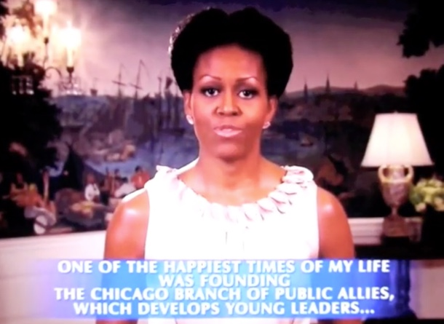

Slide 18
In 1992, Mr. Obama was a founding board member of Pubic Allies, and Michelle Obama became executive director of the Chicago chapter of Public Allies in 1993. Public Allies was nothing more than an organization that seeks to turn America’s youth into community organizers that follow the worldview of Saul Alinsky.

Slide 19
The September 4, 2008 issue of
Investor's Business Daily ,
"Michelle's Boot Camp for Radicals" Declared:
Big Brother had nothing on the Obamas. They plan to herd American youth into government-funded reeducation camps where they'll be brainwashed into thinking America is a racist, oppressive place in need of "social change."

Slide 20
The September 4, 2008 issue of
Investor's Business Daily ,
"Michelle's Boot Camp for Radicals" Declared:
But its [Public Allies] real mission is to radicalize American youth and use them to bring about "social change" through threats, pressure, tension and confrontation — the tactics used by the father of community organizing, Saul "The Red" Alinsky.

Slide 21
The September 4, 2008 issue of
Investor's Business Daily ,
"Michelle's Boot Camp for Radicals" Declared:
"Our alumni are more than twice as likely as 18-34 year olds to . . . engage in protest activities," Public Allies boasts in a document found with its tax filings. It has already deployed an army of 2,200 community organizers like Obama to agitate for "justice" and "equality" in his hometown of Chicago and other U.S. cities, including Cincinnati, Los Angeles, Milwaukee, New York, Phoenix, Pittsburgh and Washington.

Slide 22
The September 4, 2008 issue of
Investor's Business Daily ,
"Michelle's Boot Camp for Radicals" Declared:
I get to practice being an activist," and get paid for it, gushed Cincinnati recruit Amy Vincent.

Slide 23
The September 4, 2008 issue of
Investor's Business Daily ,
"Michelle's Boot Camp for Radicals" Declared:
When they're not protesting, they're staffing AIDS clinics, handing out condoms, bailing criminals out of jail and helping illegal aliens and the homeless obtain food stamps and other welfare.

Slide 24
The September 4, 2008 issue of
Investor's Business Daily ,
"Michelle's Boot Camp for Radicals" Declared:
Public Allies brags that more than 80% of graduates have continued working in nonprofit or government jobs. It's training the "next generation of nonprofit leaders"—future "social entrepreneurs.”

Slide 25
The September 4, 2008 issue of
Investor's Business Daily ,
"Michelle's Boot Camp for Radicals" Declared:
"It was too touchy-feely," said Nelly Nieblas, 29, of the 2005 Los Angeles class. "It's a lot of talk about race, a lot of talk about sexism, a lot of talk about homophobia, talk about -isms and phobias.”

Slide 26
The September 4, 2008 issue of
Investor's Business Daily ,
"Michelle's Boot Camp for Radicals" Declared:
Obama wants to fully fund it and expand it into a national program that some see costing $500 billion. "We've got to have a civilian national security force that's just as powerful, just as strong, just as well-funded" as the military, he said.

Slide 27
The September 4, 2008 issue of
Investor's Business Daily ,
"Michelle's Boot Camp for Radicals" Declared:
The gall of it: The Obamas want to create a boot camp for radicals who hate the military —and stick American taxpayers with the bill.

Slide 28

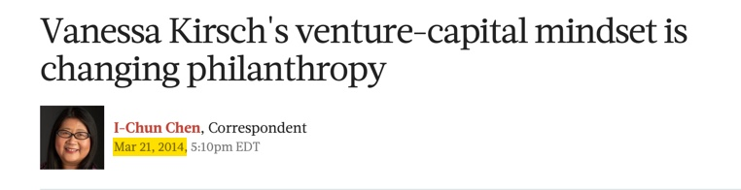
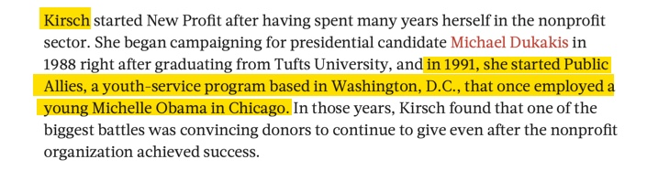
Article on Vanessa Kirsch

Slide 29
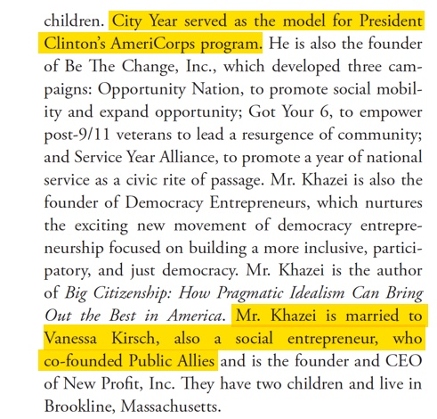
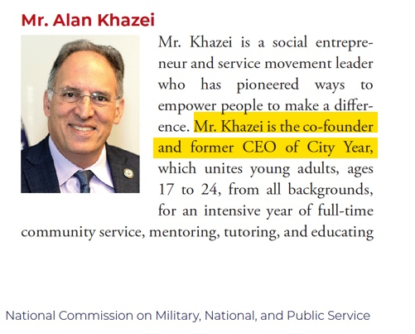

Slide 30

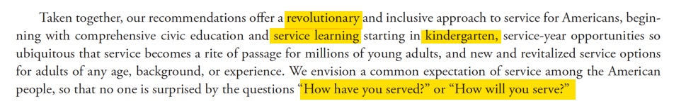

Slide 31

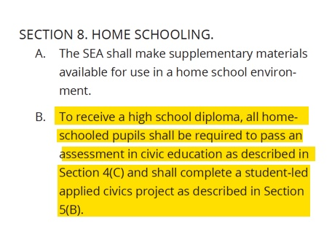

Slide 32
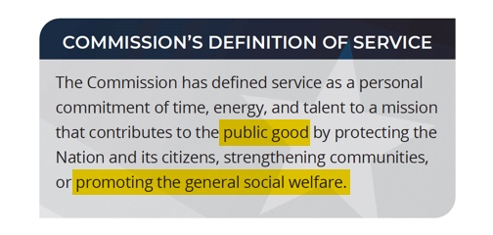

Slide 33
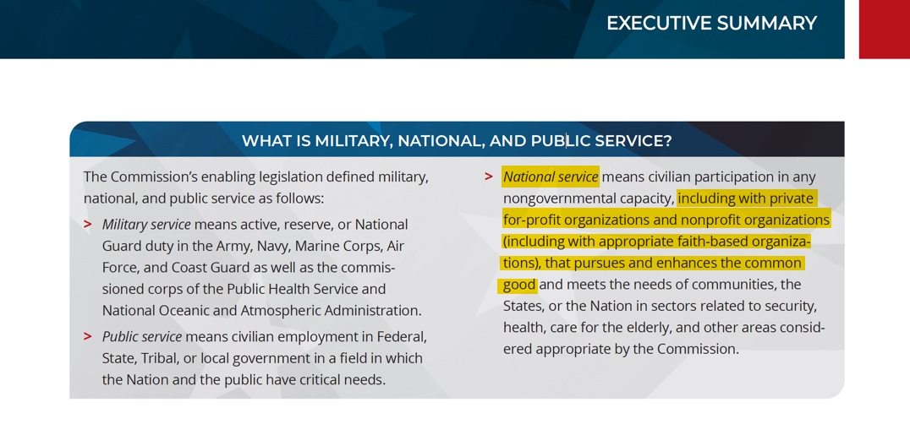

Slide 34
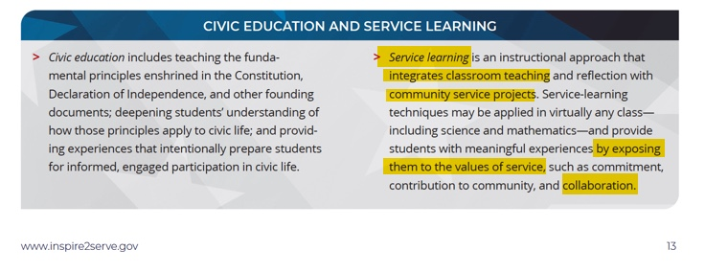

Slide 35
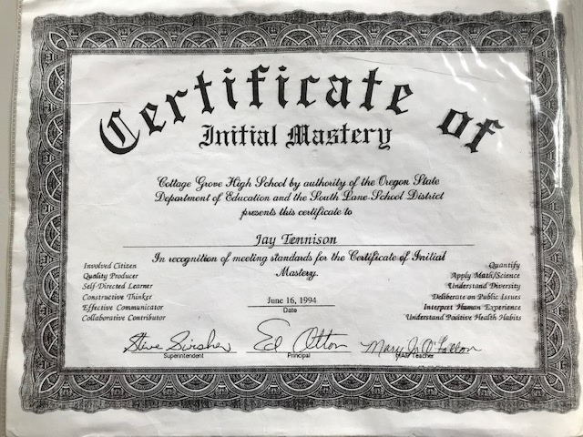
This Exhibit Traveled With Brannon Howse For Over 20 Years As He Presented it to Audiences He Spoke Before

Slide 38
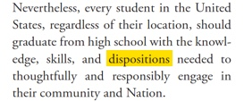

Slide 39
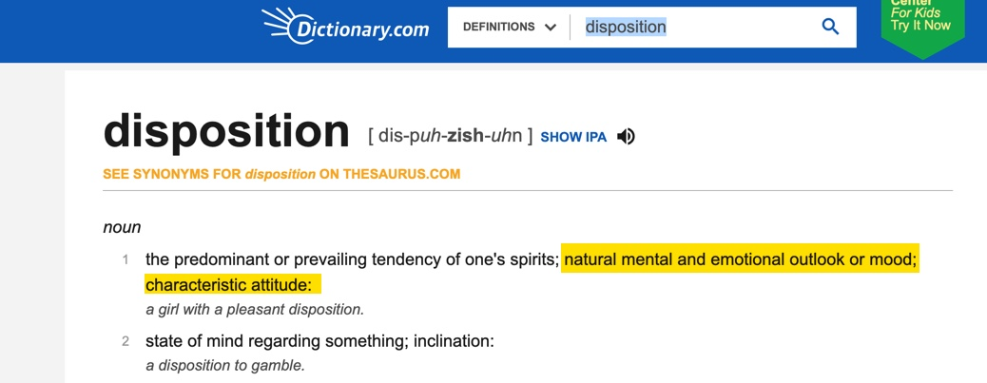

Slide 40
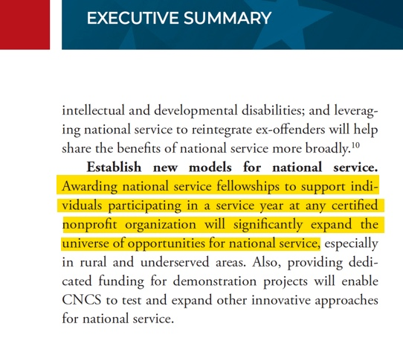

Slide 41
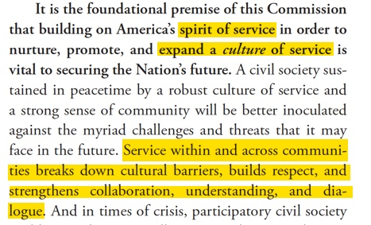

Slide 42
In New Worlds For Old
H.G. Wells Calls for
Wells argues for replacing a “social system, based on Private Ownership” with a system based on the
“spirit of service.” Wells calls for “a disconnected series of protests against the extreme theories of individualism and individualist political economy.”

Slide 43
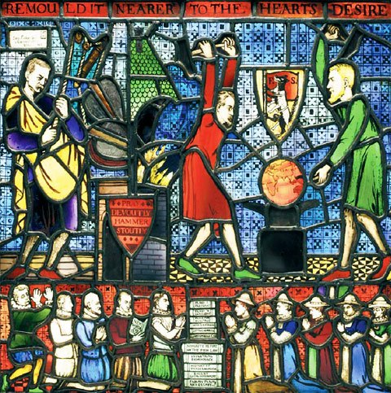

Slide 44
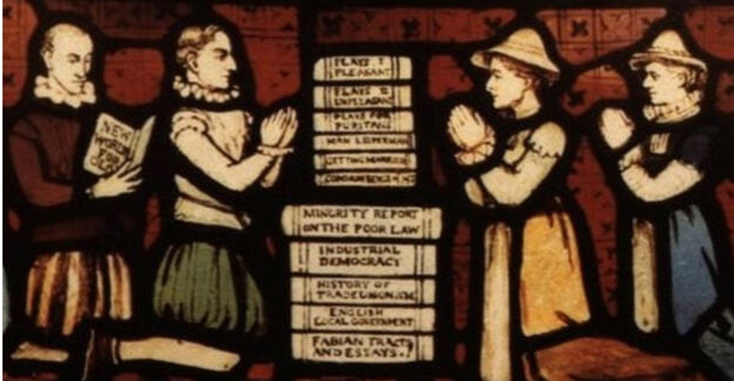

Slide 45


Slide 46
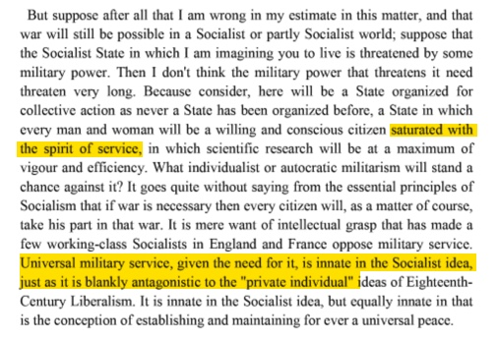

Slide 48
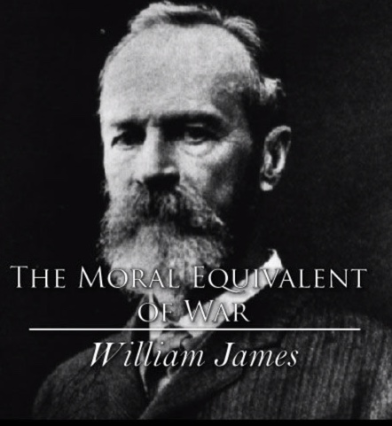
The Moral Equivalent of War was the name of an essay by William James that laid the groundwork for the insidious concept of organized national service.

Slide 49
William James:
We must make new energies and hardihoods continue the manliness to which the military mind so faithfully clings. Martial virtues must be the enduring cement; intrepidity, contempt of softness, surrender of private interest, obedience to command, must still remain the rock upon which states are built…

Slide 50
William James:
If now—and this is my idea—there were, instead of military conscription, a conscription of the whole youthful population to form for a certain number of years a part of the army enlisted against Nature…

Slide 51
William James:
…to dishwashing, clothes washing, and window-washing, to road-building and tunnel-making, to foundries and stoke-holes, and to the frames of skyscrapers, would our gilded youths be drafted off, according to their choice, to get the childishness knocked out of them, and to come back into society with healthier sympathies and soberer ideas.

Slide 52
William James:
We should be owned, as soldiers are by the army, and our pride would rise accordingly. We could be poor, then, without humiliation, as army officers now are.

Slide 53
William James:
The only thing needed henceforward is to inflame the civic temper as past history has inflamed the military temper. H. G. Wells, as usual, sees the centre of the situation. "In many ways," he says, "military organization is the most peaceful of activities.

Slide 54
William James:
When the contemporary man steps from the street, of clamorous insincere advertisement, push, adulteration, underselling and intermittent employment into the barrack-yard, he steps on to a higher social plane, into an atmosphere of service and cooperation and of infinitely more honorable emulations.

Slide 55
William James:
Here at least men are not flung out of employment to degenerate because there is no immediate work for them to do. They are fed for better services. Here at least a man is supposed to win promotion by self-forgetfulness and not by self-seeking.

Slide 56


Slide 58
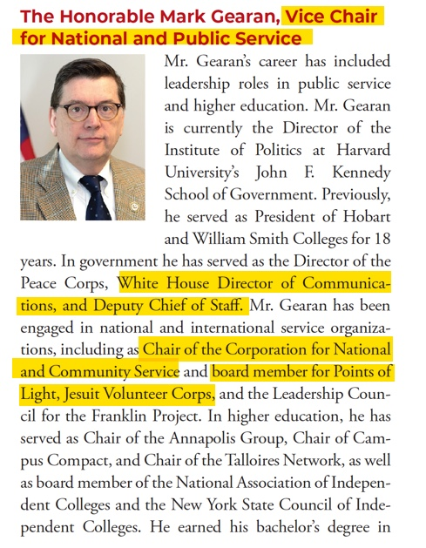
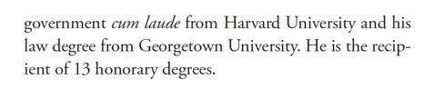

Slide 59
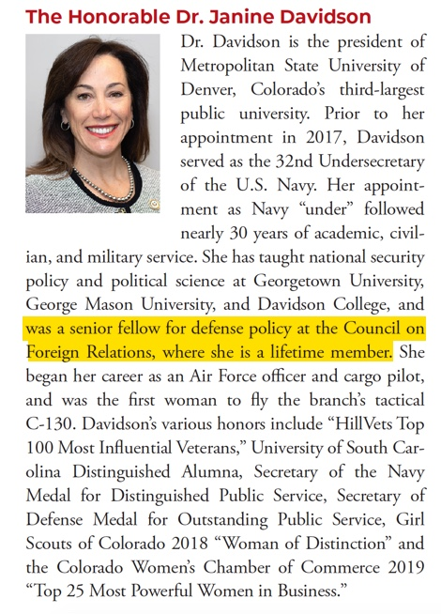

Slide 60
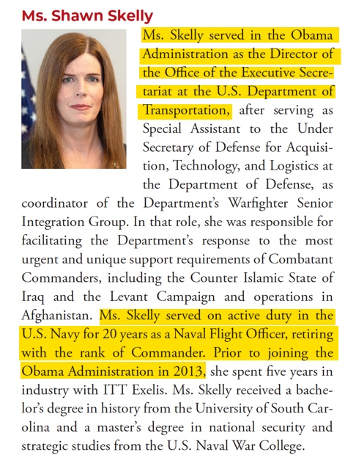

Slide 61
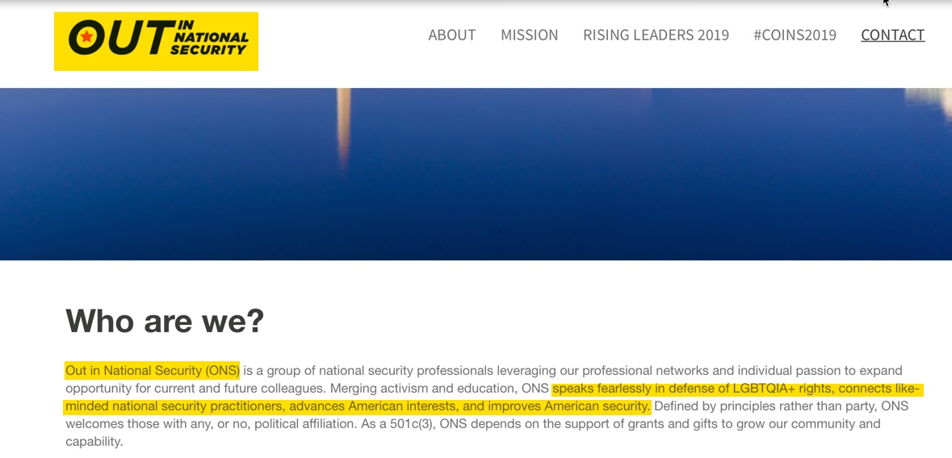

Slide 62

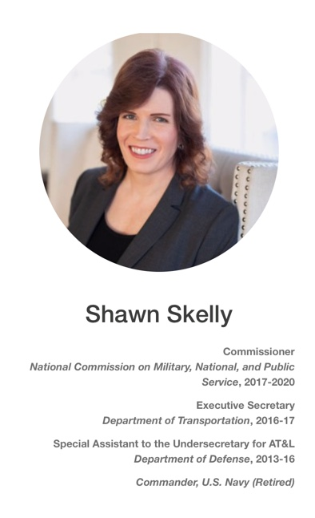
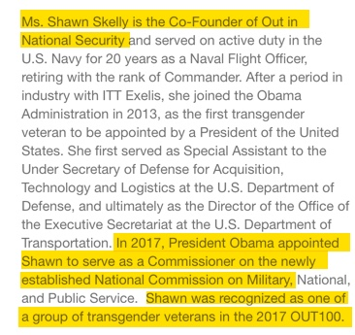

Slide 64
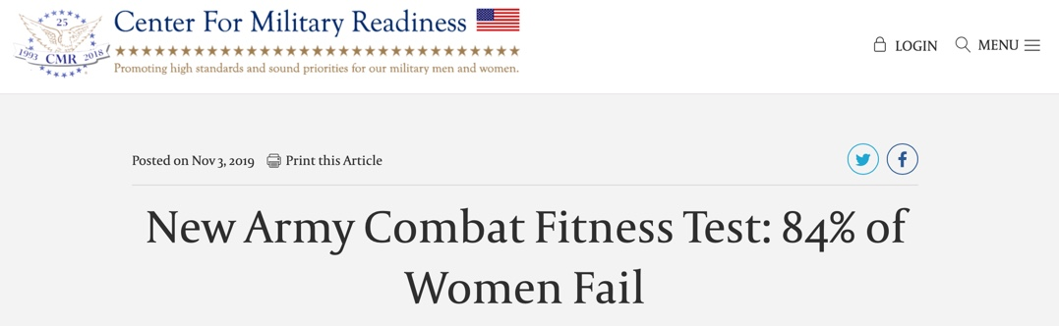

Slide 65
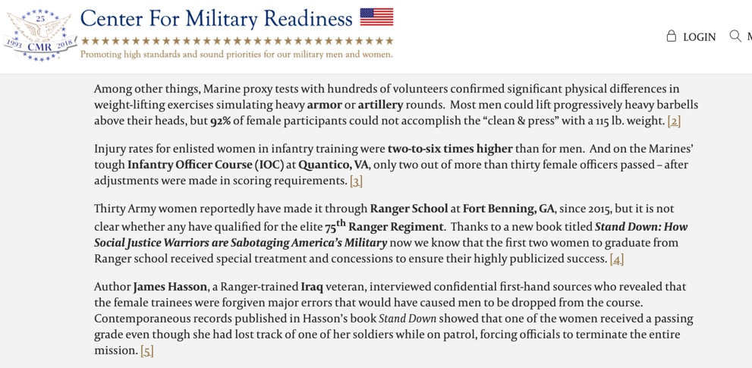

Slide 66
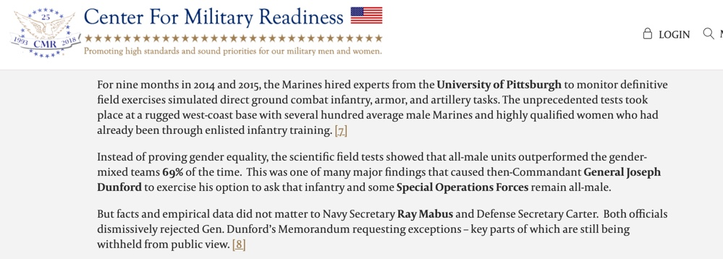

Slide 67
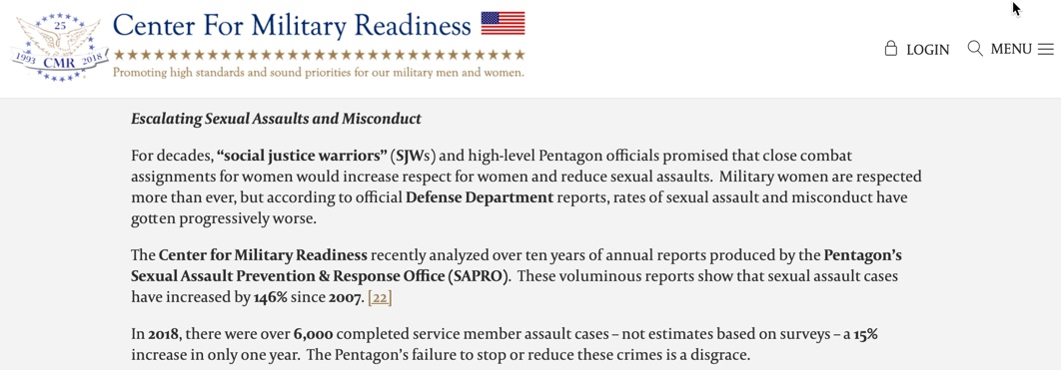

Slide 70
Simone de Beauvoir:
No women should be authorized to stay at home to raise her children…precisely because if there is such a choice, too many women will make that one.”

Slide 73
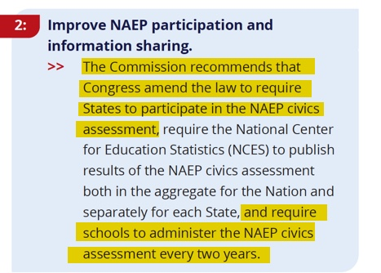

Slide 74
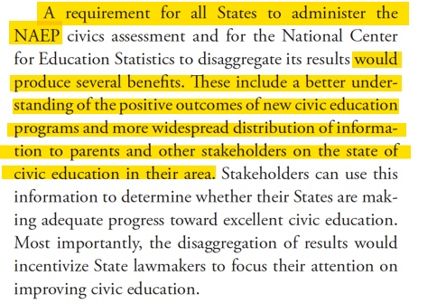

Slide 75
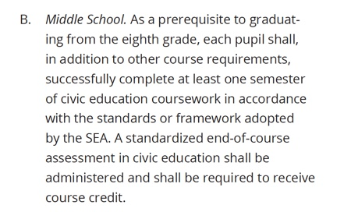

Slide 76
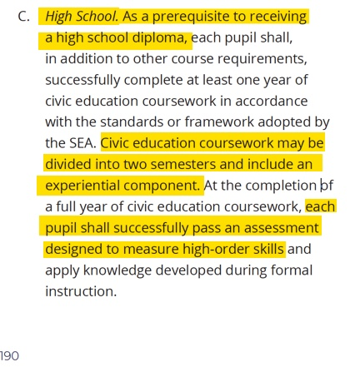

Slide 77
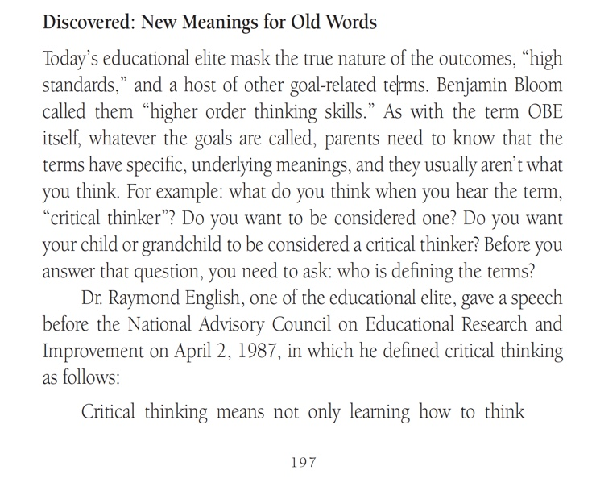


Slide 78
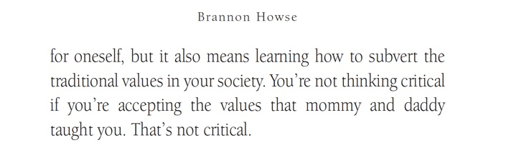

Slide 79
Past Names For Outcome-based Education:
Mastery Learning
Results Oriented
Total Quality Management
Quality Schools
Essential Schools
Transformational Education
Reformed Education, Restructured Education
Competency Based Education
Break the Mold 21st Century Schools
Exit Based Teaching
High Standards

Slide 80
Past Names For Outcome-based Education:
Performance Based Learning
High Level Learning
Mastery Teaching
Formative Testing
Correctives Teaching
Extensions Learning
Summative Evaluations
Credentialing Curriculum
Advancement Teaching
Results-Based Curriculum

Slide 81
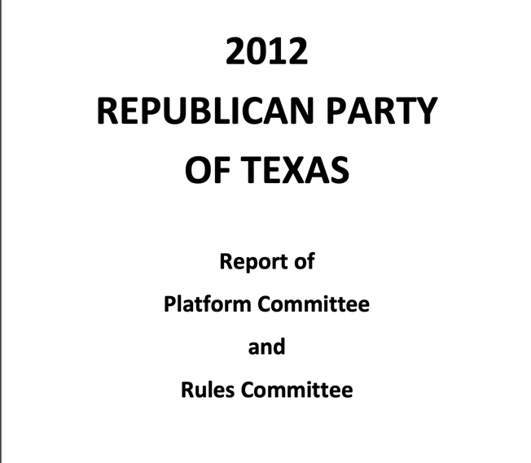

Slide 82


Slide 83
In All Our Children Learning, Bloom discloses what he believes is the ultimate goal of education:
…The curriculum may be thought of as a plan for changing students' behavior and as the actual set of learning experiences in which students, teachers, and materials interact to produce the change in students.

Slide 84
Bloom's Own Words:
[A] large part of what we call "good teaching" is the teacher's ability to attain affective objectives through challenging the student's fixed beliefs.

Slide 85
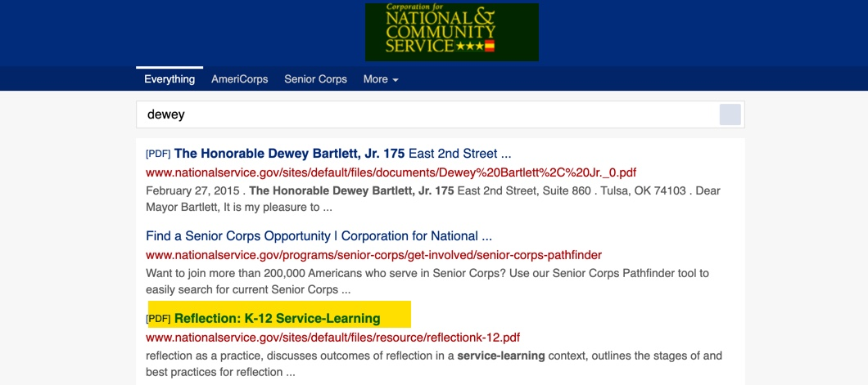

Slide 86
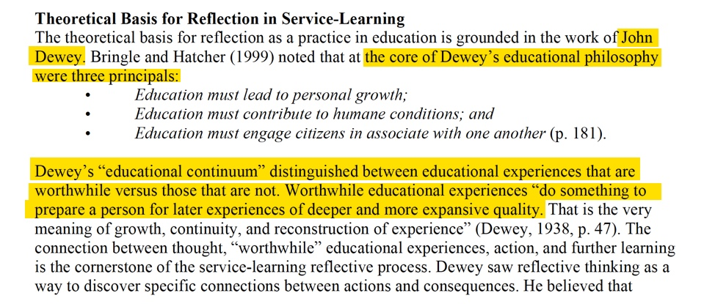

Slide 87

John Dewey Declared:
“The belief in political fixity, of the sanctity of some form of state consecrated by the efforts of our fathers and hallowed by tradition, is one of the stumbling-blocks in the way of orderly and directed change.”

Slide 88
John Dewey—“father of modern education” in America—signed the Humanist Manifesto I, was a board member of the American Humanist Association, helped establish the League for Industrial Democracy, and assisted Roger Baldwin in founding the American Civil Liberties Union. Another co-founder, William Z. Foster, had previously served as the head of the United States Communist Party.

Slide 89
Historian George Grant reports in
The Family Under Siege:
He [Baldwin] helped to establish the American Fund for Public Service—with two million dollars donated by Charles Garland, a rich young revolutionary from Boston—in order to pour vast sums of money into revolutionary causes.

Slide 90
On January 17, 1931, the U.S. House of Representatives Special Committee on Communists Activities reported:
The American Civil Liberties Union is closely affiliated with the communist movement in the United States, and fully 90 percent of its efforts are on behalf of communists who have come into conflict with the law. It claims to stand for free speech, free press, and free assembly, but it is quite apparent that the main function of the ACLU is to attempt to protect the communists in their advocacy of

Slide 91
On January 17, 1931, the U.S. House of Representatives Special Committee on Communists Activities reported:
force and violence to overthrow the Government, replacing the American flag by a red flag and erecting a Soviet Government in place of the republican form of government guaranteed to each state by the
Federal Constitution.

Slide 92
Roger Baldwin: Founder of the ACLU:
I joined. I don’t regret being a part of the Communist tactic, which increased the effectiveness of a good cause. I knew what I was doing. I was not an innocent liberal. I wanted what the Communists wanted and I traveled the United Front road to get it.

Slide 93
Baldwin Described His Deceptive
Plan as Follows:
We want to look like patriots in everything we do. We want to get a lot of flags, talk a great deal about the Constitution and what our forefathers wanted to make of this country and how that we are the fellows that really stand for the spirit of our institutions.

Slide 94


Slide 95
Baldwin Outlines His Plans:
I am for socialism, disarmament, and ultimately for abolishing the state itself as an instrument of violence and compulsion. I seek social ownership of property, the abolition of the propertied class, and sole control by those who produce wealth. Communism is the goal.

Slide 96
Baldwin Outlines His Plans:
It all sums up into one single purpose—the abolition of dog-eat-dog under which we live.

Slide 97


Slide 98


Slide 99


Slide 100

Chester Finn, Jr., We Must Take Charge: Our Schools and
Our Future (New York: The Free Press, 1991), 257.

Slide 101


Slide 102


Slide 105


Slide 106


Slide 107


Slide 108


Slide 109


Slide 110
Winston Churchill:
If you will not fight for the right when you can easily win without bloodshed, if you will not fight when your victory will be sure and not too costly, you may come to the moment when you will have to fight with all the odds against you and only a small chance of survival. There may even be a worse case: you may have to fight when there is no hope of victory, because it is better to perish than to live as slaves.

