Slide 1
John Stormer: None Dare Call it Treason:
25 Years Later, 1992 Edition
The Congressional committees which once investigated Communist activity were abolished in the mid-1970’s. Since then, the FBI has been forbidden to investigate domestic communists or keep them under surveillance unless there is evidence that a crime has been committed. As a result, on-going FBI investigations of communists activity in America dropped from 24,414 in 1973 to 51 in 1983.

Slide 2
The Destruction of America's
Anti-Communist Crusaders

Slide 3
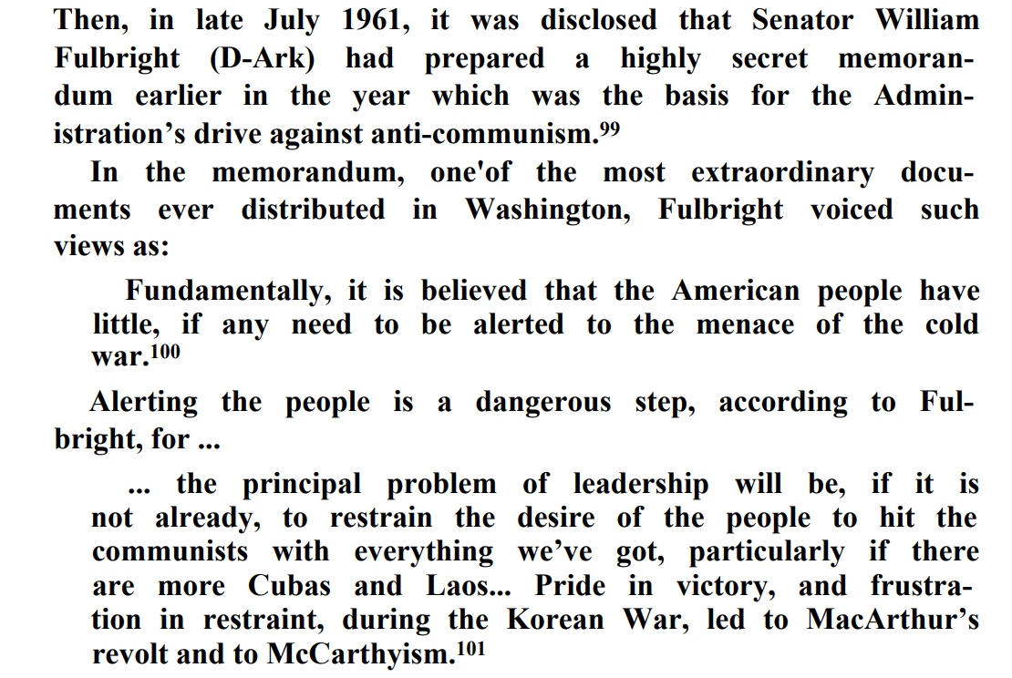

Slide 4
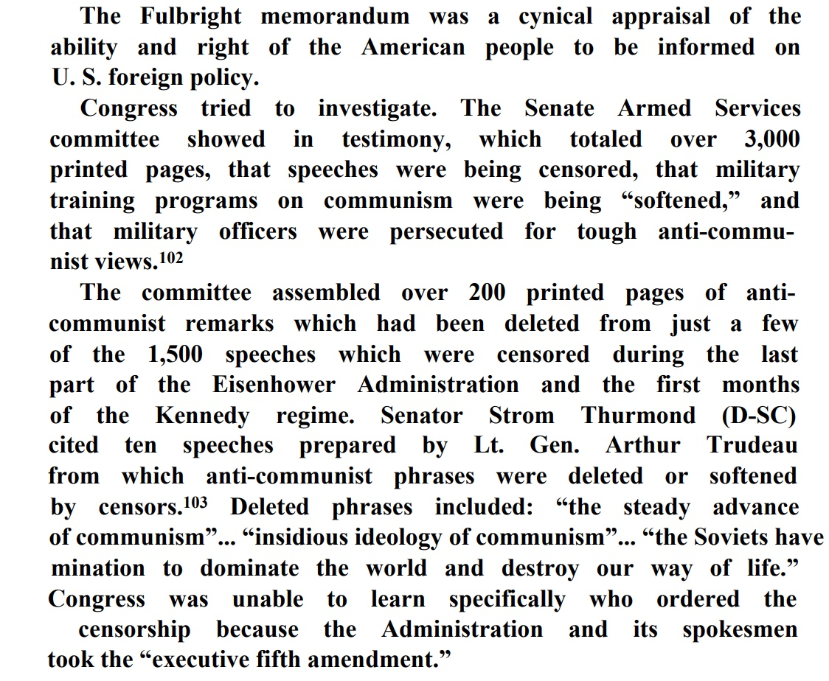

Slide 5
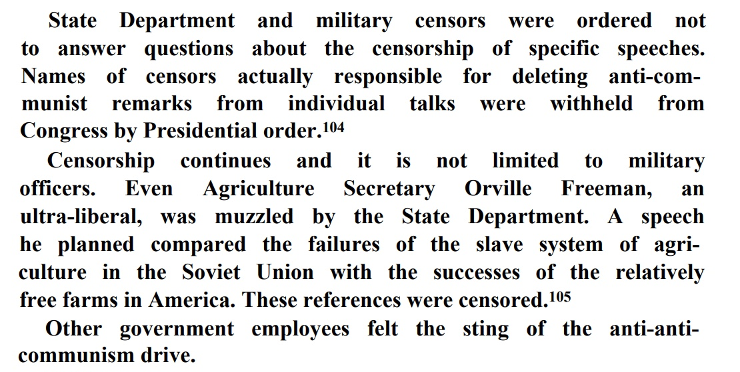

Slide 6
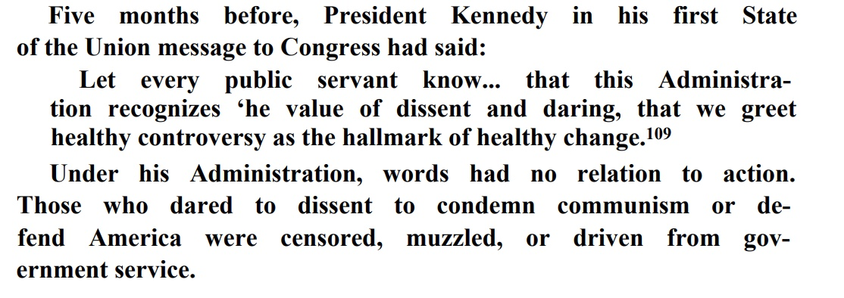

Slide 7
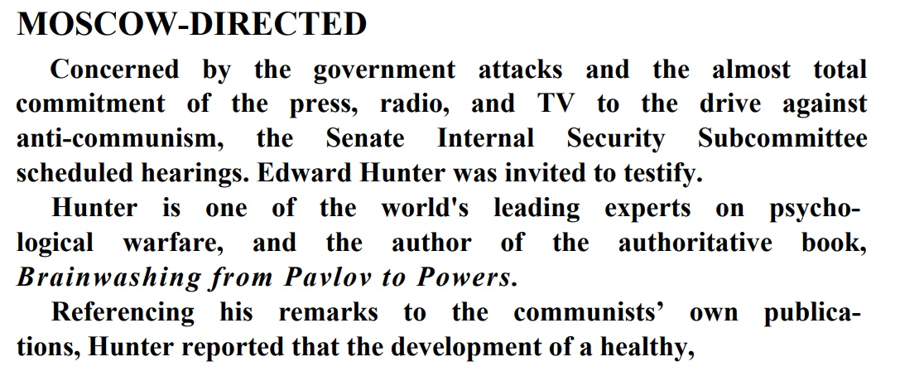

Slide 8
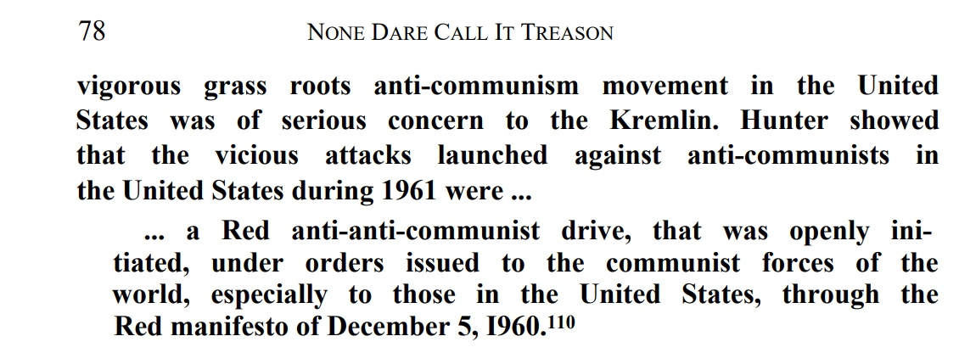

Slide 9
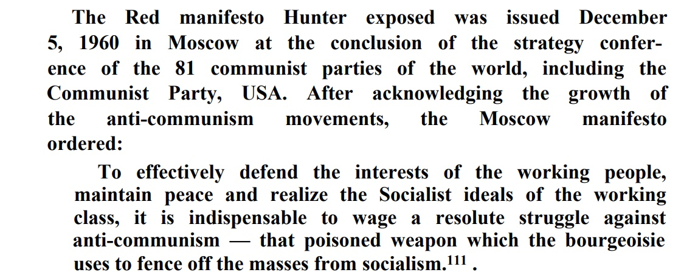

Slide 10
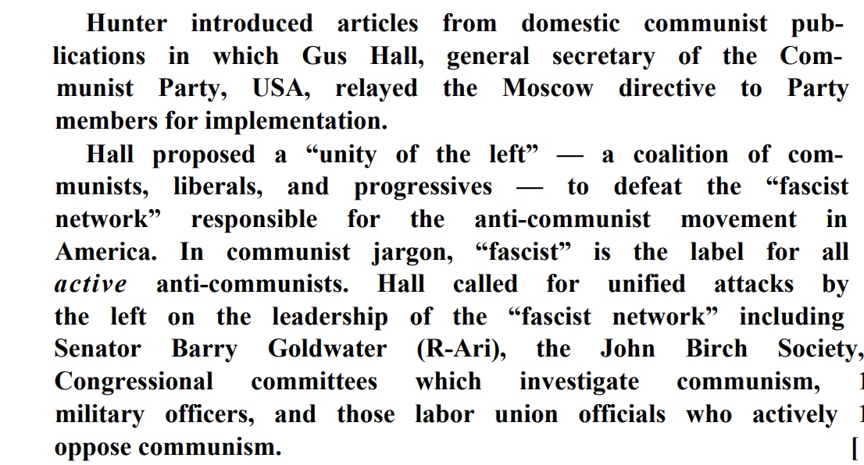

Slide 11
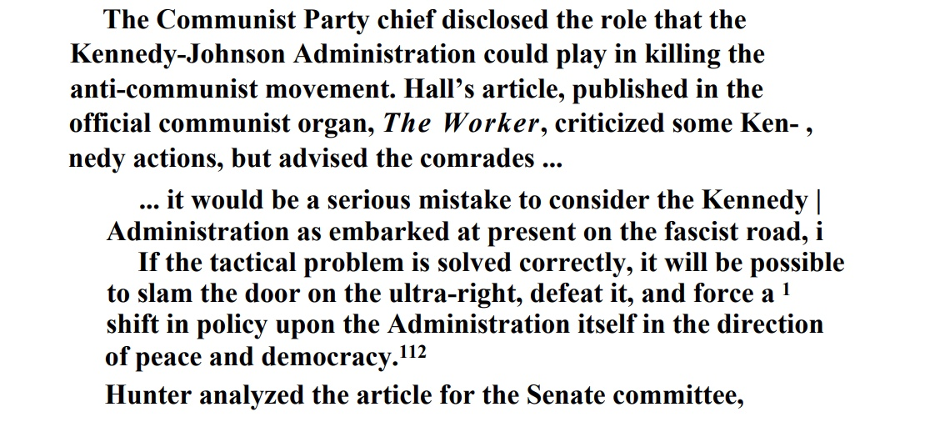

Slide 12
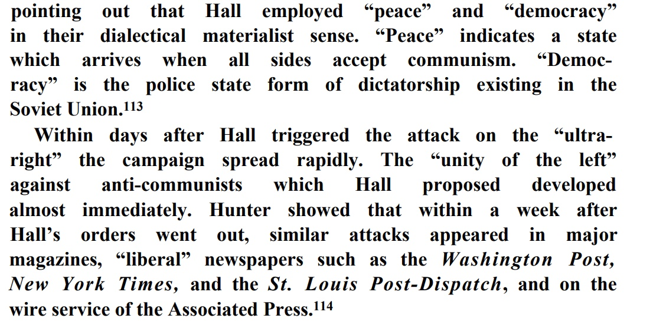

Slide 13
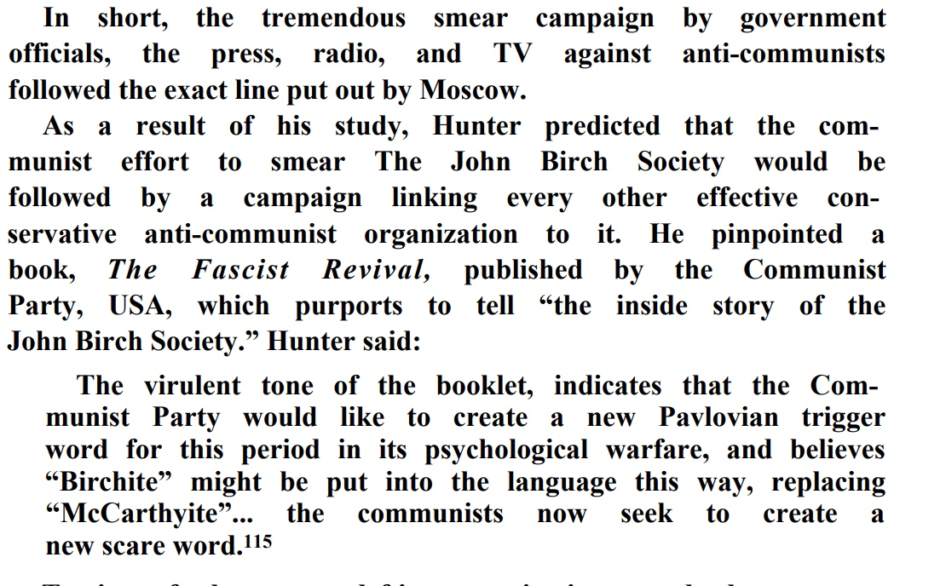

Slide 14
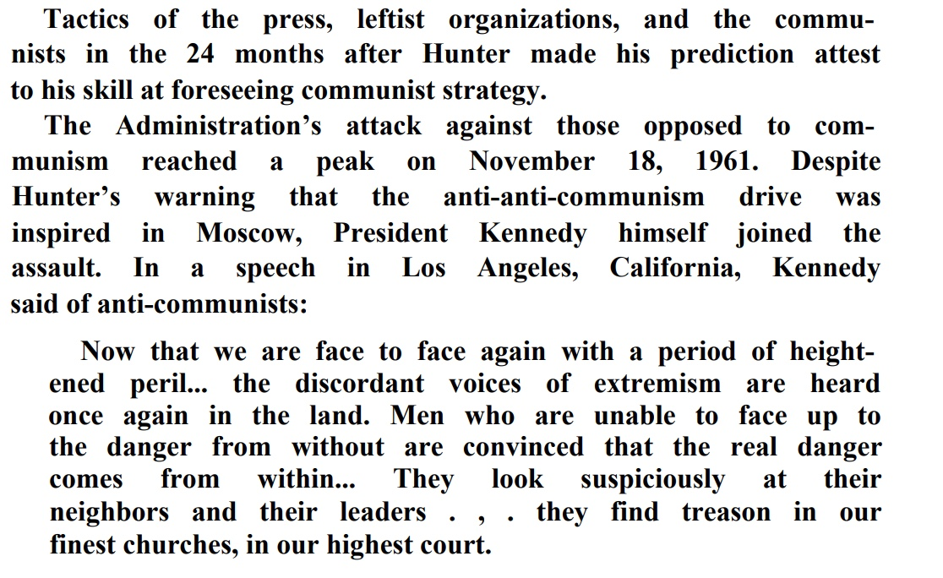

Slide 15
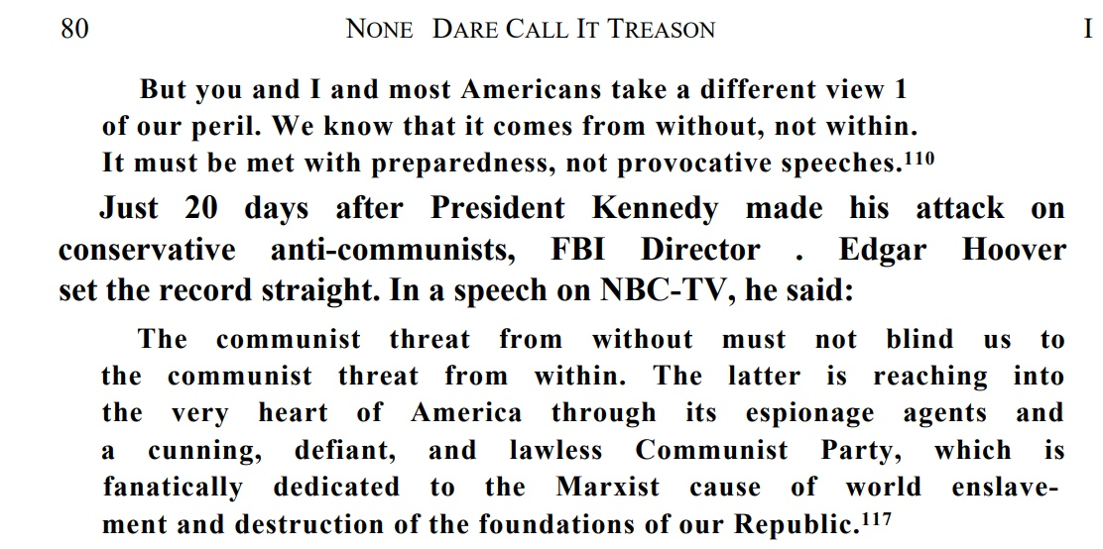

Slide 16
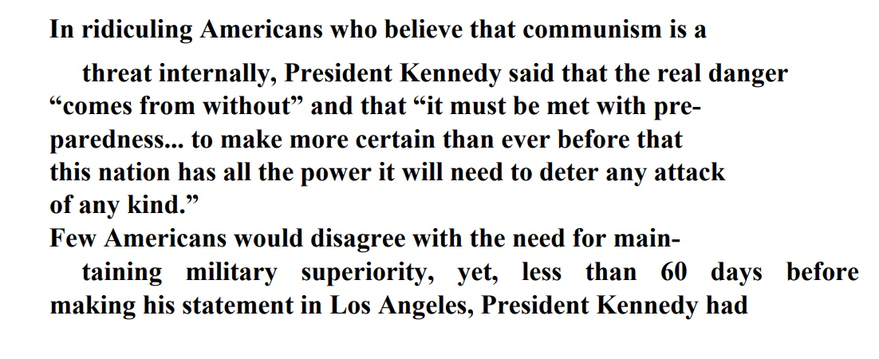

Slide 17
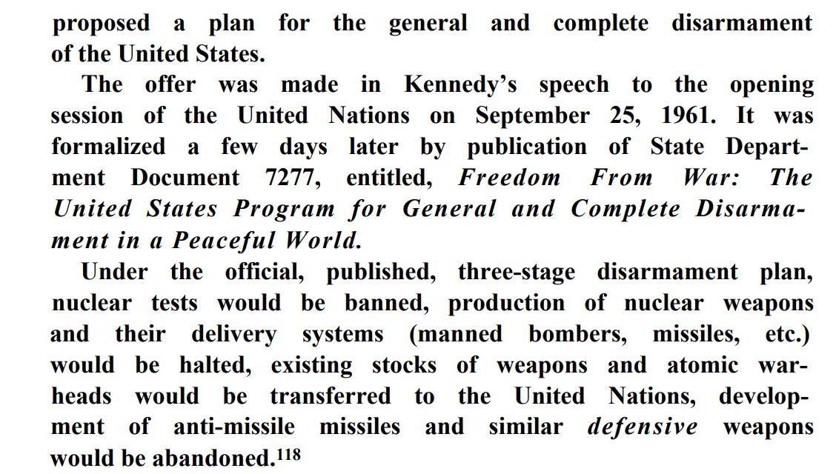

Slide 18
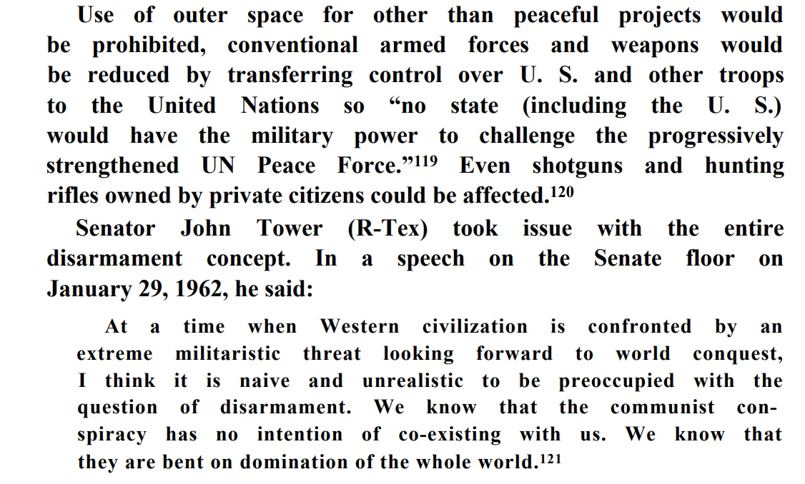

Slide 19
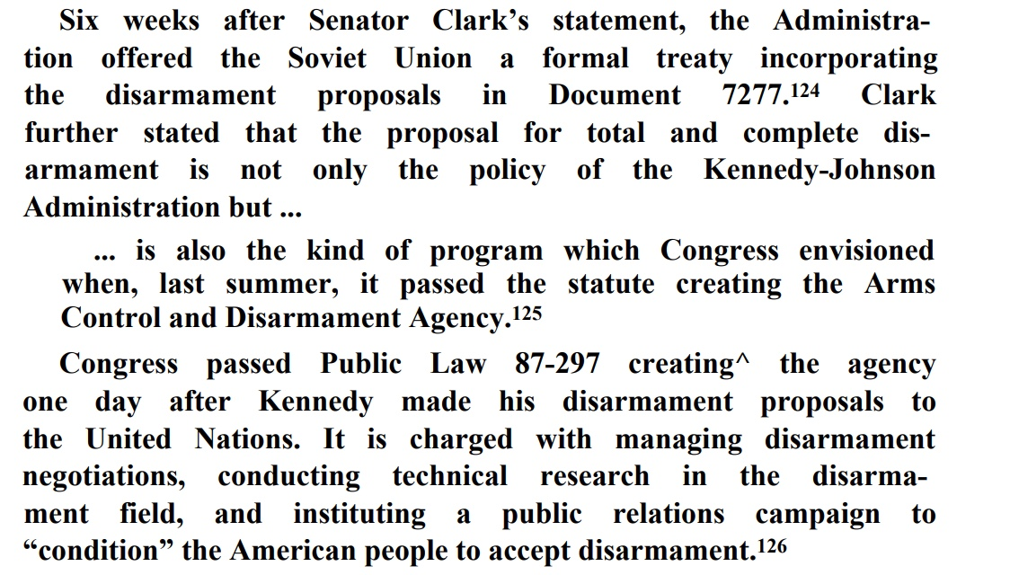

Slide 20
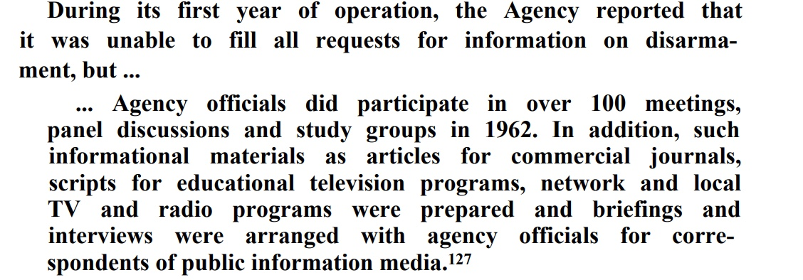

Slide 21
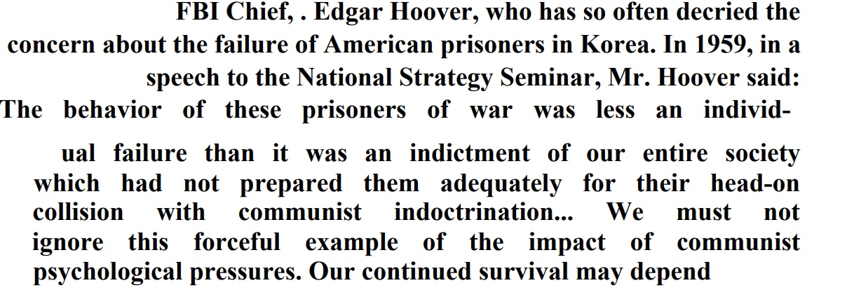

Slide 22
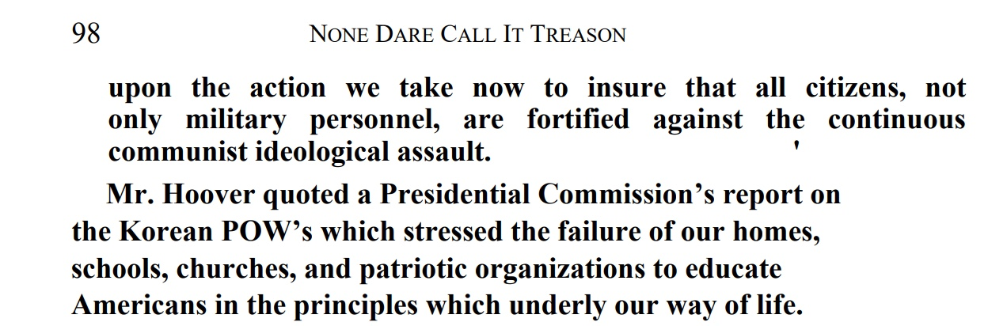

Slide 23
