Slide 1
Twisted Scripture
Twisted Theology

Slide 2
Eisegesis V. Exegesis

Slide 3
Postmodernism Mixed with Christianity Equals:
Subjective Truth
Subjective Interpretation
Subjective Application
Collective Apostasy

Slide 4
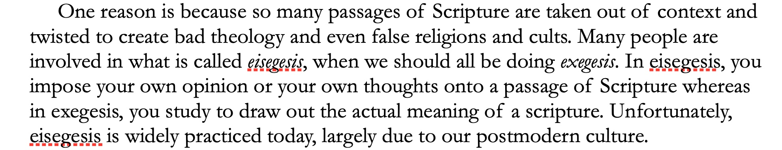
Twisted Scripture, Twisted Theology
By Brannon Howse

Slide 5
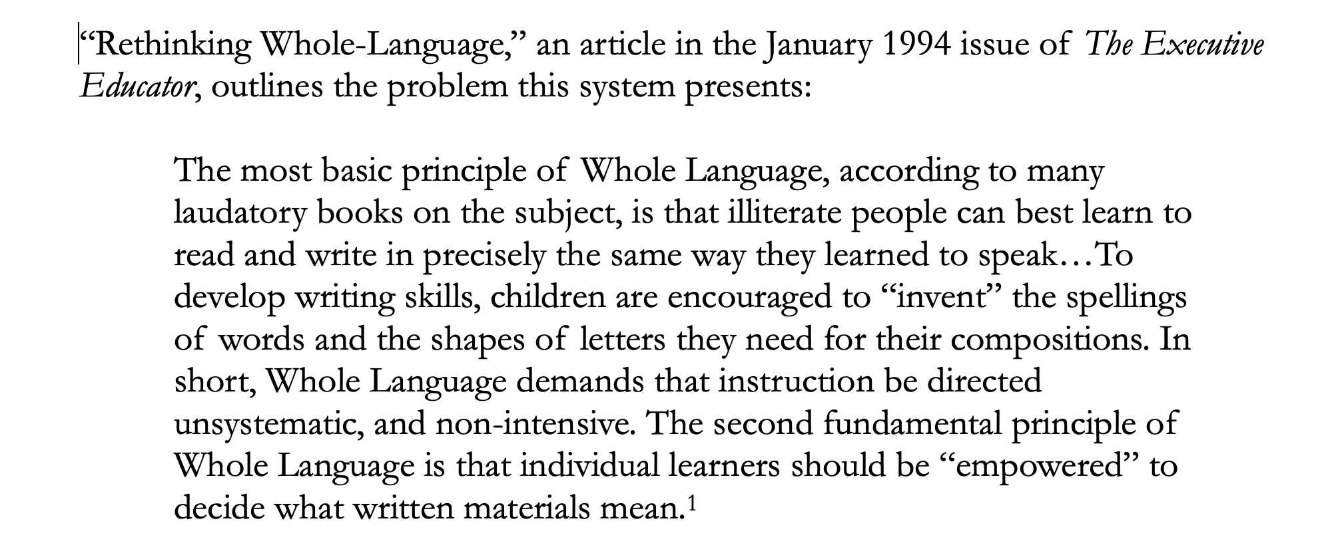
Twisted Scripture, Twisted Theology
By Brannon Howse

Slide 6
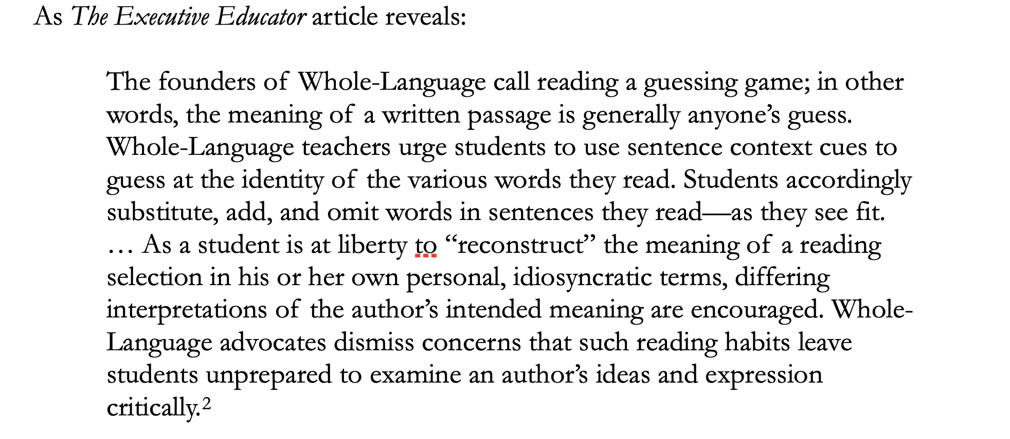
Twisted Scripture, Twisted Theology
By Brannon Howse

Slide 7
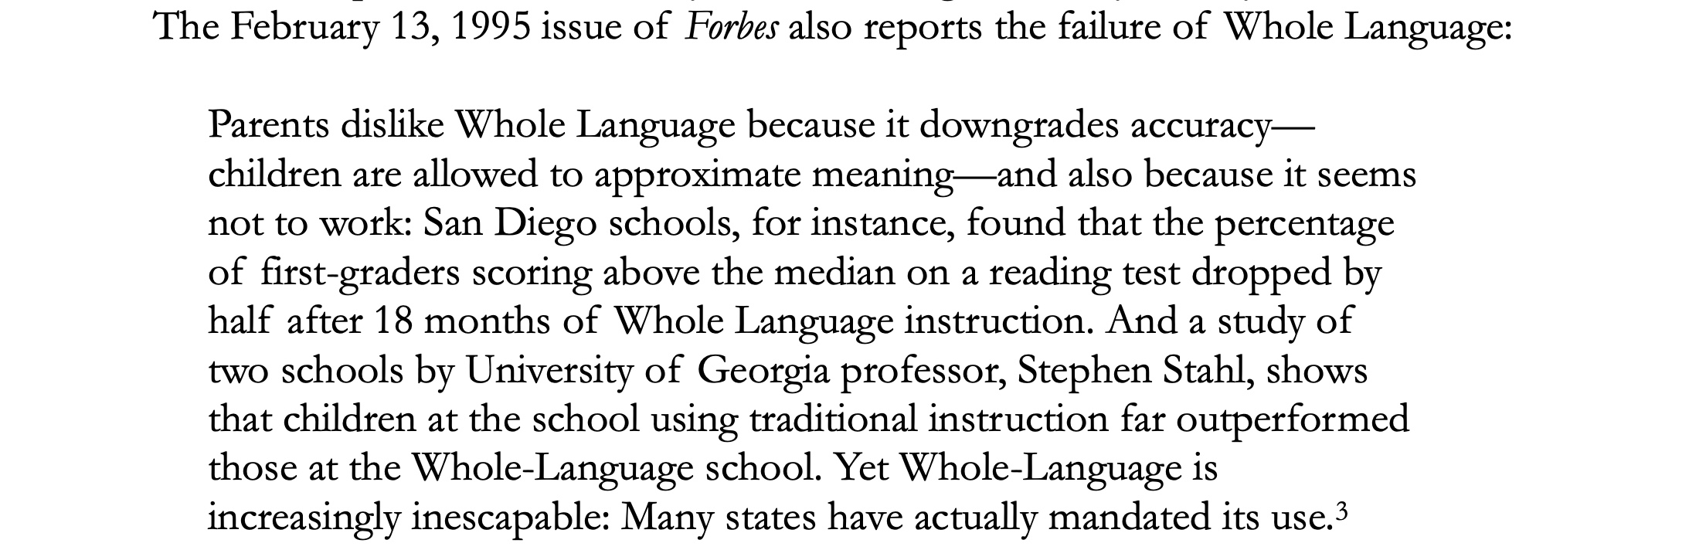
Twisted Scripture, Twisted Theology
By Brannon Howse

Slide 8
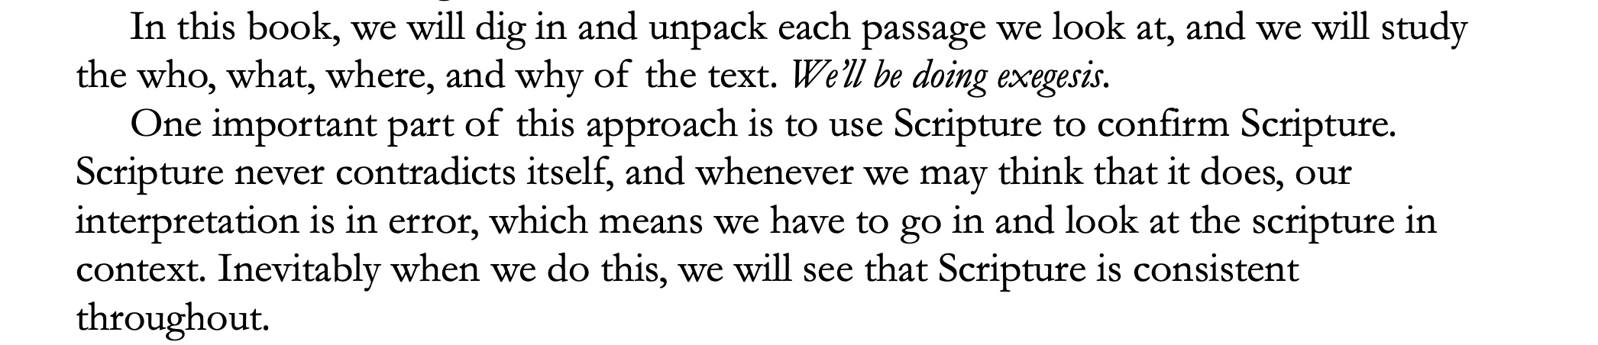
Twisted Scripture, Twisted Theology
By Brannon Howse

Slide 9
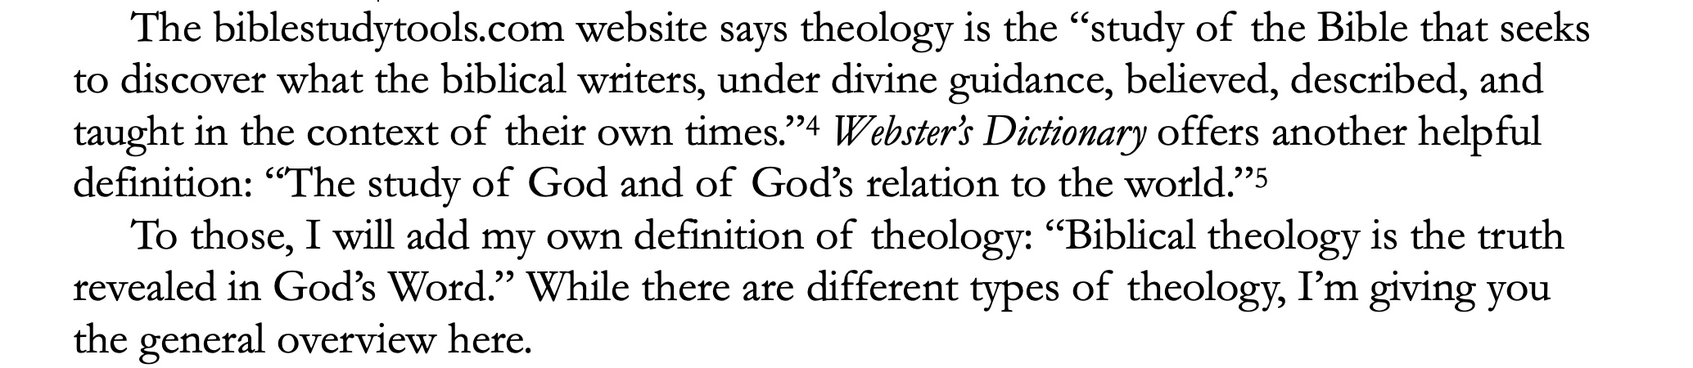
Twisted Scripture, Twisted Theology
By Brannon Howse

Slide 10
Concerning The Bible,
Jesus Christ Affirmed Its:
Author = John 17:17
Authenticity = Matthew 12:39-40
Authority = John 7:28
Application = Matthew 4:4

Slide 11
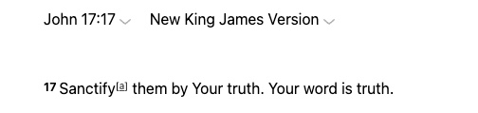

Slide 12
Concerning The Bible,
Jesus Christ Affirmed Its:
Author = John 17:17
Authenticity = Matthew 12:39-40
Authority = John 7:28
Application = Matthew 4:4

Slide 13
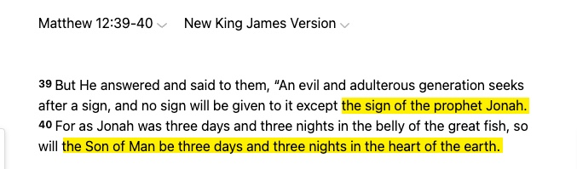

Slide 14
Concerning The Bible,
Jesus Christ Affirmed Its:
Author = John 17:17
Authenticity = Matthew 12:39-40
Authority = John 7:28
Application = Matthew 4:4

Slide 15
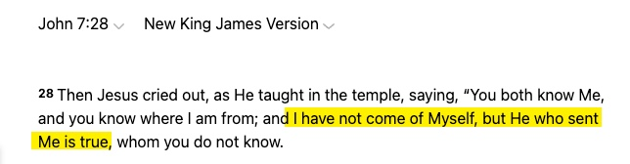

Slide 16
Concerning The Bible,
Jesus Christ Affirmed Its:
Author = John 17:17
Authenticity = Matthew 12:39-40
Authority = John 7:28
Application = Matthew 4:4

Slide 17
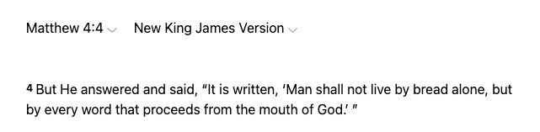

Slide 18
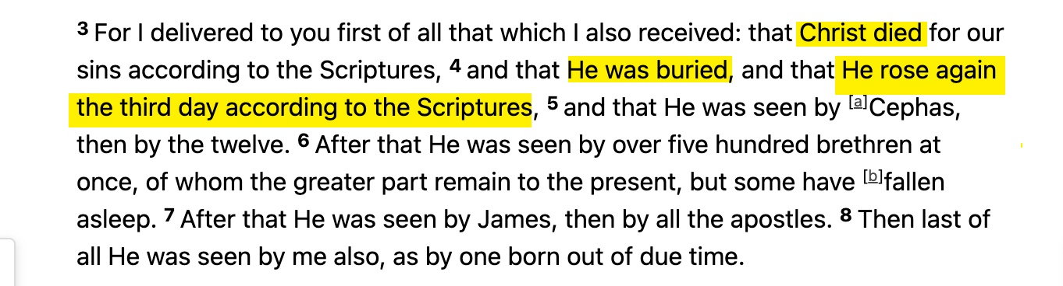
I Corinthians 15:3-8

Slide 19
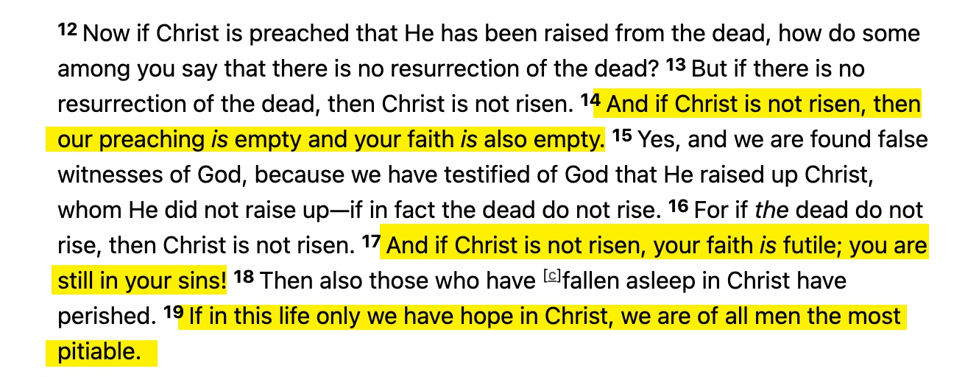
I Corinthians 15:12-19

Slide 20
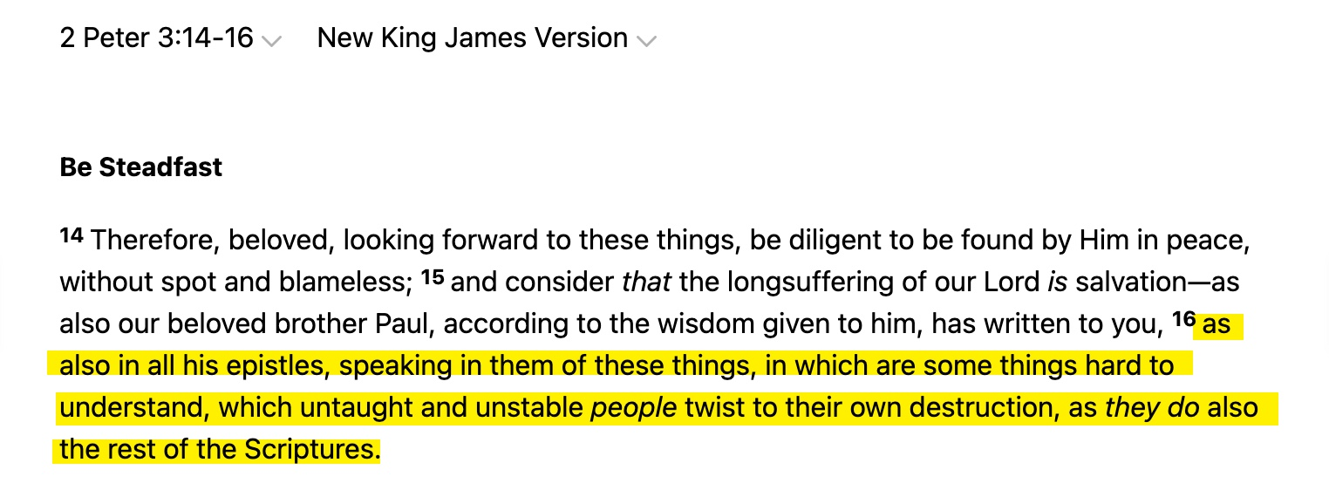

Slide 21
Why is the Bible So Hard
For Some to Understand?

Slide 23
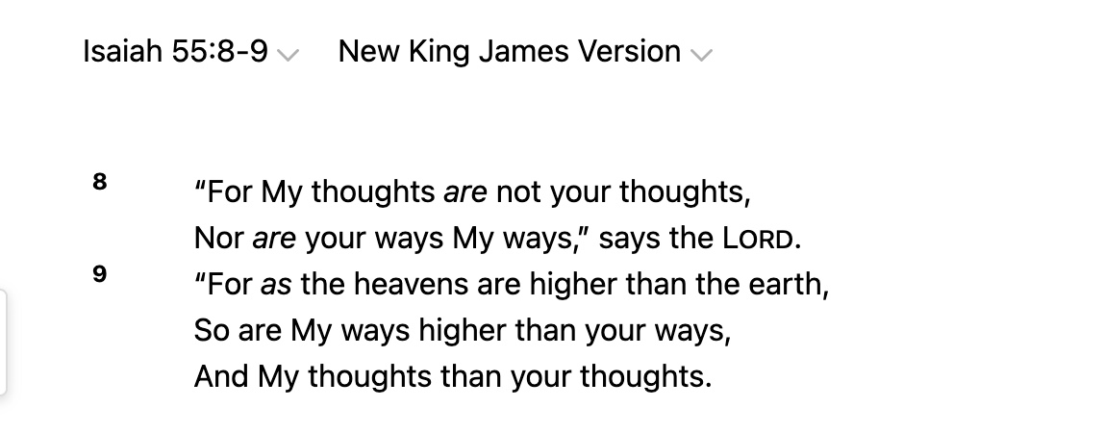

Slide 24
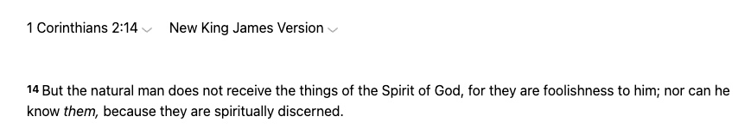

Slide 25
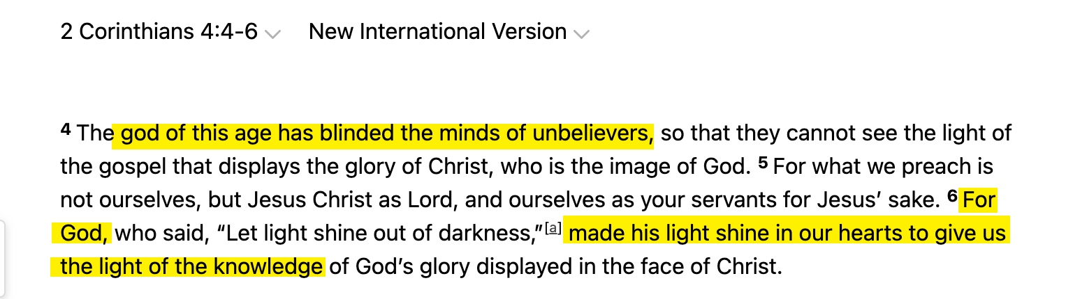

Slide 26
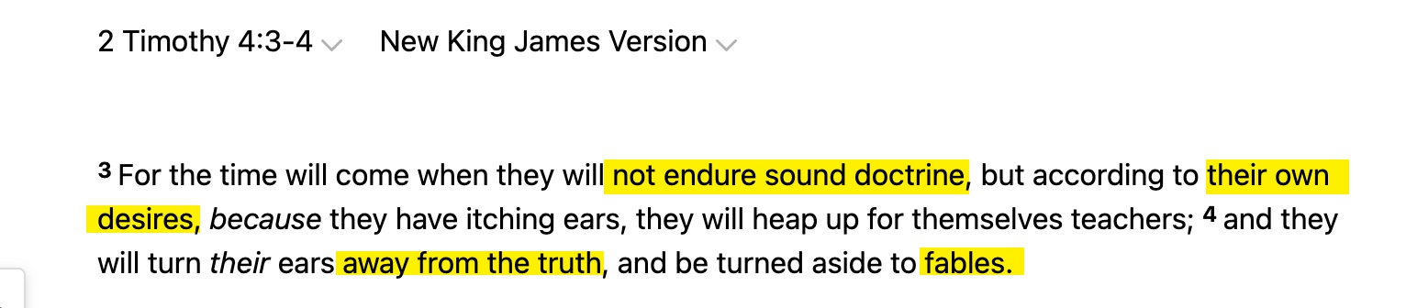

Slide 27
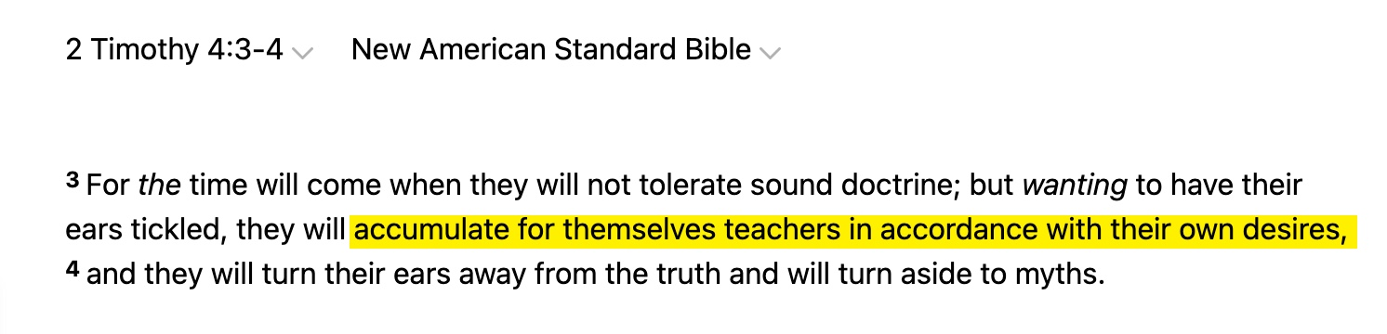

Slide 28
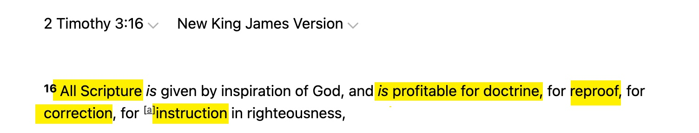

Slide 29
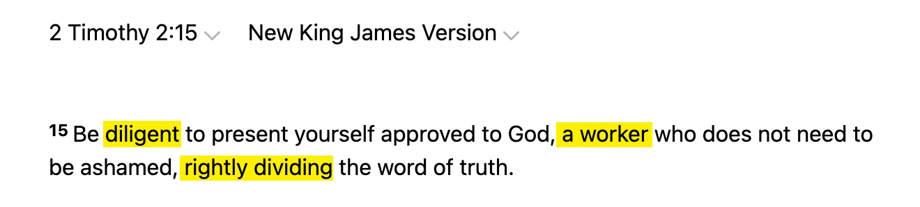

Slide 30
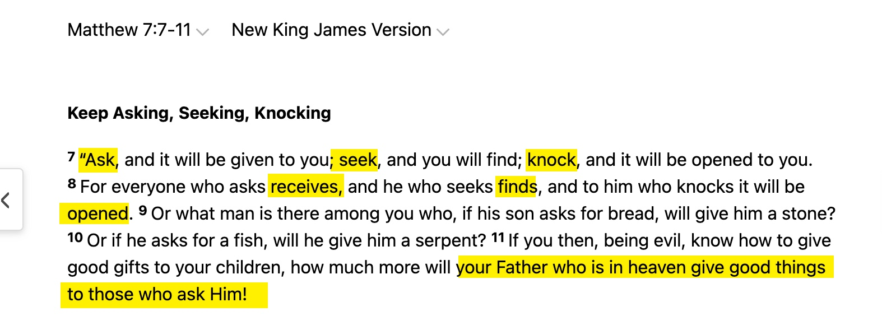

Slide 31
Context of The Text
Context of Key Words
Context of The Book
Context of The Culture
Cross Reference Confirmation

Slide 32
In his 1983 message Dr. Walter Martin predicted with pinpoint accuracy the condition of evangelicalism and how censorship of Biblical truth by self-described evangelicals would increase before the Lord’s return.

Slide 33
Dr. Walter Martin Proclaimed:
You see, the attitude of the Christian media is don’t rock the boat, and the Christian Church is suffering from that disease today by its Latin name, non rock-a-boat-us. Whatever you do, non rock-a-boat-us ecclesiastic-us. Don’t shake, rattle and roll the boat of the Church. Leave us alone….

Slide 34
Dr. Walter Martin Proclaimed:
They’re always screaming about secular humanism censoring the Christian Church, but they’re the ones that are censoring the Christian Church. They don’t want to get on television and on radio and tell it like it is. You know why? Because then they won’t get any checks from people out there whose feelings they hurt.

Slide 35
Dr. Walter Martin Proclaimed:
So, they are not governed by the Holy Spirit. They are not governed by the authority of the Scriptures which commands them to tell the truth. They are governed by the almighty checkbook of the people that are listening.

Slide 36
Twisted Scripture #1

Slide 37
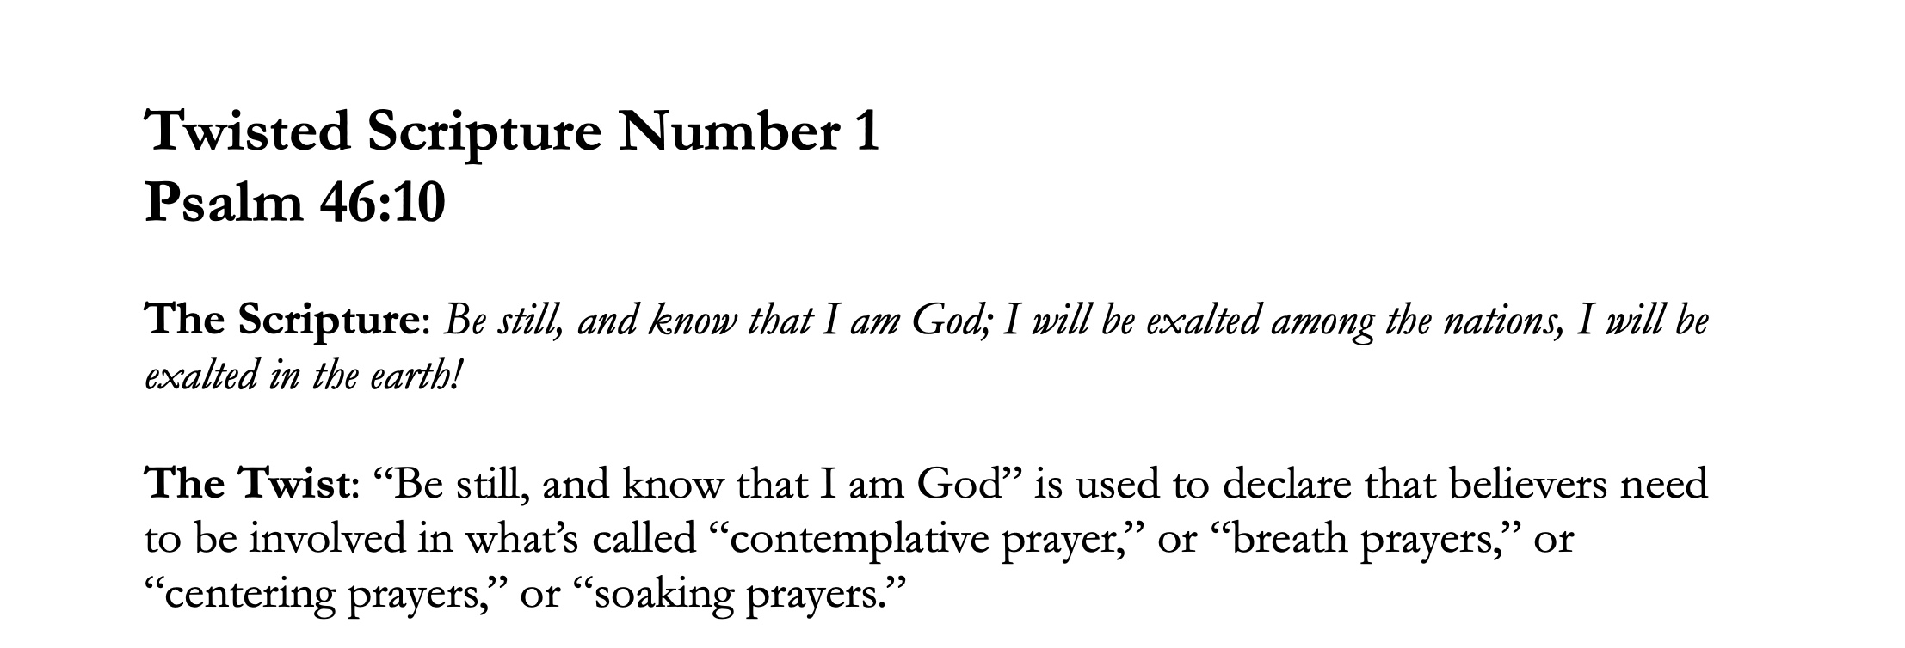

Slide 39


Slide 40


Slide 41
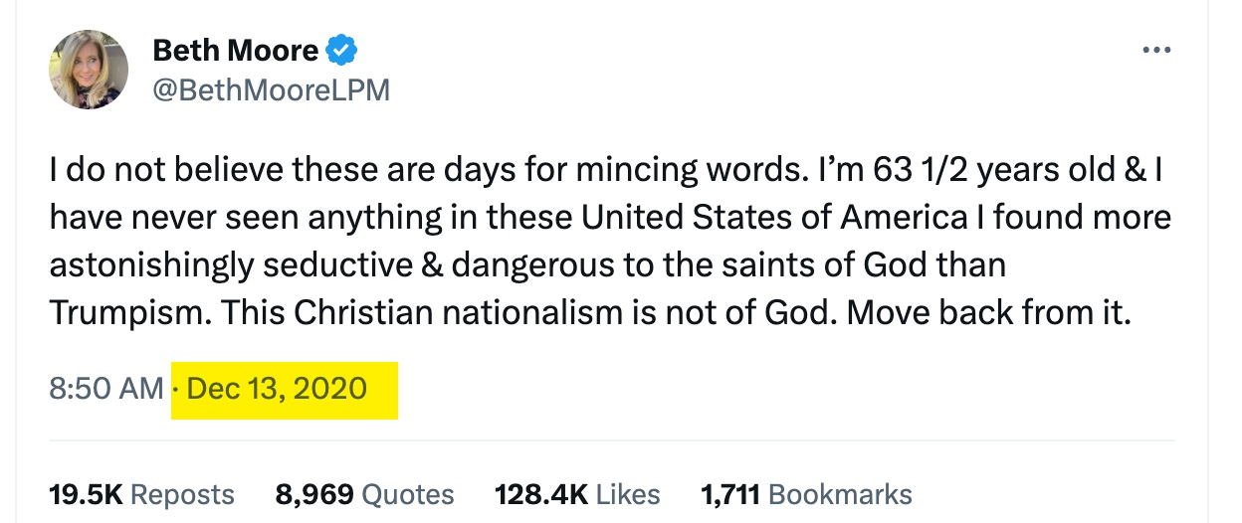

Slide 42
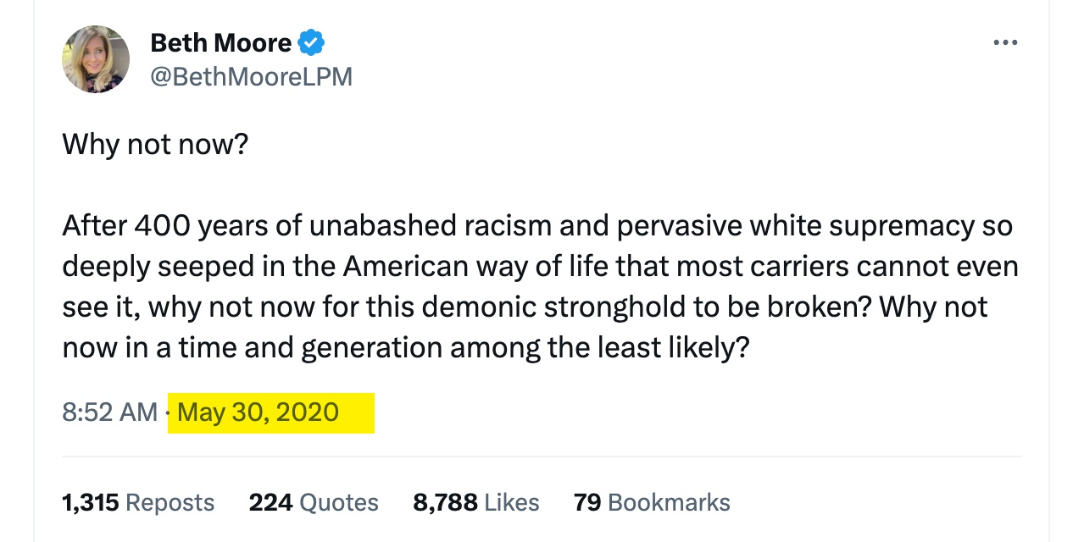

Slide 43


Slide 44


Slide 45


Slide 46


Slide 47


Slide 48


Slide 49


Slide 51


Slide 52


Slide 53
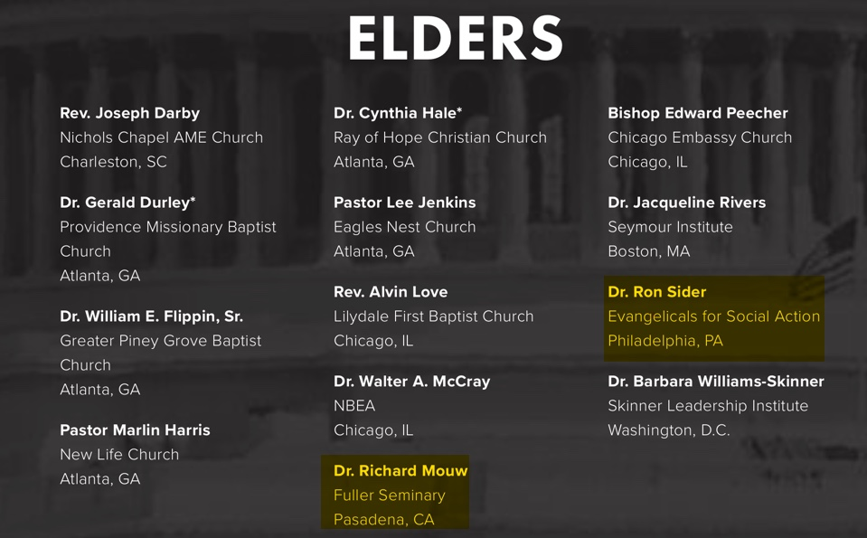

Slide 54
Third Way’s
“Come Let us Reason Together: A Fresh Look at Shared Cultural Values Between Evangelicals and Progressives.”
Rev. Brian McLaren, author of Everything Must Change;
Johnathan Merritt, Founder, Southern Baptist Environment and Climate Initiative;
Rev. Tony Jones, Author of The New Christians and Dispatches from the Emergent Frontier;
Dr. Richard Mouw, President, Fuller Theological Seminary;
Richard Foster, Author of Celebration of Discipline and other books;

Slide 55
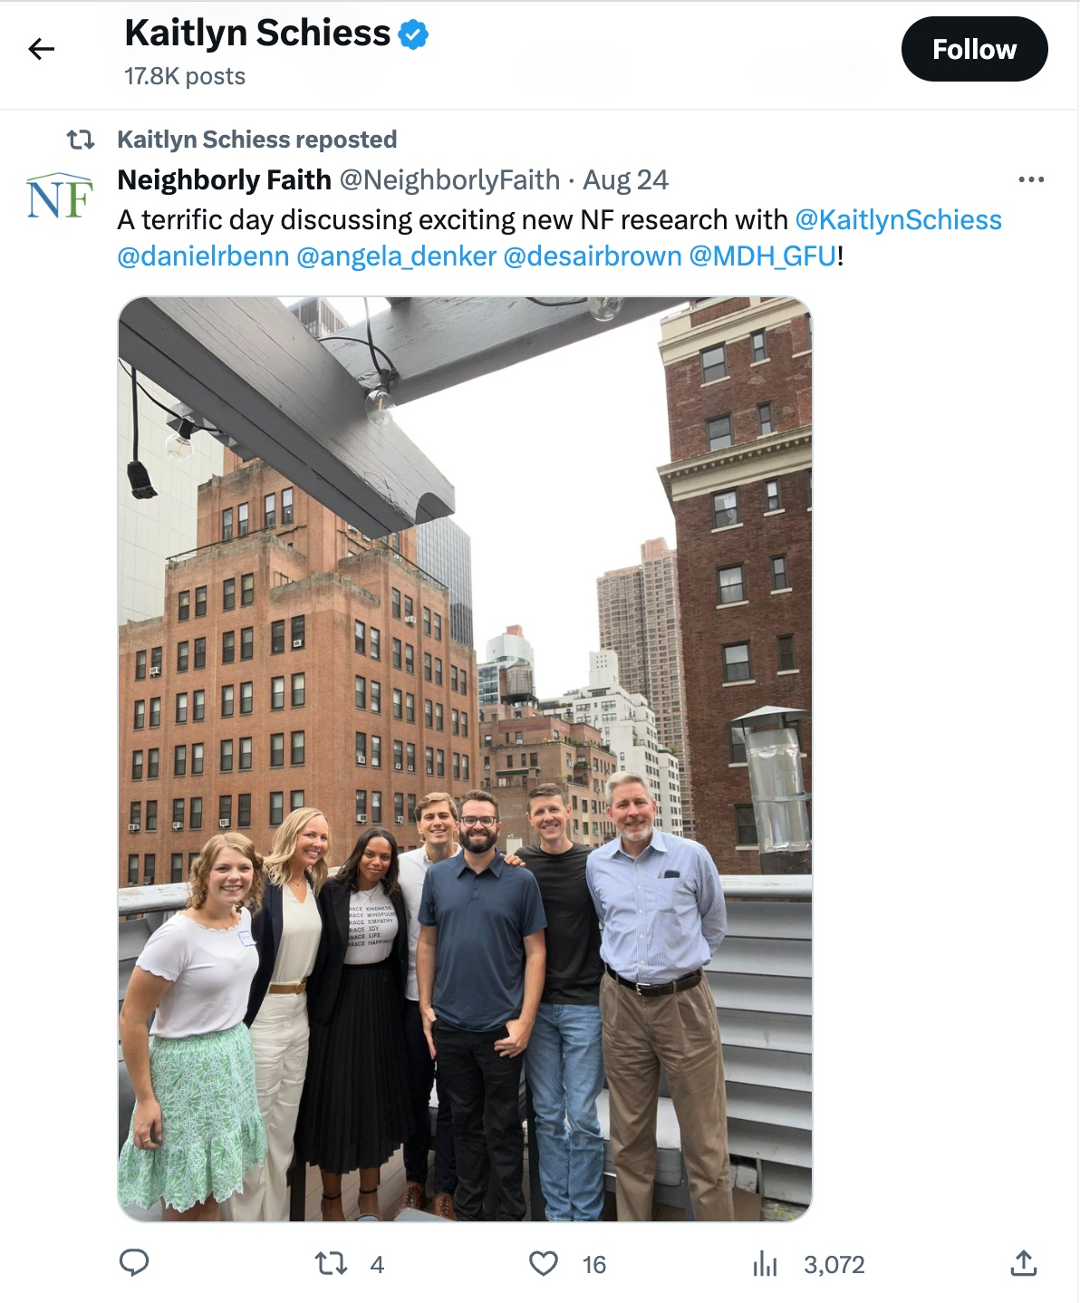

Slide 56
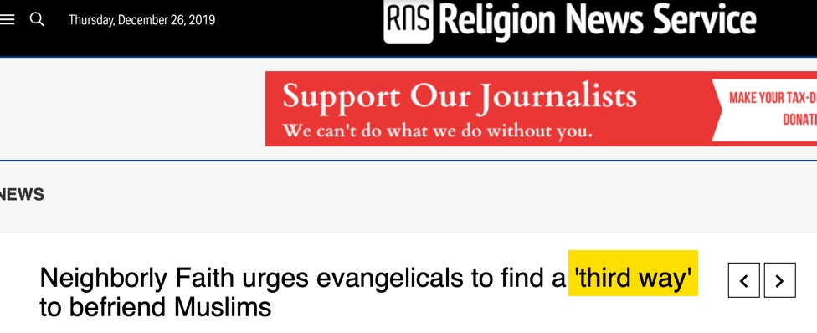

Slide 57


Slide 58


Slide 59
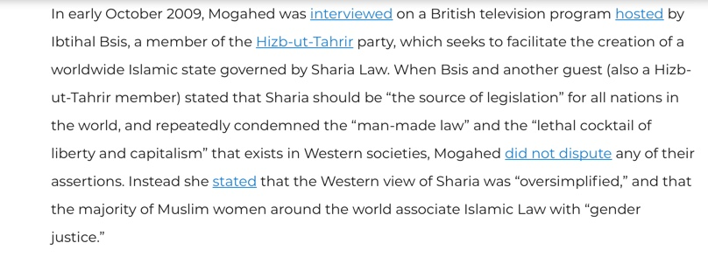
Discover The Networks

Slide 61
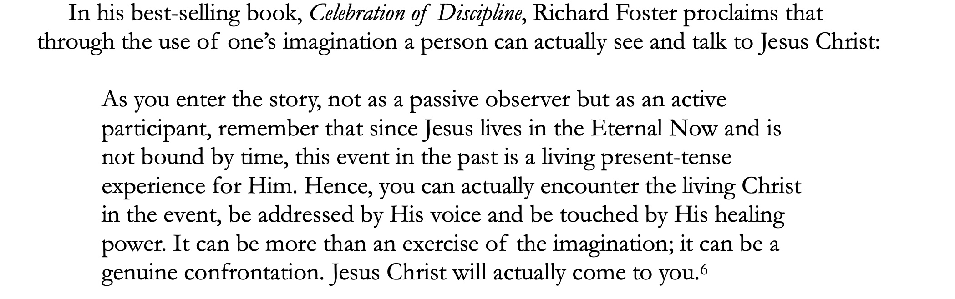

Slide 62
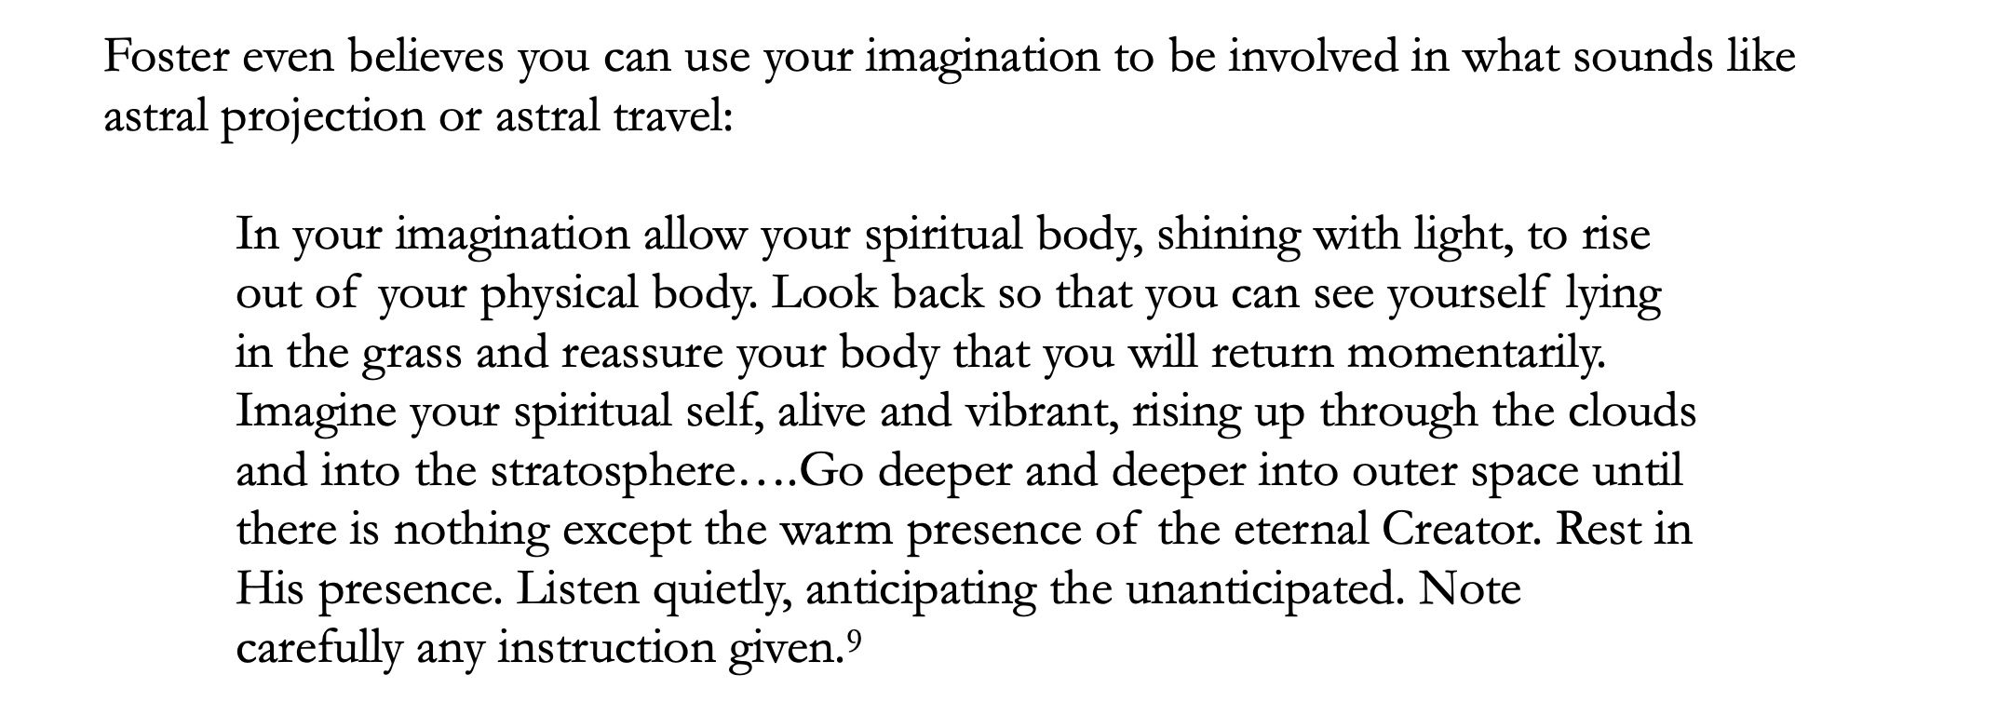

Slide 63
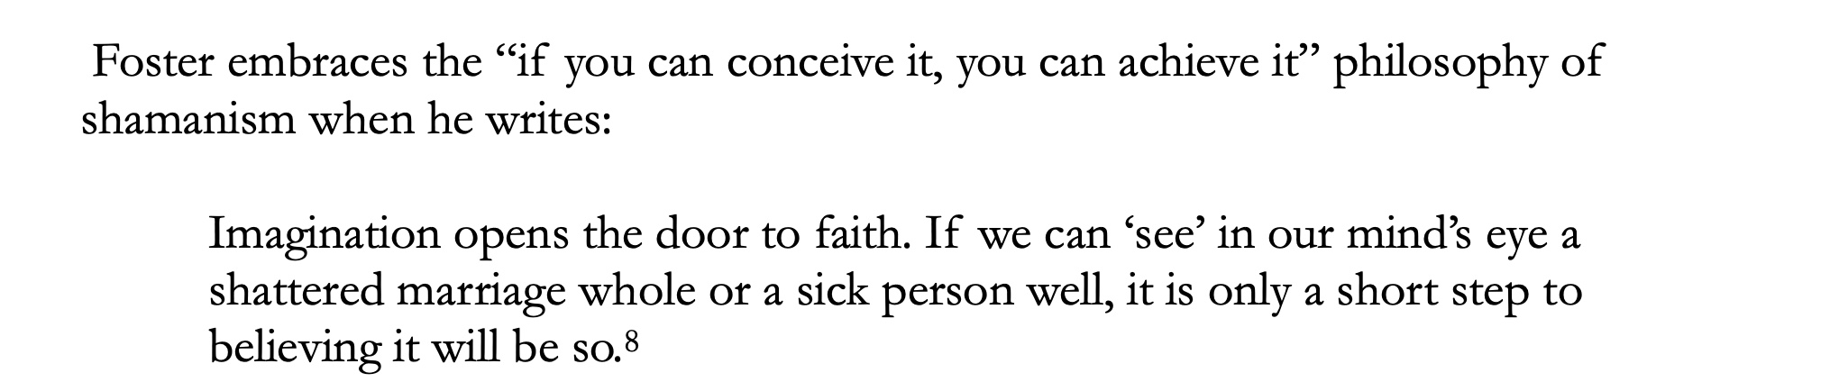

Slide 64
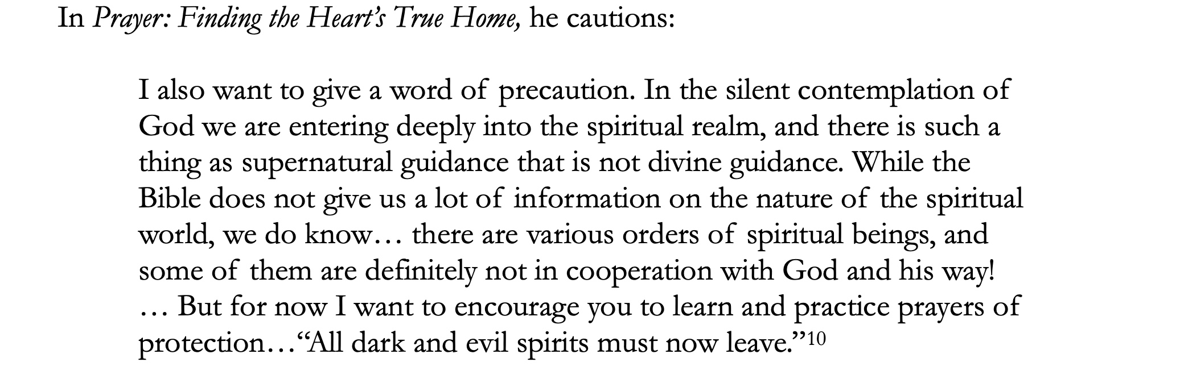

Slide 65
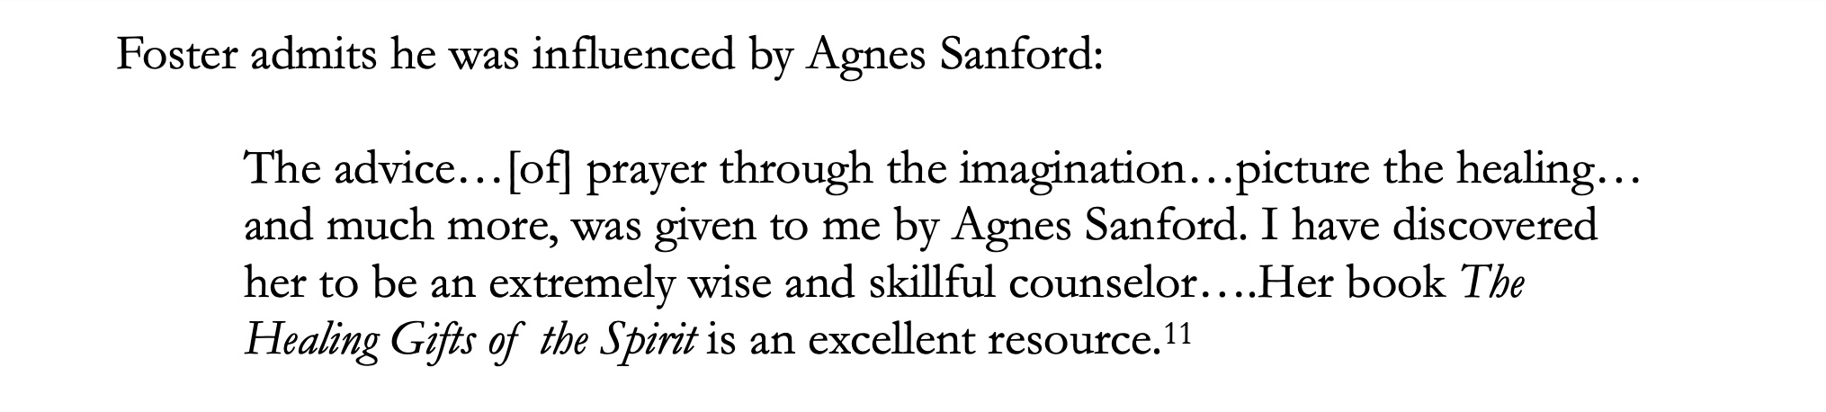

Slide 66
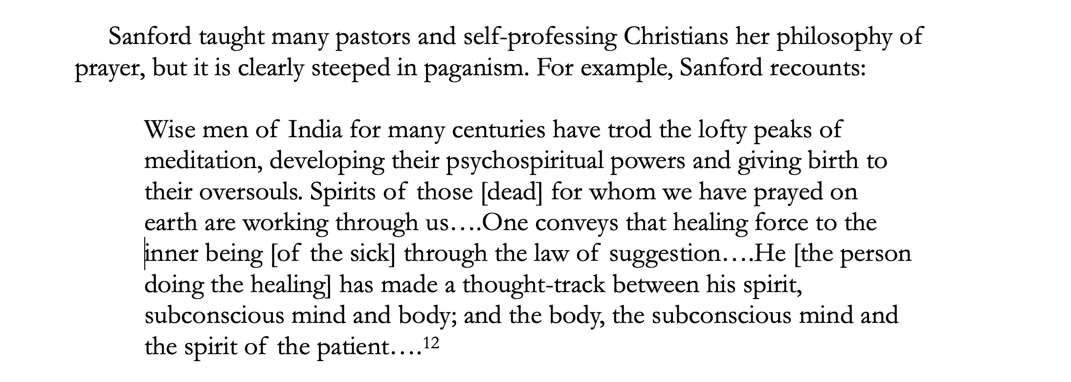

Slide 67
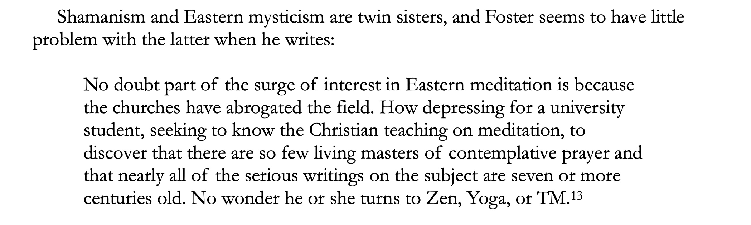

Slide 68
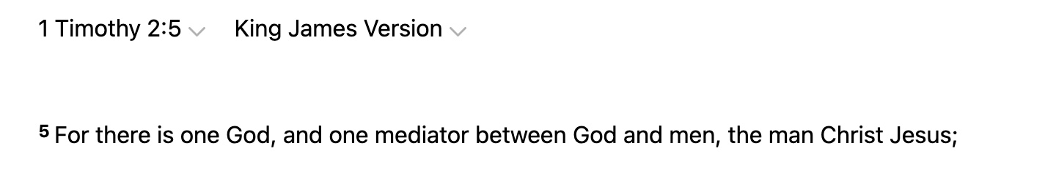

Slide 69
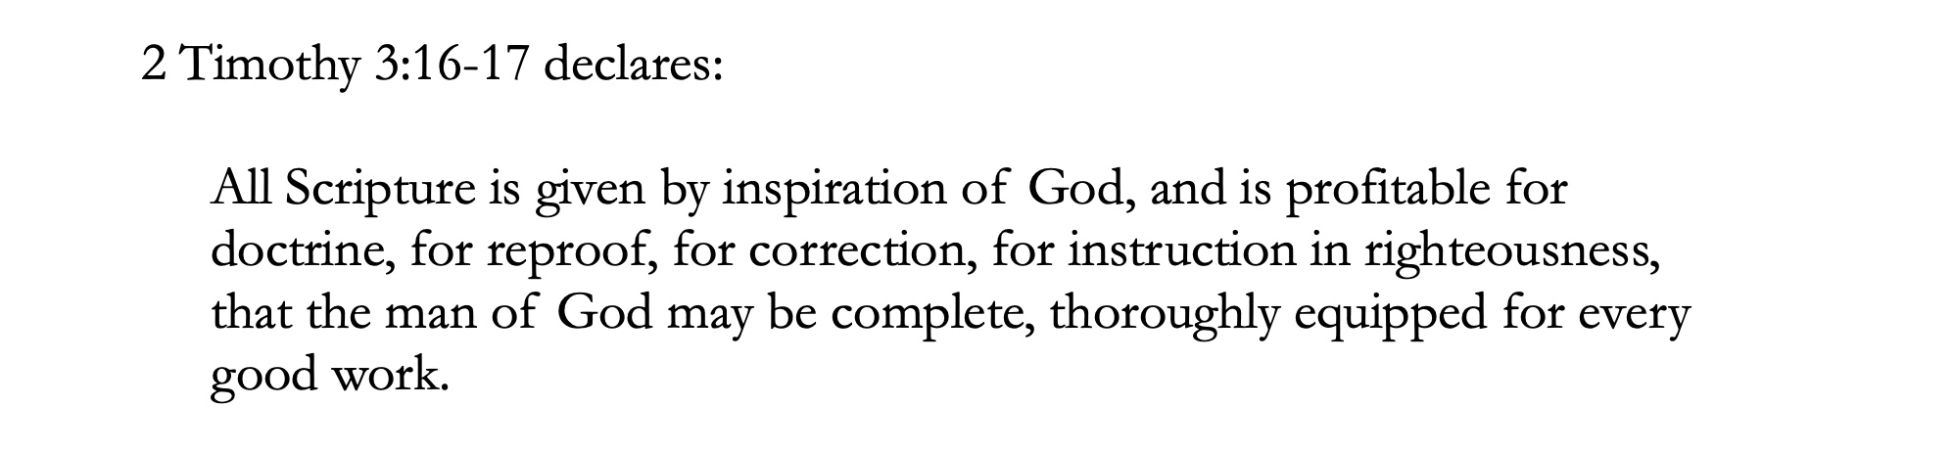

Slide 70
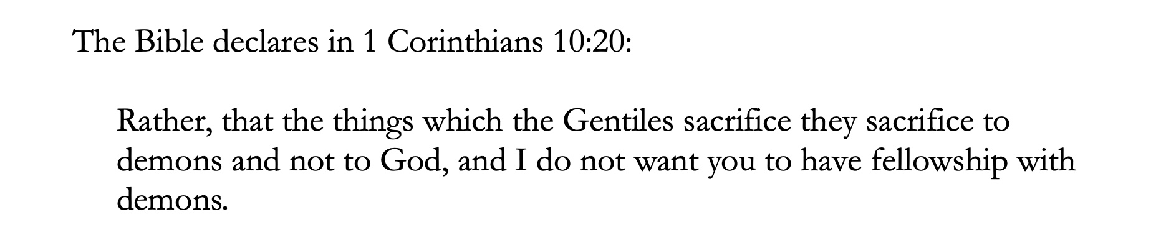

Slide 72
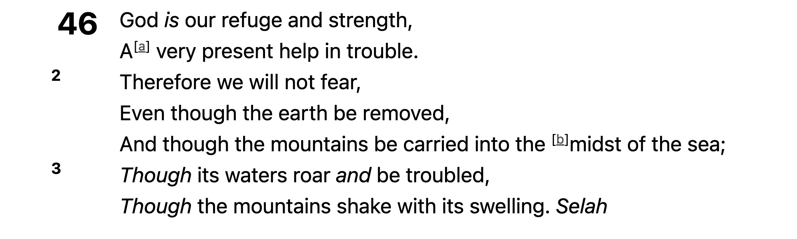

Slide 73
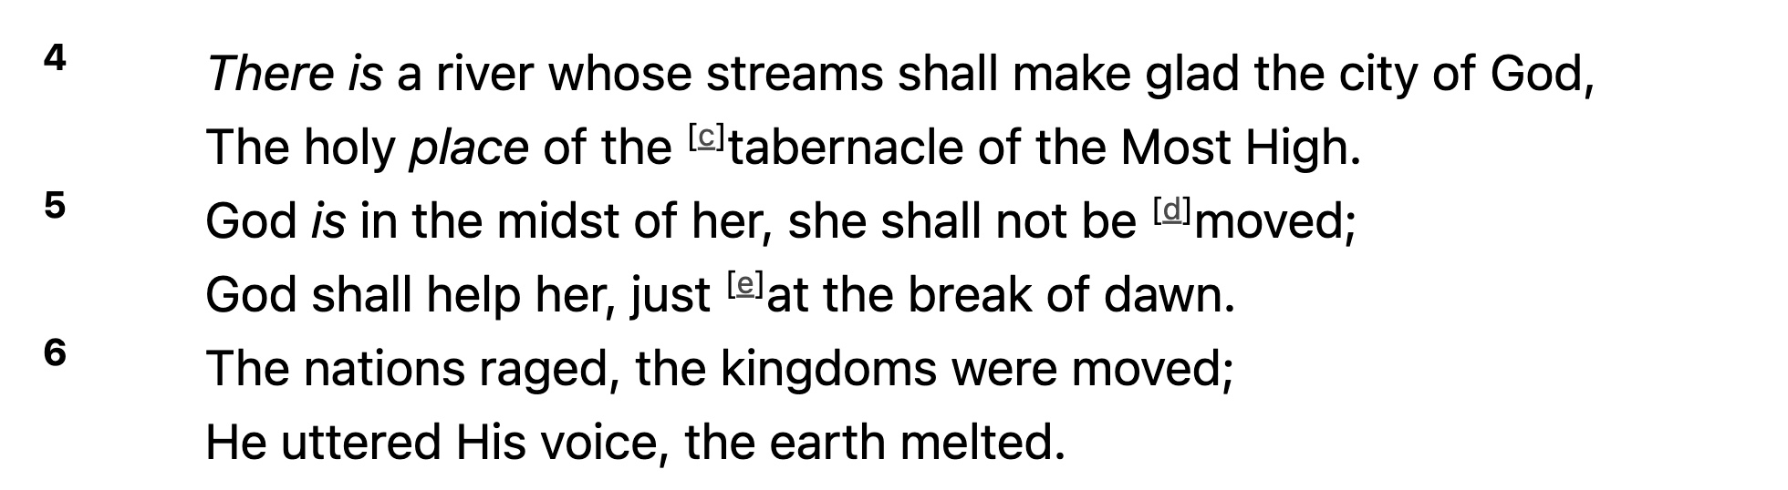

Slide 74
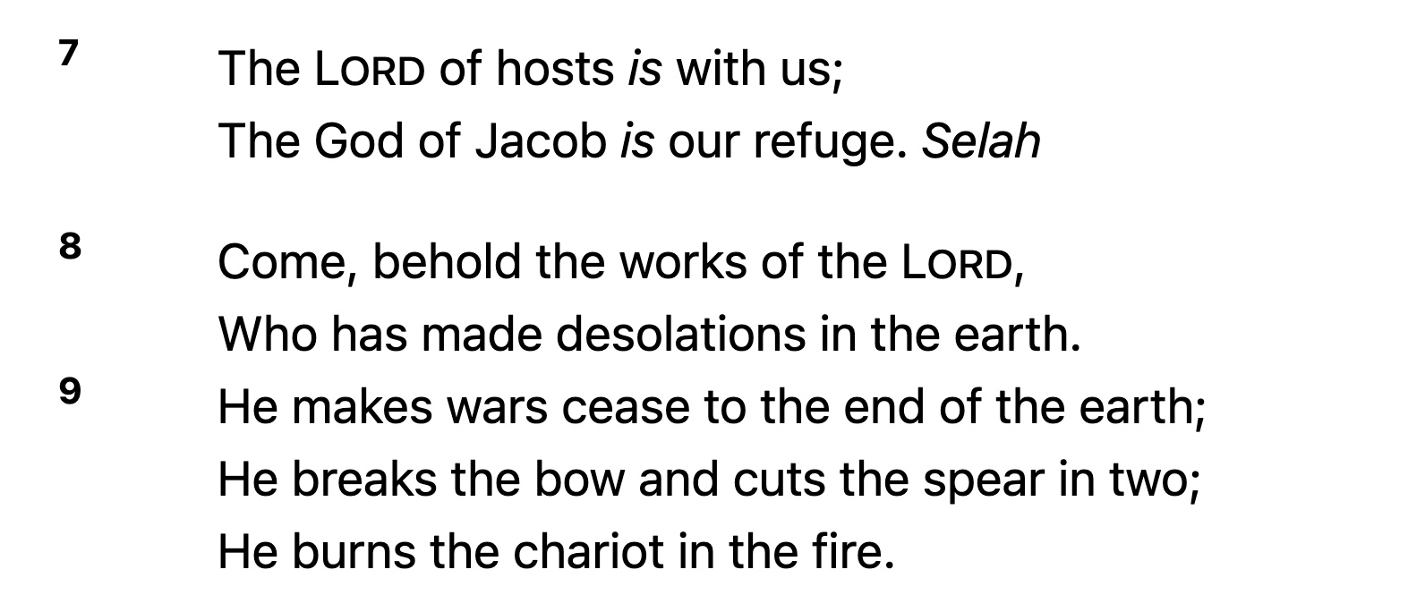

Slide 75
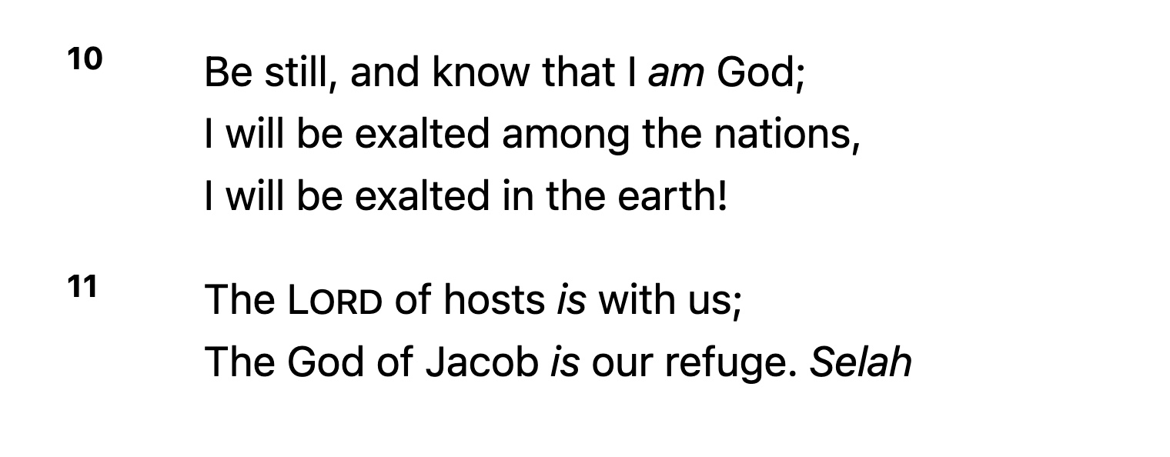

Slide 76
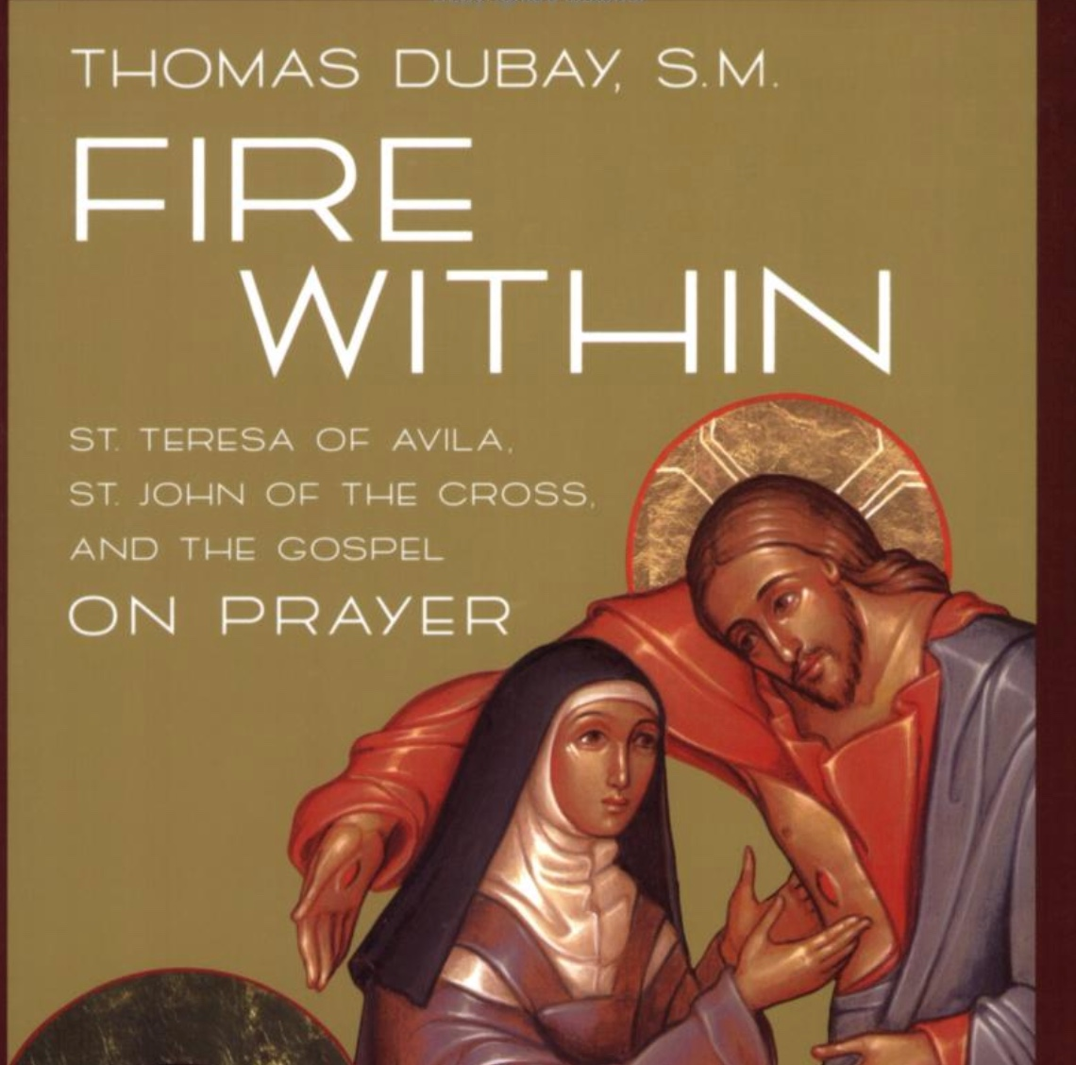

Slide 77
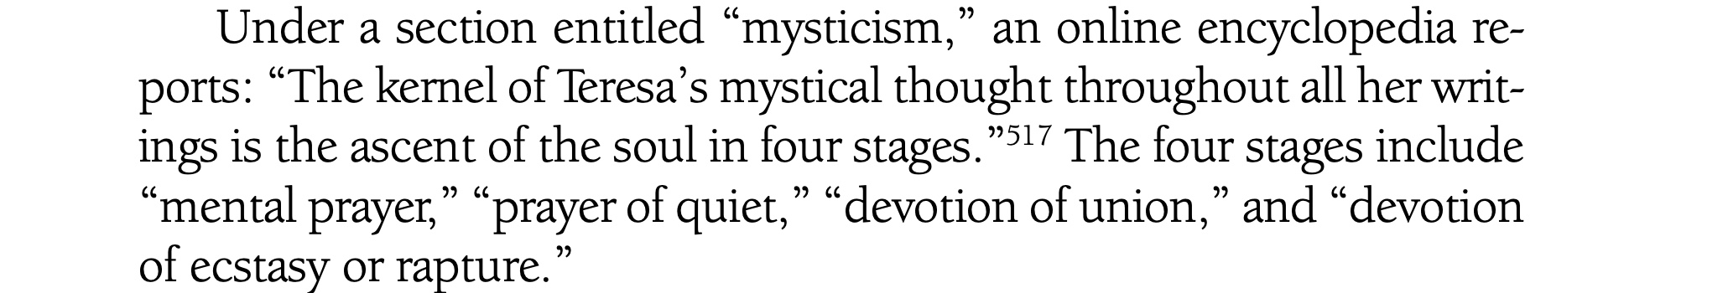

Slide 78
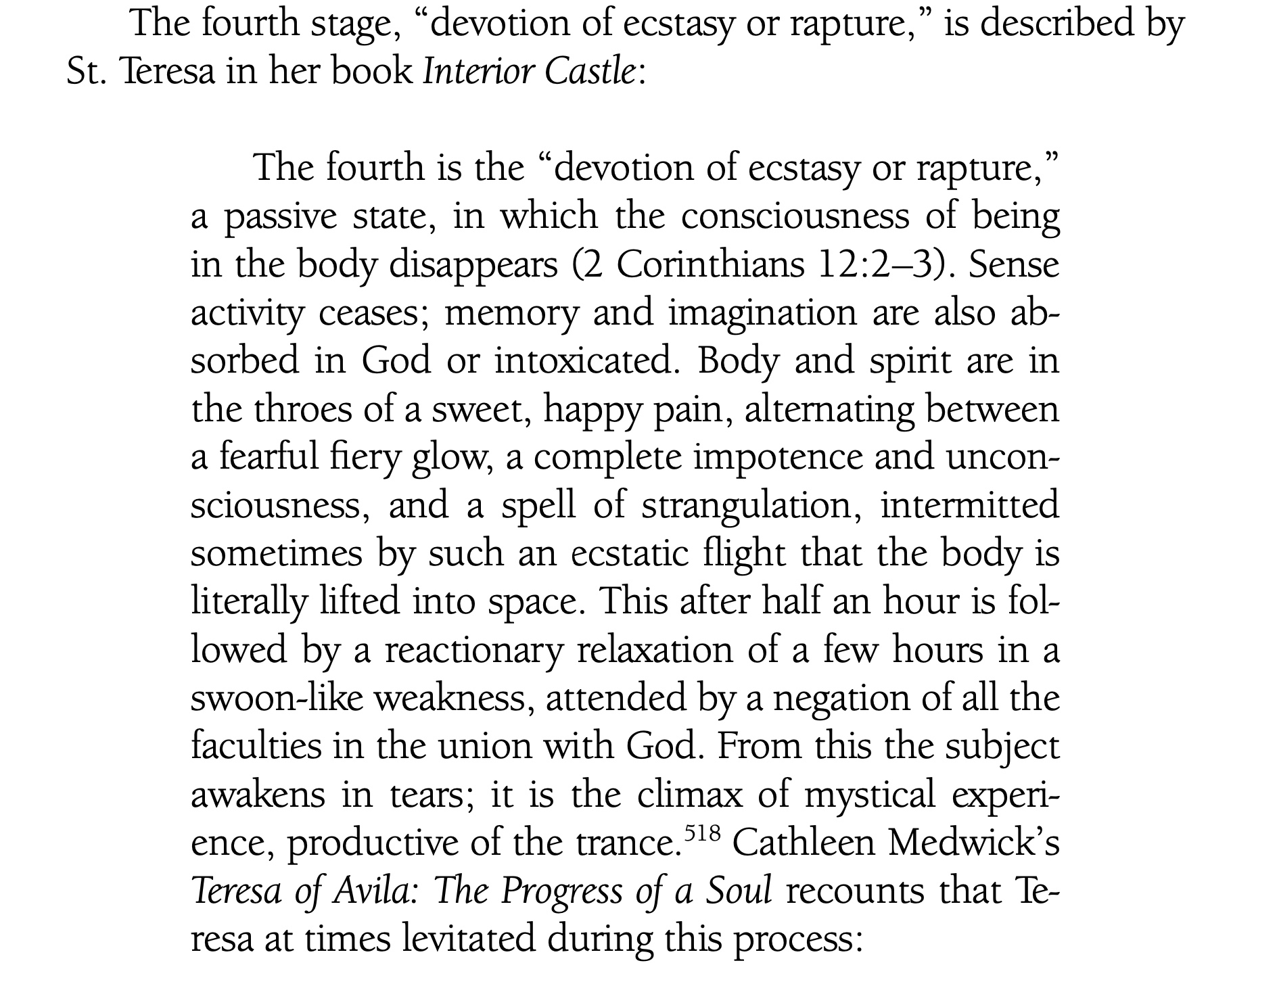

Slide 79
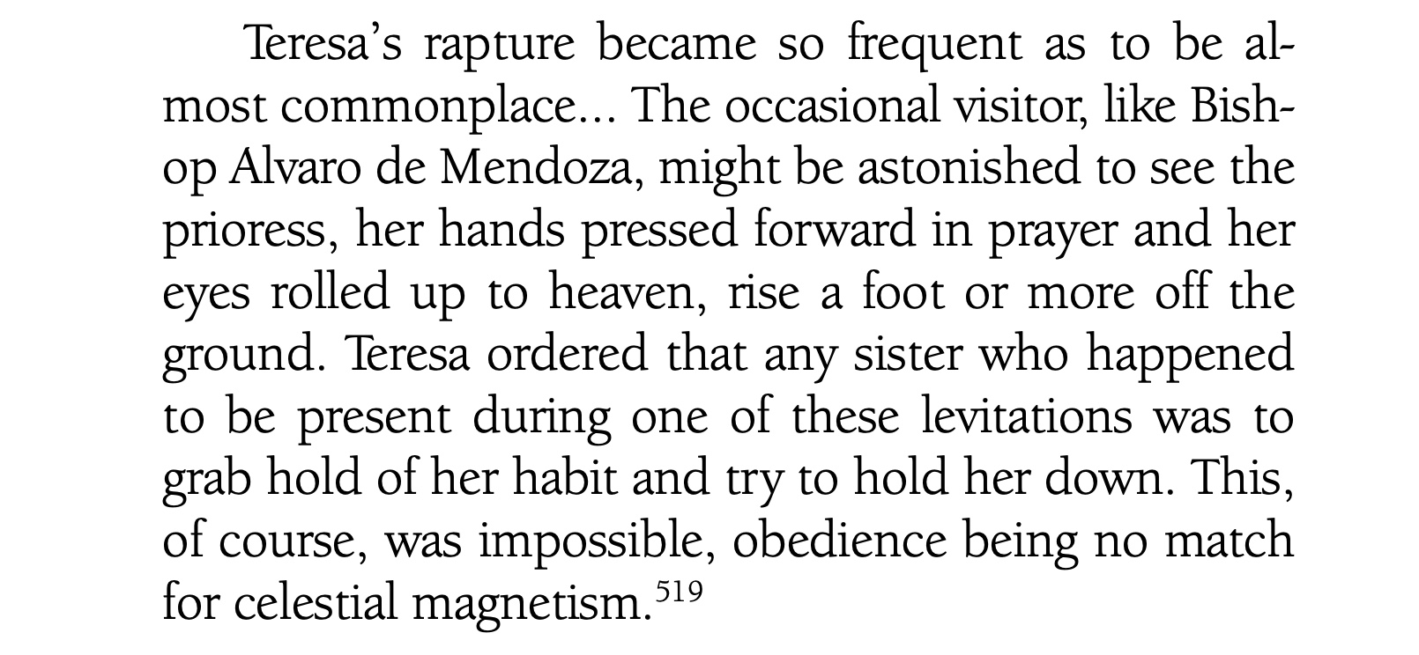

Slide 80
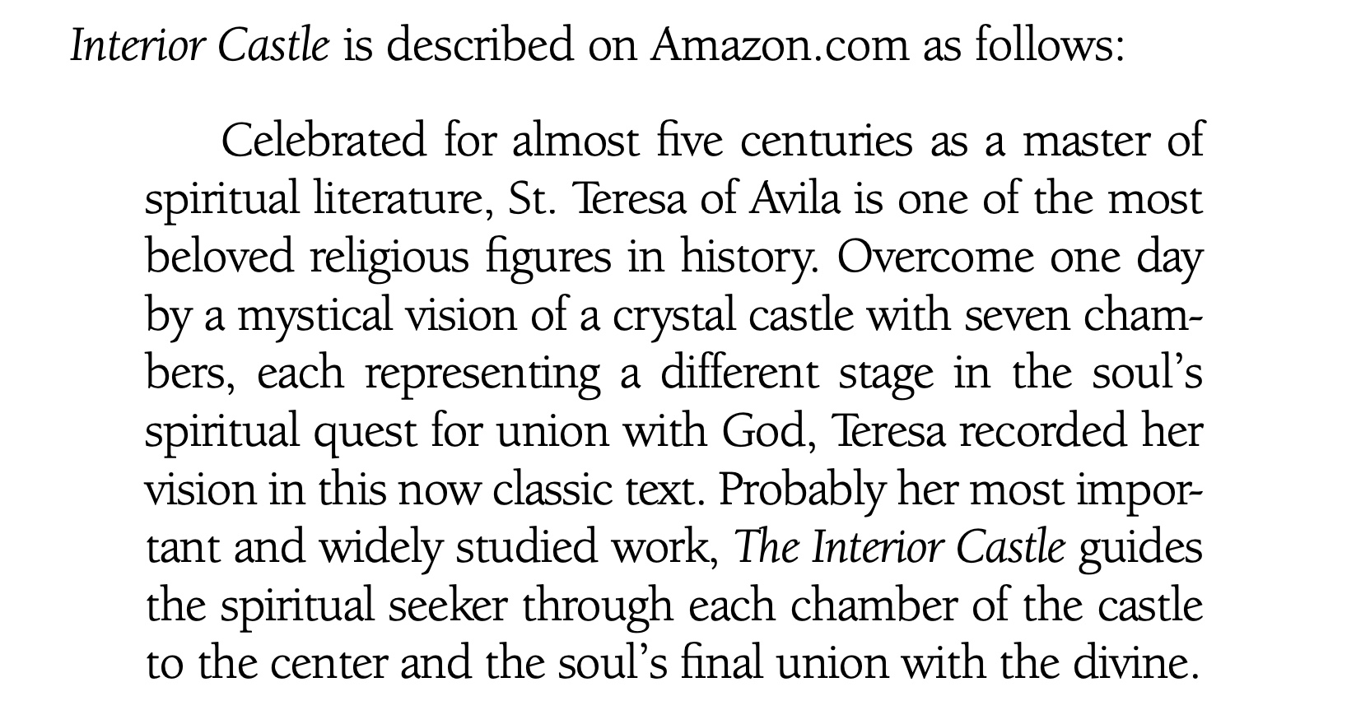

Slide 81
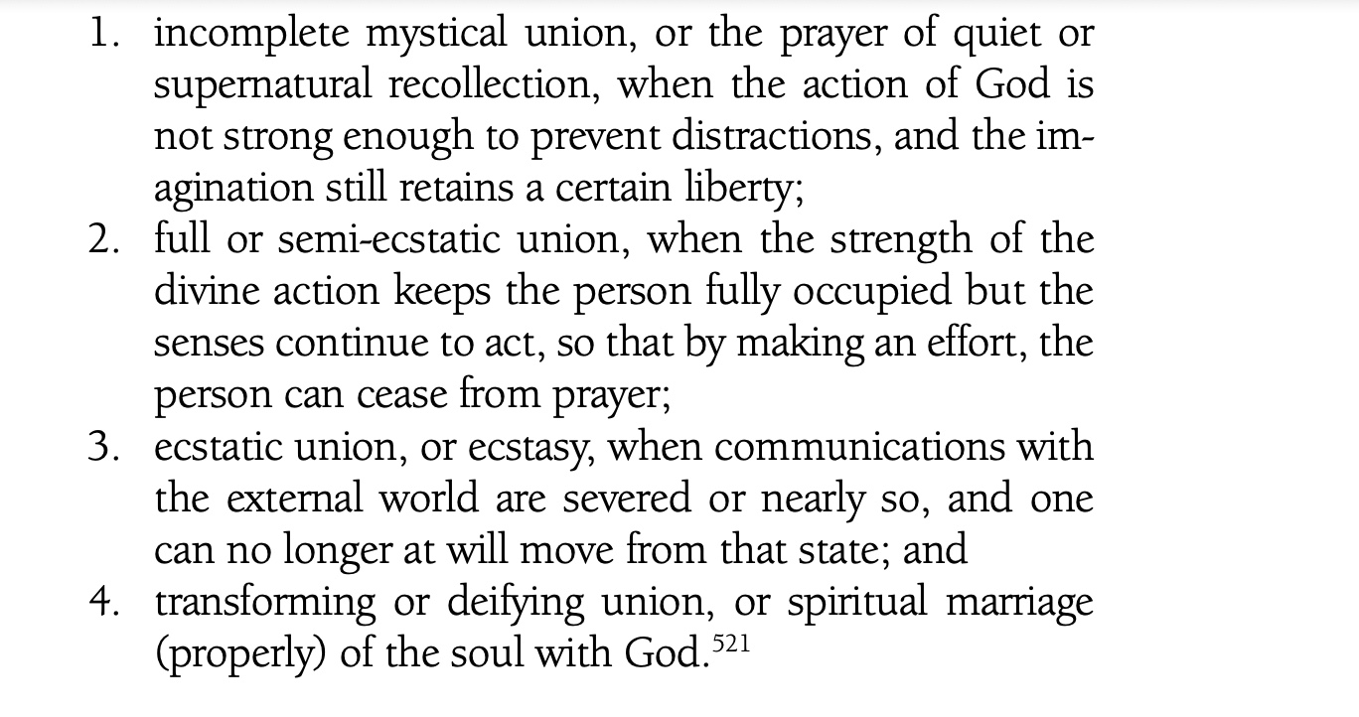

Slide 82
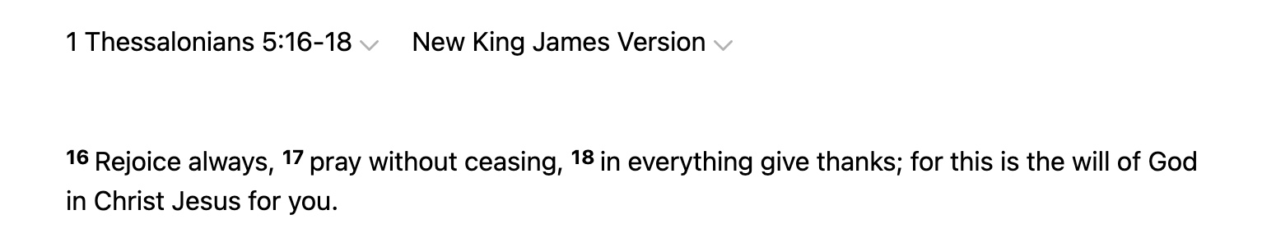

Slide 83
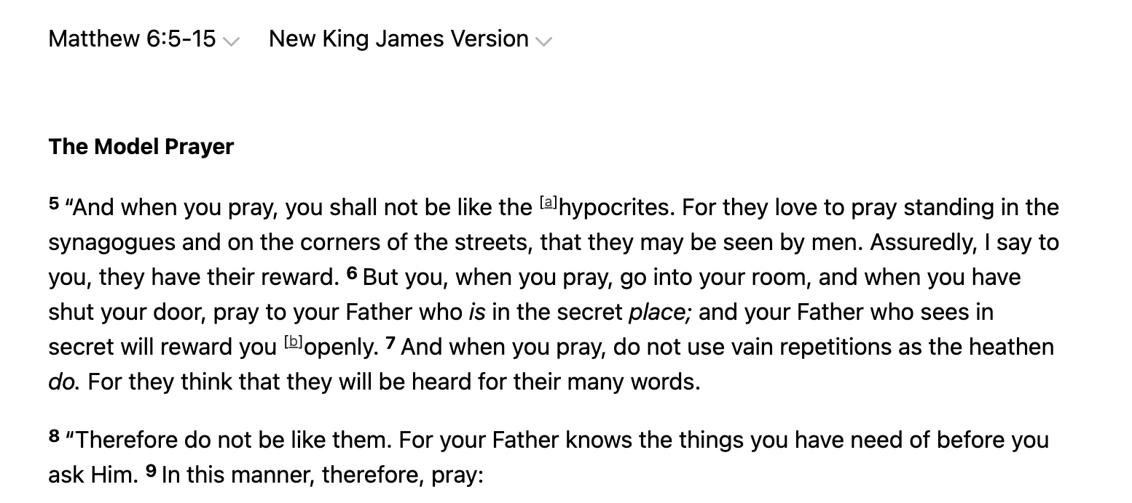

Slide 84


Slide 85


Slide 86


Slide 87


Slide 88


Slide 89


Slide 90


Slide 91
George Wood, Superintendent of the Assemblies of God
Warned That The NAR Would Teach That:
The Church could no longer rely solely on written Scripture for doctrine. It would have to develop the five-fold ministry of apostles, prophets, evangelists, pastors, and teachers, from whom the Church could learn rulership. These new “apostles” and “prophets” words would be obeyed and not judged or tested by the Church. The door would be open to ongoing revelation through which God would reveal components of His will and ways not found in the Bible.

Slide 92
Assemblies of God Leader George Wood
Warned of the False Teaching of Spiritual
Evolution Taught By The NAR/Latter Rain Movement:
The revived Church anticipated by the Kingdom Now proponents would demand a new breed of Christians: supermen and superwomen. Believers would be taught that they are more than human….

Slide 93
George Wood Warned:
Some Kingdom Now adherents go beyond being “little gods” to holding to the possibility that we are the “manifested sons of God,” ...the race of Christians whose bodies will be transformed, not by the coming of the Lord, but by His inner secret coming from within themselves.

Slide 94
August 6, 2001 report released by the
General Presbytery of the Assemblies of God (a Pentecostal denomination) included the following statement:
It is also clear that while the apostles (with the elders) were established leaders in the Early Church, there was no provision for their replacement or continuation…

Slide 95
Assemblies of God:
It is instructive, however, that nowhere in the New Testament after the replacement of Judas is any attention given to a so-called apostolic succession. No attempt was made to replace James son of Zebedee (John’s brother), executed by Herod (Acts 12:2). Other than the original appointments by Christ himself, there is nothing concerning the appointment of apostles.

Slide 96
Assemblies of God:
And apart from the criteria set for the selection of Matthias (Acts 1:21-26) and the criteria implied in the actions of Jesus and the account of Paul (1 Corinthians 15:3-11), there are no directions for making such an appointment. By contrast, there are clear qualifications and instructions for the appointment of elders/overseers and deacons (1 Timothy 3:1-13; Titus 1:5-9).

Slide 97
Assemblies of God:
It seems strange that apostles of Jesus
Christ, concerned about faithful preservation of their message (cf. 2 Timothy 2:2), would provide for the appointment of overseers/elders while ignoring their own succession if such were indeed to be maintained…In fact, there are certain exegetical hints the apostles of Jesus Christ are not to have successors.

Slide 98
In Scripture There Are Three
Kinds of Apostles:
1. Apostles of the Lord Jesus Christ,
2. Apostles of the Church,
3. False apostles.

Slide 99
1. Apostles of the Lord Jesus Christ

Slide 100
First Thessalonians 2:6:
“Nor of men sought we glory, neither of you, nor yet of others, when we might have been burdensome, as the apostles of Christ.”
The crucial phrase “apostles of Christ” shows that the apostles were not appointed by man but by God.

Slide 101
Scripture is clear that there were 12 Apostles.
Judas hung himself after betraying Jesus, and so another apostle was added to bring the number back to 12 living at the time. To be very specific, Hebrews tells us that Jesus Christ was a messenger sent by God, so in that sense, you could even say Jesus Christ Himself was an Apostle, but we will focus on the thirteen, Paul being the special—and final—Apostle of the Lord Jesus Christ.

Slide 102
2. Apostles of the Church

Slide 103
The first apostles were the Apostles of the Lord Jesus Christ, but after them came the second tier apostles of the Church. Second Corinthians 8:23 references Titus in this regard: “He is my [Paul’s] partner and fellow helper concerning your or our brethren being inquired of. They are the messengers of the churches and the glory of Christ.”

Slide 104
Another word for (small “a”) apostle is “messenger” or “sent one.” So, do we have apostles of the Church today? Yes, within this meaning of the word, your missionaries would be considered a messenger, a sent one, or an apostle.

Slide 105
Today we have apostles of the Church by the more generic meaning of the word “apostle”—those who are sent. In fact, we are all to be messengers, sent ones proclaiming the Gospel, but none of us are Apostles of the Lord Jesus Christ or the equivalent.

Slide 106
Philippians 2:25:
“Yet I suppose that necessary to send to you Epaphroditus, my brother and companion in labor and fellow soldier, but your messenger and he that ministered to my wants.”

Slide 107
3. False Apostles:

Slide 108
The Scriptures Tell us in
2 Corinthians 11:13 That:
“such are false apostles, deceitful workers, transforming themselves into the apostles of Christ.”

Slide 109
It doesn’t say they transfer themselves into the apostles of the Church. They don’t transform themselves into being a messenger or a sent one from the Church but Apostles of Christ—the context showing that those who do such a thing are by definition false apostles. This is indeed what the Scriptures say will happen in the last days.

Slide 110
Revelation 2:2 Encourages Us
To Point Out False Apostles:
“I know your works, your labor, your patience and that you cannot bear those who are evil and you have tested those who say that they are Apostles and are not and I found them liars.”

Slide 111
Distinctive #1:
Apostles of Jesus
Christ Were Appointed by God.

Slide 112
In Galatians 1:1 Paul, An Apostle Says
He Was Appointed:
“Not of men, neither by men, but by Jesus Christ and God the Father who raised him from the dead.”

Slide 113
Luke 6:13 is Also Decisive About
Who Qualifies As Apostles:
“And when it was day He [Jesus] called unto him His disciples and of them He chose 12, whom He also named Apostles.”

Slide 114
Distinctive #2:
Apostles of Jesus Christ Had to Have Seen the Risen Lord.

Slide 115
Acts 1:22 Articulates This Requirement:
“Beginning from the baptism of John unto that same day that he was taken up from us, must one be ordained to be a witness with us of His resurrection.”

Slide 116
So to be an Apostle of the Lord Jesus Christ, you had to be appointed by God and you had to have seen the risen Lord.

Slide 117
Distinctive #3:
Apostles of Jesus
Christ Were Used by God for a Limited Time to Establish the Doctrinal Foundation of the Church.

Slide 118
Apostles laid the foundation, the correct doctrinal teachings of the Church. And, of course, a foundation is laid only one time.

Slide 119
Ephesians 2:19-20 Expounds on This Idea of Foundation:
Now therefore ye are no more strangers and foreigners, but fellow citizens with the saints, and of the household of God; And are built upon the foundation of the apostles and prophets, Jesus Christ himself being the chief corner stone.

Slide 120
The foundation for the Church was built by the Apostles and the Prophets—once. That means we do not need foundation builders today.

Slide 121
Distinctive #4:
Apostles of Jesus
Christ Received Scripture From the Holy Spirit and Proclaimed God’s Word.

Slide 122
The job of an Apostle of the Lord Jesus Christ was to receive the Word of God as the Holy Spirit moved.

Slide 123
Are we receiving new revelations from
God today that are equal to the Bible?
No! Jude 3 is clear that Scripture is “once for all” delivered to the saints.
Scripture also says that we don’t add to or take away from Scripture. Because the canon of the Bible is complete, we do not need Apostles today when it comes to receiving the Word of God or revelations from Him.

Slide 124
Distinctive #5:
Apostles of the Lord
Jesus Christ had the Gifts of Signs and Wonders.

Slide 125
The true Apostles of the Lord Jesus Christ were given power from God to do signs and wonders in order to bring credibility to the message they proclaimed. It was not to glorify their own flesh or their own egos. It was simply to make the Gospel believable as they preached.

Slide 126
2 Corinthians 12:12:
“Truly the signs of an apostle were wrought among you in all patience, in signs, and wonders, and mighty deeds.”

Slide 127
Why Is the Office of Apostle Closed?

Slide 128
(1.) No one sees the risen Lord today.

Slide 129
No One See The Lord Today:
1 Peter 1:7-8: that the genuineness of your faith, being much more precious than gold that perishes, though it is tested by fire, may be found to praise, honor, and glory at the revelation of Jesus Christ, whom having not seen you love. Though now you do not see Him, yet believing, you rejoice with joy inexpressible and full of glory.

Slide 130
(2) The foundation was laid, and we don’t lay a foundation twice.

Slide 131
Each of us lives in a structure that has a foundation. And how many times did the builder lay that foundation? Once. You do not lay the foundation of your house again next week. That only needed to happen one time, and the job was assigned to the biblical Apostles of Jesus Christ.

Slide 132
(3) We are commanded not to add to the Word of God.

Slide 133
Jude 3:
Beloved, when I gave all diligence to write unto you of the common salvation, it was needful for me to write unto you, and exhort you that ye should earnestly contend for the faith which was once delivered unto the saints.

Slide 134
Proverbs 30:5-6 Makes it Clear
We Are Not to be Adding to the Word of God:
“Every word of God is pure: He is a shield unto them that put their trust in Him. Add thou not unto His words, lest he reprove thee, and thou be found a liar.”

Slide 135
Deuteronomy 12:32:
“Whatever I command you be careful to observe it. You shall not add to it nor take away from it.” Similarly, Deuteronomy 4:2 says, “You shall not add to the word, which I command you, nor take from it that you may keep the commandments of the Lord your God which I command you.”

Slide 136
(4) There are no Apostles
Mentioned in the Epistles

Slide 137
The epistles give us the specific requirements and practices of a New Testament Church and yet the topic of apostles being for today’s New Testament Church is never addressed.

Slide 138
Why Is the Office of Prophet Closed?

Slide 139
Similar to Apostles, the office of Prophet closed because there is no need for prophets today.

Slide 140
The office of Prophet is different from the gift of prophecy. Do people still have the gift of prophecy? Yes, they do. And what does that mean? The word “prophet” means “one who speaks forth or speaks out.” People with a prophetic gift speak the truth of God’s Word.

Slide 141
Facts about Prophets

Slide 142
Fact #1—Prophets, like Apostles, were appointed by God.

Slide 143
Fact #2—Whatever the Prophets of the New Testament said had to be consistent with what was proclaimed by the Apostles.

Slide 144
One reason we know that the men and women of the New Apostolic Reformation are false prophets is that much of what they say does not line up with the foundational doctrine of the Apostles.

Slide 145
1 Corinthians 14:37:
“If anyone thinks himself to be a prophet or spiritual, let him acknowledge that the things which I write to you are the commandments of the Lord.”

Slide 146
Fact #3—Prophets, along with the Apostles, laid the foundation for the Church.

Slide 147
Fact #4—Prophets were God’s spokesmen to reveal doctrinal truth about what we are to believe and the practical truth regarding how we are to live.

Slide 148
Fact #5—Prophets could perform miracles to confirm the authority and source of their revelation.

Slide 149
Fact #6—Prophets had to be
100 percent accurate, or they were killed.

Slide 150
Deuteronomy 18:20-22:
“But the prophet, which shall presume to speak a word in My name, which I have not commanded him to speak, or that shall speak in the name of other gods, even that prophet shall die.”

Slide 151
Fact #7—God Warns About False Prophets

Slide 152
Jeremiah 23:16:
“Thus saith the LORD of hosts, Hearken not unto the words of the prophets that prophesy unto you: they make you vain: they speak a vision of their own heart, and not out of the mouth of the LORD.”

Slide 153
Matthew 24 on False Prophets:
Verses 3-4: “Now as He sat on the Mount of Olives, the disciples came to Him privately, saying, ‘Tell us, when will these things be? And what will be the sign of Your coming, and of the end of the age?’ And Jesus answered and said to them: ‘Take heed that no one deceives you.’”

Slide 154
Verse 11: “Then many false prophets will rise up and deceive many.”
Verses 23-24: “Then if anyone says to you, ‘Look, here is the Christ!’ or ‘There!’ do not believe it. For false christs and false prophets will rise and show great signs and wonders to deceive, if possible, even the elect.”

Slide 155
Fact #8—False teachers and prophets proclaim unbiblical doctrine.

Slide 156
Matthew 7:16 :
“Ye shall know them by their fruits. Do men gather grapes of thorns, or figs of thistles?”
The fruit Jesus refers to is their doctrinal fruit.

Slide 157
Fact #9—False prophets and false teachers will grow worse until Christ returns.

Slide 158
2 Timothy 3:13:
“But evil men and seducers shall wax worse and worse, deceiving, and being deceived.”

Slide 159
Mathew 24:11:
“And many false prophets shall rise, and shall deceive many.”

Slide 160
Apostles and Prophets were not built upon the church but the church but the Church was built upon the Apostles and Prophets with Christ as the Corner Stone.
The church did not pick the Apostles and Prophets as they were picked by God to lay the foundation for His church

Slide 162


Slide 163


Slide 164


Slide 165


Slide 166


Slide 167


Slide 168


Slide 169


Slide 171


Slide 172


Slide 173


Slide 174


Slide 175


Slide 177


Slide 178


Slide 179


Slide 180


Slide 181
Stopped here

Slide 189


Slide 190


Slide 191


Slide 192


Slide 193

Gill's Exposition of the Entire Bible

Slide 195


Slide 196


Slide 197


Slide 198


Slide 199


Slide 200


Slide 201

Matthew 18:15-20

Slide 202


Slide 203


Slide 204

Luke 11:16-23

Slide 205


Slide 206


Slide 207


Slide 208


Slide 209


Slide 210
Stopped Here

Slide 211


Slide 212


Slide 213


Slide 214


Slide 215


Slide 216


Slide 217


Slide 218


Slide 219


Slide 220


Slide 221


Slide 222


Slide 223


Slide 224


Slide 225


Slide 226


Slide 227


Slide 228


Slide 229


Slide 230
Stopped here

Slide 231


Slide 232


Slide 233


Slide 234


Slide 235


Slide 236


Slide 237


Slide 238


Slide 239


Slide 240


Slide 241


Slide 242


Slide 243


Slide 244


Slide 245


Slide 246
Matthew 23:27
Woe to you, scribes and Pharisees, hypocrites! For you are like whitewashed tombs which indeed appear beautiful outwardly, but inside are full of dead men’s bones and all uncleanness.

Slide 247

Who Were The Pharisees?

Slide 248

Luke 11:37-45

Slide 249


Slide 250


Slide 251


Slide 252


Slide 253


Slide 254
Charles Ryrie:
Water: “it is a synonym for the Holy Spirit and may be translated, by water, even the Spirit. One truth is clear: the new birth is from God through the Spirit.

Slide 255


Slide 256


Slide 258


Slide 259


Slide 260


Slide 261


Slide 262


Slide 263


Slide 264


Slide 265


Slide 266


Slide 267


Slide 268


Slide 269


Slide 271


Slide 272


Slide 273


Slide 274


Slide 275
Stopped here

Slide 276


Slide 277


Slide 278


Slide 279


Slide 280


Slide 281


Slide 282


Slide 283


Slide 285
Stopped here

Slide 286


Slide 287


Slide 288


Slide 289


Slide 290


Slide 291


Slide 292


Slide 293


Slide 295


Slide 296


Slide 297


Slide 298


Slide 299


Slide 300


Slide 301


Slide 303


Slide 304


Slide 305


Slide 306


Slide 307


Slide 308


Slide 309


Slide 310


Slide 312


Slide 313


Slide 314


Slide 315


Slide 316


Slide 317


Slide 318


Slide 319


Slide 320


Slide 321


Slide 322


Slide 323



Slide 324
Matthew 25:31-40

Slide 325

Matthew 25:41-46

Slide 326


Slide 327


Slide 328

The Doctrine of Concurrence:
How the sovereign providence of God and man’s free will work together to accomplish God’s Will. This is also referred to the doctrine of confluence.

Slide 329

Webster’s Dictionary
Defines Confluence as:
A coming or flowing together, meeting, or gathering at one point.
The flowing together of two or more streams. The place of meeting of two streams. The combined stream formed by conjunction

Slide 330
Man’s free will and God’s total sovereignty is not a Contradiction.
While we might not understand it in our human minds, it is a Biblical fact.

Slide 331
One biologist has made the following statement regarding the complexity of a cell:
Even if we knew all there is to know about how a cell works, we would still be baffled. How nerve cells create emotions, thoughts, behavior, memory, and other perceptions cannot yet, if indeed ever, be described in the language of molecular biology.
Source: National Geographic, September 1976, 355.
Source: National Geographic, September 1976, 355.
One biologist has made the following statement regarding the complexity of a cell:
Even if we knew all there is to know about how a cell works, we would still be baffled. How nerve cells
One biologist has made the following statement regarding the complexity of a cell:
Even if we knew all there is to know about how a cell works, we would still be baffled. How nerve cells
One biologist has made the following statement regarding the complexity of a cell:
Even if we knew all there is to know about how a cell works, we would still be baffled. How nerve cells
One biologist has made the following statement regarding the complexity of a cell:
Even if we knew all there is to know about how a cell works, we would still be baffled. How nerve cells
One biologist has made the following statement regarding the complexity of a cell:
Even if we knew all there is to know about how a cell works, we would still be baffled. How nerve cells
One biologist has made the following statement regarding the complexity of a cell:
Even if we knew all there is to know about how a cell works, we would still be baffled. How nerve cells
One biologist has made the following statement regarding the complexity of a cell:
Even if we knew all there is to know about how a cell works, we would still be baffled. How nerve cells

Slide 332
The Doctrine of Concurrence:
100% God and 100% Man
Who Wrote The Book of Galatians?
Who Does The Work in Our Christian Life?
One biologist has made the following statement regarding the complexity of a cell:
Even if we knew all there is to know about how a cell works, we would still be baffled. How nerve cells
One biologist has made the following statement regarding the complexity of a cell:
Even if we knew all there is to know about how a cell works, we would still be baffled. How nerve cells
One biologist has made the following statement regarding the complexity of a cell:
Even if we knew all there is to know about how a cell works, we would still be baffled. How nerve cells
One biologist has made the following statement regarding the complexity of a cell:
Even if we knew all there is to know about how a cell works, we would still be baffled. How nerve cells
One biologist has made the following statement regarding the complexity of a cell:
Even if we knew all there is to know about how a cell works, we would still be baffled. How nerve cells
One biologist has made the following statement regarding the complexity of a cell:
Even if we knew all there is to know about how a cell works, we would still be baffled. How nerve cells
One biologist has made the following statement regarding the complexity of a cell:
Even if we knew all there is to know about how a cell works, we would still be baffled. How nerve cells

Slide 333


Slide 334


Slide 335


Slide 336


Slide 338


Slide 339


Slide 340


Slide 341


Slide 342


Slide 343


Slide 344


Slide 345


Slide 346


Slide 347


Slide 348


Slide 349


Slide 350


Slide 351


Slide 352


Slide 353


Slide 354


Slide 355


Slide 356


Slide 357


Slide 358


Slide 359


Slide 360


Slide 361


Slide 362


Slide 363


Slide 364


Slide 365


Slide 366


Slide 367


Slide 368


Slide 369


Slide 370


Slide 371


Slide 372


Slide 373


Slide 374


Slide 375


Slide 376


Slide 377


Slide 378


Slide 379


Slide 380
Charles Ryrie:
Water: “it is a synonym for the Holy Spirit and may be translated, by water, even the Spirit. One truth is clear: the new birth is from God through the Spirit.

Slide 383


Slide 384


Slide 385


Slide 386


Slide 387


Slide 388


Slide 389


Slide 390


Slide 391


Slide 392


Slide 393


Slide 394


Slide 395


Slide 396


Slide 397


Slide 398


Slide 399


Slide 400


Slide 401


Slide 402


Slide 403


Slide 404


Slide 405


Slide 406


Slide 407


Slide 408


Slide 409


Slide 410


Slide 411


Slide 412


Slide 413


Slide 414


Slide 415


Slide 416


Slide 417


Slide 418


