Slide 1
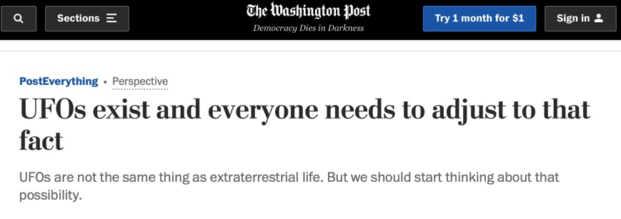

Slide 2
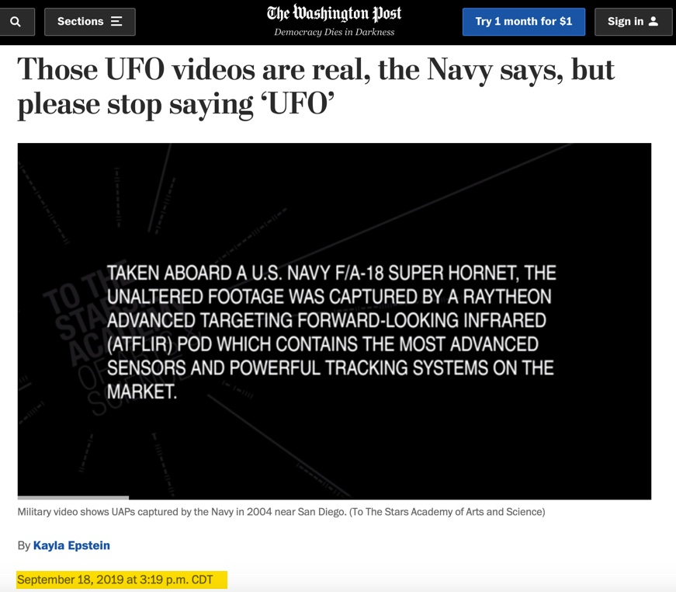

Slide 4
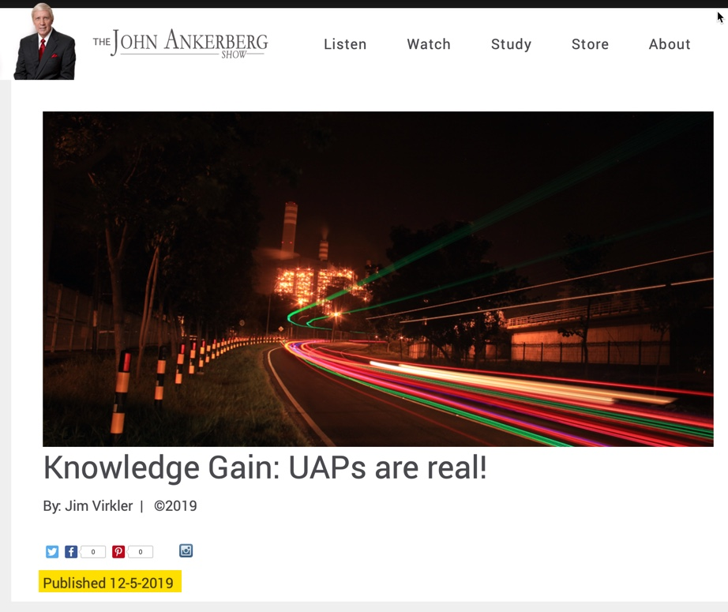

Slide 7
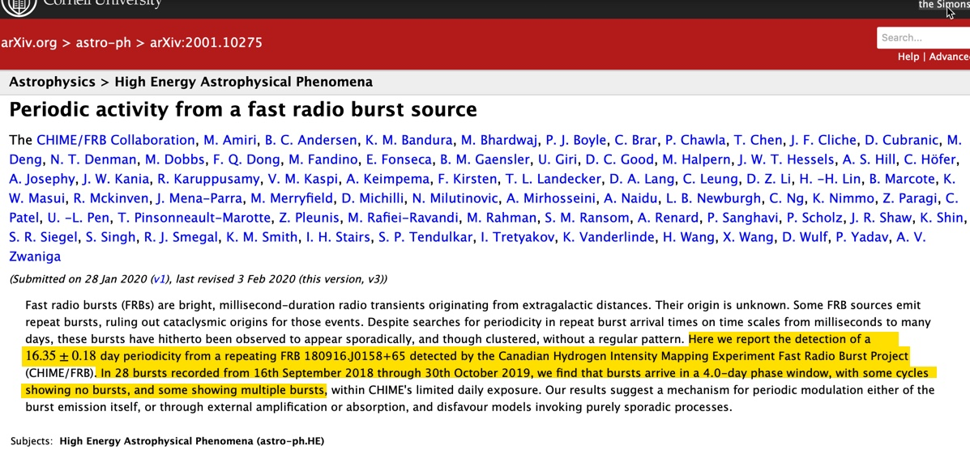
Cornell University

Slide 9
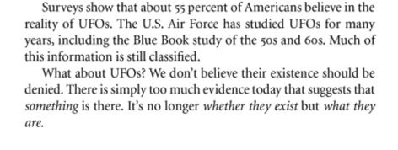

Slide 10
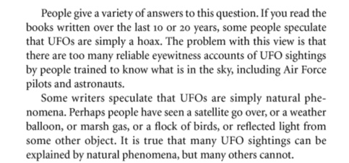

Slide 11
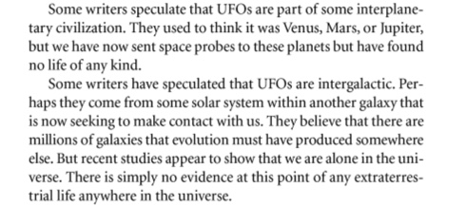

Slide 12
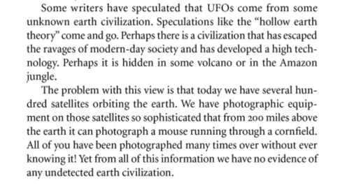

Slide 14
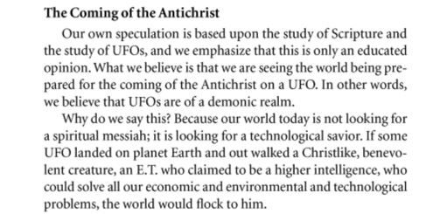

Slide 15
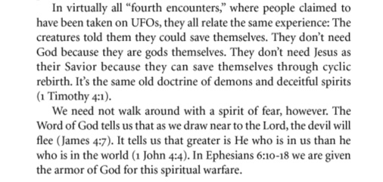

Slide 16
The Rising Interest in the Supernatural,
Presented by Larry McLean at the Seventh Mid-America Prophecy Conference, Oklahoma City, July 27, 1988:
Our generation won't be shocked by the demonic invasion. They are actually anticipating that extraterrestrial intelligent beings, who look very different from us, will some day contact the earth and help us with ecological, monetary, and political problems.

Slide 17
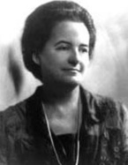
Alice Bailey: Coined The Term New Age & Wrote Over 24 Books With A Demon She Channeled

Slide 18
Helen Schucman: Wrote the “Bible” of the New Age Movement, A Course in Miracles, with a Demon She Channeled That She Called Jesus of Nazareth

Slide 19
Dr. Jacques Vallee:

Slide 20
Dr. Jacques Vallee:
We are dealing with a yet unrecognized level of consciousness, independent of man but closely linked to the earth.... I do not believe anymore that UFOs are simply the spacecraft of some race of extraterrestrial visitors. This notion is too simplistic to explain their appearance, the frequency of their manifestations through recorded history, and the structure of the information exchanged with them during contact.
Jacques Vallee:

Slide 21
Dr. Jacques Vallee:
The “medical examination” to which abductees are said to be subjected, often accompanied by sadistic sexual manipulation, is reminiscent of the medieval tales of encounters with demons.

Slide 22
Dr. Jacques Vallee:
[An] impressive parallel [can] be made between UFO occupants and the popular conceptions of demons.
...human belief... is being controlled and conditioned, man's concepts are being rearranged.” [We may be headed toward] "a massive change of human attitudes toward paranormal abilities and extraterrestrial life."

Slide 23
Dr. Jacques Vallee:
...the symbolic display seen by the abductees is identical to the type of initiations ritual or astral voyage that is imbedded in the [occult] traditions of every culture.
The structure of abduction stories is identical to that of occult initiation rituals.

Slide 24
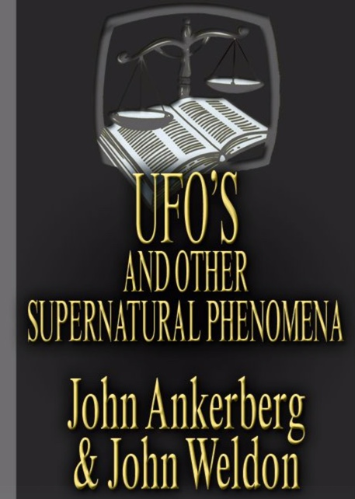
John Ankerberg and John Weldon:
In light of the messages given by the UFO entities, how credible is it to think that literally thousands of genuine extraterrestrials would fly millions or billions of light years simply to teach New Age philosophy, deny Christianity, and support the occult?

Slide 25
John Ankerberg and John Weldon:
Why would they do this with the preponderance of such activity already occurring on this planet? And why would the entities actually possess and inhabit people (as in Walk-ins and channeling) just like demons do if they were really advanced extraterrestrials? Why would they consistently lie about things which we know are true, and why would they purposely deceive their contacts? But the UFO phenomenon simply does not behave like extraterrestrial visitors. It actually molds itself in order to fit a given culture.

Slide 26
The Facts on UFO's and other Supernatural Phenomena by John Ankerberg and John Weldon:
..few unbiased researchers can logically deny that UFO experiences are of an occult nature. If we catalog the basic characteristics of the occult and compare them to UFO phenomena, we discover an essential similarity….

Slide 27
The Facts on UFO's and other Supernatural Phenomena by John Ankerberg and John Weldon:
After 20 years of research, we believe that the demonic theory dovetails extremely well with the totality of UFO phenomena. ...In fact, we know of no UFO contactee who is not basically a spiritistic medium. In addition, we have read hundreds of articles from the oldest and most respected UFO journal, the British Flying Saucer Review, that indicate the psychic and/or non-extraterrestrial aspects of UFOs which, given their actions and messages, indicate probable demonic origin.

Slide 29
Lynn E. Catoe (the senior bibliographer for a government publication researched by the Library of Congress for the U.S. Air Force Office of Scientific Research: UFOs and Related Subjects]:
A large part of the available UFO literature is closely linked with mysticism and the metaphysical. It deals with subjects like mental telepathy, automatic writing and invisible entities as well as phenomena like poltergeist [ghost] manifestations and “possession.”

Slide 30
Lynn E. Catoe:
Many of the UFO reports now being published in the popular press recount alleged incidents that are strikingly similar to demonic possession and psychic phenomena….

Slide 31
John A. Keel UFOs: Operation Trojan Horse:
The manifestations and occurrences described in this imposing literature [on demonology] are similar if not entirely identical to the UFO phenomenon itself…The UFO manifestations seem to be, by and large, merely minor variations of the age-old demonological phenomenon.

Slide 32
Ephesians 2:1-2:
And you He made alive, who were dead in trespasses and sins, in which you once walked according to the course of this world, according to the prince of the power of the air, the spirit who now works in the sons of disobedience,

Slide 33
2 Corinthians 11:13-15:
For Satan himself transforms himself into an angel of light.

Slide 35
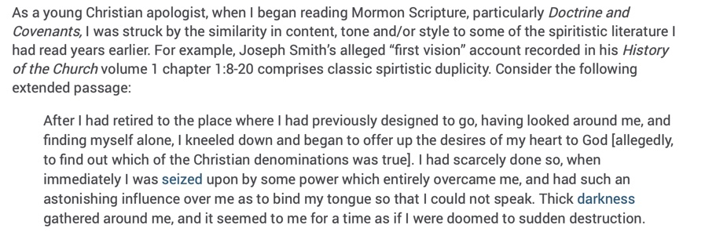

Slide 37
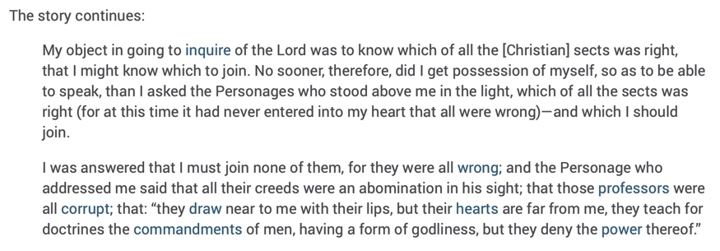

Slide 39
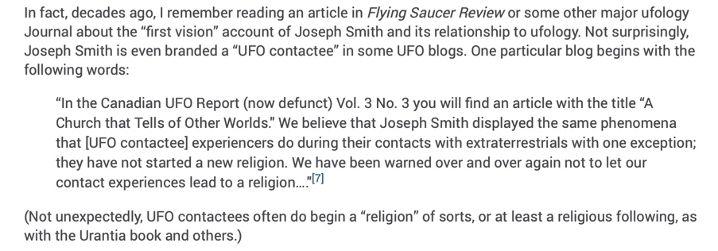

Slide 41
